Slide 1
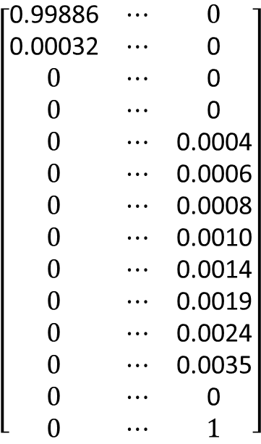
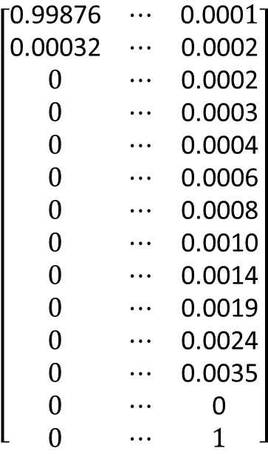
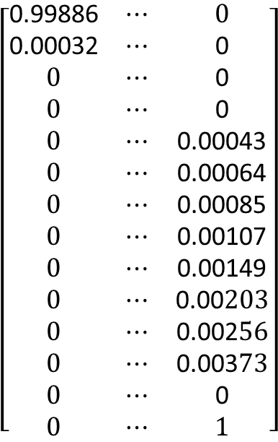
1
…
transplant
Add lost prob. to non-moving state
State #
1
2
3
4
5
6
7
8
9
10
11
12
death
transplant
$$\left[\begin{matrix}\text{0.99876} & ⋯ & \text{0.000}1 \\ \text{0.00032} & ⋯ & \text{0.0002} \\ 0 & ⋯ & \text{0.0002} \\ 0 & ⋯ & \text{0.0003} \\ 0 & ⋯ & \text{0.0004} \\ 0 & ⋯ & \text{0.0006} \\ 0 & ⋯ & \text{0.0008} \\ 0 & ⋯ & \text{0.0010} \\ 0 & ⋯ & \text{0.0014} \\ 0 & ⋯ & \text{0.0019} \\ 0 & ⋯ & \text{0.0024} \\ 0 & ⋯ & \text{0.0035} \\ 0 & ⋯ & \text{0} \\ 0 & ⋯ & 1\end{matrix}\right]$$
$$\left[\begin{matrix}\text{0.99886} & ⋯ & 0 \\ \text{0.00032} & ⋯ & \text{0} \\ 0 & ⋯ & \text{0} \\ 0 & ⋯ & \text{0} \\ 0 & ⋯ & \text{0.0004} \\ 0 & ⋯ & \text{0.0006} \\ 0 & ⋯ & \text{0.0008} \\ 0 & ⋯ & \text{0.0010} \\ 0 & ⋯ & \text{0.0014} \\ 0 & ⋯ & \text{0.0019} \\ 0 & ⋯ & \text{0.0024} \\ 0 & ⋯ & \text{0.0035} \\ 0 & ⋯ & \text{0} \\ 0 & ⋯ & 1\end{matrix}\right]$$
$$\left[\begin{matrix}\text{0.99886} & ⋯ & 0 \\ \text{0.00032} & ⋯ & \text{0} \\ 0 & ⋯ & \text{0} \\ 0 & ⋯ & \text{0} \\ 0 & ⋯ & \text{0.0004}\text{3} \\ 0 & ⋯ & \text{0.0006}\text{4} \\ 0 & ⋯ & \text{0.0008}\text{5} \\ 0 & ⋯ & \text{0.0010}\text{7} \\ 0 & ⋯ & \text{0.0014}\text{9} \\ 0 & ⋯ & \text{0.00}203 \\ 0 & ⋯ & \text{0.002}56 \\ 0 & ⋯ & \text{0.003}73 \\ 0 & ⋯ & \text{0} \\ 0 & ⋯ & 1\end{matrix}\right]$$
Apply threshold of i = 5
Reallocate lost probability
Lost daily probability of any transplants = 0.0008
Subtract added prob. from non-moving state (not shown)

