Slide 1
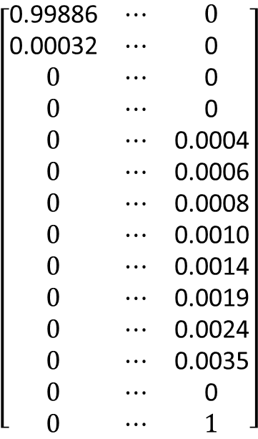
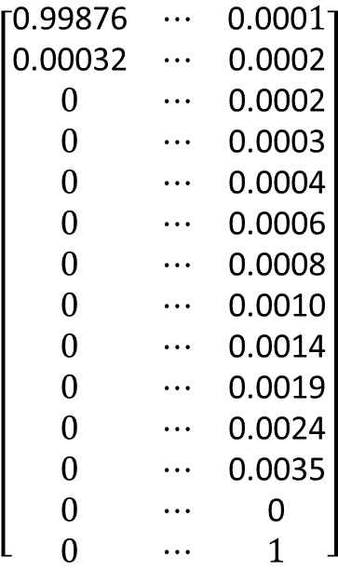
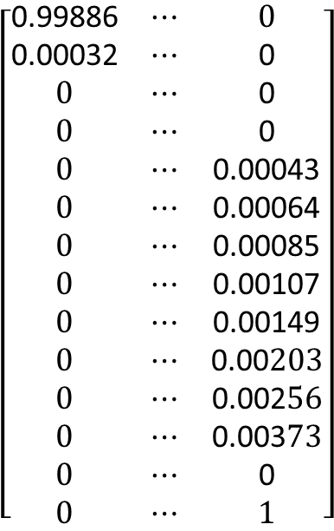
1
…
transplant
Add lost prob. to non-moving state
State #
1
2
3
4
5
6
7
8
9
10
11
12
death
transplant
$$\left[\begin{matrix}\text{0.99876} & ⋯ & \text{0.000}1 \\ \text{0.00032} & ⋯ & \text{0.0002} \\ 0 & ⋯ & \text{0.0002} \\ 0 & ⋯ & \text{0.0003} \\ 0 & ⋯ & \text{0.0004} \\ 0 & ⋯ & \text{0.0006} \\ 0 & ⋯ & \text{0.0008} \\ 0 & ⋯ & \text{0.0010} \\ 0 & ⋯ & \text{0.0014} \\ 0 & ⋯ & \text{0.0019} \\ 0 & ⋯ & \text{0.0024} \\ 0 & ⋯ & \text{0.0035} \\ 0 & ⋯ & \text{0} \\ 0 & ⋯ & 1\end{matrix}\right]$$
$$\left[\begin{matrix}\text{0.99886} & ⋯ & 0 \\ \text{0.00032} & ⋯ & \text{0} \\ 0 & ⋯ & \text{0} \\ 0 & ⋯ & \text{0} \\ 0 & ⋯ & \text{0.0004} \\ 0 & ⋯ & \text{0.0006} \\ 0 & ⋯ & \text{0.0008} \\ 0 & ⋯ & \text{0.0010} \\ 0 & ⋯ & \text{0.0014} \\ 0 & ⋯ & \text{0.0019} \\ 0 & ⋯ & \text{0.0024} \\ 0 & ⋯ & \text{0.0035} \\ 0 & ⋯ & \text{0} \\ 0 & ⋯ & 1\end{matrix}\right]$$
$$\left[\begin{matrix}\text{0.99886} & ⋯ & 0 \\ \text{0.00032} & ⋯ & \text{0} \\ 0 & ⋯ & \text{0} \\ 0 & ⋯ & \text{0} \\ 0 & ⋯ & \text{0.0004}\text{3} \\ 0 & ⋯ & \text{0.0006}\text{4} \\ 0 & ⋯ & \text{0.0008}\text{5} \\ 0 & ⋯ & \text{0.0010}\text{7} \\ 0 & ⋯ & \text{0.0014}\text{9} \\ 0 & ⋯ & \text{0.00}203 \\ 0 & ⋯ & \text{0.002}56 \\ 0 & ⋯ & \text{0.003}73 \\ 0 & ⋯ & \text{0} \\ 0 & ⋯ & 1\end{matrix}\right]$$
Apply threshold of i = 5
Reallocate lost probability
Lost daily probability of any transplants = 0.0008
Subtract added prob. from non-moving state (not shown)

Slide 2
Threshold = 5
[0.99886, 0.00101, 0. , 0. , 0. , 0. , 0. , 0. , 0. , 0. , 0. , 0. , 0.00012, 0. ],
[0.00032, 0.99855, 0.00096, 0. , 0. , 0. , 0. , 0. , 0. , 0. , 0. , 0. , 0.00017, 0. ],
[0. , 0.00113, 0.99715, 0.00147, 0. , 0. , 0. , 0. , 0. , 0. , 0. , 0. , 0.00024, 0. ],
[0. , 0. , 0.00311, 0.99338, 0.00319, 0. , 0. , 0. , 0. , 0. , 0. , 0. , 0.00032, 0. ],
[0. , 0. , 0. , 0.0067 , 0.98694, 0.00552, 0. , 0. , 0. , 0. , 0. , 0. , 0.00042, 0.00043],
[0. , 0. , 0. , 0. , 0.01069, 0.98 , 0.0081 , 0. , 0. , 0. , 0. , 0. , 0.00056, 0.00064],
[0. , 0. , 0. , 0. , 0. , 0.01475, 0.97284, 0.0108 , 0. , 0. , 0. , 0. , 0.00076, 0.00085],
[0. , 0. , 0. , 0. , 0. , 0. , 0.02432, 0.94999, 0.02359, 0. , 0. , 0. , 0.00103, 0.00107],
[0. , 0. , 0. , 0. , 0. , 0. , 0. , 0.03301, 0.93331, 0.03082, 0. , 0. , 0.00137, 0.00149],
[0. , 0. , 0. , 0. , 0. , 0. , 0. , 0. , 0.0394 , 0.91954, 0.03717, 0. , 0.00186, 0.00203],
[0. , 0. , 0. , 0. , 0. , 0. , 0. , 0. , 0. , 0.03033, 0.93319, 0.03147, 0.00245, 0.00256],
[0. , 0. , 0. , 0. , 0. , 0. , 0. , 0. , 0. , 0. , 0.0318 , 0.96092, 0.00355, 0.00373],
[0. , 0. , 0. , 0. , 0. , 0. , 0. , 0. , 0. , 0. , 0. , 0. , 1. , 0. ],
[0. , 0. , 0. , 0. , 0. , 0. , 0. , 0. , 0. , 0. , 0. , 0. , 0. , 1. ]]

Slide 3
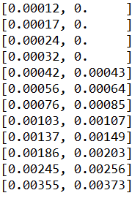
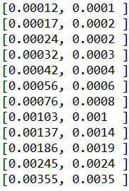
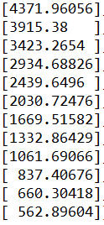
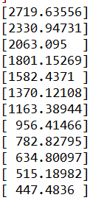
Part (a)
Expected time before death OR released from hospital
R Matrix
Threshold = 5
No threshold
Threshold = 5
No threshold
From: [I-Q]⁻¹ x [ones]

Slide 4
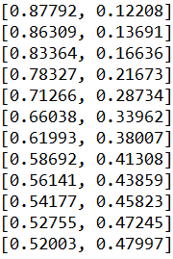
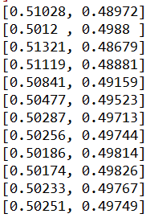
Part (b)
Exit state prob based on entrance i (AHS)
Threshold = 5
No threshold
death
transplant
death
transplant
Entrance state i
From: [I-Q]⁻¹ x [R]

