Slide 1
NSF-SCC
Yifan Ding

Slide 2
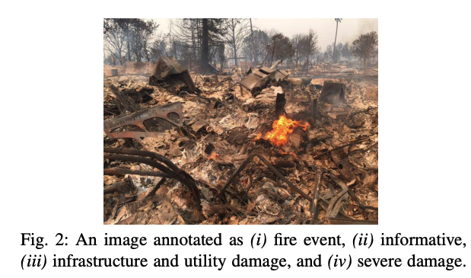
Datasets for Social Media Image Classification for Disaster Response
Disaster type detection
Informativeness
Humanitarian
Damage severity
Alam F, Ofli F, Imran M, et al. Deep learning benchmarks and datasets for social media image classification for disaster response[C]//2020 IEEE/ACM International Conference on Advances in Social Networks Analysis and Mining (ASONAM). IEEE, 2020: 151-158.

Slide 3
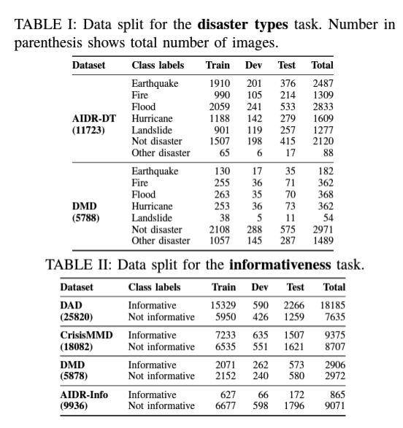
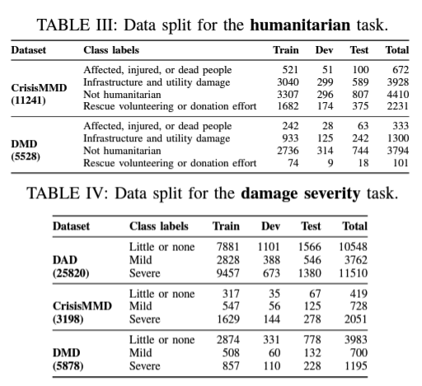
Overview of each task
Notes:
add data analysis on the dataset

Slide 4
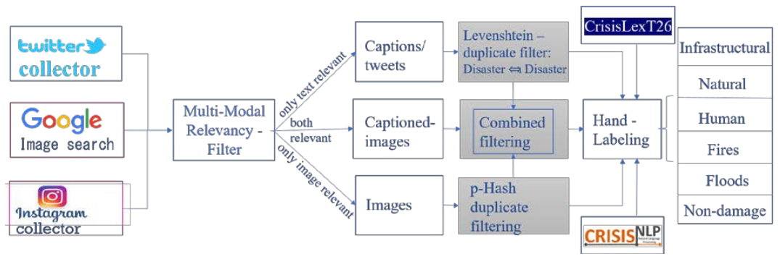
Data sources and annotations

Slide 5
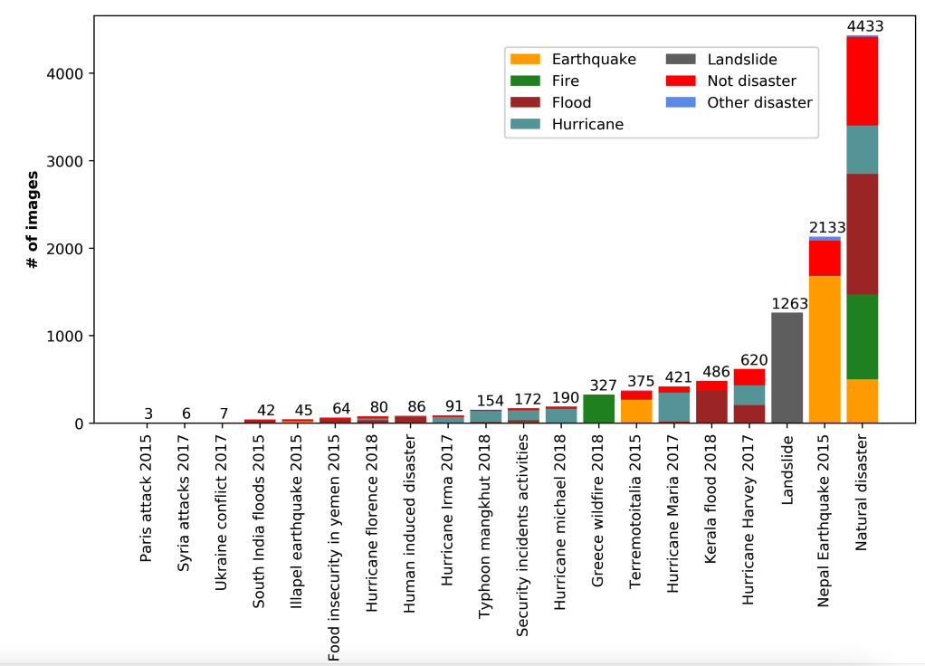
Number of disaster types labeled images from different disaster events and collections in AIDR-DT dataset

Slide 6
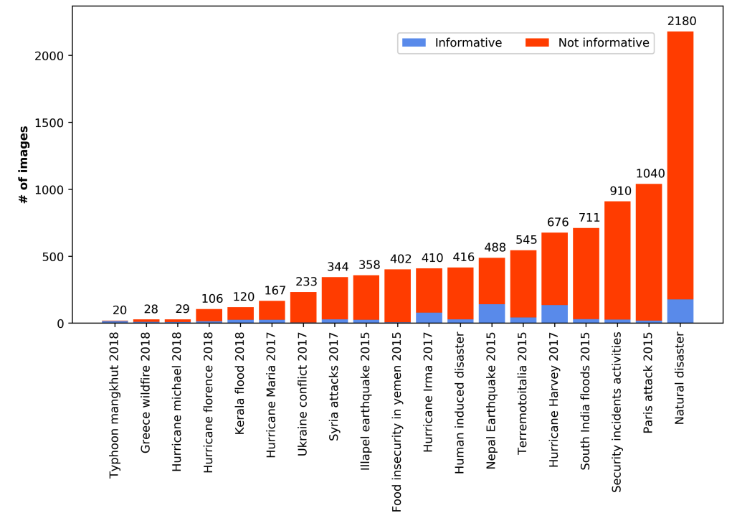
Number of labeled informative vs. not-informative images from different disaster events and collections in AIDRinfo dataset

Slide 7
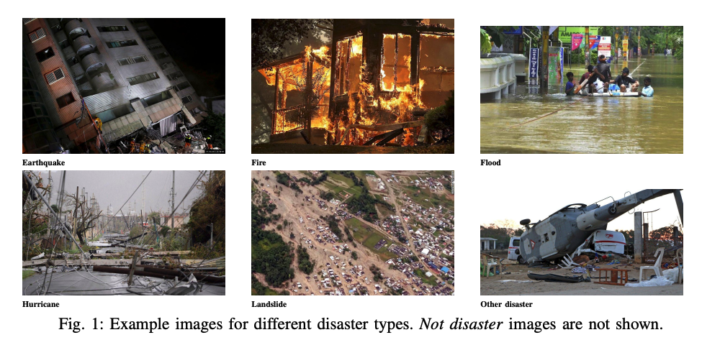
Disaster type prediction – ResNet18
Category | not disaster | earthquake | fire | flood | hurricane | landslide | other disaster | Overall
Accuracy | 80.81 | 56.93 | 73.57 | 80.30 | 56.25 | 56.72 | 70.20 | 71.33
Problems:
Imbalanced categories
Severe overfitting
Separate networks for each tasks

Slide 8
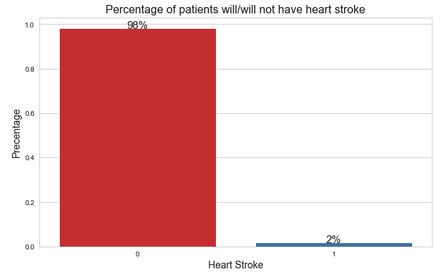
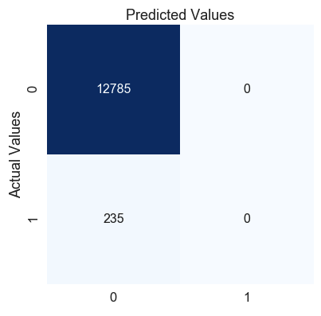
Imbalanced categories

Slide 9
Solutions
Class weight balance
New_loss_stroke = 0.02* loss_stroke
New_loss_not_stroke = 0.98* loss_not_stroke

Slide 10
Severe overfitting
test:0.6279, val:0.6170, train:0.9978,
test:0.6300, val:0.6224, train:0.9988,
test:0.6322, val:0.6218, train:0.9994,
test:0.6338, val:0.6245, train:0.9998,
test:0.6344, val:0.6245, train:0.9998,

Slide 11
GSAM
Zhuang J, Gong B, Yuan L, et al. Surrogate Gap Minimization Improves Sharpness-Aware Training[J]. arXiv preprint arXiv:2203.08065, 2022.

Slide 12
Test, val and train accuracies after GSAM
test:0.8147, val:0.7973, train:0.8056,
test:0.8100, val:0.7959, train:0.8048,
test:0.8150, val:0.8020, train:0.8070,
test:0.8150, val:0.8007, train:0.8017,
test:0.8116, val:0.7980, train:0.8038,

Slide 13
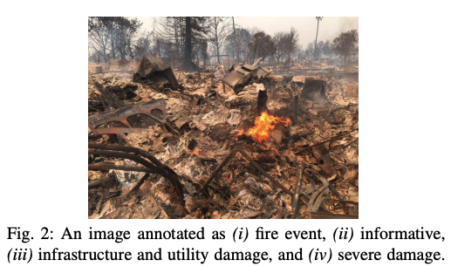
Same image for multiple tasks

Slide 14
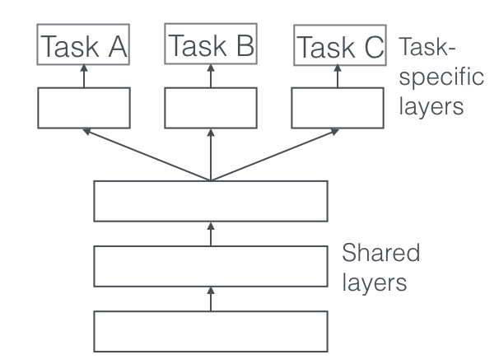
Multi-task learning
Disaster type
Damage severity
humanitarian

Slide 15
Results with class weight balance, lr schedular and GSAM
 | Test | Val
disaster_types_baseline | 78.5 | -
disaster_types | 81.16 | 79.80
damage_severity_baseline | 73.6 | -
damage_severity | 74.72 | 71.17
humanitarian_baseline | 74.9 | -
humanitarian | 76.18 | 77.54
informative_baseline | 85.1 | -
informative | 86.07 | 84.87

