Slide 1

CHAPTER 1 · GRADE 4 · WEEK 1
Energy Causes Change
Discovery / Evidence
Where can we observe evidence of energy causing change?
ENERGY
CHANGE
?
Unit 1 · Energy Transfer & Transformation
1
Notes:
MODE Title · orient
SPIKE 1 of 9 — chapter opener (CH1-HERO-01 full bleed, title in dark negative space, unresolved motif)

Slide 2

CHAPTER 1 · ENERGY CAUSES CHANGE
OBSERVE
What changed?
Reader p. 1 — you walk into a dark room and flip a switch.
Something became different.
That is a change.
DARK room · hard to see
BRIGHT room · light fills the room
2
2
Notes:
MODE Demo · observe
SPIKE 2 of 9 — dark->bright matched comparison (CH1-DARK-BRIGHT-01, uncropped)

Slide 3
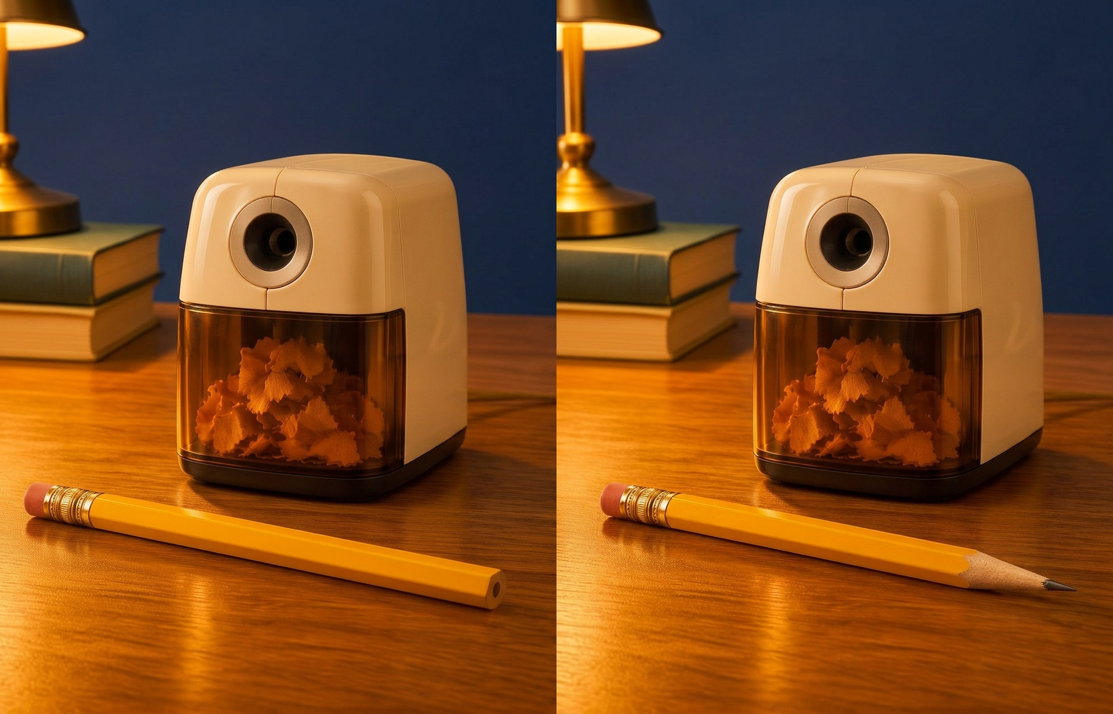
CHAPTER 1 · ENERGY CAUSES CHANGE
OBSERVE
What changed?
CHANGES
• the tip is sharper
• the pencil is shorter
• the sharpener makes a sound
BEFORE
AFTER
dull tip · sharpener quiet
shorter · sharper · sharpener humming
3
3
Notes:
MODE Demo · observe
SPIKE 3 of 9 — pencil before/after evidence (CH1-PENCIL-EVIDENCE-01, both states preserved)

Slide 4

KEY WORD
energy
the ability to cause change
Reader p. 1 · Unit 1 · Energy Transfer & Transformation
4
Notes:
MODE Vocabulary · TEACH
SPIKE 4 of 9 — ENERGY card (CH1-VOC-ENERGY-01 hero art)

Slide 5

KEY WORD
change
to become different
Reader p. 1 · Unit 1 · Energy Transfer & Transformation
5
Notes:
MODE Vocabulary · TEACH
SPIKE 5 of 9 — CHANGE card (CH1-VOC-CHANGE-01 hero art)

Slide 6

CHAPTER 1 · ENERGY CAUSES CHANGE
Look at the seashore
Reader p. 2 — the seashore changes all around us.
ENERGY
CHANGE
EVIDENCE
Waves move. Sand shifts. Water makes sound.
A change you observe is evidence that energy was involved.
6
Notes:
MODE Read · model (resolved showcase)
SPIKE 6 of 9 — ECE model (CH1-MODEL-ECE-01 subdued bg + navy nodes/gold arrows). Reveal timing preserved in canonical architecture (slide 14 '?' -> slide 16 EVIDENCE).

Slide 7
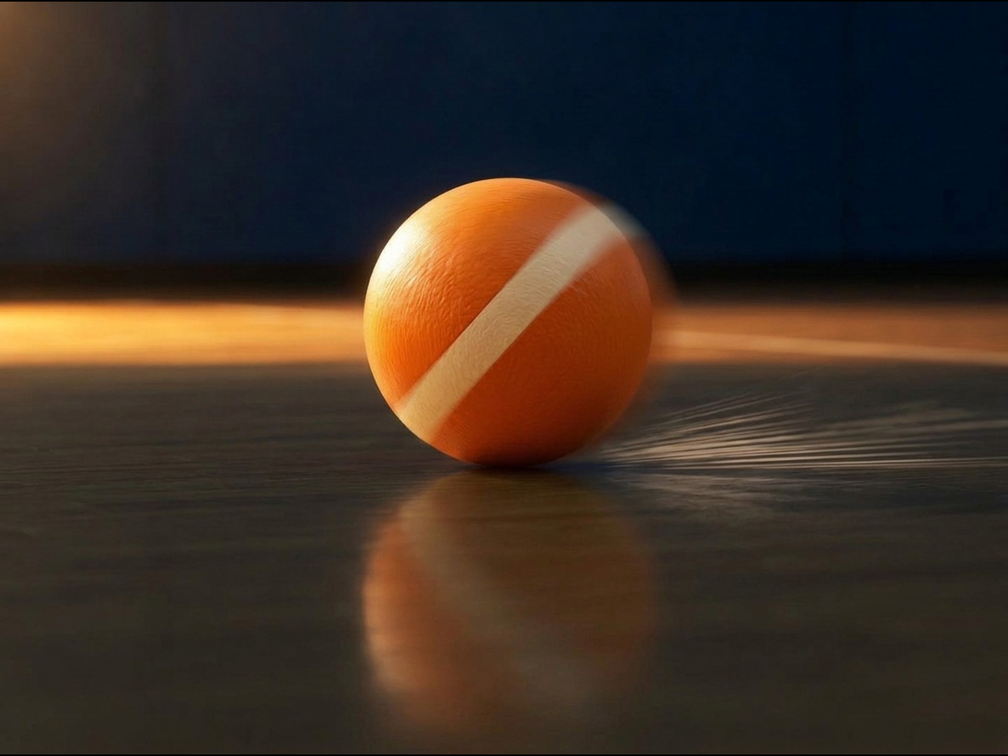
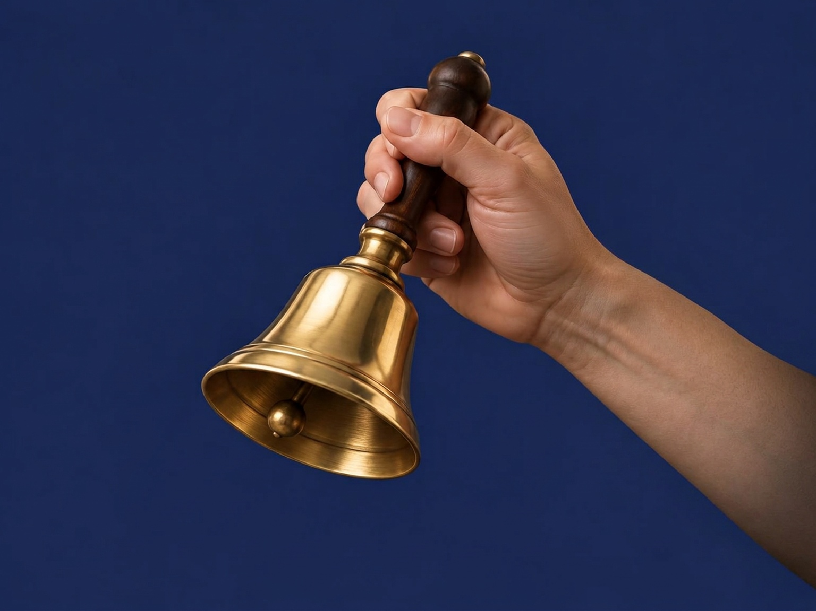

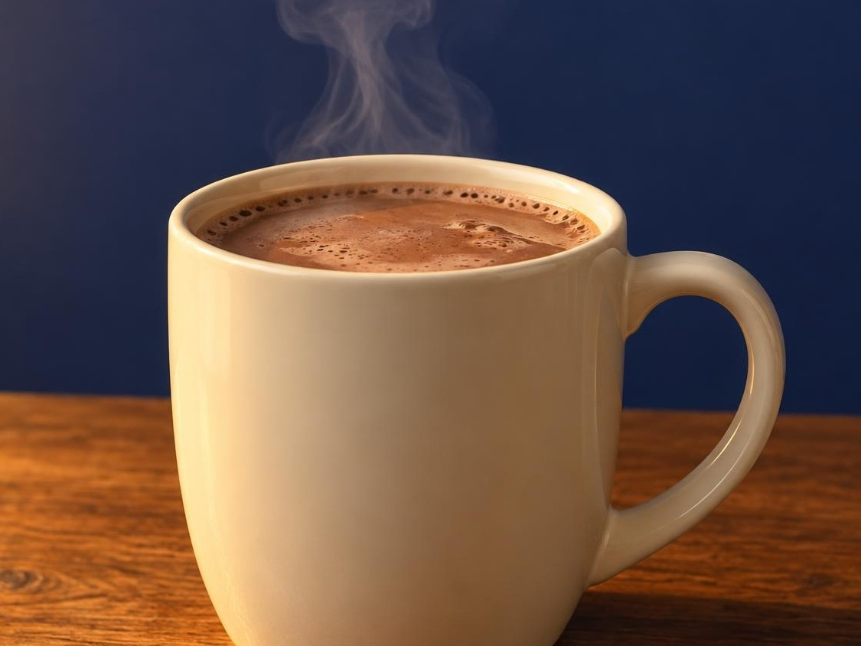
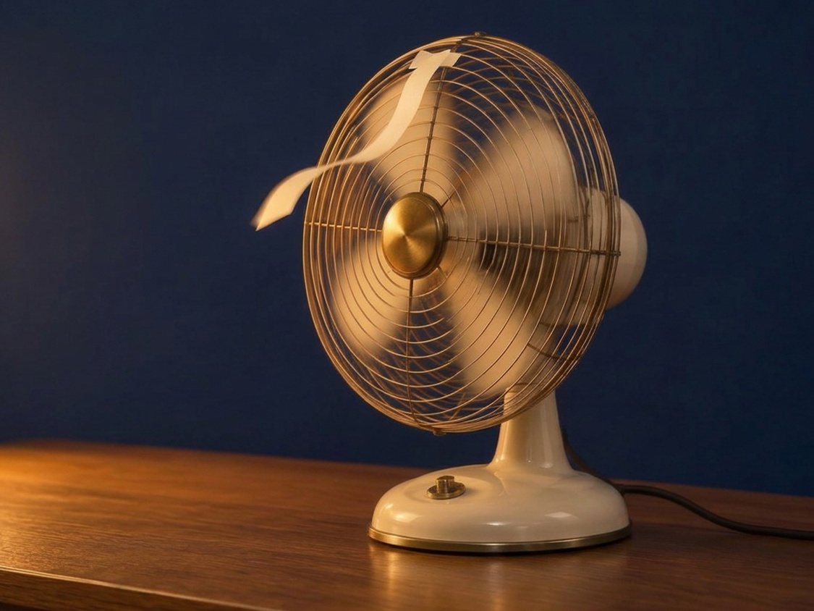
CHAPTER 1 · ENERGY CAUSES CHANGE
Energy has different forms
Reader p. 3 — think of a spinning carousel.
motion
sound
light
heat
electrical energy
On the carousel, the horses spin and move up and down.
That is motion.
7
7
Notes:
MODE Read · forms
SPIKE 7 of 9 — five-form family (uniform card system, labels exact, clues preserved)

Slide 8
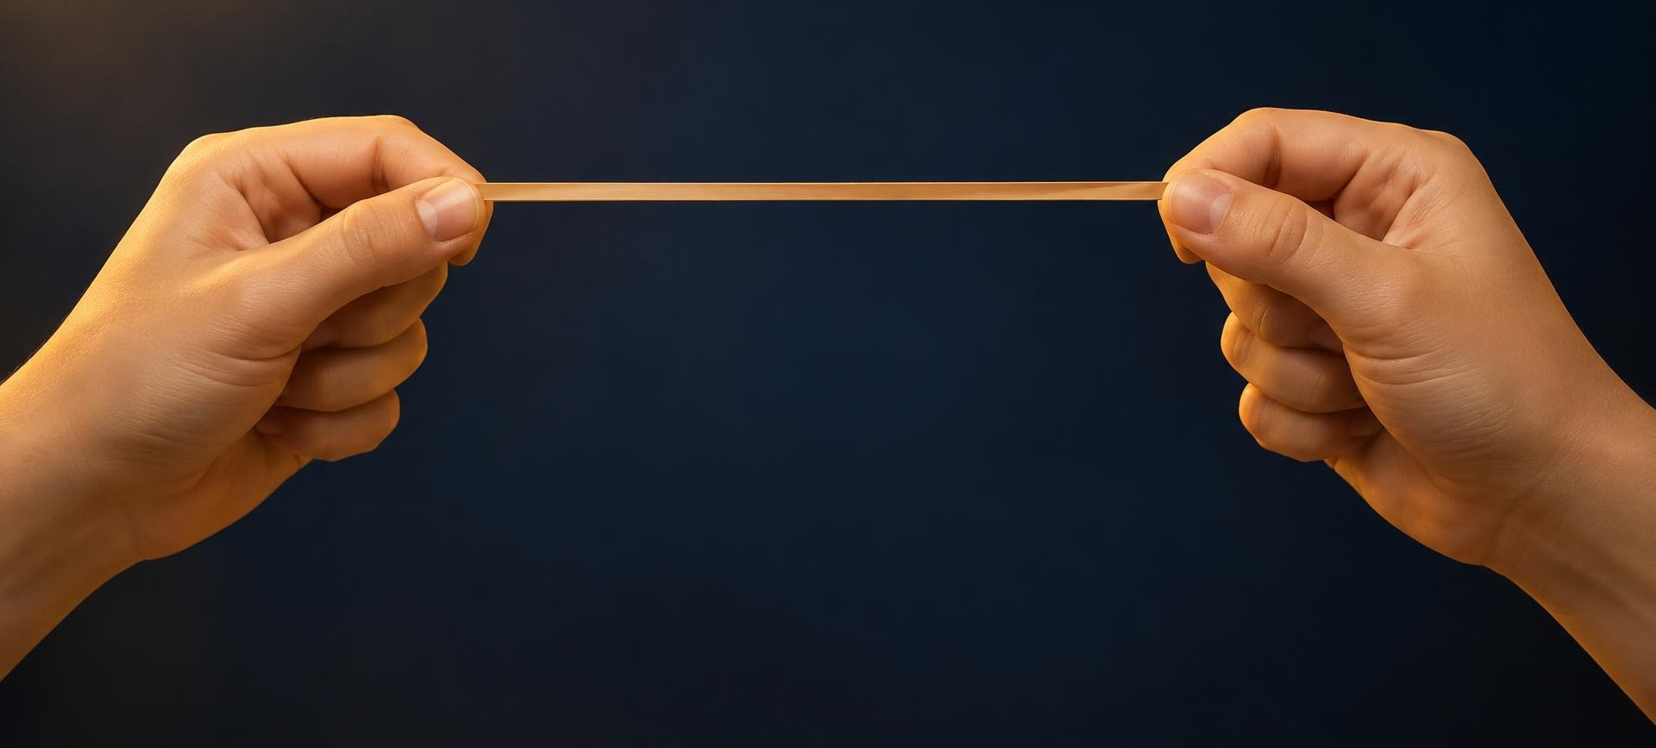
KEY WORD
stored energy
energy that has the ability to cause change at a later time
Reader p. 4 · Unit 1 · Energy Transfer & Transformation
8
Notes:
MODE Vocabulary · TEACH
SPIKE 8 of 9 — STORED ENERGY card (CH1-VOC-STORED-ENERGY-01 hero art)

Slide 9
CHAPTER 1 · ENERGY CAUSES CHANGE
WRITE
N
V1
Vocabulary — Energy & Change
Guided Notes · Reader p. 1
energy — the ability to cause _______ .
change — to become _________ .
Write the missing word in each blank.
9
Notes:
MODE Notes · V1 anchor (restraint benchmark)
SPIKE 9 of 9 — WRITE/CHECK V1, no premium image, exact notes mirror

