Slide 1
Using Fossil Fuels
Chapter 3 · Grade 4 · Week 6
Unit 2 · Using Natural Resources for Energy · Grade 4

Slide 2
2
Big Question
What are some costs and benefits of using fossil fuels?

Slide 3
Under the hood
3
THINK
Opening phenomenon
A car engine runs on gasoline — you see moving parts and feel heat.
Then a refinery photo: what happens to the fuel before it reaches the car?

Slide 4
Key Words: extract, refine, combustion
4
NOTE
Page 1 · Key Words
Extract = take from the ground · refine = change into useful products · combustion = burning.

Slide 5
From Ground to Use
5
NOTE
Page 1 · From Ground to Use
Reveal after students try.
Number the four steps in order (1–4).
EXTRACT → TRANSPORT → REFINE → BURN

Slide 6
Electricity Pathway
6
NOTE
Page 2 · Electricity Pathway
Reveal after students try.
Copy the pathway; then DRAW the pathway box.
BURN FUEL → STEAM → TURBINE → GENERATOR → ELECTRICITY

Slide 7
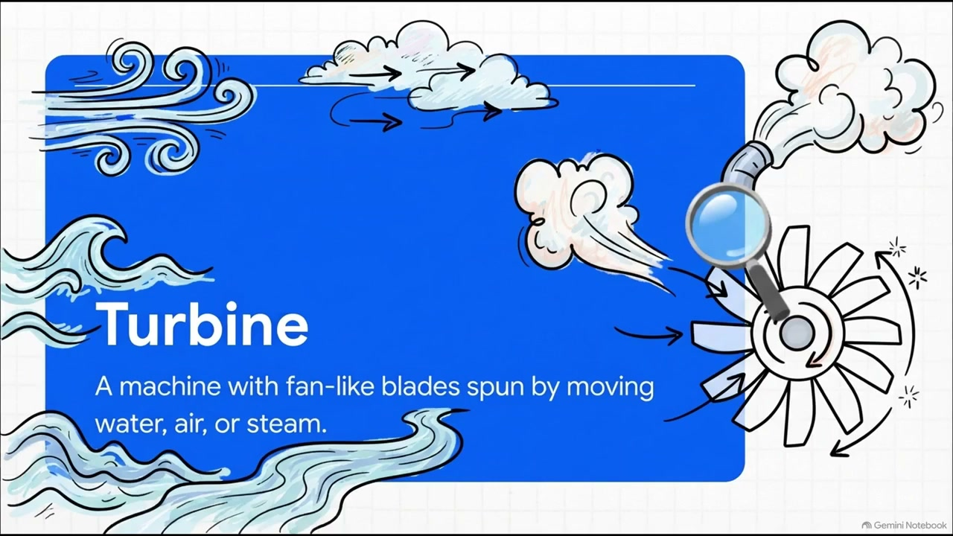
WATCH — Turbine & Generator
7
WATCH
Optional video · 3:41 · Week 6 Tuesday
THINK: What stays the same in every power plant?
Notes:
ROLE: SUPPORT
PLAY: Week 6 Tuesday — after “Electricity Pathway”, before “Benefits and Limitations”.
PURPOSE: Show that every power plant spins a turbine to turn a generator — the shared pathway students will revisit with the Water Wheel.
SKIP IF: Skip if the Water Wheel lab will demonstrate the pathway hands-on.

Slide 8
Benefits and Limitations
7
NOTE
Page 3 · Benefits and Limitations
Benefits: heat, engines, electricity, products.
Limitations: mining danger, spills, air pollution.

Slide 9
Careful Use & Stewardship
8
NOTE
Page 3 · Careful Use
Extraction and use can affect land, water, and air.
Oil spills harm wildlife; burning releases substances into the air.

Slide 10
Review
9
What is the FIRST step in using petroleum?
A. refine it
B. extract it
C. burn it
D. transport it

Slide 11
Answer
10
B. Extract (take it from the ground) first.

Slide 12
Review
11
Burning fuel heats water into —
A. ice
B. steam
C. oil
D. coal

Slide 13
Answer
12
B. Steam spins the turbine.

Slide 14
Review
13
In a power plant, the generator makes —
A. steam
B. heat
C. electricity
D. fuel

Slide 15
Answer
14
C. The generator makes electricity.

Slide 16
Review
15
Which is a BENEFIT of fossil fuels?
A. oil spills
B. mining danger
C. heating homes and cooking
D. air pollution

Slide 17
Answer
16
C. Heating and cooking are benefits.

Slide 18
Review
17
Which is a LIMITATION of fossil fuels?
A. they power engines
B. they can cause pollution and spills
C. they make electricity
D. they heat homes

Slide 19
Answer
18
B. Pollution and spills are limitations.

Slide 20
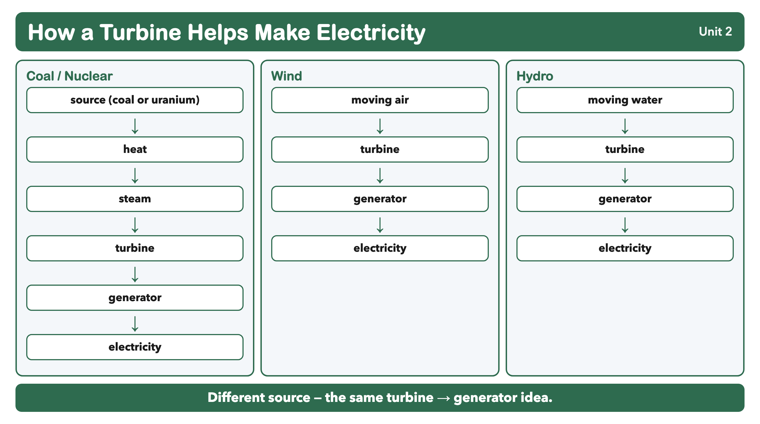
COMPARE · What stays the same? What changes?
Notes:
INFOGRAPHIC REFERENCE (COMPARE)
What stays the same? What changes?
U2 Ch3–6 turbine → generator pathways reference.
Approved rebuilt visual — production/infographics/unit2-turbine-generator-pathways.png. Locked Grade 4 vocabulary only.

