Slide 1
Wind Energy
Chapter 5 · Grade 4 · Week 7
Unit 2 · Using Natural Resources for Energy · Grade 4

Slide 2
2
Big Question
How do people use wind as a source of energy?

Slide 3
The island switch
3
THINK
Opening phenomenon
An island shuts off its diesel generator as wind turbines take over for the afternoon.
Where does the energy come from when the wind blows?

Slide 4
Key Words: wind farm, turbine
4
NOTE
Page 1 · Key Words
A turbine has blades that spin when wind pushes them; many together make a wind farm.

Slide 5
Electricity Pathway
5
NOTE
Page 1 · Electricity Pathway
Reveal after students try.
Copy the pathway; then DRAW a labeled turbine.
MOVING AIR → BLADES → GENERATOR → ELECTRICITY

Slide 6
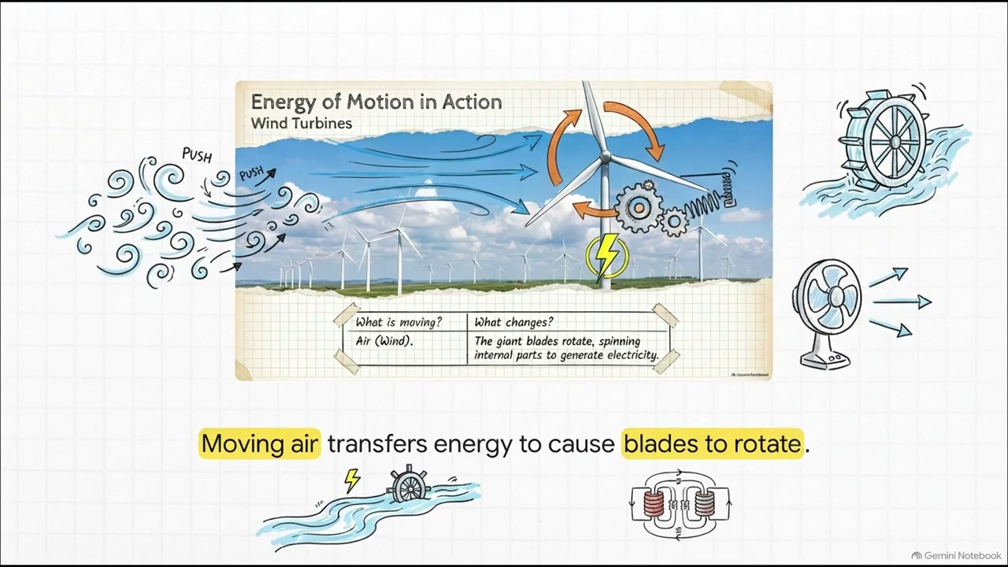
WATCH — Wind Power
6
WATCH
Optional video · 1:35 · Week 7 Monday
THINK: What makes the turbine blades spin?
Notes:
ROLE: SUPPORT
PLAY: Week 7 Monday — after “Electricity Pathway”, before “Benefits and Limitations”.
PURPOSE: Show moving air spinning turbine blades to make electricity — the wind-energy pathway.
SKIP IF: Skip if time is tight; the deck and reader cover the wind pathway.

Slide 7
Benefits and Limitations
6
NOTE
Page 2 · Benefits and Limitations
Benefits: renewable, no fuel burned.
Limitations: needs wind, not always blowing.

Slide 8
Location Matters
7
NOTE
Page 2 · Location Matters
Wind works best where it blows steadily and strongly enough.

Slide 9
Review
8
Wind turns the blades, which —
A. cool the air
B. spin a generator to make electricity
C. store water
D. burn fuel

Slide 10
Answer
9
B. Blades spin a generator that makes electricity.

Slide 11
Review
10
Wind is called renewable because —
A. it is always windy
B. wind keeps coming back
C. turbines last forever
D. wind is cheap

Slide 12
Answer
11
B. Wind is restored naturally and continuously.

Slide 13
Review
12
Wind power depends on —
A. coal
B. location and weather
C. uranium
D. dams

Slide 14
Answer
13
B. Wind power needs a steady, strong enough wind.

Slide 15
Review
14
Which is a LIMITATION of wind?
A. no fuel burned
B. renewable
C. not always blowing
D. makes electricity

Slide 16
Answer
15
C. Wind is not always blowing.

