Slide 1
Solving Problems and Designing Solutions
Thomas A. Edison · Chapter 7 · Grade 4 · Week 4
PROBLEM
DESIGN
TEST
EVIDENCE
IMPROVE

Slide 2
Big Question
How did Thomas Edison use his knowledge of energy transfer and transformation to solve problems?

Slide 3
The problem
3
Life before light bulbs
Before light bulbs, people lit the dark with open flames — torches, candles, oil lanterns.
Open flames can be unsafe. Early bulbs burned out fast and cost too much.
PROBLEM
UNSAFE LIGHT
→ SOLVE IT

Slide 4
Edison saw a chance
4
Improve, don't invent
Edison did NOT invent the first light bulb. Other engineers had already built bulbs.
He improved their designs — safer, longer-lasting, more affordable.
EXISTING BULB
→
BETTER BULB

Slide 5
Testing materials
THINK
5
More than 6,000 materials
Edison's team tested more than six thousand materials for a filament.
They wanted a material that glows a long time without burning up — and costs less.
TEST
EVIDENCE
REPEAT

Slide 6
The solution
6
1879 — bamboo + carbon
In 1879, a bamboo filament coated with carbon worked.
Electrical energy transformed to light energy.
ELECTRICAL
→ LIGHT
BULB GLOWS

Slide 7
The filament
LABEL
7
Where the change happens
The filament is the wire in a bulb that glows when electricity moves through it.
The glass protects the filament.

Slide 8
Persistence
8
Keep trying
'I haven't failed. I've just found ten thousand ways that won't work.'
Persistence = keep trying to solve a problem, even when you find ways that don't work.
FAILURE
= DATA
KEEP GOING

Slide 9
Not alone
9
Lewis Howard Latimer
Latimer improved Edison's bulb — securing the wire to the filament,
and making the filament stronger and longer-lasting. Design improves over time.

Slide 10
Beyond light bulbs
10
The alkaline battery
In 1901, Edison made the first alkaline battery — lighter and more powerful.
His electric-car idea did not succeed then, but his battery still affects your life.
STORED
→ ELECTRICAL
POWER DEVICES

Slide 11
Design never ends
11
Incandescent → CFL → LED
Each new design improves an earlier one: less electricity, less heat, longer life.
As long as there are problems, people keep designing solutions.
IMPROVE
→
IMPROVE AGAIN

Slide 12
Notes — Insert 1
NOTES
12
Engineering is a cycle
PROBLEM → DESIGN → TEST → EVIDENCE → IMPROVE.
Add one Edison example and one example from your own tabletop device.
PROBLEM
DESIGN
TEST
EVIDENCE
IMPROVE

Slide 13
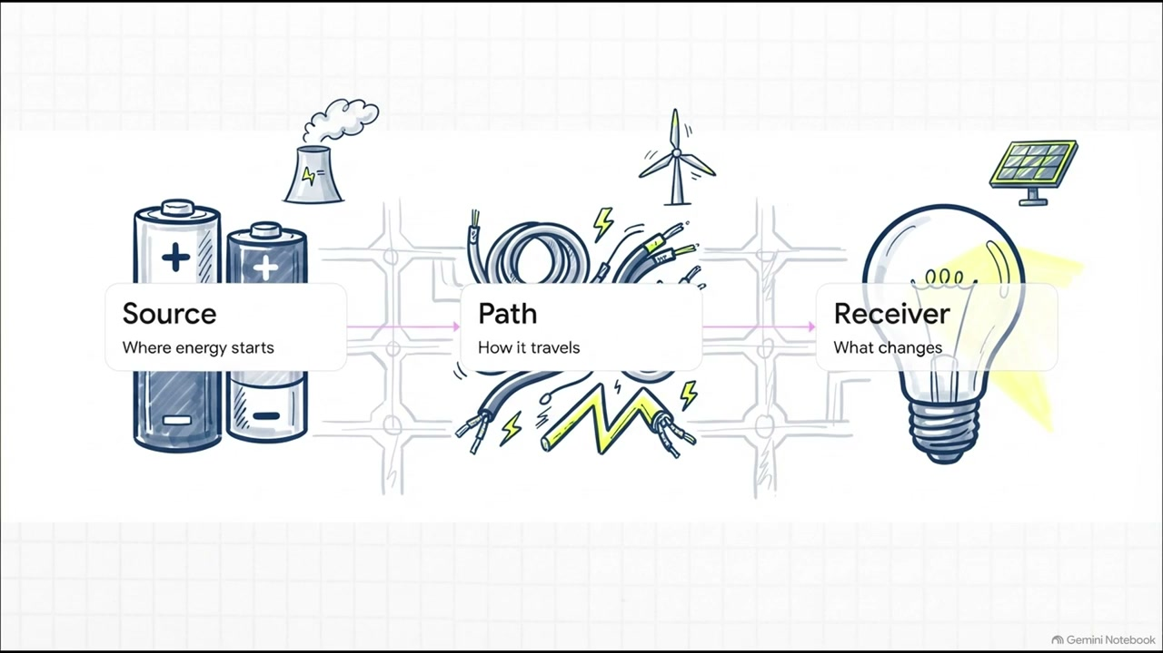
WATCH — Unit 1 Energy Core Recap
WATCH
Optional video · 2:49 · Week 4 · Chapters 1–6 recap
13
THINK: What evidence tells us energy is there, even when we can't see it?
Notes:
ROLE: SUPPORT
PLAY: Week 4 synthesis — after “Notes — Insert 1”, before “Review — Chapter 1”.
PURPOSE: Recap Unit 1 core ideas (evidence, transfer vs transformation, source/path/receiver, energy does not disappear) before the final review.
SKIP IF: Optional — use as a review aid; the unit review slides cover the same recap.

Slide 14
Review — Chapter 1
REVIEW
13
Energy causes change
Energy = the ability to cause change.
We see a change → we infer energy was involved.
ENERGY → CHANGE → EVIDENCE.
ENERGY
CHANGE
EVIDENCE

Slide 15
Review — Chapter 2
REVIEW
14
Moving objects have energy
A moving object has energy of motion.
It can cause a change when it hits or pushes.

Slide 16
Review — Chapter 3
REVIEW
15
Same object, different speed
For the SAME object, faster = more energy of motion = bigger change.
We MEASURE ramp height and cup movement; we INFER the speed.
SAME OBJECT
FASTER
BIGGER CHANGE

Slide 17
Review — Chapter 4
REVIEW
16
Energy transfers
Energy transfers by sound, light, heat, and electric current.
TRANSFER = energy moves place/object. TRANSFORMATION = form changes.
TRANSFER
TRANSFORMATION
BOTH

Slide 18
Review — Chapter 5
REVIEW
17
Collisions transfer energy
In a collision, energy of motion transfers to the target — and some becomes sound.
Energy does NOT disappear.
MOTION
→ TARGET
+ SOUND

Slide 19
Review — Chapter 6
REVIEW
18
Transformations + engineering
INPUT → TRANSFORMATION → OUTPUT. Engineers solve problems with energy changes,
judged by criteria under constraints.
INPUT
TRANSFORMATION
OUTPUT

Slide 20
Notes — Insert 2
NOTES
19
Energy Unit Concept Map
Center: ENERGY. Branches: causes change · motion · speed · transfer · collisions ·
transformation · engineering. Add one example under each.

Slide 21
Data / graph review
REVIEW
20
Same-object speed
Read a ramp-height vs cup-displacement table.
What pattern do you see? What do we measure vs infer?
RAMP HEIGHT ↑
→
CUP MOVEMENT ↑

Slide 22
Transfer / Transformation / BOTH
REVIEW
21
Retrieval sort
Classify: warm spoon · flashlight · dominoes · buzzer · toy-car collision.
State the system boundary first.
TRANSFER
TRANSFORMATION
BOTH

Slide 23
Fair test
REVIEW
22
One thing at a time
A fair test changes ONE thing and keeps everything else the same.
That way we know what caused the change.
CHANGE ONE
KEEP REST SAME
COMPARE

Slide 24
Criteria & constraints
REVIEW
23
Engineering review
Criteria = what a good solution must do.
Constraints = the limits (materials, time, safety).
CRITERIA
CONSTRAINTS
SOLUTION

Slide 25
Assessment expectations
24
What to expect
Multiple choice · diagrams · data tables · graph reading · short answers · one CER.
Show your evidence. Use your Core Vocabulary cards if allowed.
READ
SHOW EVIDENCE
EXPLAIN

Slide 26
Correction process
25
Learn from mistakes
MISSED ITEM → ORIGINAL THINKING → CORRECT IDEA → EVIDENCE → NEW EXAMPLE.
Corrections are about learning, not punishment.
MISSED
EVIDENCE
REPAIR

Slide 27
Unit closure
NOTES
26
From change to engineering
ENERGY → CHANGE → EVIDENCE → ENGINEERING.
Notes Insert 3 — Unit Reflection: something I can explain, strong evidence,
one improvement, one question.
ENERGY
CHANGE
ENGINEERING

