Slide 1

CHAPTER 2 • GRADE 4 • WEEK 1
Moving Objects
Have Energy
MOTION • CHANGE • EVIDENCE
How are energy, change, and movement of objects related?
MOVING OBJECT
→
CHANGE
→
EVIDENCE
Unit 1 • Energy Transfer & Transformation
Notes:
MODE Chapter opener
TIME 1 min
SESSION 1 — Wednesday
PLAN REQUIRED
STUDENT RESOURCE none
READER PAGE none
SAY / ASK What can a moving object do to other things?
DO
LISTEN FOR move, hit, change
REVEAL
MISCONCEPTION
NEXT Open the Big Question.
IF SHORT Continue to the next required slide.
MATERIALS none

Slide 2
CHAPTER 2 • MOVING OBJECTS HAVE ENERGY
BQ
TURN & TALK
Big Question
BIG QUESTION
How are energy, change, and movement of objects related?
Keep this question in mind. We will return to it.
Think: What is ONE change a moving object can cause?
2
Notes:
MODE Big Question discussion
TIME 2 min; Session 2 re-entry uses 1 min
SESSION 1 and 2
PLAN REQUIRED
STUDENT RESOURCE Guided Notes p. 1
READER PAGE p. 7
SAY / ASK What change have you seen a moving object cause?
DO
LISTEN FOR a named moving object and change
REVEAL Do not answer the Big Question yet.
MISCONCEPTION
NEXT Record first thinking.
IF SHORT Continue to the next required slide.
MATERIALS none

Slide 3
CHAPTER 2 • MOVING OBJECTS HAVE ENERGY
BQ • WRITE
WRITE
Big Question: My first thinking
Guided Notes p. 1
How are energy, change, and movement of objects related?
My first thinking
Write 1–2 quick ideas. No wrong answer yet.
3
Notes:
MODE Guided Notes write
TIME 2 min
SESSION 1 — Wednesday
PLAN REQUIRED
STUDENT RESOURCE Guided Notes p. 1
READER PAGE p. 7
SAY / ASK Write your first idea.
DO Wait quietly while students write.
LISTEN FOR a moving object causing any observable change
REVEAL No sample answer yet.
MISCONCEPTION Accept a reasonable first idea without correcting it.
NEXT Observe the marble collision.
IF SHORT Continue to the next required slide.
MATERIALS none

Slide 4
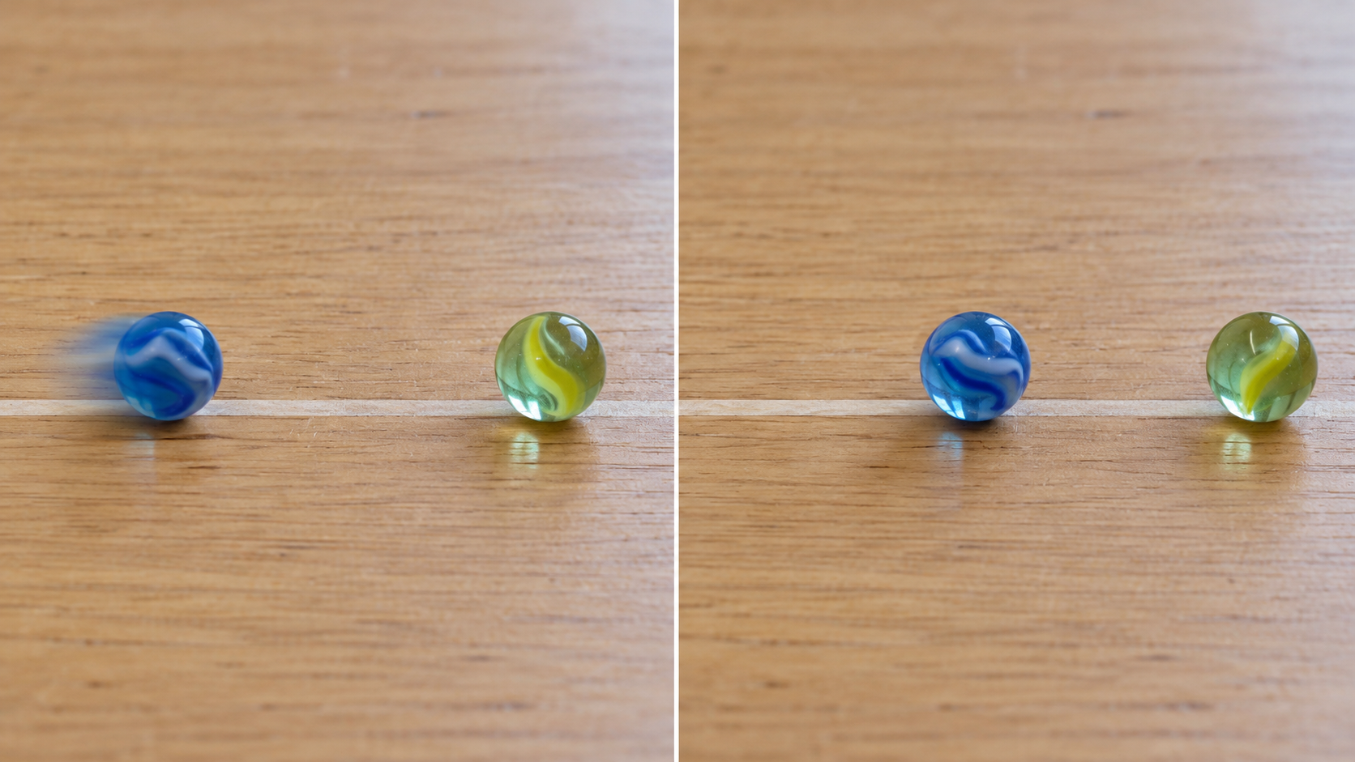
CHAPTER 2 • MOVING OBJECTS HAVE ENERGY
D
OBSERVE
Marble Collision: Before
One marble is still. Another marble will roll toward it.
BEFORE
One marble is still.
One marble is ready to move.
What do you notice before the marbles touch?
4
Notes:
MODE Demonstration observe
TIME 1 min
SESSION 1 — Wednesday
PLAN REQUIRED
STUDENT RESOURCE none
READER PAGE TG Lesson 3
SAY / ASK What does each marble look like right now?
DO Set one target marble still and place the rolling marble several inches away.
LISTEN FOR still, ready to roll, separated
REVEAL Nothing yet.
MISCONCEPTION A still photograph alone does not prove motion; the live roll follows.
NEXT Predict what will happen.
IF SHORT Continue to the next required slide.
MATERIALS two marbles and a clear tabletop lane

Slide 5
CHAPTER 2 • MOVING OBJECTS HAVE ENERGY
D
PREDICT
Predict: What will happen?
Think before the moving marble reaches the still marble.
When the moving marble hits the still marble, the still marble will…
________________________________
● → ●
Say your prediction to a partner.
5
Notes:
MODE Prediction
TIME 1 min
SESSION 1 — Wednesday
PLAN REQUIRED
STUDENT RESOURCE none
READER PAGE none
SAY / ASK What will happen to the still marble?
DO Give five seconds of quiet thinking, then partner share.
LISTEN FOR the target may start moving
REVEAL Do not confirm before the roll.
MISCONCEPTION
NEXT Run the live demonstration.
IF SHORT Continue to the next required slide.
MATERIALS two marbles and lane

Slide 6
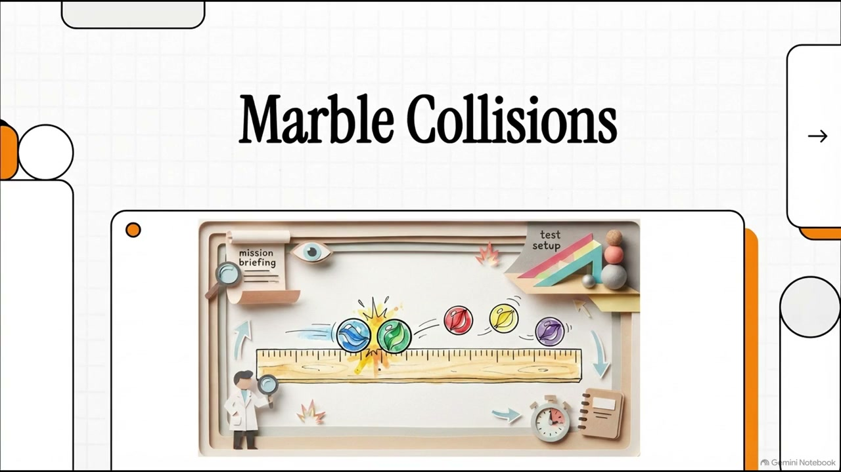
OPTIONAL SUPPORT
Marble Collision Replay
What changes after the marbles touch?
Live demonstration is the default. Continue to Slide 7 if video is unavailable.
6
Notes:
MODE Media support or live demonstration
TIME 0 min in core route
SESSION 1 — Wednesday
PLAN OPTIONAL
STUDENT RESOURCE none
READER PAGE none
SAY / ASK Watch the target marble. What changes?
DO Use only if an approved replay binary exists. The live roll remains the default.
LISTEN FOR the target marble starts moving
REVEAL No answer overlay.
MISCONCEPTION
NEXT Compare before and after.
IF SHORT Skip directly to Slide 7.
MATERIALS approved media binary if available

Slide 7
CHAPTER 2 • MOVING OBJECTS HAVE ENERGY
D
OBSERVE
What changed?
CHANGE
The target marble changed from still to moving.
BEFORE
target marble still
AFTER
target marble now moving
Describe only what you observed.
7
Notes:
MODE Demonstration observe
TIME 2.5 min
SESSION 1 — Wednesday
PLAN REQUIRED
STUDENT RESOURCE none
READER PAGE none
SAY / ASK Name the change you saw.
DO Roll one marble into the target. Repeat once only if students missed the target's movement.
LISTEN FOR the target marble changed from still to moving
REVEAL The target marble changed from still to moving.
MISCONCEPTION Do not discuss energy transfer or the first marble slowing.
NEXT Use the change as evidence.
IF SHORT Continue to the next required slide.
MATERIALS two marbles and lane

Slide 8
CHAPTER 2 • MOVING OBJECTS HAVE ENERGY
D
EXPLAIN
How do we know it had energy?
Energy can be invisible. We look for the change.
MOVING OBJECT
→
CHANGE
→
EVIDENCE
The target marble started to move. That change is evidence that the moving marble had energy.
We observe the change. We infer that energy was involved.
8
Notes:
MODE Evidence explanation
TIME 1.5 min
SESSION 1 — Wednesday
PLAN REQUIRED
STUDENT RESOURCE none
READER PAGE p. 9
SAY / ASK How do we know the moving marble had energy if we cannot see energy?
DO
LISTEN FOR we saw the target change
REVEAL Trace moving object, change, evidence.
MISCONCEPTION Say evidence, not proof. Energy is not a visible substance.
NEXT Define motion.
IF SHORT Continue to the next required slide.
MATERIALS none

Slide 9

CHAPTER 2 • MOVING OBJECTS HAVE ENERGY
V1 • TEACH
RECITE
Vocabulary
KEY WORD
motion
the process of an object changing position
Reader p. 7
9
Notes:
MODE Vocabulary teach
TIME 2.5 min
SESSION 1 — Wednesday
PLAN REQUIRED
STUDENT RESOURCE Guided Notes V1
READER PAGE p. 7
SAY / ASK What changes when an object is in motion?
DO
LISTEN FOR its position
REVEAL Read the exact definition together.
MISCONCEPTION Motion is the process; it is not the same as speed.
NEXT Record V1.
IF SHORT Continue to the next required slide.
MATERIALS none

Slide 10
CHAPTER 2 • MOVING OBJECTS HAVE ENERGY
V1 • WRITE
WRITE
Vocabulary: Motion
Guided Notes • Reader p. 7
motion — the process of an object changing ______________ .
Write the missing word.
10
Notes:
MODE Guided Notes write
TIME 1.5 min
SESSION 1 — Wednesday
PLAN REQUIRED
STUDENT RESOURCE Guided Notes p. 1, V1
READER PAGE p. 7
SAY / ASK Fill in the blank.
DO Wait for students to write.
LISTEN FOR position
REVEAL Do not say or show the answer until Slide 11.
MISCONCEPTION
NEXT Check V1.
IF SHORT Continue to the next required slide.
MATERIALS none

Slide 11
CHAPTER 2 • MOVING OBJECTS HAVE ENERGY
V1 • CHECK
CHECK
Vocabulary: Motion
Guided Notes • Reader p. 7
motion — the process of an object changing position .
position
11
Notes:
MODE Guided Notes check
TIME 0.5 min
SESSION 1 — Wednesday
PLAN REQUIRED
STUDENT RESOURCE Guided Notes p. 1, V1
READER PAGE p. 7
SAY / ASK
DO
LISTEN FOR
REVEAL position
MISCONCEPTION
NEXT Read about how motion begins.
IF SHORT Continue to the next required slide.
MATERIALS none

Slide 12
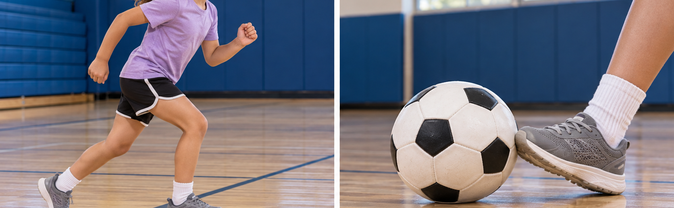
CHAPTER 2 • MOVING OBJECTS HAVE ENERGY
R
OBSERVE
How did each object begin to move?
Reader p. 8
PERSON
BALL
What started the motion in each example?
12
Notes:
MODE Reader bridge
TIME 2 min
SESSION 1 — Wednesday
PLAN REQUIRED
STUDENT RESOURCE Reader p. 8
READER PAGE p. 8
SAY / ASK How did the person and the ball begin to move?
DO
LISTEN FOR the person moved muscles; a kick put the ball into motion
REVEAL Keep the notes words hidden.
MISCONCEPTION
NEXT Record N1.
IF SHORT Continue to the next required slide.
MATERIALS none

Slide 13
CHAPTER 2 • MOVING OBJECTS HAVE ENERGY
N1 • WRITE
WRITE
Write the Missing Words
Guided Notes • Reader p. 8
A moving object can cause a ______________ .
Players cause their own motion. A ball does not. Something else puts the ball into motion.
Some objects cause their own motion. Other objects are put into motion by
____________ motion.
Fill both blanks in order.
13
Notes:
MODE Guided Notes write
TIME 2.5 min
SESSION 1 — Wednesday
PLAN REQUIRED
STUDENT RESOURCE Guided Notes p. 1, N1
READER PAGE p. 8
SAY / ASK Fill both blanks in order.
DO
LISTEN FOR change; outside
REVEAL Keep both answers hidden until Slide 14.
MISCONCEPTION
NEXT Check N1.
IF SHORT Continue to the next required slide.
MATERIALS none

Slide 14
CHAPTER 2 • MOVING OBJECTS HAVE ENERGY
N1 • CHECK
CHECK
Moving Objects Can Cause Changes
Guided Notes • Reader p. 8
A moving object can cause a change .
Players cause their own motion. A ball does not. Something else puts the ball into motion.
Some objects cause their own motion. Other objects are put into motion by
outside motion.
change • outside
14
Notes:
MODE Guided Notes check
TIME 0.5 min
SESSION 1 — Wednesday
PLAN REQUIRED
STUDENT RESOURCE Guided Notes p. 1, N1
READER PAGE p. 8
SAY / ASK
DO
LISTEN FOR
REVEAL change; outside
MISCONCEPTION
NEXT Teach energy of motion.
IF SHORT Continue to the next required slide.
MATERIALS none

Slide 15

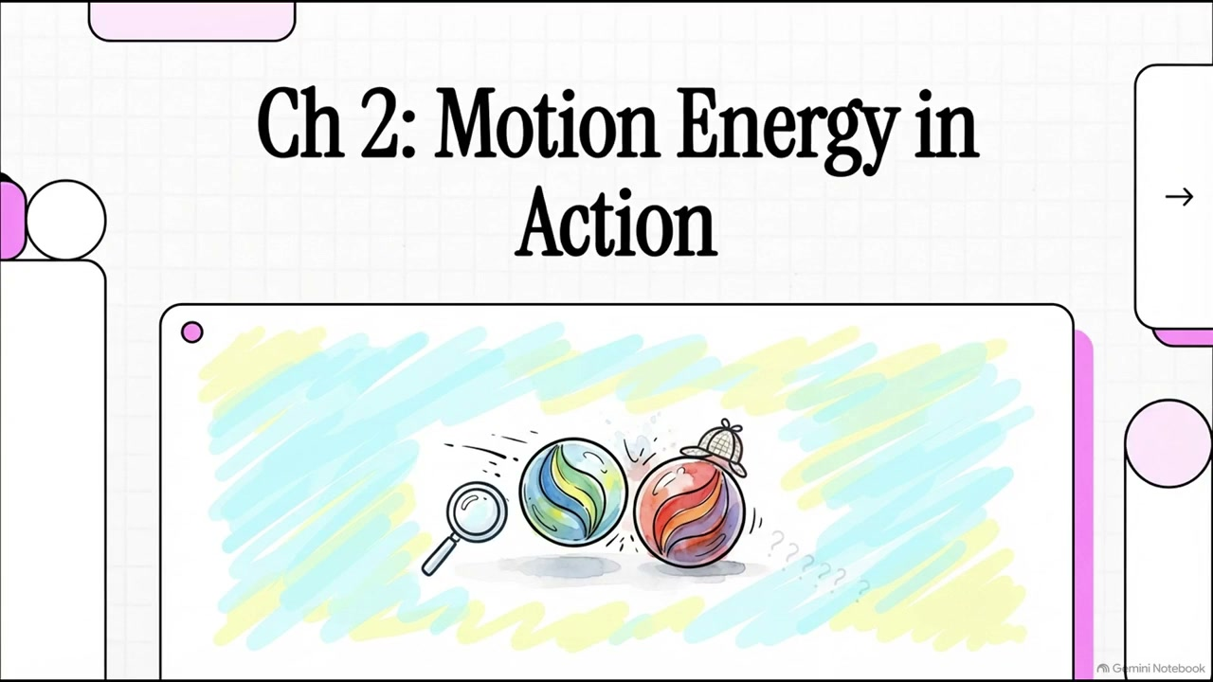
CHAPTER 2 • MOVING OBJECTS HAVE ENERGY
R • A
OBSERVE
Look for the change
Reader pp. 8–9
What changed because the ball was moving?
MOVING BALL
→
NET CHANGES
15
Notes:
MODE Reader application
TIME 0 min in core route
SESSION 1 — Wednesday
PLAN OPTIONAL
STUDENT RESOURCE Reader pp. 8–9
READER PAGE pp. 8–9
SAY / ASK What changed because the ball was moving?
DO
LISTEN FOR the net moved or bent
REVEAL Moving ball, net changes.
MISCONCEPTION
NEXT Teach V2.
IF SHORT Skip directly to Slide 16.
MATERIALS none

Slide 16

CHAPTER 2 • MOVING OBJECTS HAVE ENERGY
V2 • TEACH
RECITE
Vocabulary
KEY WORD
energy of motion
the energy an object possesses while it is moving
Reader p. 9
16
Notes:
MODE Vocabulary teach
TIME 2 min
SESSION 1 — Wednesday
PLAN REQUIRED
STUDENT RESOURCE Guided Notes p. 2, V2
READER PAGE p. 9
SAY / ASK Does a rolling ball have energy? How do you know?
DO
LISTEN FOR yes; it can cause a change
REVEAL Read the exact definition together.
MISCONCEPTION Energy of motion is not speed.
NEXT Record V2.
IF SHORT Continue to the next required slide.
MATERIALS none

Slide 17
CHAPTER 2 • MOVING OBJECTS HAVE ENERGY
V2 • WRITE
WRITE
Vocabulary: Energy of Motion
Guided Notes • Reader p. 9
energy of motion — the energy an object possesses while it is ______________ .
Write the missing word.
17
Notes:
MODE Guided Notes write
TIME 1 min
SESSION 1 — Wednesday
PLAN REQUIRED
STUDENT RESOURCE Guided Notes p. 2, V2
READER PAGE p. 9
SAY / ASK Fill in the blank.
DO
LISTEN FOR moving
REVEAL Keep moving hidden until Slide 18.
MISCONCEPTION
NEXT Check V2.
IF SHORT Continue to the next required slide.
MATERIALS none

Slide 18
CHAPTER 2 • MOVING OBJECTS HAVE ENERGY
V2 • CHECK
CHECK
Vocabulary: Energy of Motion
Guided Notes • Reader p. 9
energy of motion — the energy an object possesses while it is moving .
moving
18
Notes:
MODE Guided Notes check
TIME 0.5 min
SESSION 1 — Wednesday
PLAN REQUIRED
STUDENT RESOURCE Guided Notes p. 2, V2
READER PAGE p. 9
SAY / ASK
DO
LISTEN FOR
REVEAL moving
MISCONCEPTION
NEXT End Session 1. Session 2 reopens on Slide 2, then continues to Slide 19.
IF SHORT Continue to the next required slide.
MATERIALS none

Slide 19
CHAPTER 2 • MOVING OBJECTS HAVE ENERGY
R
EXPLAIN
Moving objects have energy
Reader p. 9
MOVING OBJECT
→
CHANGE
→
EVIDENCE
Energy is the ability to cause change.
A moving object causes change, so it has energy.
Trace the model from left to right.
19
Notes:
MODE Reader model
TIME 1 min
SESSION 2 — Thursday
PLAN REQUIRED
STUDENT RESOURCE Reader p. 9
READER PAGE p. 9
SAY / ASK Trace moving object, change, evidence.
DO
LISTEN FOR a change is evidence
REVEAL The full model is visible because the next blank is motion, not a model node.
MISCONCEPTION Use evidence, not proof.
NEXT Record N2.
IF SHORT Continue to the next required slide.
MATERIALS none

Slide 20
CHAPTER 2 • MOVING OBJECTS HAVE ENERGY
N2 • WRITE
WRITE
Moving Objects Have Energy
Guided Notes • Reader p. 9
All moving objects have energy of ______________ .
Energy is the ability to cause change. A moving object causes change, so it has energy.
MOVING OBJECT
→
CHANGE
→
EVIDENCE
Write the missing word.
20
Notes:
MODE Guided Notes write
TIME 1 min
SESSION 2 — Thursday
PLAN REQUIRED
STUDENT RESOURCE Guided Notes p. 2, N2
READER PAGE p. 9
SAY / ASK Fill in the blank.
DO
LISTEN FOR motion
REVEAL Keep motion hidden until Slide 22.
MISCONCEPTION
NEXT Recall and draw the marble change.
IF SHORT Continue to the next required slide.
MATERIALS none

Slide 21
CHAPTER 2 • MOVING OBJECTS HAVE ENERGY
N2 • DRAW
DRAW
Marble Collision: Observe
Guided Notes • Reader p. 9
OBSERVE: one moving marble rolls into a target marble.
BEFORE
AFTER
draw
→
draw
What changed?
21
Notes:
MODE Guided Notes draw and observe
TIME 2 min
SESSION 2 — Thursday
PLAN REQUIRED
STUDENT RESOURCE Guided Notes p. 2, N2 OBSERVE
READER PAGE p. 9
SAY / ASK Draw the target marble before and after. What changed?
DO Use one 30-second reminder roll only if students do not remember.
LISTEN FOR the target was still, then moved
REVEAL Do not draw the sample for students.
MISCONCEPTION
NEXT Check N2.
IF SHORT Continue to the next required slide.
MATERIALS two marbles only if a reminder roll is needed

Slide 22
CHAPTER 2 • MOVING OBJECTS HAVE ENERGY
N2 • CHECK
CHECK
Moving Objects Have Energy
Guided Notes • Reader p. 9
All moving objects have energy of motion .
MOVING OBJECT
→
CHANGE
→
EVIDENCE
Sample observation
The target marble changed from sitting still to moving.
The change matters more than the drawing style.
22
Notes:
MODE Guided Notes check
TIME 0.5 min
SESSION 2 — Thursday
PLAN REQUIRED
STUDENT RESOURCE Guided Notes p. 2, N2
READER PAGE p. 9
SAY / ASK
DO
LISTEN FOR
REVEAL motion; sample: The target marble changed from sitting still to moving.
MISCONCEPTION
NEXT Read the three useful examples.
IF SHORT Continue to the next required slide.
MATERIALS none

Slide 23
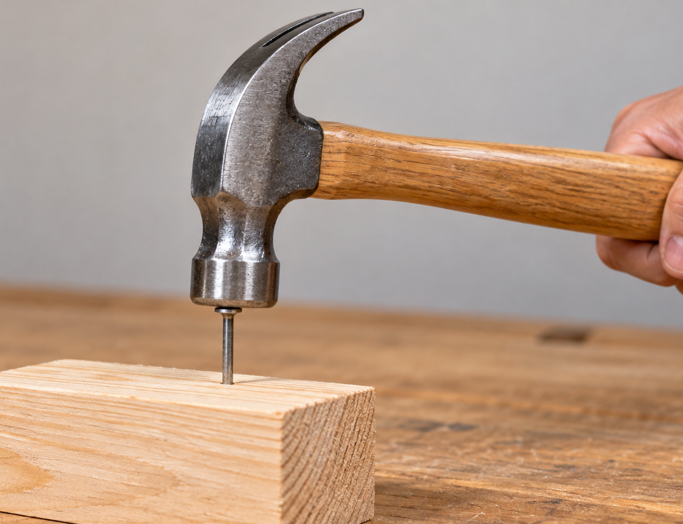


CHAPTER 2 • MOVING OBJECTS HAVE ENERGY
R • A
OBSERVE
People use the energy of motion
Reader pp. 10–12
moving hammer
swinging pendulum
moving air
What changes?
What moves?
What changes?
23
Notes:
MODE Reader examples
TIME 1 min
SESSION 2 — Thursday
PLAN REQUIRED
STUDENT RESOURCE Reader pp. 10–12
READER PAGE pp. 10–12
SAY / ASK What change does each moving thing cause?
DO
LISTEN FOR hammer drives nail; pendulum turns gears; wind spins blades
REVEAL Keep table wording for the next slides.
MISCONCEPTION
NEXT Record N3.
IF SHORT Continue to the next required slide.
MATERIALS none

Slide 24
CHAPTER 2 • MOVING OBJECTS HAVE ENERGY
N3 • WRITE
WRITE
People Use the Energy of Motion
Guided Notes • Reader pp. 10–12
Write or draw the change each moving object causes.
MOVING OBJECT | WHAT CHANGE DOES IT CAUSE?
hammer (swinging)
pendulum (swinging)
wind (moving air)
24
Notes:
MODE Guided Notes table
TIME 1.5 min
SESSION 2 — Thursday
PLAN REQUIRED
STUDENT RESOURCE Guided Notes p. 3, N3
READER PAGE pp. 10–12
SAY / ASK Write or draw the change each moving object causes.
DO
LISTEN FOR source-faithful useful change
REVEAL No samples until Slide 25.
MISCONCEPTION
NEXT Check N3.
IF SHORT Continue to the next required slide.
MATERIALS none

Slide 25
CHAPTER 2 • MOVING OBJECTS HAVE ENERGY
N3 • CHECK
CHECK
People Use the Energy of Motion
Guided Notes • Reader pp. 10–12
SAMPLE ANSWERS — YOUR WORDING MAY DIFFER
MOVING OBJECT | WHAT CHANGE DOES IT CAUSE?
hammer (swinging) | drives a nail into the wood
pendulum (swinging) | turns the clock gears
wind (moving air) | spins the turbine blades
25
Notes:
MODE Guided Notes check
TIME 0.5 min
SESSION 2 — Thursday
PLAN REQUIRED
STUDENT RESOURCE Guided Notes p. 3, N3
READER PAGE pp. 10–12
SAY / ASK
DO
LISTEN FOR
REVEAL hammer drives a nail into the wood; pendulum turns the clock gears; wind spins the turbine blades
MISCONCEPTION
NEXT Check Your Thinking.
IF SHORT Continue to the next required slide.
MATERIALS none

Slide 26
CHAPTER 2 • MOVING OBJECTS HAVE ENERGY
CHECK • WRITE
WRITE
Check Your Thinking
Guided Notes • Reader pp. 7–12
How do we know a moving object has energy?
Start with: “We know because the moving object causes …”
26
Notes:
MODE Guided Notes synthesis write
TIME 1.5 min
SESSION 2 — Thursday
PLAN REQUIRED
STUDENT RESOURCE Guided Notes p. 3, CHECK
READER PAGE pp. 7–12
SAY / ASK Complete the sentence starter.
DO
LISTEN FOR the moving object causes a change
REVEAL No sample response until Slide 27.
MISCONCEPTION
NEXT Reveal a sample.
IF SHORT Continue to the next required slide.
MATERIALS none

Slide 27
CHAPTER 2 • MOVING OBJECTS HAVE ENERGY
CHECK • REVEAL
CHECK
Check Your Thinking
Guided Notes • Reader pp. 7–12
SAMPLE RESPONSE — WORDING MAY VARY
“We know because the moving object causes a change, like a moving marble making another marble move.”
MOVING OBJECT
→
CHANGE
→
EVIDENCE
27
Notes:
MODE Guided Notes sample reveal
TIME 0.5 min
SESSION 2 — Thursday
PLAN REQUIRED
STUDENT RESOURCE Guided Notes p. 3, CHECK
READER PAGE pp. 7–12
SAY / ASK
DO
LISTEN FOR
REVEAL Sample response; accept any response using change as evidence.
MISCONCEPTION
NEXT Return to the Big Question.
IF SHORT Continue to the next required slide.
MATERIALS none

Slide 28
CHAPTER 2 • MOVING OBJECTS HAVE ENERGY
A
VOTE
Which example shows energy of motion?
A moving marble makes a still marble move.
A rock keeps sitting still on the ground.
A pencil rests on a desk.
Look for a moving object that causes a change.
28
Notes:
MODE Optional application
TIME 2 min
SESSION 2 — Thursday
PLAN OPTIONAL
STUDENT RESOURCE none
READER PAGE none
SAY / ASK Which example shows a moving object causing a change?
DO
LISTEN FOR the moving marble
REVEAL The moving marble causes a change.
MISCONCEPTION
NEXT Optional observation/inference check or BQ return.
IF SHORT Skip to Slide 30.
MATERIALS none

Slide 29
CHAPTER 2 • MOVING OBJECTS HAVE ENERGY
OPTIONAL
EXPLAIN
Observation and inference
OBSERVATION
INFERENCE
The target marble moved.
The moving marble had energy.
What we directly saw
What the change tells us
29
Notes:
MODE Optional reasoning support
TIME 0 min in core route
SESSION 2 — Thursday
PLAN OPTIONAL
STUDENT RESOURCE none
READER PAGE none
SAY / ASK Which statement tells what we saw? Which tells what we conclude?
DO
LISTEN FOR target moved is observation; moving marble had energy is inference
REVEAL
MISCONCEPTION Do not say we saw energy.
NEXT Answer the Big Question.
IF SHORT Skip to Slide 30.
MATERIALS none

Slide 30
CHAPTER 2 • MOVING OBJECTS HAVE ENERGY
BQ • NOW I THINK
WRITE
Big Question: Now I think
Guided Notes p. 3
How are energy, change, and movement of objects related?
Now I think…
Use what you learned about motion and energy of motion.
30
Notes:
MODE Final Guided Notes synthesis
TIME 1.5 min
SESSION 2 — Thursday
PLAN REQUIRED
STUDENT RESOURCE Guided Notes p. 3, BQ return
READER PAGE pp. 7–12
SAY / ASK Answer the Big Question now.
DO
LISTEN FOR moving object has energy and causes a change
REVEAL No model answer on this slide.
MISCONCEPTION
NEXT Transition to the Chapter 2 quiz.
IF SHORT Continue to the next required slide.
MATERIALS none

Slide 31
CHAPTER 2 • MOVING OBJECTS HAVE ENERGY
ASSESS
Chapter 2 Check
12 POINTS
Moving Objects Have Energy
1
Write your name and homeroom.
2
Read each question carefully.
3
Use complete thoughts when a question asks you to explain.
4
When you finish, turn your paper over and wait quietly.
You will have about 12 minutes. Teacher chooses open note or closed note.
31
Notes:
MODE Assessment transition
TIME 12 min including handout and collection
SESSION 2 — Thursday
PLAN REQUIRED
STUDENT RESOURCE Chapter 2 quiz, 8 questions, 12 points
READER PAGE none
SAY / ASK Read the directions and answer independently.
DO Circle open note or closed note on each paper before distribution. Protect the full 12 minutes.
LISTEN FOR quiet questions about directions only
REVEAL No answers or definitions.
MISCONCEPTION
NEXT Collect quizzes. Optional review or extension may follow later.
IF SHORT Continue to the next required slide.
MATERIALS printed Chapter 2 quizzes and pencils

Slide 32
CHAPTER 2 • MOVING OBJECTS HAVE ENERGY
Q1 • VOTE
VOTE
Review 1: concept
A moving object has energy. What is this energy called?
A
stored energy
B
energy of motion
C
energy of light
D
energy of sound
32
Notes:
MODE Review 1 question
TIME 1 min
SESSION Optional review after quiz or later
PLAN OPTIONAL
STUDENT RESOURCE none
READER PAGE none
SAY / ASK Students vote A, B, C, or D.
DO
LISTEN FOR energy of motion
REVEAL Do not reveal yet.
MISCONCEPTION
NEXT Reveal the answer.
IF SHORT Skip optional review.
MATERIALS none

Slide 33
CHAPTER 2 • MOVING OBJECTS HAVE ENERGY
Q1 • CHECK
CHECK
Review 1: Answer
A moving object has energy. What is this energy called?
A
stored energy
✓ B
energy of motion
C
energy of light
D
energy of sound
Energy of motion (Reader p. 9).
33
Notes:
MODE Review 1 answer
TIME 0.5 min
SESSION Optional review after quiz or later
PLAN OPTIONAL
STUDENT RESOURCE none
READER PAGE none
SAY / ASK
DO
LISTEN FOR
REVEAL B: energy of motion
MISCONCEPTION
NEXT Continue to the next question.
IF SHORT Skip optional review.
MATERIALS none

Slide 34
CHAPTER 2 • MOVING OBJECTS HAVE ENERGY
Q2 • VOTE
VOTE
Review 2: visual
A marble rolls and hits a still marble. What change do you observe?
A
Both marbles stop moving
B
The still marble starts to move
C
The marbles change color
D
Nothing happens
34
Notes:
MODE Review 2 question
TIME 1 min
SESSION Optional review after quiz or later
PLAN OPTIONAL
STUDENT RESOURCE none
READER PAGE none
SAY / ASK Students vote A, B, C, or D.
DO
LISTEN FOR The still marble starts to move
REVEAL Do not reveal yet.
MISCONCEPTION
NEXT Reveal the answer.
IF SHORT Skip optional review.
MATERIALS none

Slide 35
CHAPTER 2 • MOVING OBJECTS HAVE ENERGY
Q2 • CHECK
CHECK
Review 2: Answer
A marble rolls and hits a still marble. What change do you observe?
A
Both marbles stop moving
✓ B
The still marble starts to move
C
The marbles change color
D
Nothing happens
The still marble starts to move (Reader p. 8).
35
Notes:
MODE Review 2 answer
TIME 0.5 min
SESSION Optional review after quiz or later
PLAN OPTIONAL
STUDENT RESOURCE none
READER PAGE none
SAY / ASK
DO
LISTEN FOR
REVEAL B: The still marble starts to move
MISCONCEPTION
NEXT Continue to the next question.
IF SHORT Skip optional review.
MATERIALS none

Slide 36
CHAPTER 2 • MOVING OBJECTS HAVE ENERGY
Q3 • VOTE
VOTE
Review 3: scenario
A swinging hammer hits a nail. What change does the hammer cause?
A
The hammer turns to liquid
B
The hammer floats away
C
The nail is driven into the wood
D
The nail melts
36
Notes:
MODE Review 3 question
TIME 1 min
SESSION Optional review after quiz or later
PLAN OPTIONAL
STUDENT RESOURCE none
READER PAGE none
SAY / ASK Students vote A, B, C, or D.
DO
LISTEN FOR The nail is driven into the wood
REVEAL Do not reveal yet.
MISCONCEPTION
NEXT Reveal the answer.
IF SHORT Skip optional review.
MATERIALS none

Slide 37
CHAPTER 2 • MOVING OBJECTS HAVE ENERGY
Q3 • CHECK
CHECK
Review 3: Answer
A swinging hammer hits a nail. What change does the hammer cause?
A
The hammer turns to liquid
B
The hammer floats away
✓ C
The nail is driven into the wood
D
The nail melts
The hammer drives the nail in (Reader p. 10).
37
Notes:
MODE Review 3 answer
TIME 0.5 min
SESSION Optional review after quiz or later
PLAN OPTIONAL
STUDENT RESOURCE none
READER PAGE none
SAY / ASK
DO
LISTEN FOR
REVEAL C: The nail is driven into the wood
MISCONCEPTION
NEXT Continue to the next question.
IF SHORT Skip optional review.
MATERIALS none

Slide 38
CHAPTER 2 • MOVING OBJECTS HAVE ENERGY
Q4 • VOTE
VOTE
Review 4: application
How do we know a moving object has energy if we cannot see the energy itself?
A
We can always see energy directly
B
We guess without any evidence
C
Moving objects never have energy
D
We observe the change it causes
38
Notes:
MODE Review 4 question
TIME 1 min
SESSION Optional review after quiz or later
PLAN OPTIONAL
STUDENT RESOURCE none
READER PAGE none
SAY / ASK Students vote A, B, C, or D.
DO
LISTEN FOR We observe the change it causes
REVEAL Do not reveal yet.
MISCONCEPTION
NEXT Reveal the answer.
IF SHORT Skip optional review.
MATERIALS none

Slide 39
CHAPTER 2 • MOVING OBJECTS HAVE ENERGY
Q4 • CHECK
CHECK
Review 4: Answer
How do we know a moving object has energy if we cannot see the energy itself?
A
We can always see energy directly
B
We guess without any evidence
C
Moving objects never have energy
✓ D
We observe the change it causes
We know because it causes a change.
39
Notes:
MODE Review 4 answer
TIME 0.5 min
SESSION Optional review after quiz or later
PLAN OPTIONAL
STUDENT RESOURCE none
READER PAGE none
SAY / ASK
DO
LISTEN FOR
REVEAL D: We observe the change it causes
MISCONCEPTION
NEXT Continue to the next question.
IF SHORT Skip optional review.
MATERIALS none

Slide 40
CHAPTER 2 • MOVING OBJECTS HAVE ENERGY
Q5 • VOTE
VOTE
Review 5: scenario
Wind (moving air) spins windmill blades. What does this show?
A
Moving air has energy of motion
B
Still air is stronger
C
Windmills work without energy
D
Blades move on their own
40
Notes:
MODE Review 5 question
TIME 1 min
SESSION Optional review after quiz or later
PLAN OPTIONAL
STUDENT RESOURCE none
READER PAGE none
SAY / ASK Students vote A, B, C, or D.
DO
LISTEN FOR Moving air has energy of motion
REVEAL Do not reveal yet.
MISCONCEPTION
NEXT Reveal the answer.
IF SHORT Skip optional review.
MATERIALS none

Slide 41
CHAPTER 2 • MOVING OBJECTS HAVE ENERGY
Q5 • CHECK
CHECK
Review 5: Answer
Wind (moving air) spins windmill blades. What does this show?
✓ A
Moving air has energy of motion
B
Still air is stronger
C
Windmills work without energy
D
Blades move on their own
Moving air has energy of motion (Reader p. 12).
Moving objects have energy because they can cause change.
41
Notes:
MODE Review 5 answer
TIME 0.5 min
SESSION Optional review after quiz or later
PLAN OPTIONAL
STUDENT RESOURCE none
READER PAGE none
SAY / ASK
DO
LISTEN FOR
REVEAL A: Moving air has energy of motion
MISCONCEPTION
NEXT Finish review or begin the optional extension.
IF SHORT Skip optional review.
MATERIALS none

Slide 42

CHAPTER 2 • OPTIONAL EXTENSION
FLEX • A
OBSERVE
Moving Marbles
OPTIONAL • NOT GRADED
Can a moving marble cause an observable change?
MOVING MARBLE
→
CHANGE
→
EVIDENCE
42
Notes:
MODE Optional extension opener
TIME 1 min
SESSION After quiz or later
PLAN OPTIONAL
STUDENT RESOURCE Moving Marbles student sheet
READER PAGE none
SAY / ASK Can a moving marble cause an observable change?
DO
LISTEN FOR a prediction grounded in the core demo
REVEAL
MISCONCEPTION
NEXT Prepare materials and review safety.
IF SHORT Skip the entire extension.
MATERIALS none

Slide 43
CHAPTER 2 • OPTIONAL EXTENSION
FLEX • A
OBSERVE
Materials and safety
OPTIONAL • NOT GRADED
Materials
• two identical marbles
• clear testing lane
• Moving Marbles sheet
• pencil
Roll, do not throw.
Keep hands out of the lane during a roll.
Retrieve marbles after the trial stops.
43
Notes:
MODE Optional activity setup
TIME 2 min
SESSION After quiz or later
PLAN OPTIONAL
STUDENT RESOURCE Moving Marbles student sheet
READER PAGE none
SAY / ASK What keeps this activity safe and fair?
DO Distribute two identical marbles per group and premark lanes.
LISTEN FOR roll, keep hands clear, reset the same setup
REVEAL
MISCONCEPTION
NEXT Make a prediction.
IF SHORT Skip the entire extension.
MATERIALS two identical marbles per group, marked lane, student sheet, pencils

Slide 44
CHAPTER 2 • OPTIONAL EXTENSION
FLEX • PREDICT
PREDICT
Before you roll
OPTIONAL • NOT GRADED
What do you think will change when the moving marble reaches the target marble?
● → ●
Record your prediction on the Moving Marbles sheet.
44
Notes:
MODE Optional activity prediction
TIME 2 min
SESSION After quiz or later
PLAN OPTIONAL
STUDENT RESOURCE Moving Marbles student sheet, prediction
READER PAGE none
SAY / ASK What do you think will change?
DO
LISTEN FOR the target may move
REVEAL No answer yet.
MISCONCEPTION
NEXT Run the trial.
IF SHORT Skip the entire extension.
MATERIALS none

Slide 45
CHAPTER 2 • OPTIONAL EXTENSION
FLEX • A
OBSERVE
Run one fair observation trial
OPTIONAL • NOT GRADED
1
2
3
4
5
Place the target marble in the marked spot.
Roll the moving marble toward it.
Watch what moves before contact.
Watch what changes after contact.
Record only what you observed.
→
→
→
→
Keep the setup the same. Do not measure speed.
45
Notes:
MODE Optional activity procedure
TIME 5 min
SESSION After quiz or later
PLAN OPTIONAL
STUDENT RESOURCE Moving Marbles student sheet, trial table
READER PAGE none
SAY / ASK What moved before? What changed after?
DO Run three quick rolls with the same setup.
LISTEN FOR direct observations only
REVEAL
MISCONCEPTION Do not measure speed, distance, mass, or energy transfer.
NEXT Draw before and after.
IF SHORT Run one roll instead of three.
MATERIALS two identical marbles and lane

Slide 46
CHAPTER 2 • OPTIONAL EXTENSION
FLEX • DRAW
DRAW
Show what happened
OPTIONAL • NOT GRADED
BEFORE
AFTER
→
What changed?
46
Notes:
MODE Optional activity drawing
TIME 3 min
SESSION After quiz or later
PLAN OPTIONAL
STUDENT RESOURCE Moving Marbles student sheet, page 2
READER PAGE none
SAY / ASK Show the target marble before and after one roll. What changed?
DO
LISTEN FOR target still, then moved
REVEAL No sample yet.
MISCONCEPTION
NEXT Discuss the evidence.
IF SHORT Students may finish the drawing later.
MATERIALS none

Slide 47
CHAPTER 2 • OPTIONAL EXTENSION
FLEX • EXPLAIN
TURN & TALK
Evidence discussion
OPTIONAL • NOT GRADED
What change is evidence that the moving marble had energy?
I know the moving marble had energy because ________________________________.
MOVING OBJECT
→
CHANGE
→
EVIDENCE
47
Notes:
MODE Optional evidence discussion
TIME 2 min
SESSION After quiz or later
PLAN OPTIONAL
STUDENT RESOURCE Moving Marbles student sheet
READER PAGE none
SAY / ASK Complete the discussion stem using what you observed.
DO
LISTEN FOR the target marble moved
REVEAL Wait for students to share before the sample.
MISCONCEPTION Students observed the change; they inferred energy.
NEXT Compare with one possible observation.
IF SHORT One partner share only.
MATERIALS none

Slide 48
CHAPTER 2 • OPTIONAL EXTENSION
FLEX • CHECK
CHECK
One possible observation
OPTIONAL • NOT GRADED
SAMPLE — YOUR TRIAL MAY LOOK DIFFERENT
The target marble was still before the collision. After the collision, it moved.
That change is evidence that the moving marble had energy.
48
Notes:
MODE Optional activity sample check
TIME 1 min
SESSION After quiz or later
PLAN OPTIONAL
STUDENT RESOURCE Moving Marbles student sheet
READER PAGE none
SAY / ASK
DO
LISTEN FOR
REVEAL One possible observation and evidence statement.
MISCONCEPTION
NEXT Close Chapter 2 and preview the next question.
IF SHORT Skip to Slide 49 or end.
MATERIALS none

Slide 49
CHAPTER 2 • OPTIONAL EXTENSION
FLEX • CLOSE
TURN & TALK
Chapter 2 close
OPTIONAL • NOT GRADED
Moving objects have energy because they can cause change.
If the SAME object moves faster, could it cause a bigger change?
NEXT: CHAPTER 3 • ENERGY AND SPEED ARE RELATED
49
Notes:
MODE Optional closure and bridge
TIME 1 min
SESSION After quiz or later
PLAN OPTIONAL
STUDENT RESOURCE none
READER PAGE none
SAY / ASK If the same object moves faster, could it cause a bigger change?
DO
LISTEN FOR curiosity only; do not confirm
REVEAL No Chapter 3 answer.
MISCONCEPTION Do not teach faster means more energy here.
NEXT Chapter 3 investigates the question.
IF SHORT End after the first statement.
MATERIALS none

