Slide 1
Collisions Transfer Energy
Chapter 5 · Grade 4 · Week 3
COLLISION
MOTION CAN CHANGE
ENERGY CAN TRANSFER
ENERGY DOES NOT DISAPPEAR

Slide 2
2
Big Question
How is energy involved in collisions?

Slide 3
Clap. Stomp. Tap.
3
Opening phenomenon
Clap your hands. Stomp your foot. Tap a pencil.
Every time, something changed.

Slide 4
I notice… I wonder…
4
Opening phenomenon
I notice: a sound, a feeling, maybe a shape changed.
I wonder: how is energy involved?

Slide 5
What is a collision?
WRITE
5
Definition
A collision happens when two objects come together with impact.
collide = to come together with impact
collision = an instance of colliding
TWO OBJECTS
COME TOGETHER
WITH IMPACT

Slide 6
Notes — collision vocab
NOTES
6
Insert 1
Fill in the blanks: collide, collision, sound.
Draw one collision and label what changed.

Slide 7
Changes in motion
7
Reader pp. 25–26
A bowling ball hits the pins.
Some energy of motion transfers to the pins.
The pins move — the ball keeps less.
BALL MOVES
TRANSFERS
PINS MOVE

Slide 8
Changes in shape
8
Reader p. 27
Clay flattens on a wall. An egg cracks.
A collision can change an object's shape.

Slide 9
Changes we hear — sound
9
Reader p. 28
Collisions often make a sound.
Some energy of motion becomes sound energy.
sound = a form of energy from a vibrating object
MOTION
→
SOUND

Slide 10
Speed affects collisions
10
Reader p. 29
The SAME object moving faster has greater energy of motion.
Faster → transfers more energy → greater change.
SAME OBJECT
FASTER
GREATER CHANGE

Slide 11
Weight affects collisions
11
Reader p. 30
At about the SAME speed, the heavier object has more energy of motion.
Heavier → greater change.
SAME SPEED
HEAVIER
GREATER CHANGE

Slide 12
Check — Lesson 10
WRITE
12
AP 10.1
Look at the picture (foot + ball).
What objects collide?
What energy is there before? After?

Slide 13
Fair test — change ONE thing
13
Investigating collisions
Part A: change ONLY ramp height (same car, same target, same surface).
Part B: change ONLY mass/weight (same ramp, same target, same surface).
We measure how far the TARGET moves.
CHANGE ONE THING
KEEP THE REST
MEASURE THE CHANGE

Slide 14
Notes — model + fair test
NOTES
14
Insert 2
Copy the model:
COLLISION → MOTION CAN CHANGE → ENERGY CAN TRANSFER → ENERGY DOES NOT DISAPPEAR
COLLISION
MOTION CAN CHANGE
ENERGY CAN TRANSFER
ENERGY DOES NOT DISAPPEAR

Slide 15
Crash Lab Part A — SPEED
15
Predict
Same car, three ramp heights.
Which height will move the target farthest?
Why?

Slide 16
Part A setup
LABEL
16
Fair test
SAME car, SAME target, SAME surface.
Change ONLY ramp height: 1 / 2 / 3 books.
Higher ramp → faster car (inferred).
SAME CAR
VARY RAMP
MEASURE TARGET

Slide 17
Part A test
WRITE
17
Test + record
Roll the car from each ramp height.
Measure target displacement (cm).
3 trials each. Listen for the sound (loud/quiet).

Slide 18
Part A compare + explain
REVEAL
18
Compare
Highest ramp → target moved farthest.
Faster car → more energy of motion → greater change.
HIGHER RAMP
FASTER CAR
MORE CHANGE

Slide 19
Crash Lab Part B — MASS / WEIGHT
19
Predict
Same ramp, three masses.
Which mass will move the target farthest?
Why?

Slide 20
Part B setup
LABEL
20
Fair test
SAME ramp height, SAME target, SAME surface.
Change ONLY mass: 1 / 2 / 3 cars taped.
Cars roll at about the same speed.
SAME RAMP
VARY MASS
MEASURE TARGET

Slide 21
Part B test
WRITE
21
Test + record
Roll each mass down the SAME ramp height.
Measure target displacement (cm).
3 trials each. Listen for the sound (loud/quiet).

Slide 22
Part B compare + explain
REVEAL
22
Compare
Heaviest car → target moved farthest.
Same speed, heavier car → more energy of motion.
SAME SPEED
HEAVIER
MORE CHANGE

Slide 23
Notes — Part A + B evidence
NOTES
23
Insert 2
Write your evidence: the target moved farthest when ____.
Circle the ONE thing you changed in each part.

Slide 24
Energy does NOT disappear
REVEAL
24
Synthesis
A car hits a cup. The cup moves. We hear a sound.
Energy moved to the cup + became sound (+ a tiny bit of heat).
Energy did NOT disappear.
COLLISION
MOTION CAN CHANGE
ENERGY CAN TRANSFER
ENERGY DOES NOT DISAPPEAR

Slide 25
Notes — lift the flap
NOTES
25
Insert 3
Q: Did the energy disappear?
Lift the flap → A: No — it transferred.

Slide 26
Misconception check
REVEAL
26
Synthesis
“Did the energy vanish when the car stopped?”
NO — it transferred to the target and became sound.

Slide 27
Predictable collisions
27
Synthesis
PREDICT → TEST → OBSERVE → COMPARE → EXPLAIN
Same setup → same kind of outcome.
PREDICT
TEST
OBSERVE
COMPARE
EXPLAIN

Slide 28
Review / exit
28
Chapter 5
Name ONE change a collision causes and where the energy went.

Slide 29
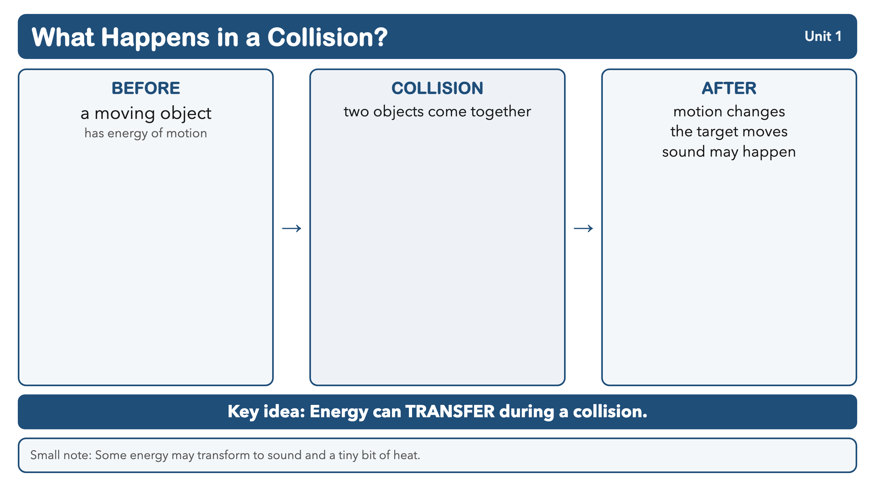
REFERENCE · What transfers during a collision?
Notes:
INFOGRAPHIC REFERENCE (REFERENCE)
What transfers during a collision?
Ch5 collision energy-transfer reference.
Approved rebuilt visual — production/infographics/unit1-collision-energy-transfer.png. Locked Grade 4 vocabulary only.

