Slide 1

CHAPTER 1 · GRADE 4 · WEEK 1
Energy Causes Change
Discovery / Evidence
Where can we observe evidence of energy causing change?
ENERGY
CHANGE
?
Unit 1 · Energy Transfer & Transformation
1
Notes:
MODE Title · orient
TIME 1 min
PLAN Session 1 (Mon 10/12) · REQUIRED · 1 min
STUDENT RESOURCE Guided Notes (not yet open)
ASK What do you think energy does?
LISTEN FOR words like move, change, power
NEXT Flip the lights as you open the Big Question.
SESSIONS Mon: slides 1-3, 6-16 (optional 4-5) · Tue: slides 2, 17, 19-27 (18 is OPTIONAL) · Fri: slides 2 then 28-31, 33 (optional 32), then the quiz. Slides 34-45 = optional review.

Slide 2
CHAPTER 1 · ENERGY CAUSES CHANGE
TURN & TALK
BQ
Big Question
Where can we observe evidence of energy causing change?
Keep it in mind all chapter. We will come back to it.
Think: What is ONE change you have seen happen?
2
Notes:
MODE BQ · introduce
TIME 2 min
PLAN Session 1 (Mon 10/12) · REQUIRED · 2 min · RE-ENTRY: Sessions 2 and 3 also open on this slide (re-read the Big Question; ask 'What evidence have we collected so far?') - 1 / 0.5 min
STUDENT RESOURCE Guided Notes p.1 (BQ box)
ASK What change have you seen happen today?
LISTEN FOR any observable change (light, sound, movement)
REVEAL Do not answer the BQ yet — we collect evidence first.
NEXT Session 1: My first thinking (slide 3) · Session 2: Forms of energy (slide 17) · Session 3: Recognizing evidence (slide 28).

Slide 3
CHAPTER 1 · ENERGY CAUSES CHANGE
WRITE
N
BQ
Big Question — My first thinking
Guided Notes p. 1
Where can we observe evidence of energy causing change?
My first thinking
Write 1–2 quick ideas. No wrong answer yet.
3
Notes:
MODE Notes · BQ anchor
TIME 2 min
PLAN Session 1 (Mon 10/12) · REQUIRED · 2 min
STUDENT RESOURCE Guided Notes p.1 top
ASK What change have you seen? Write your first idea.
LISTEN FOR students naming a change (not 'energy')
MISCONCEPTION Accept any change; do not correct yet.
NEXT Observe the light switch.

Slide 4


CHAPTER 1 · ENERGY CAUSES CHANGE
OBSERVE
D
What changed?
Reader p. 1 — you walk into a dark room and flip a switch.
Something became different.
That is a change.
DARK room
BRIGHT room
hard to see
light fills the room
4
Notes:
MODE Demo · observe
TIME 2 min
PLAN Session 1 (Mon 10/12) · OPTIONAL - skip freely · 2 min
STUDENT RESOURCE Reader p.1
ASK What changed when I flipped the switch?
LISTEN FOR 'the room got bright' / 'light came on'
REVEAL The room changed from dark to light — a change.
NEXT Notice & wonder.

Slide 5
CHAPTER 1 · ENERGY CAUSES CHANGE
TURN & TALK
D
I notice… I wonder…
I NOTICE
I WONDER
The room is different now.
Light is everywhere.
What made the light
change so fast?
Share one notice and one wonder with a partner.
5
Notes:
MODE Demo · discuss
TIME 2 min
PLAN Session 1 (Mon 10/12) · OPTIONAL - skip freely · 2 min
STUDENT RESOURCE none
ASK What did you notice? What do you wonder?
LISTEN FOR change words and curiosity
NEXT Electric pencil sharpener demo.

Slide 6

CHAPTER 1 · ENERGY CAUSES CHANGE
OBSERVE
D
Electric Pencil Sharpener
Observe the pencil BEFORE we sharpen it.
BEFORE
A dull pencil — tip is flat, and it is quiet.
Look closely. What do you see? What do you hear?
6
Notes:
MODE Demo · observe
TIME 1 min
PLAN Session 1 (Mon 10/12) · REQUIRED · 1 min
STUDENT RESOURCE none (live demo)
ASK What does the pencil look and sound like right now?
LISTEN FOR dull, flat, quiet, still
NEXT Predict before sharpening.

Slide 7
CHAPTER 1 · ENERGY CAUSES CHANGE
PREDICT
D
Predict: what will change?
Think before we turn it on.
When the sharpener runs, the pencil will…
get ____________________
Make a prediction. Say it to your partner.
7
Notes:
MODE Demo · predict
TIME 1 min
PLAN Session 1 (Mon 10/12) · REQUIRED · 1 min
STUDENT RESOURCE none
ASK What will change about the pencil? The sharpener?
LISTEN FOR shorter, sharper, noise
REVEAL Do not confirm yet — run the demo.
NEXT Observe the change.

Slide 8
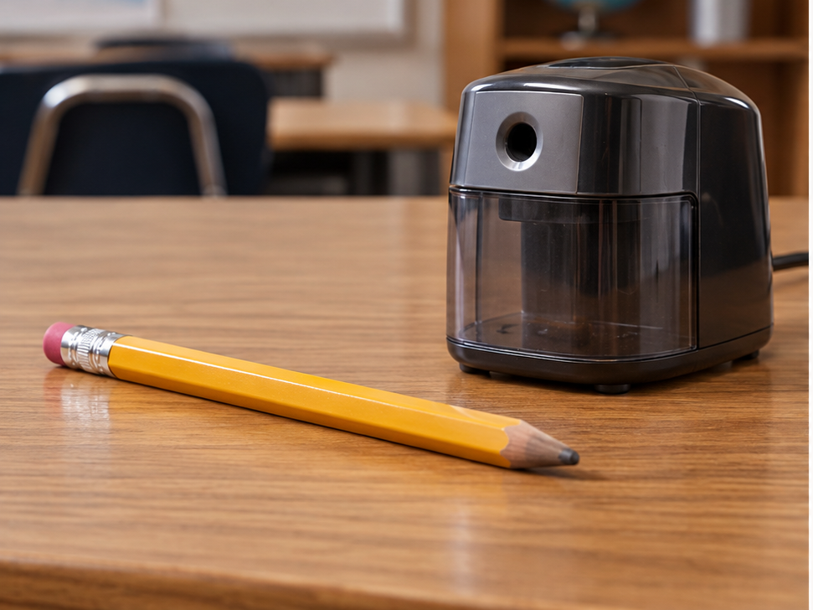
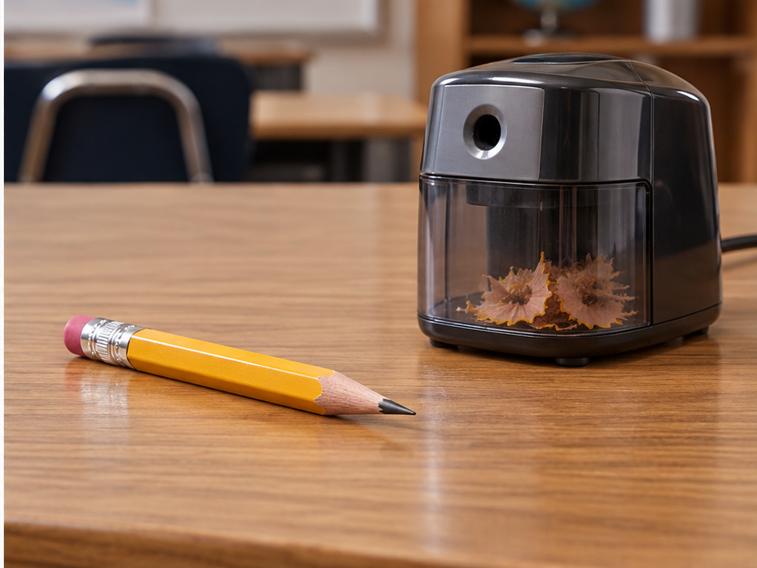
CHAPTER 1 · ENERGY CAUSES CHANGE
OBSERVE
D
What changed?
BEFORE
AFTER
CHANGES
• the tip is sharper
• the pencil is shorter
• it makes a sound
dull tip · quiet
shorter · sharper · humming
8
Notes:
MODE Demo · observe
TIME 3 min
PLAN Session 1 (Mon 10/12) · REQUIRED · 3 min
STUDENT RESOURCE none
ASK Name every change you saw or heard.
LISTEN FOR shorter, sharper, noise
REVEAL Record all three changes.
NEXT Turn changes into evidence.

Slide 9
CHAPTER 1 · ENERGY CAUSES CHANGE
EXPLAIN
D
How do we know energy was involved?
Energy can be invisible. We look for the change.
ENERGY
CHANGE
?
The pencil got shorter and sharper and made a sound.
Those changes are clues that energy was involved.
9
Notes:
MODE Demo · evidence
TIME 2 min
PLAN Session 1 (Mon 10/12) · REQUIRED · 2 min
STUDENT RESOURCE Reader p.2 (Change Is Evidence of Energy)
ASK How do we know energy was here if we can't see it?
LISTEN FOR 'we saw the change' / 'clues'
REVEAL The word EVIDENCE is introduced from the Reader on slide 14 - do not name it here; the '?' box stays open.
MISCONCEPTION We see the change, not the energy itself.
NEXT Vocabulary: energy + change.

Slide 10
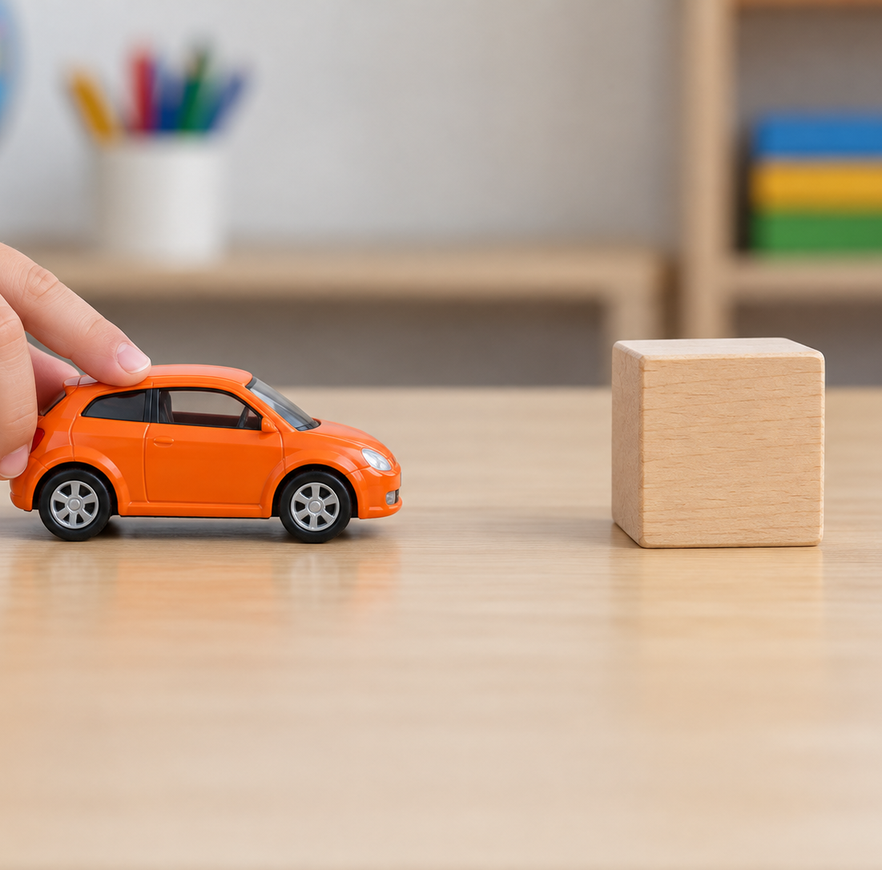


CHAPTER 1 · ENERGY CAUSES CHANGE
V
Vocabulary — Energy & Change
Reader p. 1
VOCABULARY
TEACH
VOCABULARY
TEACH
energy
change
the ability to cause change
to become different
ENERGY
CHANGE
BEFORE
AFTER
Reader p. 1
Reader p. 1
10
Notes:
MODE Vocabulary · TEACH
TIME 3 min
PLAN Session 1 (Mon 10/12) · REQUIRED · 3 min
STUDENT RESOURCE Guided Notes V1
ASK Read each definition together. Use each word in a sentence.
LISTEN FOR 'energy causes change' and 'to become different'
REVEAL Full definitions shown — these are the two V1 terms.
NEXT Record V1 on notes.

Slide 11
CHAPTER 1 · ENERGY CAUSES CHANGE
WRITE
N
V1
Vocabulary — Energy & Change
Guided Notes · Reader p. 1
energy — the ability to cause _______ .
change — to become _________ .
Write the missing word in each blank.
11
Notes:
MODE Notes · V1 anchor
TIME 2 min
PLAN Session 1 (Mon 10/12) · REQUIRED · 2 min
STUDENT RESOURCE Guided Notes V1 (Reader p.1)
ASK Fill in each blank.
LISTEN FOR 'change' and 'different'
REVEAL Reveal after students write.
NEXT Check answers.

Slide 12
CHAPTER 1 · ENERGY CAUSES CHANGE
CHECK
N
V1
Vocabulary — Energy & Change
Guided Notes · Reader p. 1
energy — the ability to cause change .
change — to become different .
change · different
12
Notes:
MODE Notes · V1 reveal
TIME 0.5 min
PLAN Session 1 (Mon 10/12) · REQUIRED · 0.5 min
STUDENT RESOURCE Guided Notes V1
REVEAL change · different
NEXT Energy Causes Change (N1).

Slide 13
CHAPTER 1 · ENERGY CAUSES CHANGE
RECITE
R
What is energy?
Reader p. 1
Energy is the ability to cause change.
Say it together: “Energy is the ability to cause change.”
13
Notes:
MODE Read · concept
TIME 1 min
PLAN Session 1 (Mon 10/12) · REQUIRED · 1 min
STUDENT RESOURCE Reader p.1
ASK What is energy?
LISTEN FOR 'the ability to cause change'
REVEAL Energy is the ability to cause change.
NEXT Change is evidence.

Slide 14

CHAPTER 1 · ENERGY CAUSES CHANGE
TRACE
R
Look at the seashore
Reader p. 2 — the seashore changes all around us.
Read Reader p. 2.
Waves move. Sand shifts. Water makes sound.
What are these changes a clue about?
ENERGY
CHANGE
?
14
Notes:
MODE Read · model
TIME 3 min
PLAN Session 1 (Mon 10/12) · REQUIRED · 3 min
STUDENT RESOURCE Reader p.2
ASK What changes can you find at the seashore? What are those changes a clue about?
LISTEN FOR 'evidence' / 'a clue' / 'energy is there'
LANGUAGE The Reader says 'evidence, or proof.' Teach and use the word EVIDENCE (it is in the Big Question). If a student says 'proof', accept it and restate: 'Yes - we say evidence.'
REVEAL Keep the third box as '?' - students name it on the next slide's notes, then slide 16 completes the model.
NEXT Record N1 on notes.

Slide 15
CHAPTER 1 · ENERGY CAUSES CHANGE
WRITE
N
N1
Energy Causes Change
Guided Notes · Reader pp. 1–2
Energy has the ability to cause change.
When you see a change, you are seeing _________ of energy.
Write the missing word in the sentence. Leave the last box of your model empty for now.
15
Notes:
MODE Notes · N1 anchor
TIME 2 min
PLAN Session 1 (Mon 10/12) · REQUIRED · 2 min
STUDENT RESOURCE Guided Notes N1 (Reader pp.1–2)
ASK Fill in the one blank in the sentence. The last box of the model on the notes page is empty on purpose - do not fill it yet.
LISTEN FOR evidence
REVEAL Reveal after writing.
NEXT Check answer.

Slide 16
CHAPTER 1 · ENERGY CAUSES CHANGE
CHECK
N
N1
Energy Causes Change
Guided Notes · Reader pp. 1–2
Energy has the ability to cause change.
When you see a change, you are seeing evidence of energy.
ENERGY
CHANGE
EVIDENCE
Now write the same word in the last box of your model.
16
Notes:
MODE Notes · N1 reveal
TIME 1 min
PLAN Session 1 (Mon 10/12) · REQUIRED · 1 min
STUDENT RESOURCE Guided Notes N1
REVEAL evidence (accept 'proof' once, then restate 'evidence'). Students check their sentence, then copy the word into the empty last box of the model on the notes page.
NEXT Close Session 1. Session 2 opens on slide 2 (the Big Question).

Slide 17

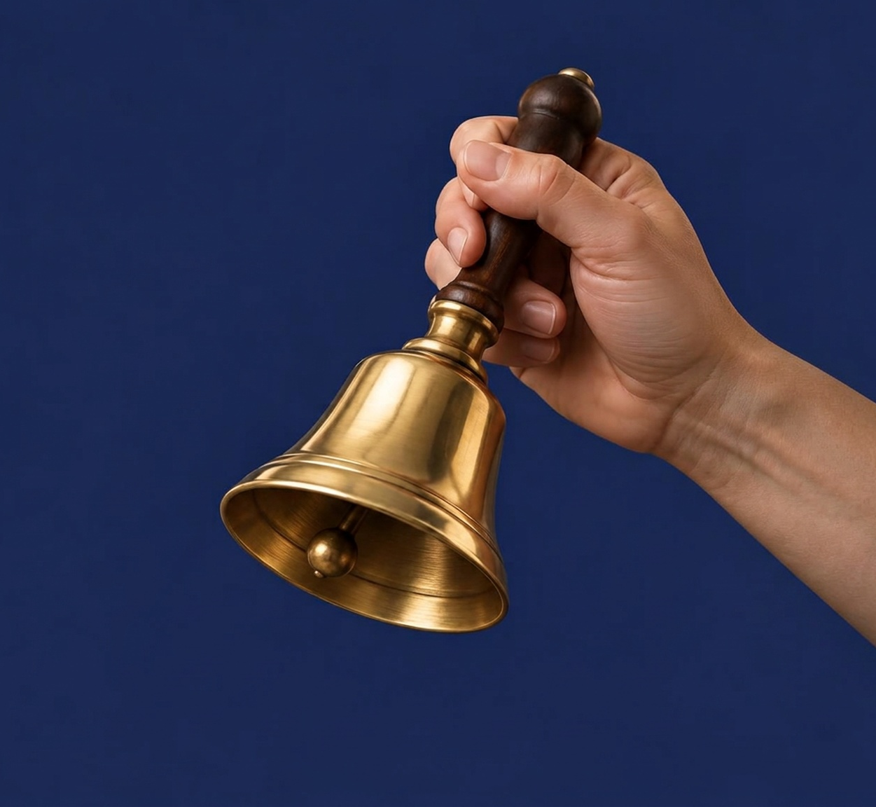


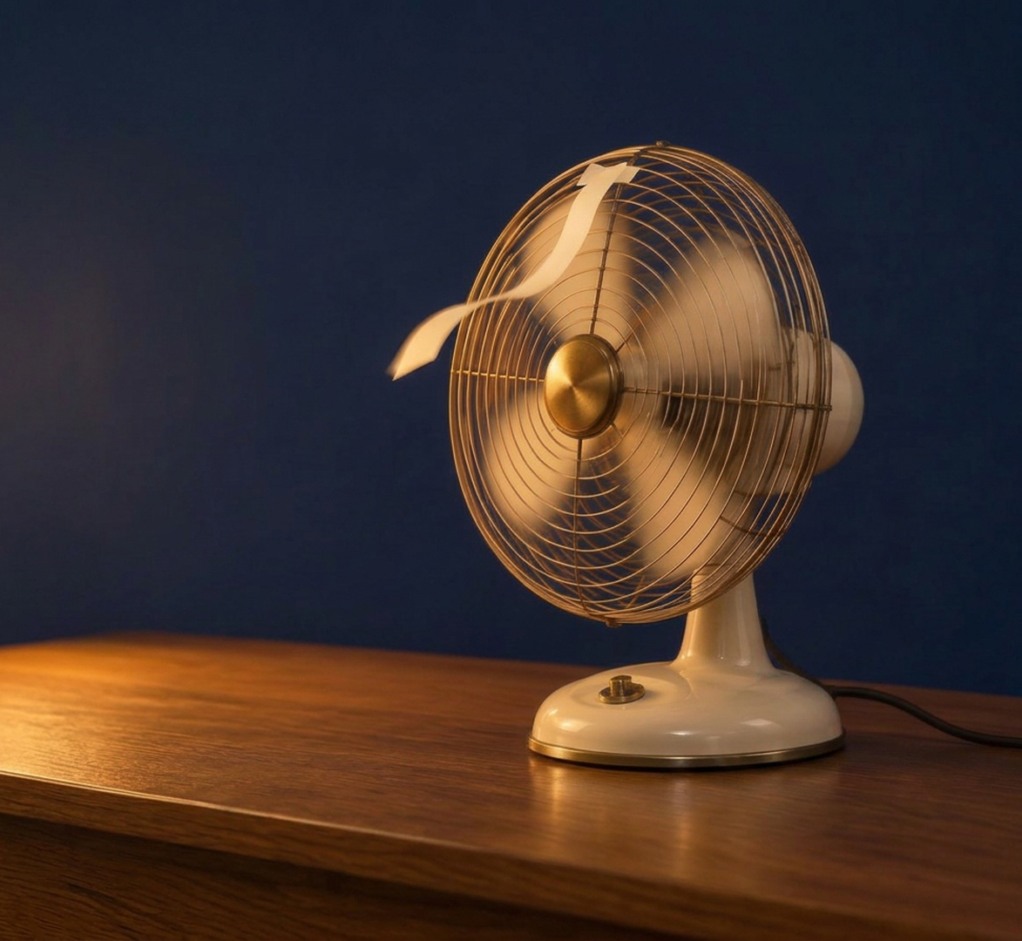
CHAPTER 1 · ENERGY CAUSES CHANGE
R
Energy has different forms
Reader p. 3 — think of a spinning carousel.
motion
sound
light
heat
electrical energy
On the carousel, the horses spin and move up and down.
That is motion.
Find the other forms in the Reader.
17
Notes:
MODE Read · forms
TIME 3 min
PLAN Session 2 (Tue 10/13) · REQUIRED · 3 min
STUDENT RESOURCE Reader p.3
ASK What forms of energy do you see or hear on a carousel?
LISTEN FOR motion, sound, light, heat, electrical
REVEAL Model ONLY the motion example. Do not supply examples for the other four forms - students write their own on slide 19.
NEXT Record examples on notes (N2).

Slide 18
CHAPTER 1 · ENERGY CAUSES CHANGE
OBSERVE
C
Clap three times
What forms of energy do you observe?
When you clap…
What do you SEE?
What do you HEAR?
What do you FEEL in your hands?
18
Notes:
MODE Check · forms
TIME 2 min
PLAN Session 2 (Tue 10/13) · OPTIONAL - skip freely · 2 min
STUDENT RESOURCE Reader p.3
ASK What forms of energy can you observe when you clap?
LISTEN FOR motion, sound, and maybe heat (students name them - not shown on the slide)
NEXT Record N2 table.

Slide 19
CHAPTER 1 · ENERGY CAUSES CHANGE
WRITE
N
N2
Energy Occurs in Different Forms
Guided Notes · Reader p. 3
Write one example that shows a change for each form.
FORM
ONE EXAMPLE THAT SHOWS A CHANGE
motion
sound
light
heat
electrical energy
19
Notes:
MODE Notes · N2 anchor
TIME 5 min
PLAN Session 2 (Tue 10/13) · REQUIRED · 5 min
STUDENT RESOURCE Guided Notes N2 (Reader p.3)
ASK Write one example per form. Then turn & talk: share two examples with a partner and add one new idea from your partner.
LISTEN FOR carousel examples, clap examples, home/school examples - accept any real example that shows a change
REVEAL There is no answer slide for N2. Circulate; use student examples as the check.
NEXT Stored energy (V2).

Slide 20

CHAPTER 1 · ENERGY CAUSES CHANGE
V
Vocabulary — Stored Energy
Reader p. 4
VOCABULARY
TEACH
stored energy
energy that has the ability to cause change at a later time
STILL
LATER
CHANGE
Reader p. 4
20
Notes:
MODE Vocabulary · TEACH
TIME 3 min
PLAN Session 2 (Tue 10/13) · REQUIRED · 3 min
STUDENT RESOURCE Guided Notes V2 (Reader p.4)
ASK What does the word 'later' tell us about when the change can happen? (Save examples for slide 23.)
LISTEN FOR 'not right now - after'
REVEAL stored energy = ability to cause change at a later time.
NEXT Record V2.

Slide 21
CHAPTER 1 · ENERGY CAUSES CHANGE
WRITE
N
V2
Vocabulary — Stored Energy
Guided Notes · Reader p. 4
stored energy — energy that has the ability to cause change at a ______ time.
Write the missing word in the blank.
21
Notes:
MODE Notes · V2 anchor
TIME 1 min
PLAN Session 2 (Tue 10/13) · REQUIRED · 1 min
STUDENT RESOURCE Guided Notes V2 (Reader p.4)
ASK Fill in the blank.
LISTEN FOR 'later'
REVEAL Reveal after writing.
NEXT Check answer.

Slide 22
CHAPTER 1 · ENERGY CAUSES CHANGE
CHECK
N
V2
Vocabulary — Stored Energy
Guided Notes · Reader p. 4
stored energy — energy that has the ability to cause change at a later time.
later
22
Notes:
MODE Notes · V2 reveal
TIME 0.5 min
PLAN Session 2 (Tue 10/13) · REQUIRED · 0.5 min
STUDENT RESOURCE Guided Notes V2
REVEAL later
NEXT Objects can store energy (N3).

Slide 23
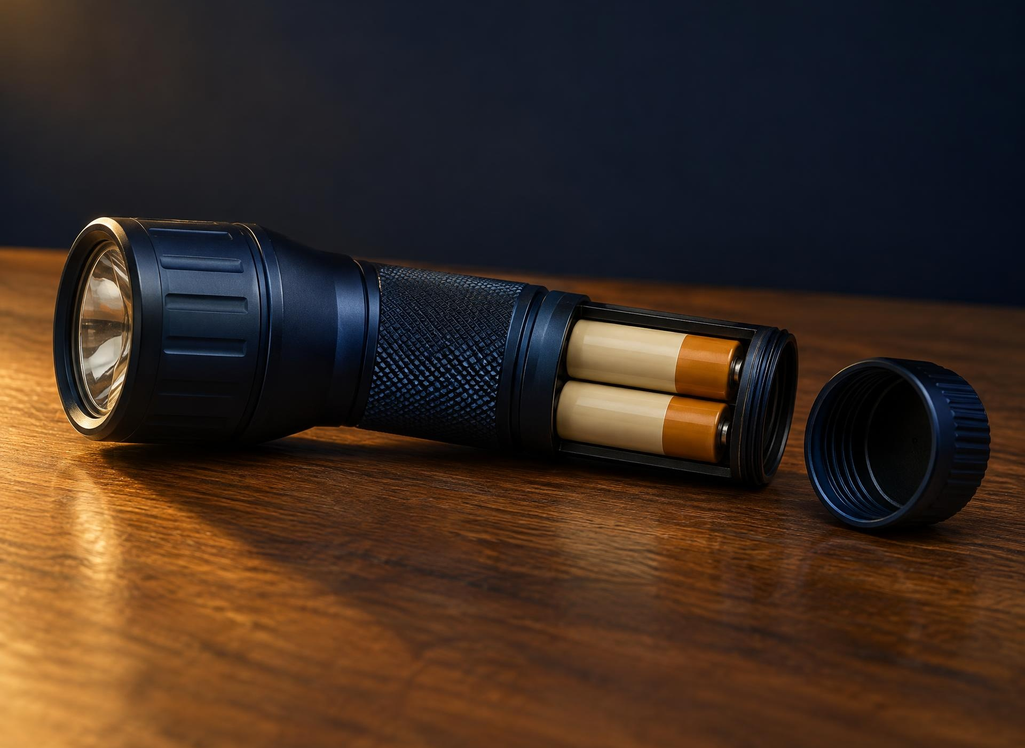
CHAPTER 1 · ENERGY CAUSES CHANGE
PREDICT
R
Does a still battery have energy?
Reader p. 4 — think about a battery inside a flashlight.
A battery sits still in a flashlight that is switched off.
Yes or no? Make a prediction.
Tell your partner why.
23
Notes:
MODE Read · predict
TIME 2 min
PLAN Session 2 (Tue 10/13) · REQUIRED · 2 min
STUDENT RESOURCE Reader p.4
ASK Does a still battery have energy? Take yes/no predictions and reasons - do not confirm yet.
LISTEN FOR 'yes' / 'no' with a reason; accept any prediction
REVEAL After students predict, read the battery paragraph on Reader p. 4 aloud: the chemicals inside a battery store energy. The screen stays a question; slide 25 shows the Reader fact.
MISCONCEPTION Only moving objects have energy → pair moving + stored.
NEXT Position.

Slide 24

CHAPTER 1 · ENERGY CAUSES CHANGE
R
The stored energy of position
Reader p. 5 — an object held up can cause a change later.
Raised apple → let go → ?
An apple held above the ground has stored energy
because of its position. Imagine you let go. What will happen?
24
Notes:
MODE Read · position
TIME 2 min
PLAN Session 2 (Tue 10/13) · REQUIRED · 2 min
STUDENT RESOURCE Reader p.5
ASK Why does a raised apple have stored energy?
LISTEN FOR 'because of its position'
NEXT Build the stored-energy model.

Slide 25

CHAPTER 1 · ENERGY CAUSES CHANGE
TRACE
R
Stored energy can cause a change later
Reader p. 4 — back to our battery: the chemicals inside it store energy.
STORED ENERGY
RELEASE
CHANGE
Stretch a rubber band — it now stores energy.
Let it go. What change will you see and hear?
25
Notes:
MODE Read · model
TIME 2 min
PLAN Session 2 (Tue 10/13) · REQUIRED · 2 min
STUDENT RESOURCE Reader p.4
REVEAL (closes the slide 23 prediction) The Reader says chemicals inside a battery store energy - so yes, a still battery has energy. Do not say what the flashlight does yet: students write that in the N3 table.
ASK Trace: stored → release → change.
LISTEN FOR rubber band SNAP example
NEXT Record N3 on notes.

Slide 26
CHAPTER 1 · ENERGY CAUSES CHANGE
WRITE
N
N3
Objects Can Store Energy
Guided Notes · Reader pp. 4–5
STORED ENERGY
RELEASE
CHANGE
EXAMPLE
WHAT CHANGE COULD HAPPEN LATER?
battery (in a flashlight)
stretched rubber band
raised object (apple)
Objects also have stored energy because of their ________ .
26
Notes:
MODE Notes · N3 anchor
TIME 4 min
PLAN Session 2 (Tue 10/13) · REQUIRED · 4 min
STUDENT RESOURCE Guided Notes N3 (Reader pp.4–5)
ASK Fill in the blank; note the three examples.
LISTEN FOR 'position'
REVEAL Reveal after writing.
NEXT Check answer.

Slide 27
CHAPTER 1 · ENERGY CAUSES CHANGE
CHECK
N
N3
Objects Can Store Energy
Guided Notes · Reader pp. 4–5
STORED ENERGY
RELEASE
CHANGE
EXAMPLE
WHAT CHANGE COULD HAPPEN LATER?
battery (in a flashlight)
the flashlight lights up
stretched rubber band
it snaps and makes a sound
raised object (apple)
it falls down
Objects also have stored energy because of their position .
position · Sample answers shown - yours may differ.
27
Notes:
MODE Notes · N3 reveal
TIME 1 min
PLAN Session 2 (Tue 10/13) · REQUIRED · 1 min
STUDENT RESOURCE Guided Notes N3
REVEAL position. Table cells show SAMPLE answers only - accept any reasonable later change.
NEXT Close Session 2. Session 3 opens on slide 2 (the Big Question), then N4.

Slide 28


CHAPTER 1 · ENERGY CAUSES CHANGE
EVIDENCE
R
Recognizing evidence
Reader pp. 1–5 — think about the clues we can see, hear, or feel.
Energy can be invisible.
What clues could show that energy is at work?
Think of a change you have seen. What did you see, hear, or feel?
28
Notes:
MODE Read · evidence
TIME 2 min
PLAN Session 3 (Fri 10/16) · REQUIRED · 2 min
STUDENT RESOURCE Reader pp.1–5
ASK What clues could show that energy is at work? (Do not give the CHECK YOUR THINKING answer yet.)
LISTEN FOR movement, sound, light, heat, something different
LANGUAGE Say evidence (not proof).
FRIDAY CLOCK The quiz is handed out NO LATER THAN MINUTE 12. Priority: N4 draw > BQ NOW I THINK > CHECK YOUR THINKING. Minute 6: N4 should be done.
NEXT Draw before/after (N4).

Slide 29
CHAPTER 1 · ENERGY CAUSES CHANGE
DRAW
N
N4
Recognizing Evidence
Guided Notes · Reader pp. 1–5
Draw a change you observed. Show what it looked like BEFORE and AFTER.
BEFORE
AFTER
draw
draw
What changed?
29
Notes:
MODE Notes · N4 anchor
TIME 3.5 min
PLAN Session 3 (Fri 10/16) · REQUIRED · 3.5 min
STUDENT RESOURCE Guided Notes N4 (Reader pp.1–5)
ASK Draw one change before and after; write what changed.
LISTEN FOR clear before/after pairs
NEXT Check your thinking.

Slide 30
CHAPTER 1 · ENERGY CAUSES CHANGE
WRITE
N
N4
Check Your Thinking
Guided Notes · Reader pp. 1–5
CHECK YOUR THINKING
How do we know energy is involved if we cannot see energy itself?
Start with: “We know because we see …”
30
Notes:
MODE Notes · Check Your Thinking
TIME 2.5 min
PLAN Session 3 (Fri 10/16) · REQUIRED · 2.5 min
STUDENT RESOURCE Guided Notes N4
FRIDAY CLOCK Past minute 6 when you reach this slide? SKIP slides 30-31 (CHECK YOUR THINKING goes home / catch-up) and go straight to slide 33.
ASK Complete the sentence starter.
LISTEN FOR 'a change, like a ball starting to move'
REVEAL Do not show slide 31 until most students have written.
NEXT Reveal a sample response.

Slide 31
CHAPTER 1 · ENERGY CAUSES CHANGE
CHECK
C
We know because we see a change
SAMPLE
“We know because we see a change — like a ball starting to move or a light turning on.”
Any change you observe is evidence of energy.
31
Notes:
MODE Check · evidence
TIME 1 min
PLAN Session 3 (Fri 10/16) · REQUIRED · 1 min
STUDENT RESOURCE Guided Notes N4
REVEAL Sample response (accept any change-as-evidence).
NEXT Apply: classify evidence.

Slide 32
CHAPTER 1 · ENERGY CAUSES CHANGE
EVIDENCE
C
Which change shows energy at work?
A toy car starts to roll.
A rock keeps sitting still.
A room stays dark.
Pick one. Tell your partner why.
32
Notes:
MODE Apply · evidence
TIME 2 min
PLAN Session 3 (Fri 10/16) · OPTIONAL - skip freely · 2 min
STUDENT RESOURCE none
ASK Which one shows a change (energy at work)?
LISTEN FOR 'the toy car'
REVEAL The toy car starts to roll — a change. Then say aloud: 'Look for a change — that is the evidence of energy.' (Spoken after the vote; it is not on the question slide.)
NEXT Return to the Big Question.

Slide 33

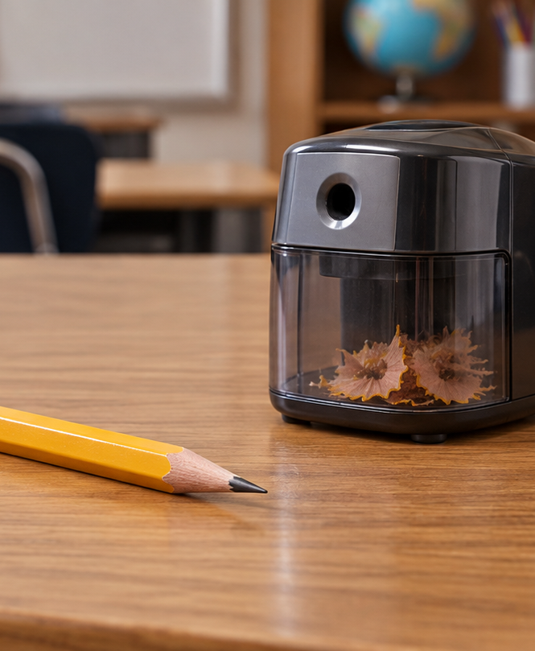


CHAPTER 1 · ENERGY CAUSES CHANGE
WRITE
N
BQ
BQ · Now I Think
Guided Notes p. 3
BIG QUESTION
Where can we observe evidence of energy causing change?
Now I think…
33
Notes:
MODE Notes · BQ return
TIME 2.5 min
PLAN Session 3 (Fri 10/16) · REQUIRED · 2.5 min
STUDENT RESOURCE Guided Notes p.3
FRIDAY CLOCK Start this slide by minute 9.5; if you are later, do NOT start it before the quiz - students write it after handing in the quiz or at home / in catch-up. The quiz is handed out by minute 12.
ASK Answer the Big Question now.
LISTEN FOR any change named as evidence
NEXT Friday quiz (Session 3). Optional end-of-chapter review slides 34-45 are for a review day or FLEX only.

Slide 34
CHAPTER 1 · ENERGY CAUSES CHANGE
C
Review 1 — concept
Energy is best described as —
A
a visible glow
B
something only batteries have
C
the ability to cause change
D
a kind of fuel
34
Notes:
MODE Check · review Q1
TIME 1 min
PLAN OPTIONAL · end-of-chapter review (review day / Friday FLEX only; never inside a required block) · 1 min
STUDENT RESOURCE none
ASK Read aloud; students vote A/B/C/D.
REVEAL Do not reveal yet.
NEXT Reveal the answer.

Slide 35
CHAPTER 1 · ENERGY CAUSES CHANGE
CHECK
C
Review 1 — answer
Energy is best described as —
A
a visible glow
B
something only batteries have
C
the ability to cause change
D
a kind of fuel
Energy is the ability to cause change (Reader p. 1).
35
Notes:
MODE Check · review Q1 answer
TIME 0.5 min
PLAN OPTIONAL · end-of-chapter review (review day / Friday FLEX only; never inside a required block) · 0.5 min
REVEAL the ability to cause change
NEXT Next question (or close).

Slide 36
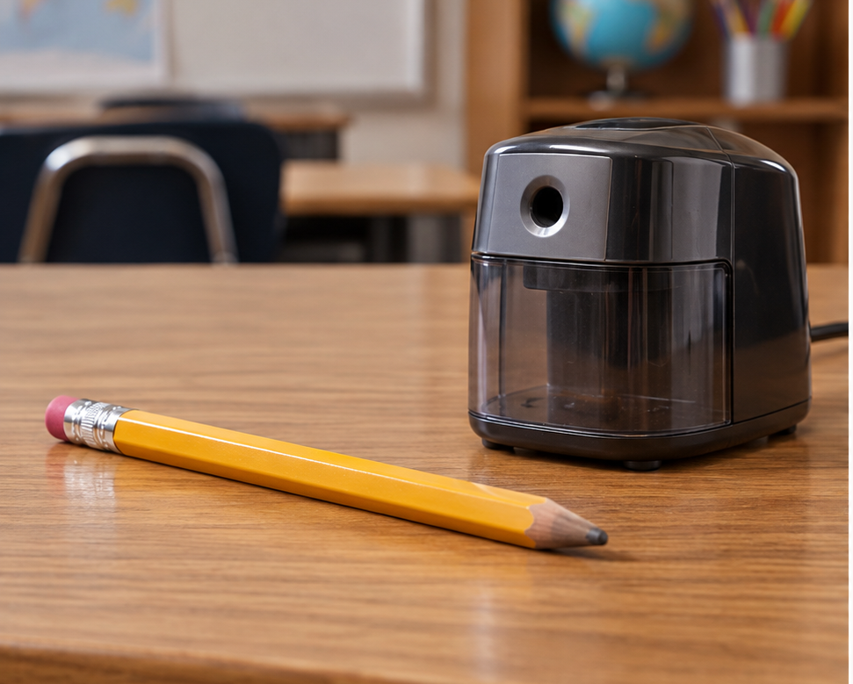
CHAPTER 1 · ENERGY CAUSES CHANGE
C
Review 2 — visual
A pencil is dull, then you sharpen it. What change do you observe?
A
It gets shorter and sharper
B
It gets longer
C
It changes color
D
It disappears
36
Notes:
MODE Check · review Q2
TIME 1 min
PLAN OPTIONAL · end-of-chapter review (review day / Friday FLEX only; never inside a required block) · 1 min
STUDENT RESOURCE none
ASK Read aloud; students vote A/B/C/D.
REVEAL Do not reveal yet.
NEXT Reveal the answer.

Slide 37
CHAPTER 1 · ENERGY CAUSES CHANGE
CHECK
C
Review 2 — answer
A pencil is dull, then you sharpen it. What change do you observe?
A
It gets shorter and sharper
B
It gets longer
C
It changes color
D
It disappears
The pencil becomes shorter and sharper — a change.
37
Notes:
MODE Check · review Q2 answer
TIME 0.5 min
PLAN OPTIONAL · end-of-chapter review (review day / Friday FLEX only; never inside a required block) · 0.5 min
REVEAL It gets shorter and sharper
NEXT Next question (or close).

Slide 38
CHAPTER 1 · ENERGY CAUSES CHANGE
C
Review 3 — scenario
Which object has stored energy that can cause a change LATER?
A
A ball already rolling
B
A toy already moving
C
A flashlight already on
D
A stretched rubber band
38
Notes:
MODE Check · review Q3
TIME 1 min
PLAN OPTIONAL · end-of-chapter review (review day / Friday FLEX only; never inside a required block) · 1 min
STUDENT RESOURCE none
ASK Read aloud; students vote A/B/C/D.
REVEAL Do not reveal yet.
NEXT Reveal the answer.

Slide 39
CHAPTER 1 · ENERGY CAUSES CHANGE
CHECK
C
Review 3 — answer
Which object has stored energy that can cause a change LATER?
A
A ball already rolling
B
A toy already moving
C
A flashlight already on
D
A stretched rubber band
The rubber band stores energy; it changes when released.
39
Notes:
MODE Check · review Q3 answer
TIME 0.5 min
PLAN OPTIONAL · end-of-chapter review (review day / Friday FLEX only; never inside a required block) · 0.5 min
REVEAL A stretched rubber band
NEXT Next question (or close).

Slide 40
CHAPTER 1 · ENERGY CAUSES CHANGE
C
Review 4 — comparison
A carousel spins and plays music. Which two forms of energy come from the spinning and the music?
A
only light
B
motion and sound
C
motion and silence
D
sound and stillness
40
Notes:
MODE Check · review Q4
TIME 1 min
PLAN OPTIONAL · end-of-chapter review (review day / Friday FLEX only; never inside a required block) · 1 min
STUDENT RESOURCE none
ASK Read aloud; students vote A/B/C/D.
REVEAL Do not reveal yet.
NEXT Reveal the answer.

Slide 41
CHAPTER 1 · ENERGY CAUSES CHANGE
CHECK
C
Review 4 — answer
A carousel spins and plays music. Which two forms of energy come from the spinning and the music?
A
only light
B
motion and sound
C
motion and silence
D
sound and stillness
The spinning is motion; the music is sound (Reader p. 3).
41
Notes:
MODE Check · review Q4 answer
TIME 0.5 min
PLAN OPTIONAL · end-of-chapter review (review day / Friday FLEX only; never inside a required block) · 0.5 min
REVEAL motion and sound
NEXT Next question (or close).

Slide 42
CHAPTER 1 · ENERGY CAUSES CHANGE
C
Review 5 — concept
How do we know energy is involved if we cannot see it?
A
We observe a change happen
B
Energy can always be seen
C
We guess without evidence
D
Nothing can change
42
Notes:
MODE Check · review Q5
TIME 1 min
PLAN OPTIONAL · end-of-chapter review (review day / Friday FLEX only; never inside a required block) · 1 min
STUDENT RESOURCE none
ASK Read aloud; students vote A/B/C/D.
REVEAL Do not reveal yet.
NEXT Reveal the answer.

Slide 43
CHAPTER 1 · ENERGY CAUSES CHANGE
CHECK
C
Review 5 — answer
How do we know energy is involved if we cannot see it?
A
We observe a change happen
B
Energy can always be seen
C
We guess without evidence
D
Nothing can change
We see a change — like movement — as evidence.
43
Notes:
MODE Check · review Q5 answer
TIME 0.5 min
PLAN OPTIONAL · end-of-chapter review (review day / Friday FLEX only; never inside a required block) · 0.5 min
REVEAL We observe a change happen
NEXT Next question (or close).

Slide 44
CHAPTER 1 · ENERGY CAUSES CHANGE
C
Review 6 — scenario
A battery sits still in a flashlight. Does it have energy?
No — still objects have no energy
Only when it is moving
A
B
Yes — stored energy that can cause change later
Only when the flashlight is on
C
D
44
Notes:
MODE Check · review Q6
TIME 1 min
PLAN OPTIONAL · end-of-chapter review (review day / Friday FLEX only; never inside a required block) · 1 min
STUDENT RESOURCE none
ASK Read aloud; students vote A/B/C/D.
REVEAL Do not reveal yet.
NEXT Reveal the answer.

Slide 45
CHAPTER 1 · ENERGY CAUSES CHANGE
CHECK
C
Review 6 — answer
A battery sits still in a flashlight. Does it have energy?
No — still objects have no energy
Only when it is moving
A
B
Yes — stored energy that can cause change later
Only when the flashlight is on
C
D
A battery stores energy. It can cause a change later.
45
Notes:
MODE Check · review Q6 answer
TIME 0.5 min
PLAN OPTIONAL · end-of-chapter review (review day / Friday FLEX only; never inside a required block) · 0.5 min
REVEAL Yes — stored energy that can cause change later
NEXT Next question (or close).

