Slide 1
Types of Fossil Fuels
Chapter 2 · Grade 4 · Week 5
Unit 2 · Using Natural Resources for Energy · Grade 4

Slide 2
2
Big Question
What are fossil fuels?

Slide 3
A long train trip
3
THINK
Opening phenomenon
A train engine runs on diesel, is lubricated with oil, and the engineer eats with a plastic fork.
What do these three things have in common?

Slide 4
Key Words: coal, petroleum, natural gas
4
NOTE
Page 1 · Key Words
Coal (solid) · petroleum/crude oil (liquid) · natural gas (gas).

Slide 5
Three Fossil Fuels
5
NOTE
Page 1 · Three Fossil Fuels
All three form from the remains of organisms that lived long ago.

Slide 6
How They Form
6
NOTE
Page 1 · How They Form
Reveal after students try.
Buried remains + heat + pressure over millions of years.
Coal from swamp plants · petroleum from marine organisms · gas rises and gets trapped.

Slide 7
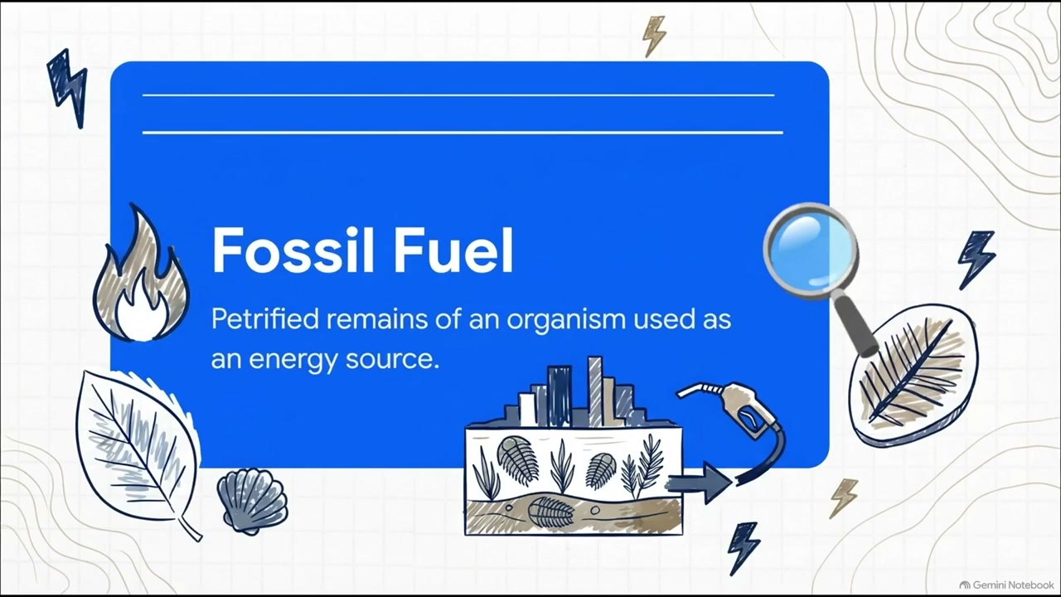
WATCH — Fossil Fuel Formation
7
WATCH
Optional video · 3:39 · Week 5 Wednesday
THINK: What do all three fossil fuels have in common?

Slide 8
Check Your Thinking
7
THINK
Page 1 · Check Your Thinking
How are coal and petroleum alike? How are they different?

Slide 9
Review
8
Which fossil fuel is a liquid?
A. coal
B. natural gas
C. petroleum
D. peat

Slide 10
Answer
9
C. Petroleum (crude oil) is a liquid.

Slide 11
Review
10
Coal forms mainly from the remains of —
A. marine organisms
B. swamp plants
C. dinosaurs
D. minerals

Slide 12
Answer
11
B. Coal forms from plants that became peat, then coal.

Slide 13
Review
12
Natural gas rises through Earth's crust because it is —
A. less dense than rock
B. heavier than oil
C. solid
D. cold

Slide 14
Answer
13
A. Natural gas is less dense and gets trapped under rock.

Slide 15
Review
14
Which is a fossil fuel?
A. wind
B. sunlight
C. natural gas
D. flowing water

Slide 16
Answer
15
C. Natural gas is a fossil fuel.

Slide 17
Review
16
Why are they called FOSSIL fuels?
A. they are old rocks
B. they form from the remains of organisms
C. they are found in fossils
D. they are very hard

Slide 18
Answer
17
B. They form from fossilized remains of organisms.

