Slide 1
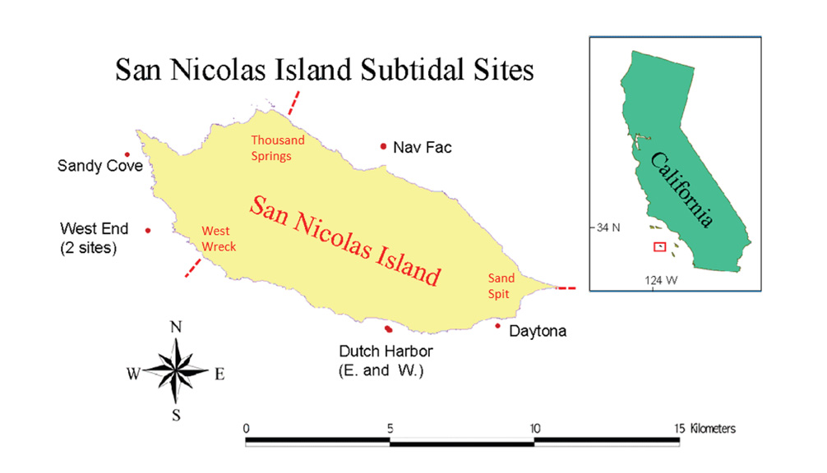
Mac: Macrocystis > 1m
Young mac: Macrocystis <1m
Understory: Pterygophora and Laminaria
Urchins: Strongylocentrotus purpuratus, S. fransciscanus
Site | Mac on understory | Understory on understory | Understory on young mac | Urchin on Mac | Urchin on Understory | Urchin on young mac
Nav Fac | NA | + | + | +/- | - | -
Dutch | - | + | + | + | - | +
Daytona | - | + | + | - | - | NA
West End | +/- | + | +/- | - | - | -

Slide 2
Mac: Macrocystis > 1m
Young mac: Macrocystis <1m
Understory: Pterygophora and Laminaria
Urchins: Strongylocentrotus purpuratus, S. fransciscanus
 | Red Urchin on Purple Urchin | Purple Urchin on Red Urchin | NPGO on Mac | Waves on Mac
Nav Fac | NA | NA | + | +
Dutch | NA | NA | + | +/-
Daytona | + | +/- | - | +
West End | + | - | + | -

Slide 3
Mac: Macrocystis > 1m
Young mac: Macrocystis <1m
Understory: Pterygophora and Laminaria
Urchins: Strongylocentrotus purpuratus, S. fransciscanus
Change from Barrens to Non-barrens (West End)
Effect | Mac on understory | Understory on understory | Understory on young mac | Urchin on Mac | Urchin on Understory | Red Urchin on Purple Urchin | Purple Urchin on Red Urchin
 | less positive to negative | more positive | Mostly negative in barren, mostly positive in non-barren | more negative | more negative (but positive for purp on lam) | more positive | no difference

Slide 4
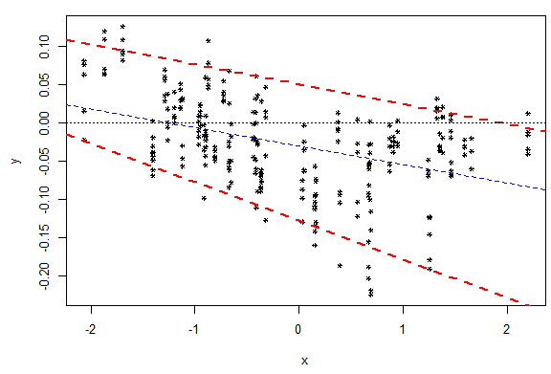
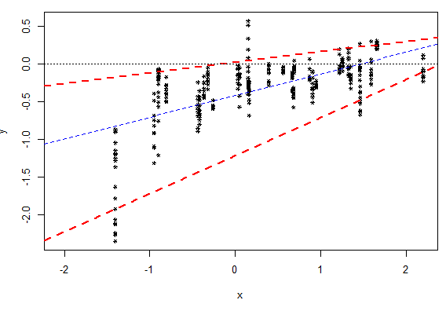
Mac: Macrocystis > 1m
Young mac: Macrocystis <1m
Understory: Pterygophora and Laminaria
Urchins: Strongylocentrotus purpuratus, S. fransciscanus
Change with Physical Variables
Effect of Mac on Laminaria
Effect of Purple Urchin on young mac
NPGO
NPGO

