Slide 1
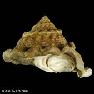

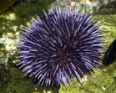
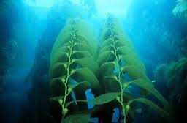

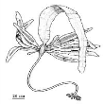

Meg.und
Str.fra
Str.pur
Mac.pyr
Mac.pyr (j)
Pte.cal
Lam.spp
NPGO

Slide 2
Competition
Meg.und
Str.fra
Str.pur
Mac.pyr
Mac.pyr (j)
Pte.cal
Lam.spp
NPGO

Slide 3
Mutualism
Meg.und
Str.fra
Str.pur
Mac.pyr
Mac.pyr (j)
Pte.cal
Lam.spp
NPGO

Slide 4
“Herbivory”
Meg.und
Str.fra
Str.pur
Mac.pyr
Mac.pyr (j)
Pte.cal
Lam.spp
NPGO

Slide 5
Commensalism
Meg.und
Str.fra
Str.pur
Mac.pyr
Mac.pyr (j)
Pte.cal
Lam.spp
NPGO

Slide 6
Amensalism
Meg.und
Str.fra
Str.pur
Mac.pyr
Mac.pyr (j)
Pte.cal
Lam.spp
NPGO

Slide 7
Macrocystis as Dominant
Meg.und
Str.fra
Str.pur
Mac.pyr
Mac.pyr (j)
Pte.cal
Lam.spp
NPGO

Slide 8
Cascade?
Meg.und
Str.fra
Str.pur
Mac.pyr
Mac.pyr (j)
Pte.cal
Lam.spp
NPGO

