Slide 1

Moviever Proof of Concept
By Frank, Navdeep, Alex and David

Slide 2

Our Idea
Build a dashboard to find high quality, underpromoted movies targeting the underserved movie buff / cinephile audience
Store uses the dashboard to inform decisions on what films to stock and promote
Dashboard can also be used to search for films and identify hidden gems using a gems scoring system

Slide 3
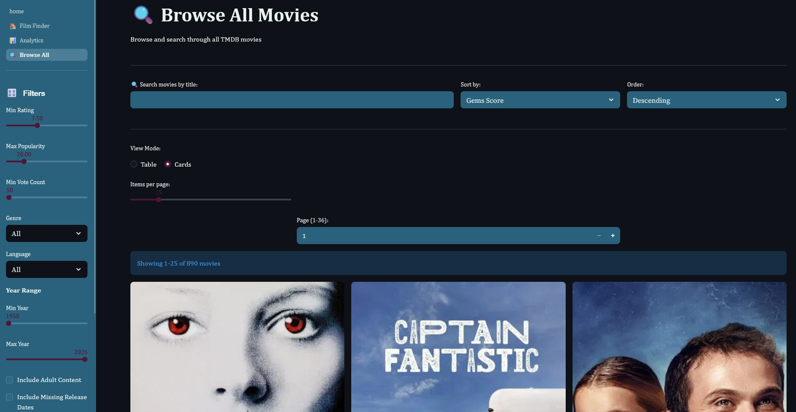
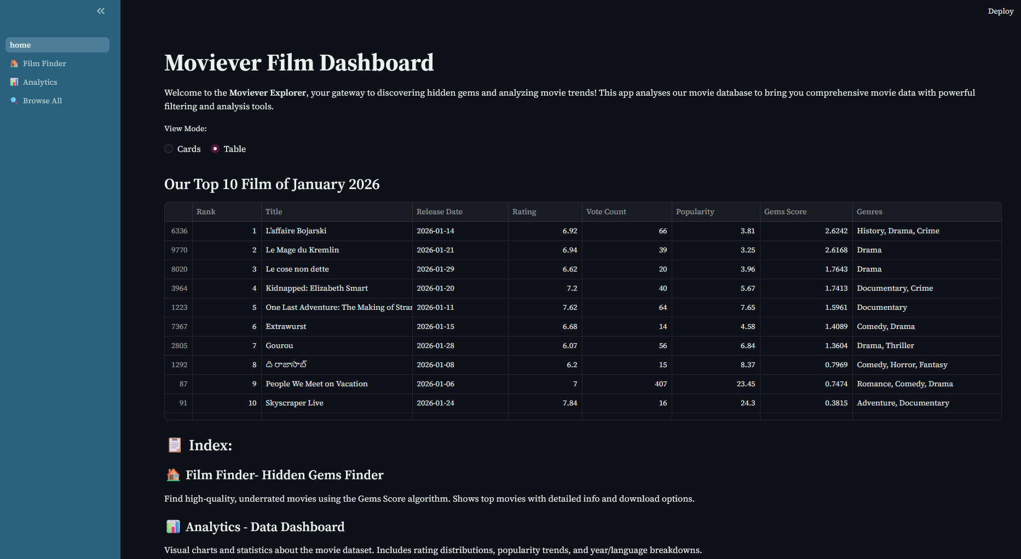
Our Product
Created a dashboard
Film recommendations with filters
Implemented gems scoring system
Created page
  Top films by specification
  Display analytics
  Browse full stored data

Slide 4
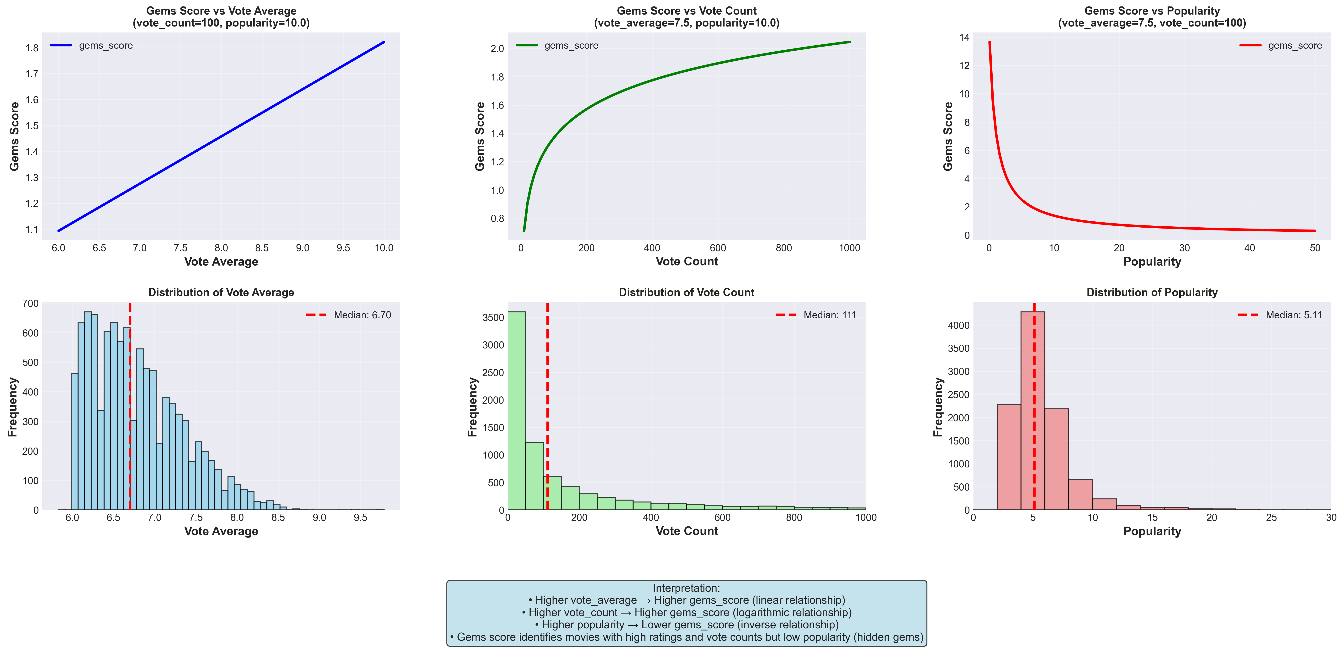

Gems Score Formula
$$score = \frac{vote_average × \log{(vote_count + 1)}}{popularity + 1}$$

Slide 5
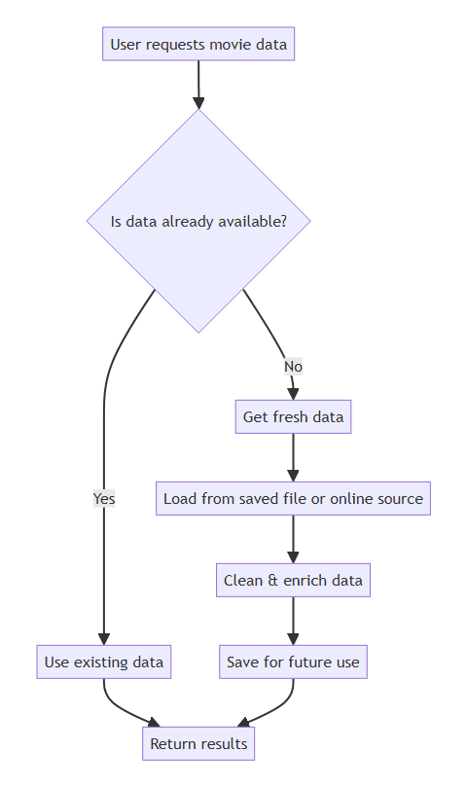
Data Pipeline
Previously loaded and processed data from the API is cached
Ensures speedy data access
Reduces latency
Regularly updates with new data from API

Slide 6
Insights/Next steps
  Short term:
  Better selection of films
  Better sales for collectables/rentals
  Long term:
  Strengthen Moviever's niche and brand
  Insights:
  Check sales figures before and after release
  Compare sales figures for collections

