Slide 1
Medical MythTriage
Can a fast decision model be trusted to pre-screen medical claims?
Background — Owen Liu, a medical master's student at Stanford (CS 329Z). Latest research from Anthropic and Stanford: a model cannot reliably say “I was wrong.” My grandmother is the same — total confidence, every time.
Owen Liu · CS 329Z · Midway
Feng et al. (2026). When Do Models Admit They Are Wrong?
arXiv:2609.33220 · https://arxiv.org/abs/2609.33220

Slide 2
The rule is one line.
The quick model answers once and says how sure it feels. Code — not the model — decides what happens next.
GLANCER
GATE · in code
BELOW 90%
→
→
answers each claim once
+ how sure it feels
90% sure or more?
the answer stands
a slow checker verifies
— or “I don't know.”
The failure line — written before any run: if no setting of this rule is both safe and useful, the honest result is “don't delegate.”
The model proposes. The code disposes.

Slide 3
The rule worked — on one kind of claim.
Measured separately on two kinds of claims. Never mixed.
16%
0%
of expert-written claims settled fast
could be settled safely on smooth claims
HealthFC · every one of them right
MEDFACT · it let 64% through — 30% of those were wrong
Same model. Same rule. The claims changed.
The gate's own numbers: settled share and how many settled answers were right.

Slide 4
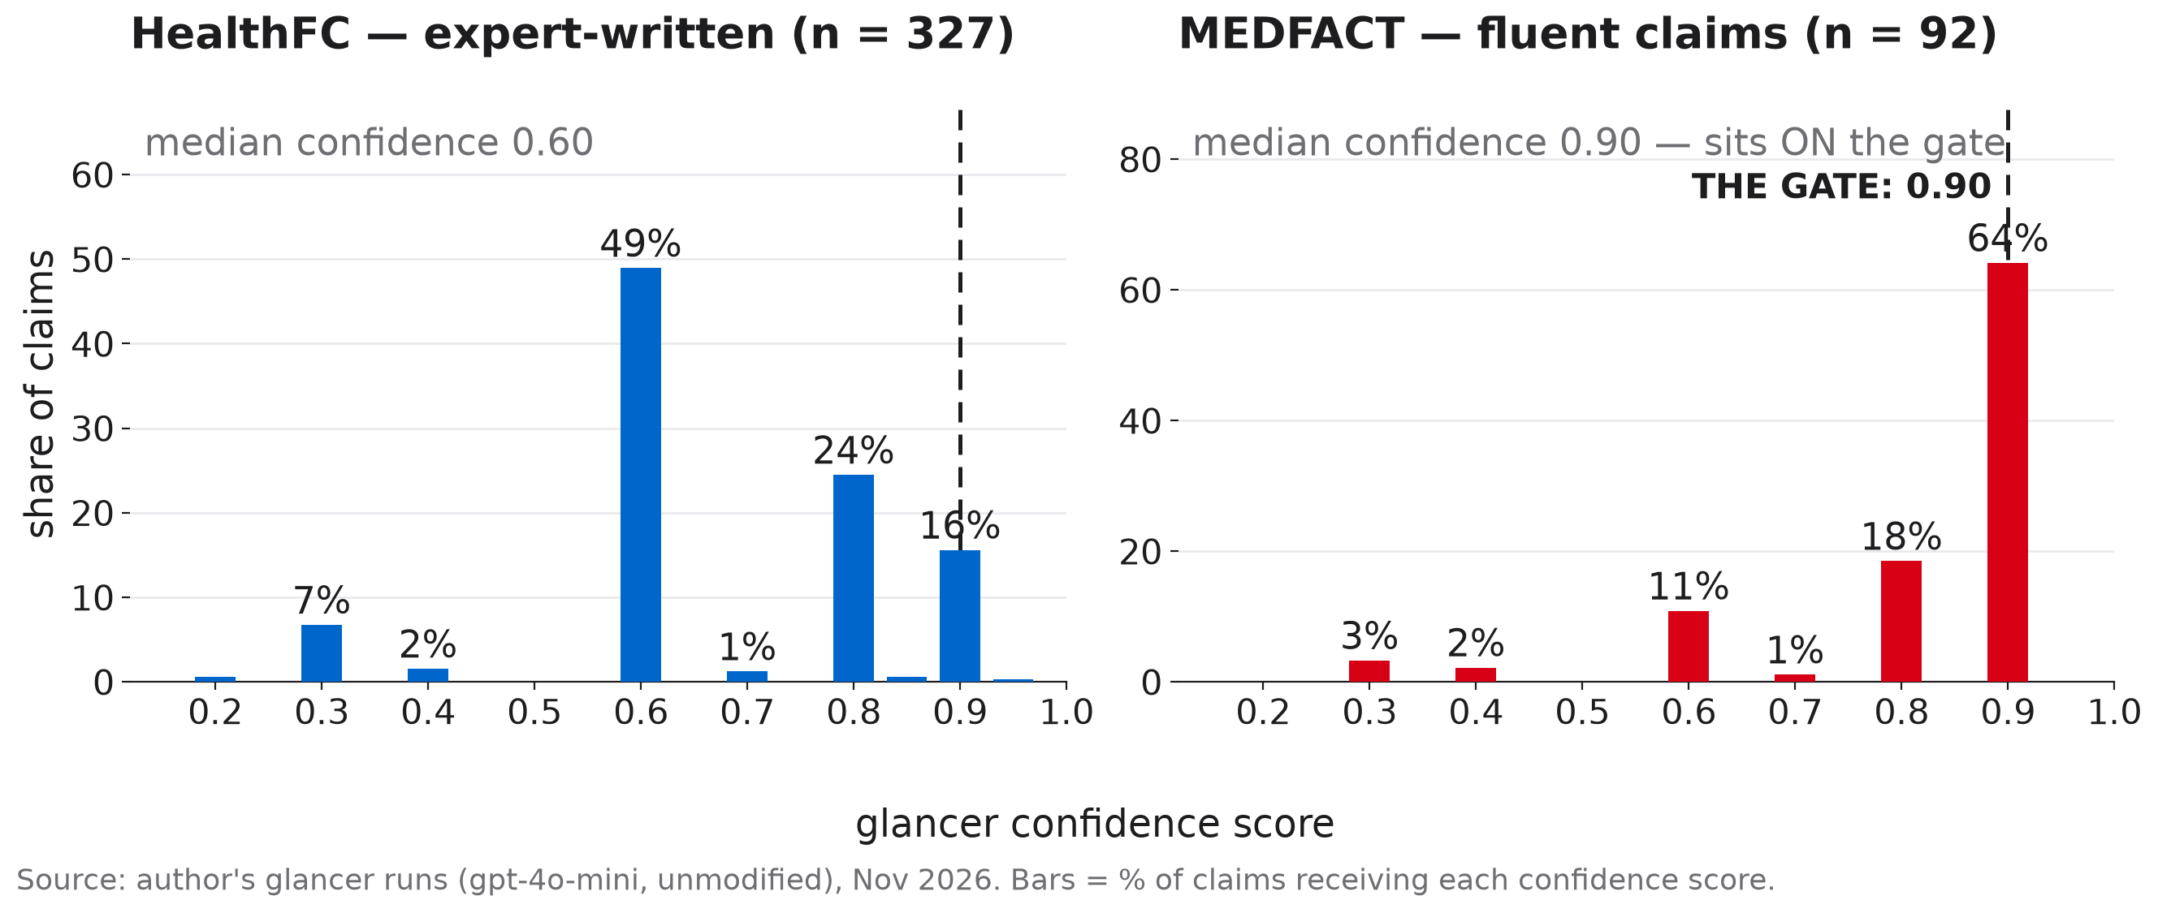
One claim, and why it fooled the gate.
“Drink about two liters of water a day.” Certified TRUE at 90% sure — a MEDFACT myth.
The line never moved. The crowd did.

Slide 5
The full table.
External validation · the glancer alone, no verifier · reported per dataset, never pooled
HealthFC · expert-written
MEDFACT · fluent claims
Abstention rate
58%
16%
Accuracy when it decides
92.0%
66.2%
Myth identification
71.0%
18.8%
Settled by the 90% gate
15.9%
64.1%
Precision of the settled claims
100%
71.2%
Pre-registered K3′: if no confidence threshold reaches 95% precision at any coverage, fast delegation is unsafe — met on MEDFACT.

Slide 6
What I learned.
Moving the decision into code was only half the fix.
The code still reads the model's own feeling —
and that feeling tracks how a claim is written, not whether it is true.
Sounding sure is a style, not a fact.
Still unmeasured: whether the slow checker rescues the mistakes that reach it. Final phase: measure the rescue — starting with the claims that sound like family.
For the claims that sound like family.

Slide 7
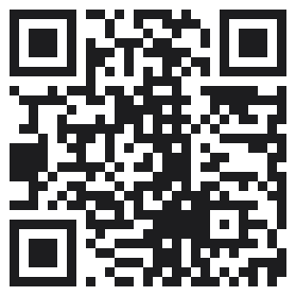
Try it yourself.
The whole measurement on one page — in words a 12-year-old can follow.
Drag the gate. The numbers are real — 419 recorded runs.
the gate · 90%
0.50
0.99
HealthFC ★★★ settles 16% — every one correct
● LIVE owenyliu.github.io/mythtriage
Flip on “Explain it like I'm 12.”
Then move the gate yourself.
MEDFACT ☆☆☆ no position of the gate is safe
Slides (PowerPoint)
owenyliu.github.io/mythtriage/slides.pptx
Same gate, same model — the stars follow the claims, not the model.

