Slide 1
Sequential Neural Network
汇报人：倪杰

Slide 2
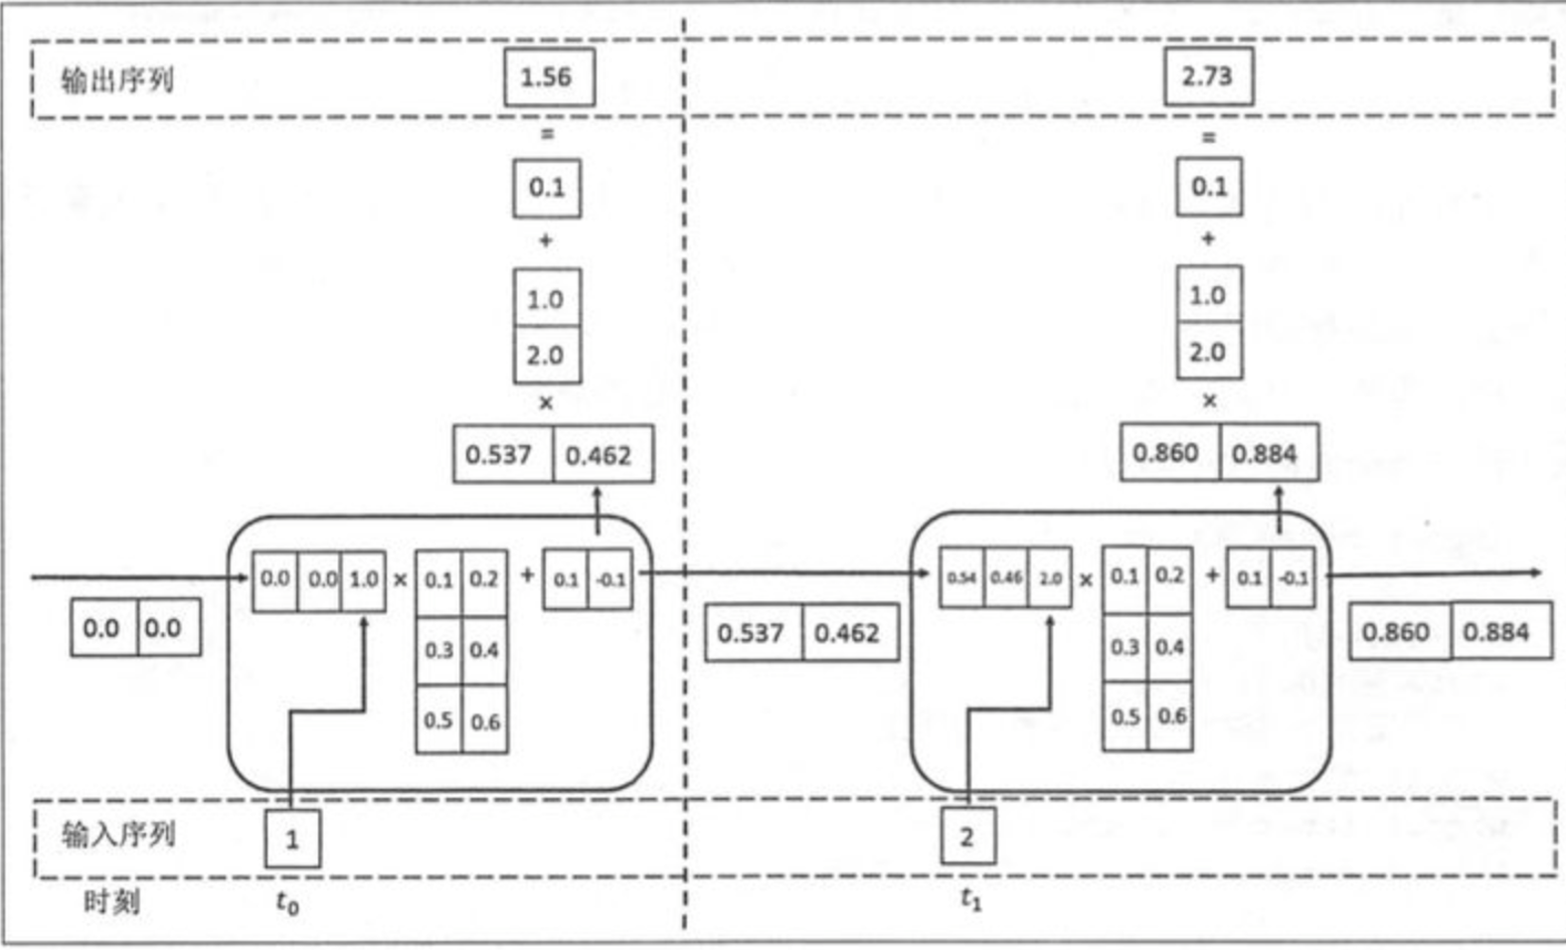
RNN(Recurrent neural networks)
The input is related to the previous time step
Notes:
1997

Slide 3
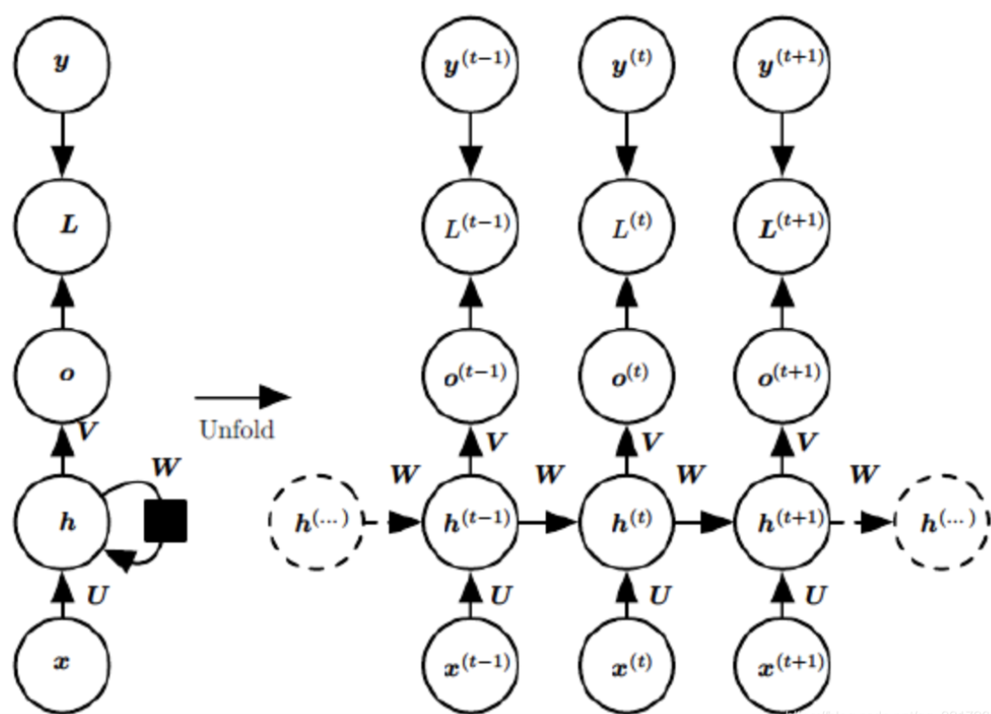



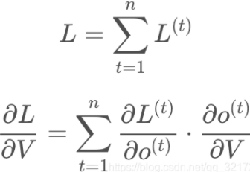
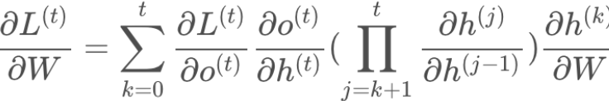
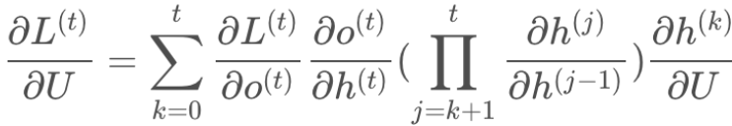
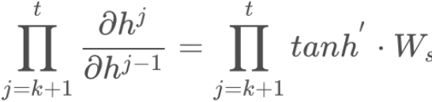
BPTT(Back-Propagation Through Time)
Vanishing Gradient
No more than 5-10 time steps
Notes:
1994
有时候一些分类问题往往取的是最后一个时间步的输出。

Slide 4
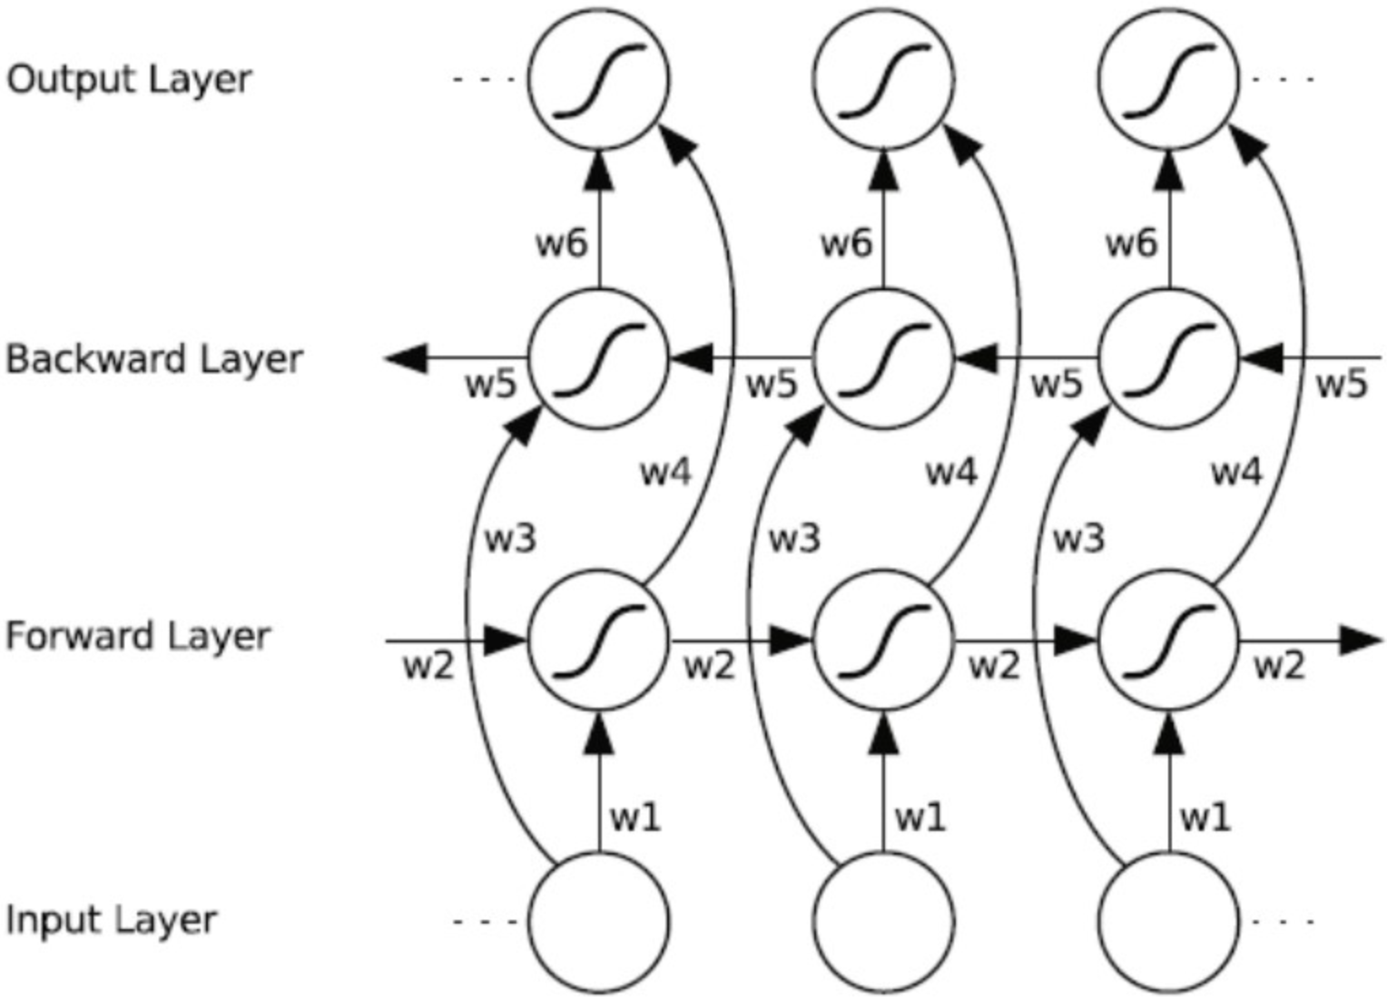
BRNN(Bidirectional RNN)
The output is both related to past and future information
Two networks given input of different directions
Notes:
1997

Slide 5
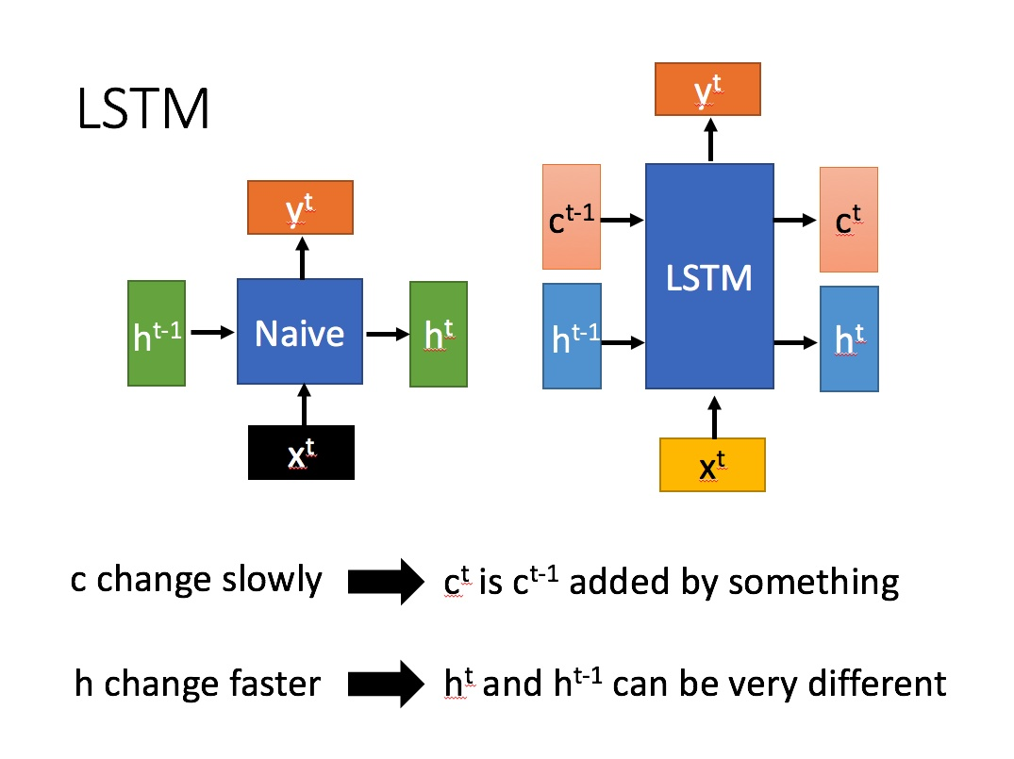
RNN and LSTM
Multivariate data stream
unsupervised
test in single window
Hypothesis test
multivariate generalization of Ma
p-value available
RNN
Notes:
梯度消失和梯度爆炸

Slide 6
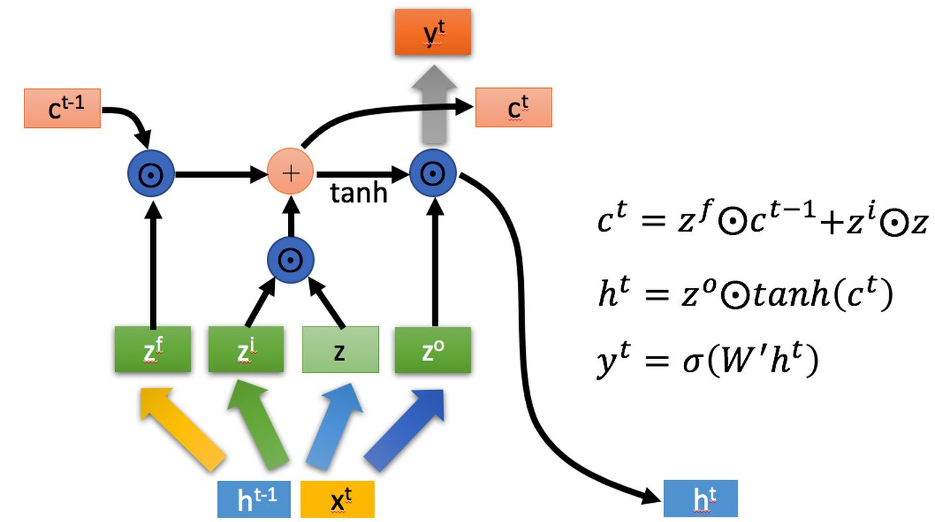
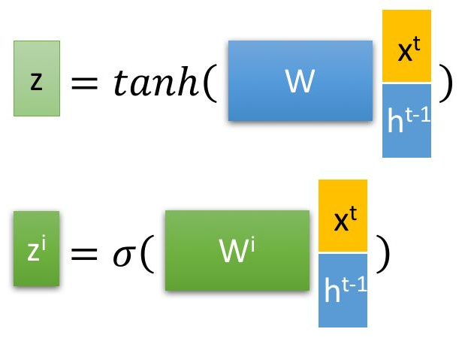
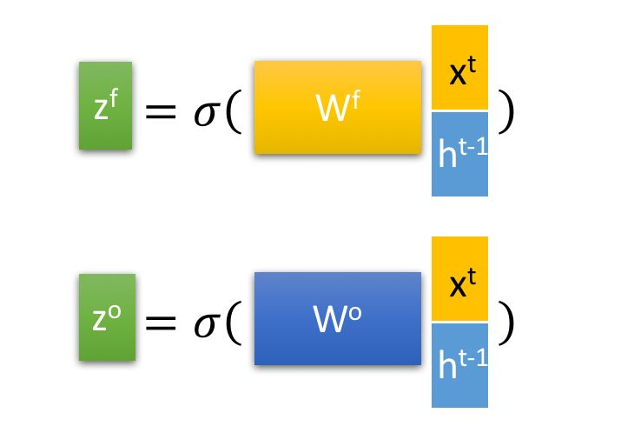

LSTM
$c^{t}:$ long term memory
$h^{t}:$short term memory
Three gates: Input gate, Forget gate, Output gate
Get p-value
Notes:
1997

Slide 7
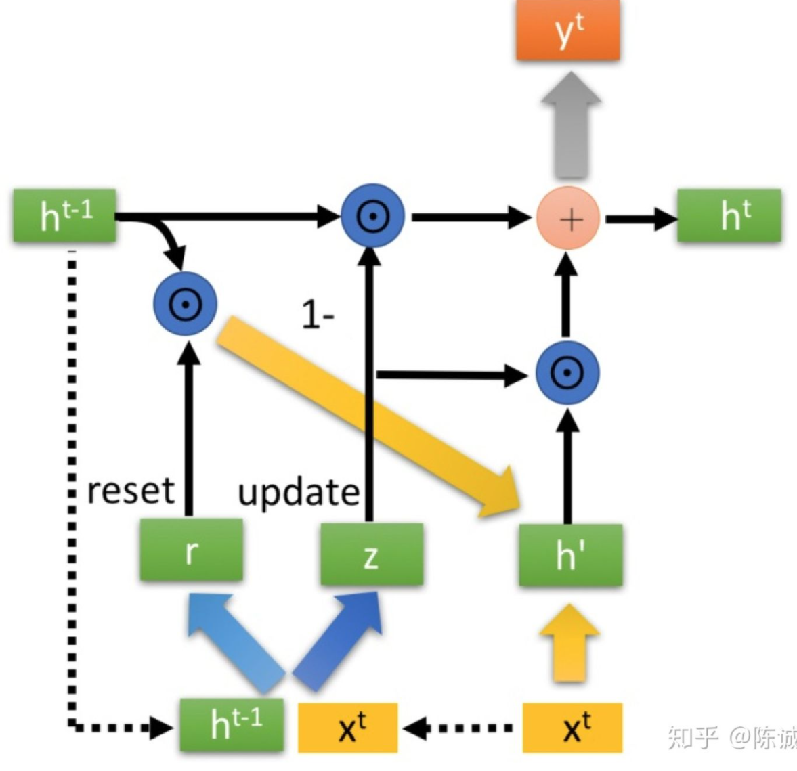
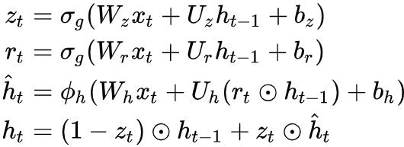


GRU(Gate Recurrent Unit)
Two gates :Reset gate, Update gate
z
z
Notes:
2014
Zt选择记忆阶段
Update gate 通过线性变换同时进行遗忘和记忆
参数少,时间开销小很多

Slide 8
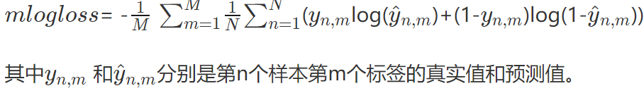
Experiment
Masked data-medical diagnosis
text classification
10000 instances
Multilabel with 17 classes
4-104 words per instance
RNN: logloss: 0.1117 time cost: 359.2s
LSTM: logloss: 0.0369 time cost: 389.5s
GRU: logloss: 0.0468 time cost: 371.5s

