Slide 1
LSTM (Long Short-Term Memory)
汇报人：倪杰

Slide 2
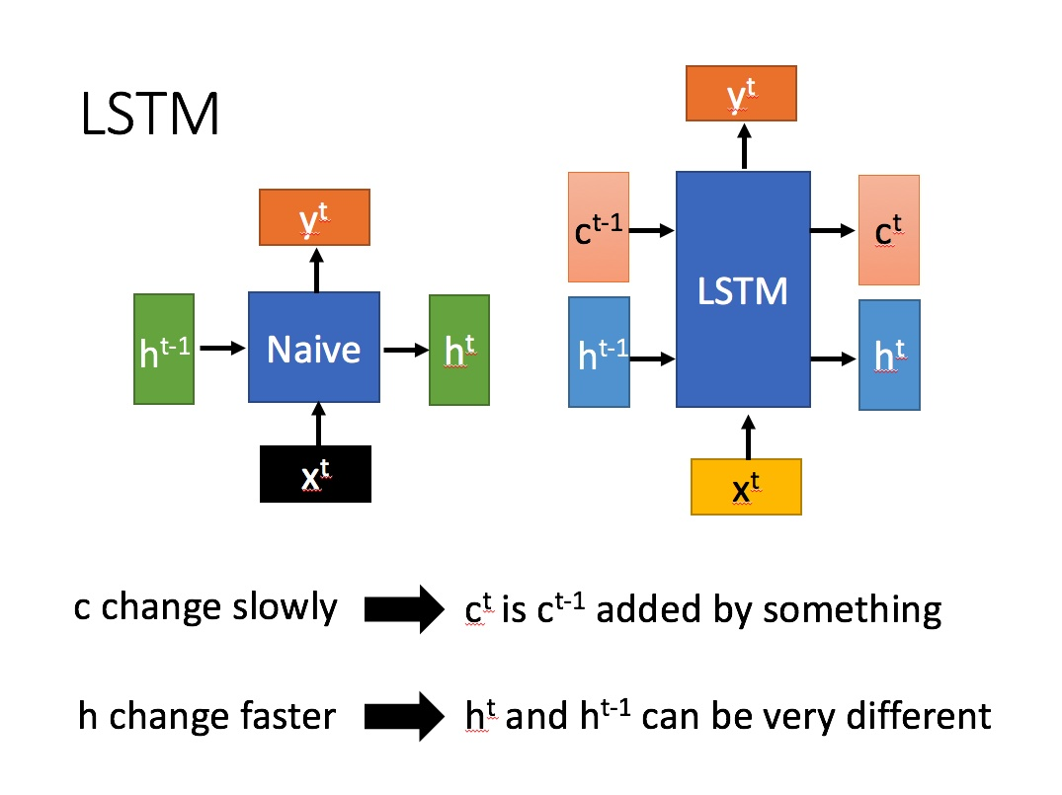
RNN and LSTM
Multivariate data stream
unsupervised
test in single window
Hypothesis test
multivariate generalization of Ma
p-value available
RNN
Notes:
梯度消失和梯度爆炸

Slide 3
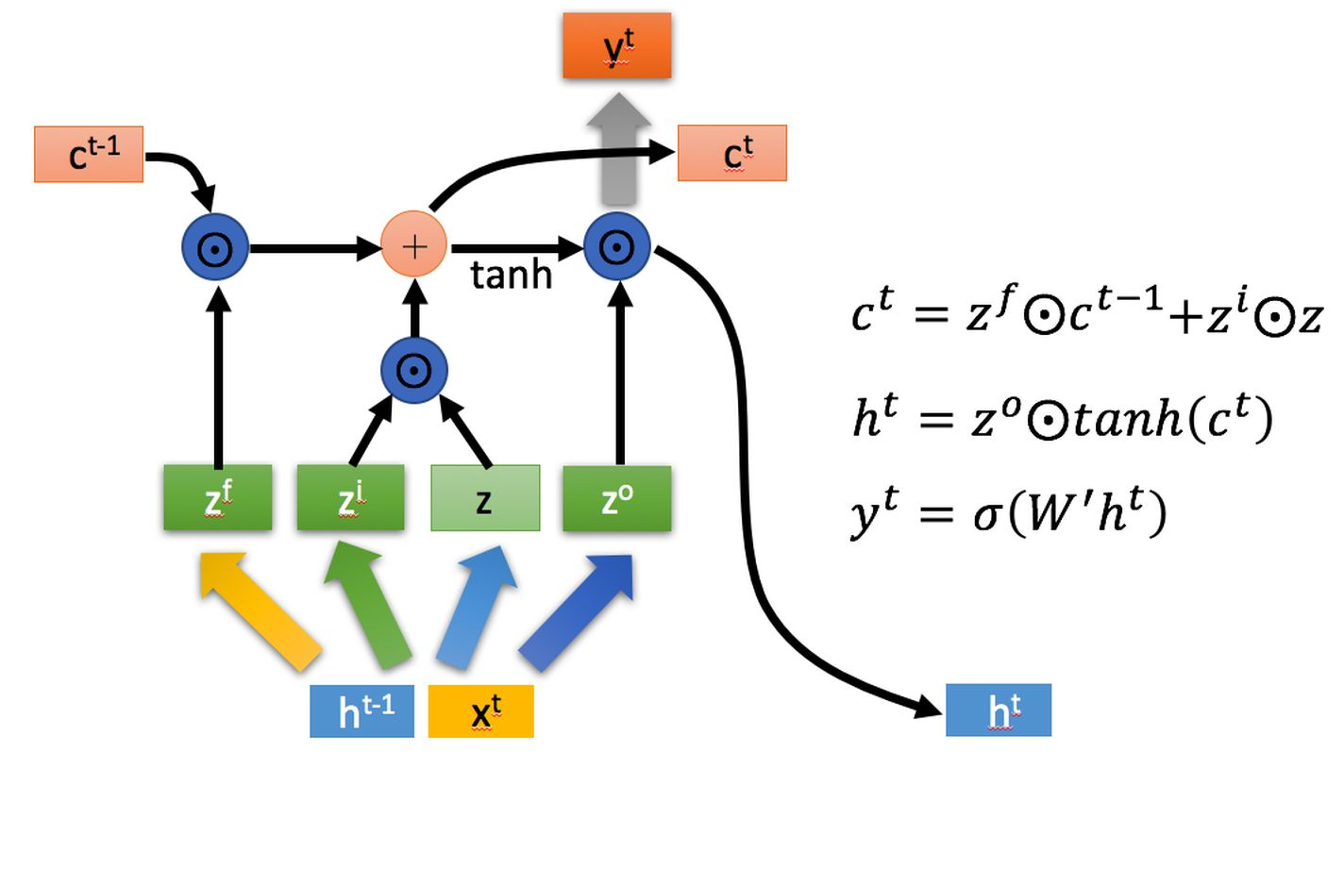
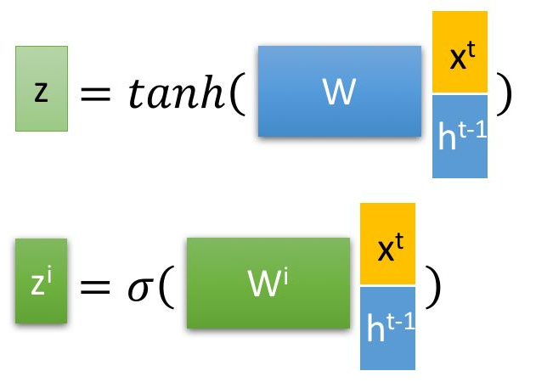
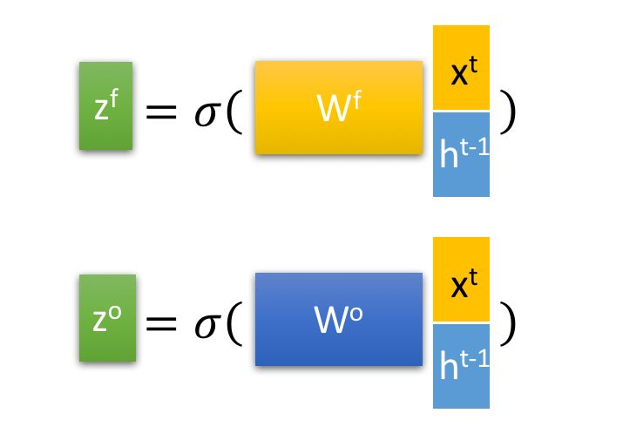

Algorithm
$c^{t}:$ long term memory
$h^{t}:$short term memory
Compute where
Get p-value

Slide 4
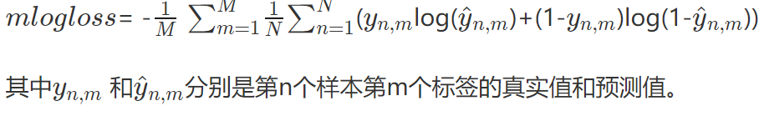
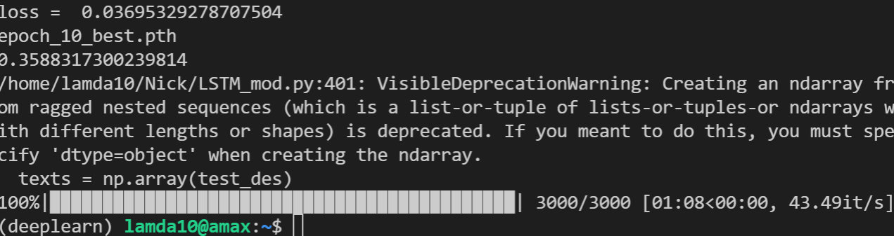
Experiment
Masked data-medical diagnosis
text classification
10000 instances
Multilabel with 17 classes
4-104 words per instance
logloss: 0.0369

