Slide 1
SGD, Batch Normalization and hyperparameter-tuning
汇报人：倪杰
Notes:
两者都是以色列本古里安大学

Slide 2

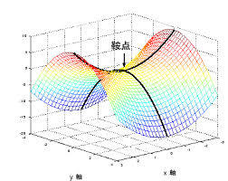
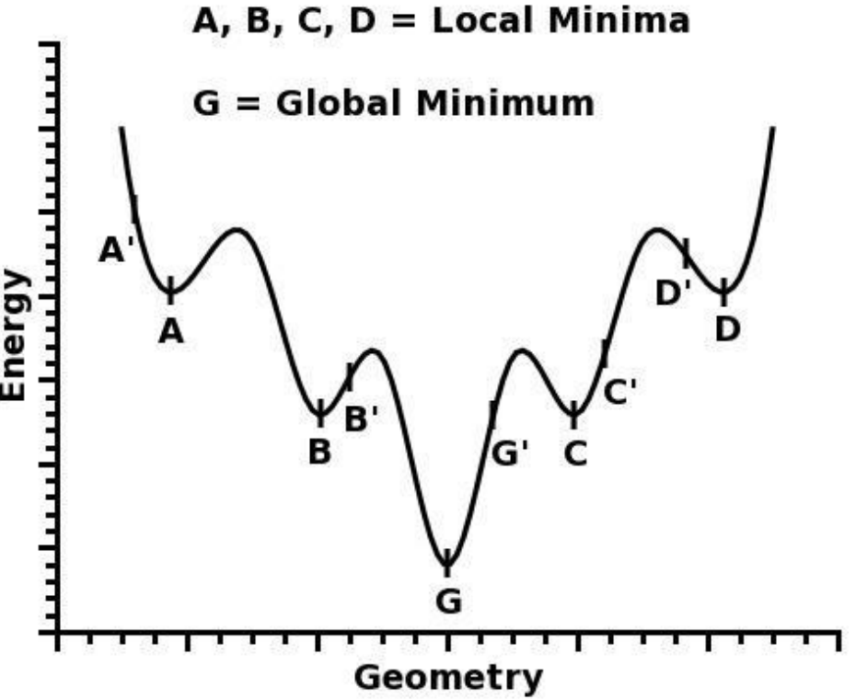
Gradient Descent
Minimize loss function step by step
Compute the negative Gradient
Give the learning rate
Use all the data to update the parameter
Problems: saddle point and local minimum
Notes:
R(x)是真实分布的期望

Slide 3
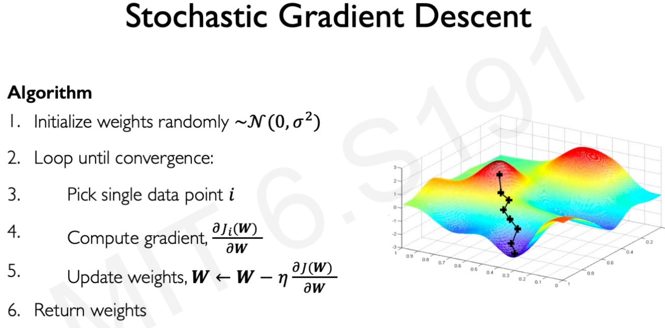
Stochastic Gradient Descent
Use gradient of minibatch to update
Allows for larger learning rate
Faster than GD
Stochastic thus may escape from saddle point and local minimum
Adapted for nonconvex problem

Slide 4
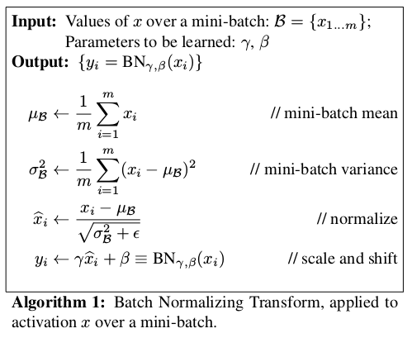
Batch Normalization
Motivation: internal covariate shift
distribution of layer inputs change
The layers continuously adapt to new distribution
Problems get worse when the net is deep

Slide 5

Batch Normalization
Normalization Step
Normalize to N(0,1)
Depends only on inputs
Scale and Shift
Data can be rebuilt by using mean and variance
Get the scale and bias by back propagation
Output:
Advantages:
Faster when net gets deep
Better performance
Allows for larger learning rate
Less careful about Initialization
Notes:
Adaptation to reduce dependency

Slide 6
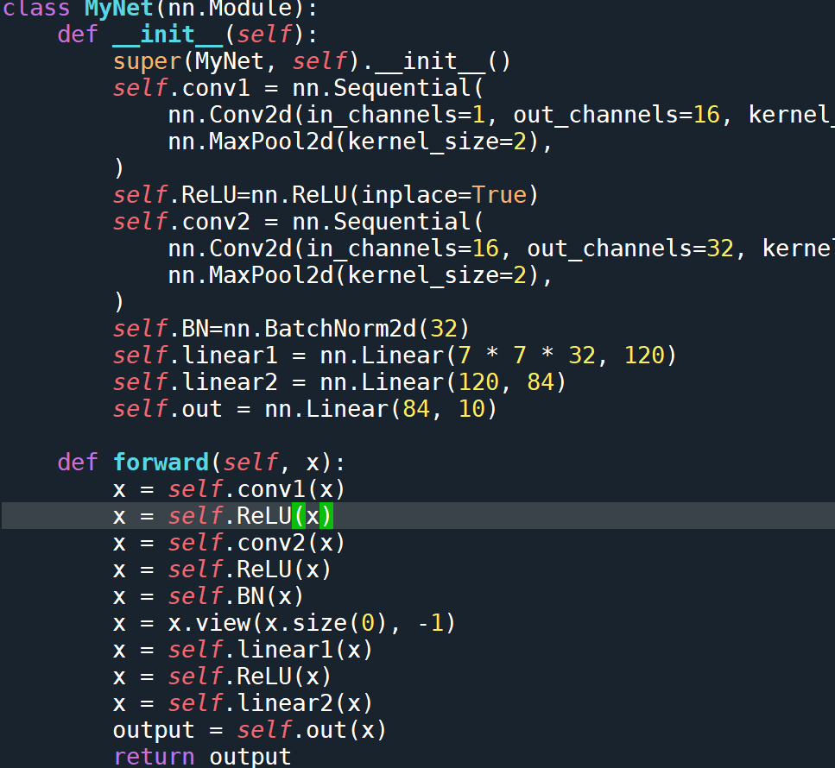
Experiment
Dataset: MINIST(60000×28×28)
Model: 2 conv2d+BN+2FCL
Notes:
Adaptation to reduce dependency

Slide 7
Experiment
Dataset: MINIST(60000×28×28) test:10000
Model: 2 conv2d+BN+2FCL
Notes:
Adaptation to reduce dependency

Slide 8
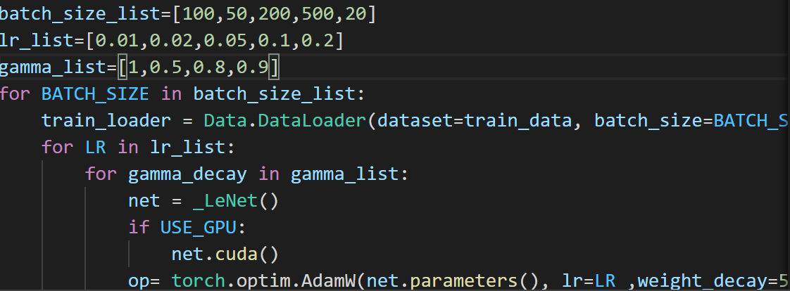
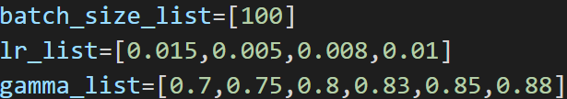
Hyperparameter tuning
Hyperparameters: batch size, learning rate, gamma
Small trick: Find adequate batch size first
Narrow down the scale
Notes:
Adaptation to reduce dependency

Slide 9
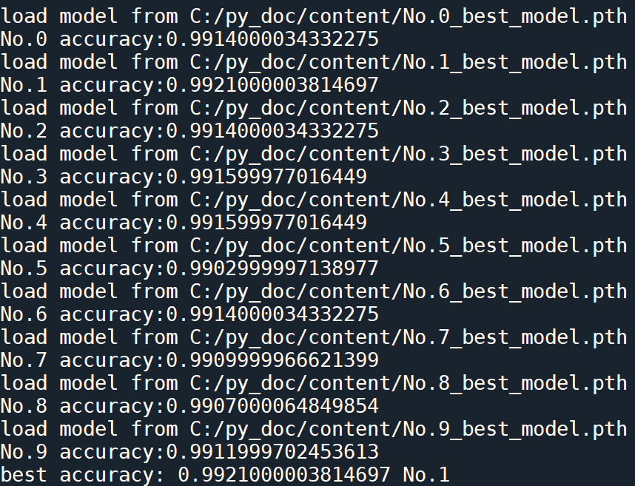
Hyperparameter tuning
Use part of data and save 10 best net parameters
Test 10 best net in full data
Best accuracy: 99.21
Batch size:100 Initial lr:0.05 lr decay:0.85
Notes:
Adaptation to reduce dependency

