Slide 1
Experiment on Convolution Neural Networks
2021.8.20
汇报人：倪杰

Slide 2
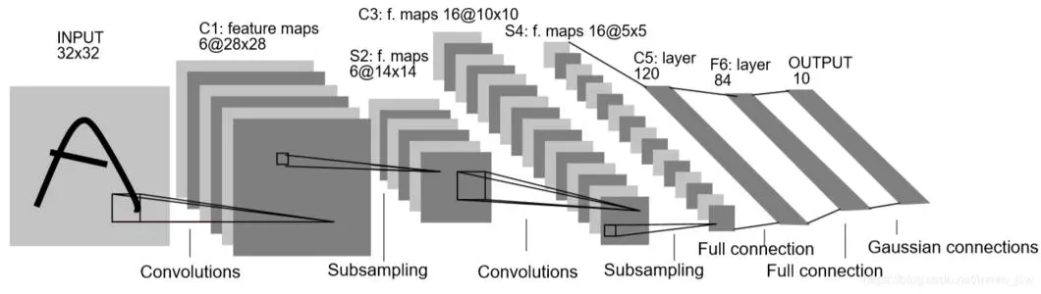
CNN models
LeNet
2ConvLayer+3FC Layer
Kernel_size: 5×5
Channels:6-6
No ReLU
Notes:
Adaptation to reduce dependency

Slide 3
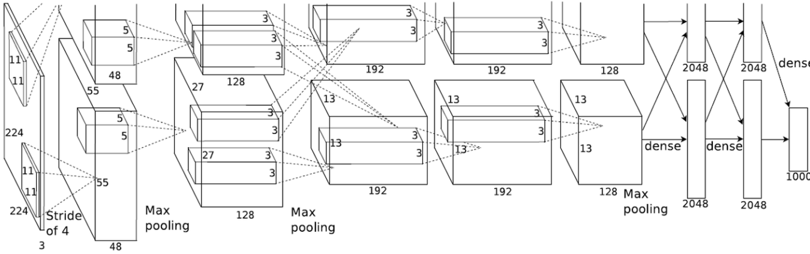
CNN models
AlexNet
5ConvLayer+3FC Layer
Kernel_size: 11-5-3-3-3
Channels:128-256-384-384-256
Maxpooling+LRN
Notes:
Adaptation to reduce dependency

Slide 4
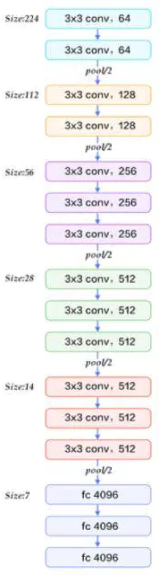
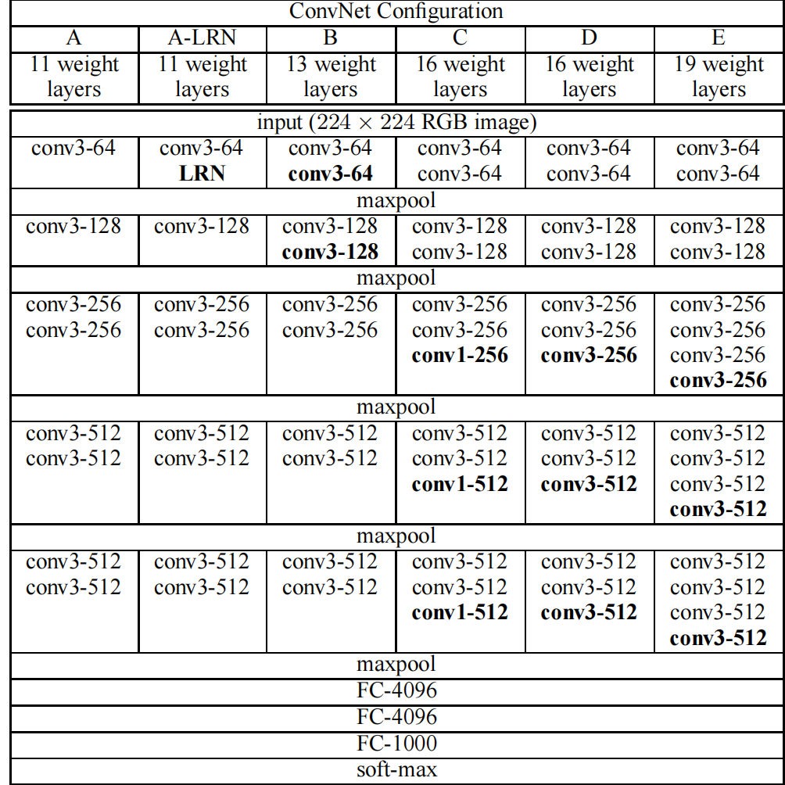
CNN models
VGGNet:Small kernels
13ConvLayer+3FC Layer(VGG-16)
Kernel_size: 3×3
Channels:2×64-2×128-3×256-3×512-3×512
5Maxpooling
Notes:
Adaptation to reduce dependency

Slide 5
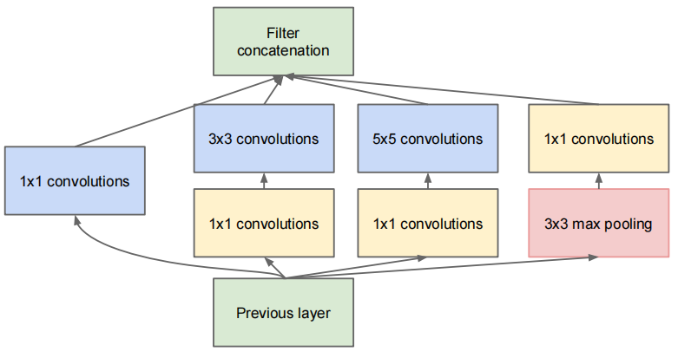
GoogleNet and Inception
InceptionV1
“Broaden” the net structure
Advantages
Abstract features from different scales simultaneously
1×1conv allows for less computation cost
Notes:
Adaptation to reduce dependency

Slide 6
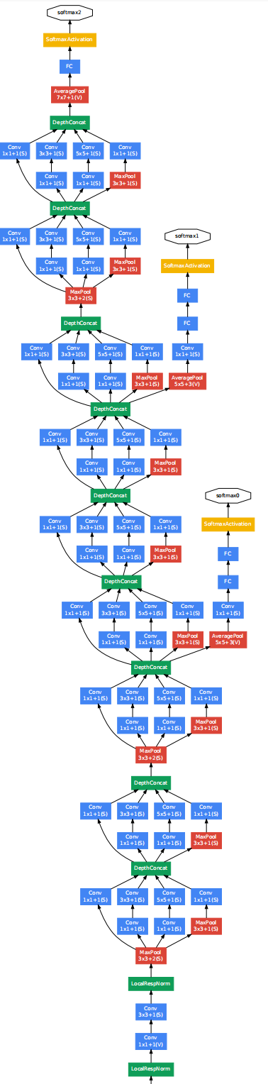
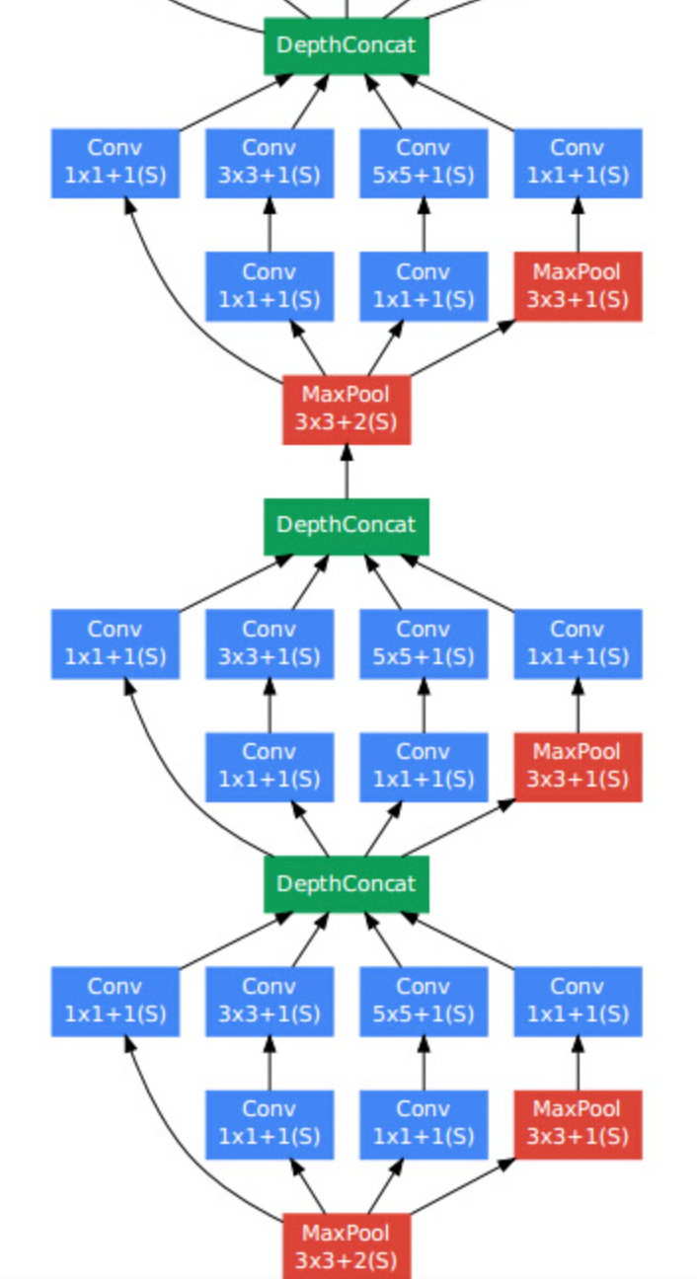
GoogleNet and Inception
GoogleNet
Notes:
Adaptation to reduce dependency

Slide 7


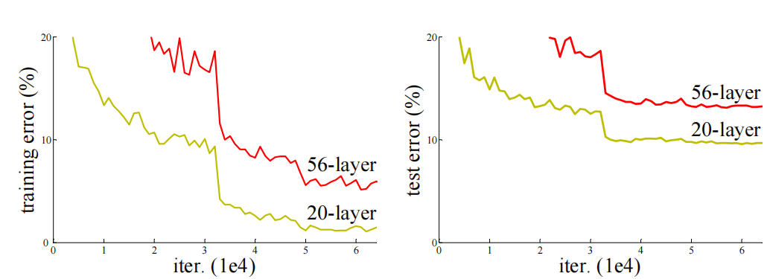
ResNet
Motivation: Degradation problem
Performance gets worse when the net gets deeper
Not over-fitting
The expected function is more like identity function than zero function
Solution: Learn the residual rather than original mapping
Notes:
为什么不是over-fitting

Slide 8

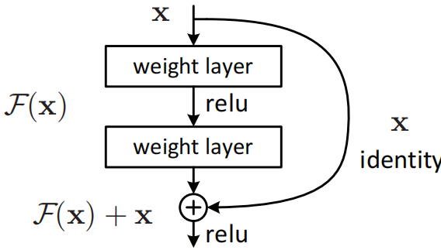

ResNet
Shortcut Connection
Two or three layers per unit
One layer is just linear mapping
Dimensions expected to be equal
Adapted to convlayer:element addition channel by channel
Reduce gradient vanishing : BN+Shortcut
Notes:
152

Slide 9
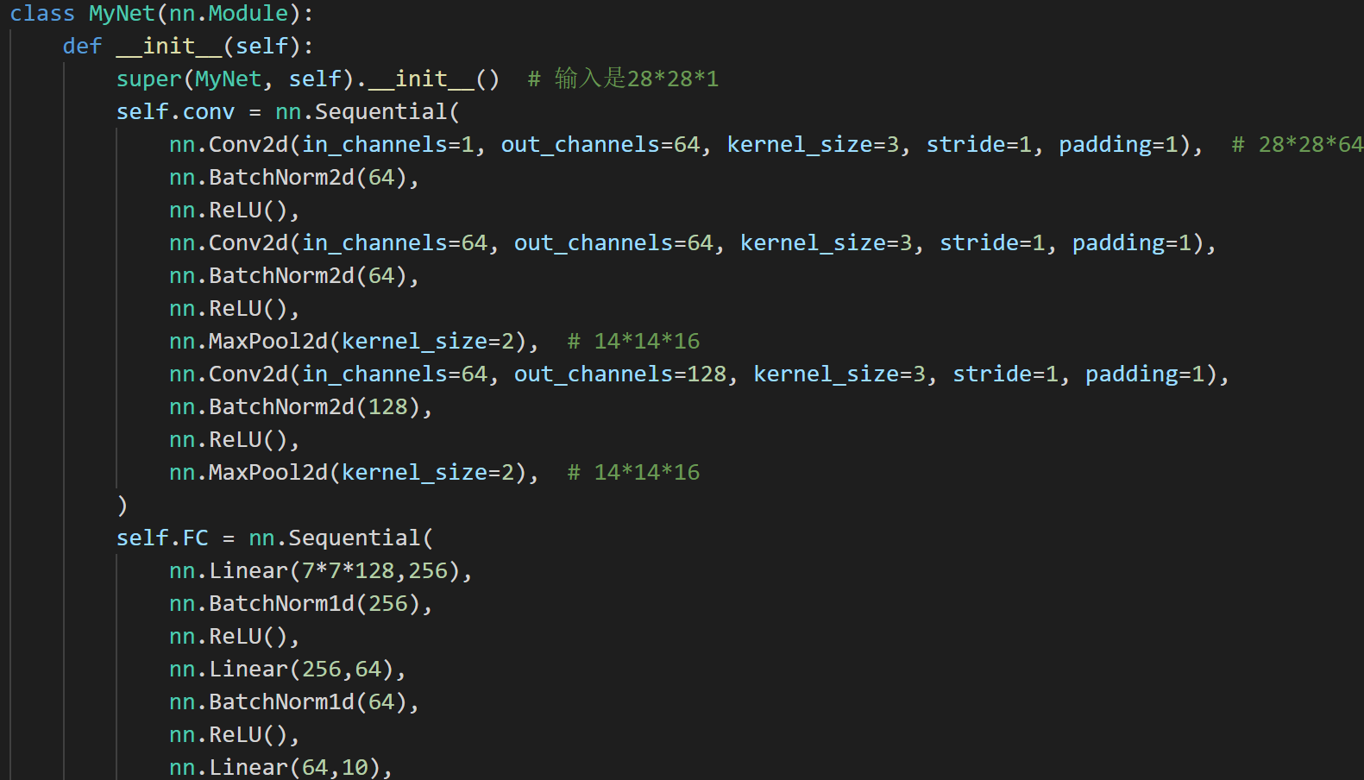
Experiment
Dataset: MINIST(60000×28×28) test:10000
Model: 3Conv+2MaxP+3FC+BN
Kernel_size: 5×5 3×3 3×3
Channels: 64-64-128
FC-nodes: 256-64-10
Notes:
Adaptation to reduce dependency

Slide 10
Hyperparameter tuning
ConvLayers-Kernel_size-Channels
Slightly better performance of 5×5 kernel in first layer
Change the channels
16-16-32(99.41)
32-32-64(99.46)
64-64-128(99.53)
128-128-256(99.44)
Hyperparameters tuning: batch size, learning rate, weight decay, dropout
Notes:
Adaptation to reduce dependency
先在对数尺度上找学习率

Slide 11
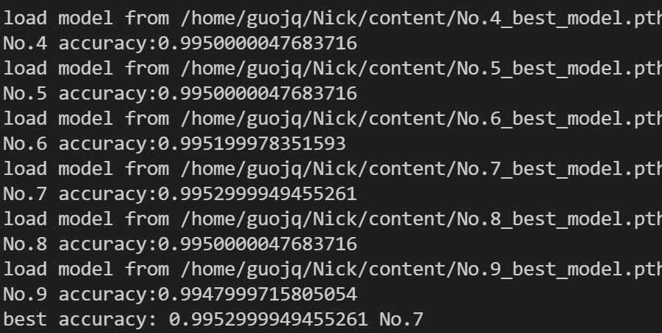
Hyperparameter tuning
Using BN in Conv and FC, skip dropout
Result
Best accuracy: 99.53
Batch size:128 Initial lr:0.003 lr decay:0.9
Notes:
Adaptation to reduce dependency

Slide 12
Dataset
Intel image classification (25000×150×150×3)
Multiclass classification(6 classes)
Test data size:3000
Model: 3Conv+2MaxP+3FC+BN
Kernel_size: 11×11 5×5 3×3
Channels: 64-64-128
FC-nodes: 256-64-10
Best accuracy:85.7％
Hyperparameter
Batch_size:64
Lr:0.001
Weight_decay: 0.9

