Slide 1
Generative Adversarial Network
2021.8.27
滕明卓

Slide 2








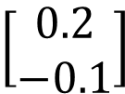


Background
Generator
NN
Generator
code
code
code
vectors
code:
$$\left[\begin{aligned}0.1 \\ −0.5\end{aligned}\right]$$
$$\left[\begin{aligned}0.1 \\ 0.9\end{aligned}\right]$$
$$\left[\begin{aligned}0.2 \\ −0.1\end{aligned}\right]$$
$$\left[\begin{aligned}0.3 \\ 0.2\end{aligned}\right]$$
(where does they come from?)
Image:

Slide 3


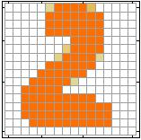
Auto-encoder
Auto-encoder
Weekness
As close as possible
NN
Encoder
NN
Decoder
code
= Generator
1 pixel error
1 pixel error
6 pixel errors
6 pixel errors
Target

Slide 4
Discriminator
Discriminator is a function D (network, can deep)
Output D(x): scalar which represents how “good” an object x is
Can we use the discriminator to generate objects?

Slide 5

GAN
Generator
Discriminator
Generator
image
vector
Discri-minator
image
scalar
Larger value means real, smaller value means fake.

Slide 6
GAN - Train
Training discriminator
Training generator
fake - 0
Generator
image
Discri-minator
L(scalar,label)
real - 1
Generator
Discri-minator
image
maximize
scalar

Slide 7


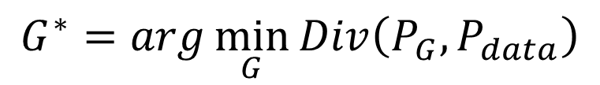

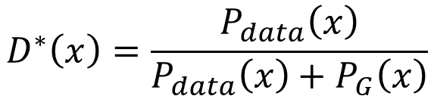

Optimization
Generator
Discriminator
$V\left(G,D^{∗}\right)$ $=−2log2+2JSD\left(P_{data}||P_{G}\right)$
$$G^{∗}=arg\min_{G}{Div\left(P_{G},P_{data}\right)}$$
$$V\left(G,D\right)=E_{x∼P_{data}}\left[logD\left(x\right)\right]+E_{x∼P_{G}}\left[log\left(1−D\left(x\right)\right)\right]$$
$$D^{∗}=arg\max_{D}{V\left(D,G\right)}$$
$$D^{∗}\left(x\right)=\frac{P_{data}\left(x\right)}{P_{data}\left(x\right)+P_{G}\left(x\right)}$$
$$G^{∗}=arg\min_{G}{Div\left(P_{G},P_{data}\right)}$$
$$\max_{D}{V\left(G,D\right)}$$

Slide 8



Application
Generate …
Conditional generate …
Context Encoder, Super-Resolution GAN, …
c: description
G
Image
x = G(c,z)
$$z$$
$$c$$
D
x is realistic or not +
c and x are matched or not
scalar
$$x$$

Slide 9
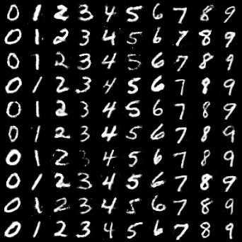
Experiment
Conditional GAN
Mnist, generate 10 images for each class
4 layers fully connected network (G & D) with Dropout

Slide 10
Thanks！
Notes:
西交利物浦大学
后四个是老师

