Slide 1

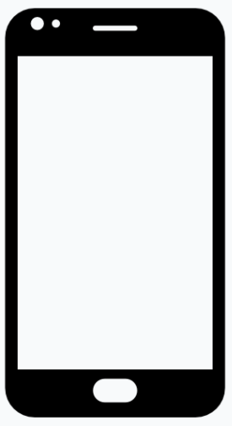

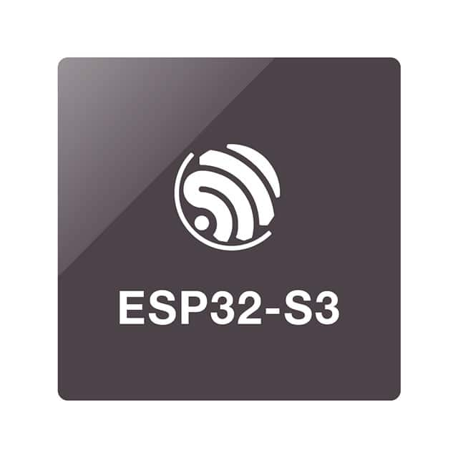
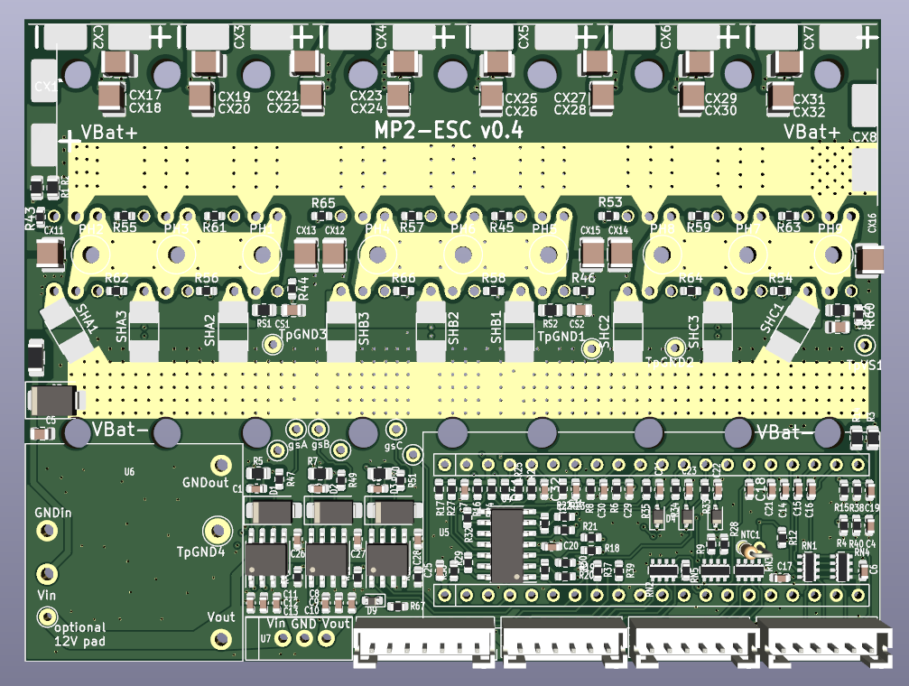
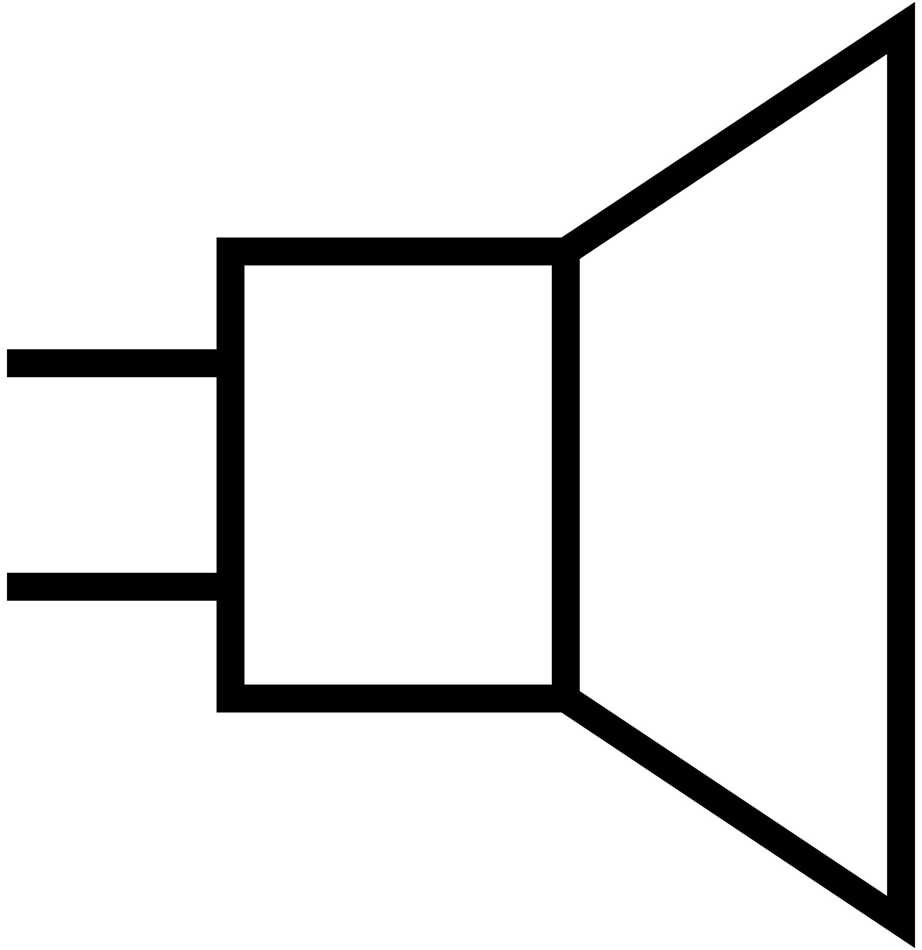
MP2 Data Logger
SCL
SDA
Teensy 4.1
GPS NEO-M9N
MPU6050
UART1
I2C
Serial terminal
UART2
Speaker
SD
Card
MP2 Controller

