Slide 1







Van’s Intern Presentation Summer 2003
Me

Slide 2

Hello Mister Van
Van Nguyen
University of Texas at Austin
Junior Fall 2003
Electrical Engineering
3rd Summer Internship @ Motorola
SoC Applications Team
Self-Proclaimed Wasabi Challenge Champion

Slide 3


Projects
Online Training Evaluation system
SoC Web Consolidation project
Stingray Frontend Basic training
Other fun summer stuff

Slide 4
Online Training Evaluation Project
Over the past year, SoC has used the online evaluation system to collect and analyze evaluation data from customers on SoC sponsored training. However, additional requirements have been identified that need to be implemented for the system to remain an effective solution for SoC.

Slide 5
Online Training Evaluation Project
Requirements
  Generate additional types of evaluation forms
  Administrator edit capabilities
  Added the ‘Delete feature’ for instructor class listing.
  Coordinate testing
  Debug system based on test feedback
  Schedule to train SoC training team on modifications

Slide 6

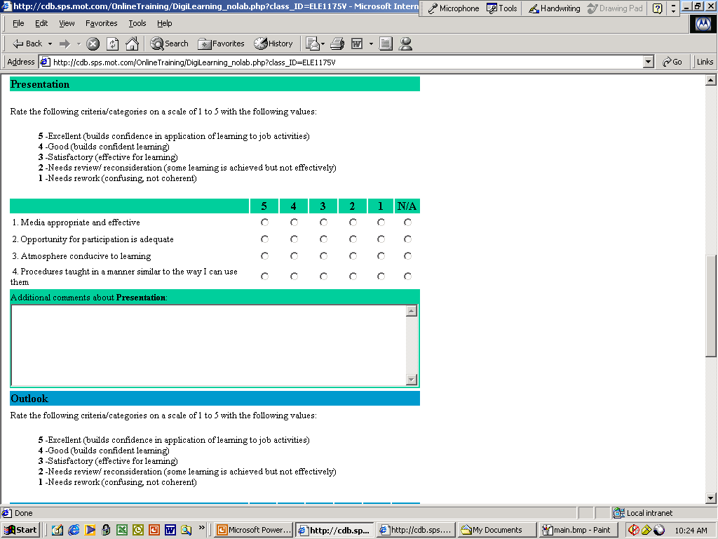
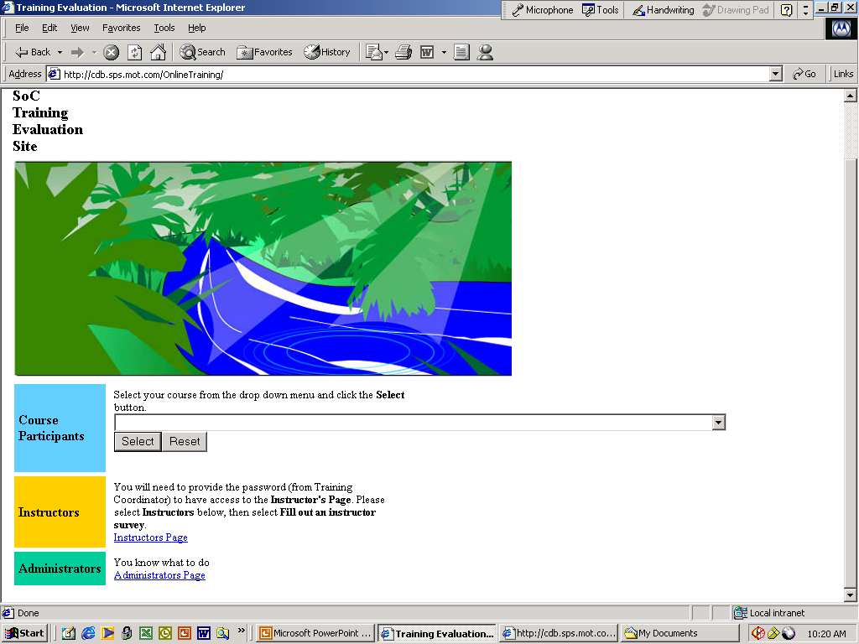

Slide 7

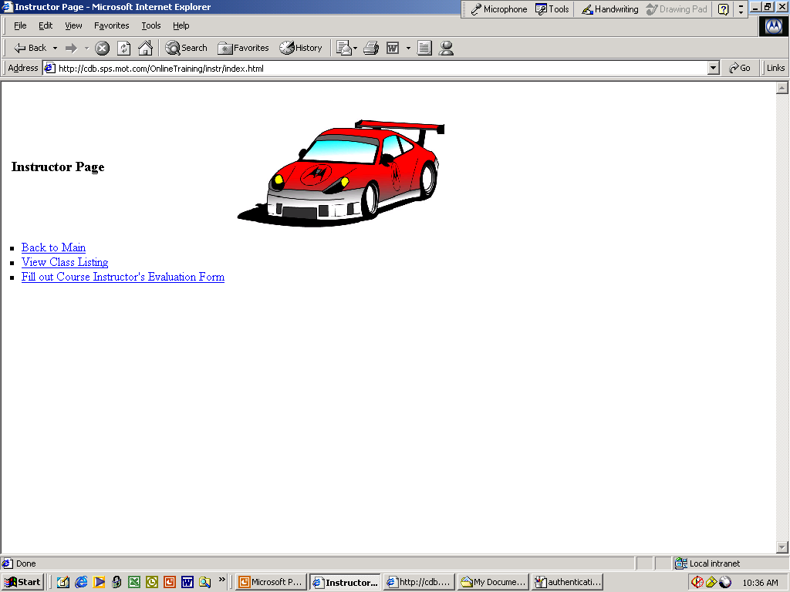
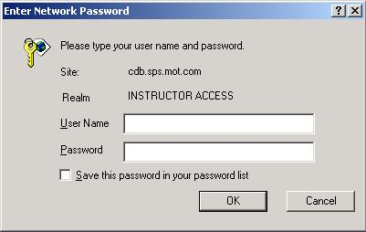
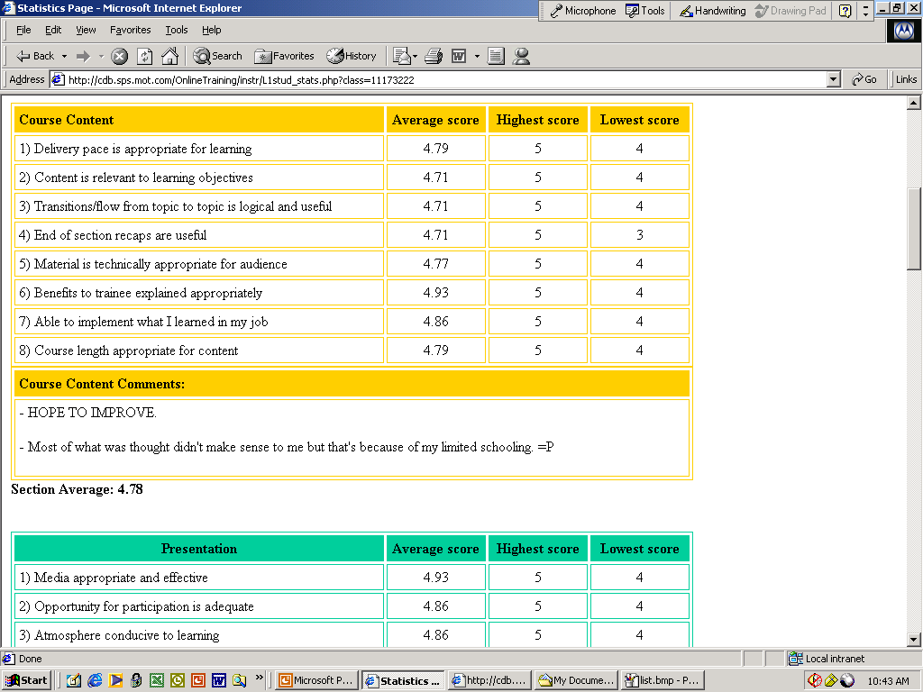
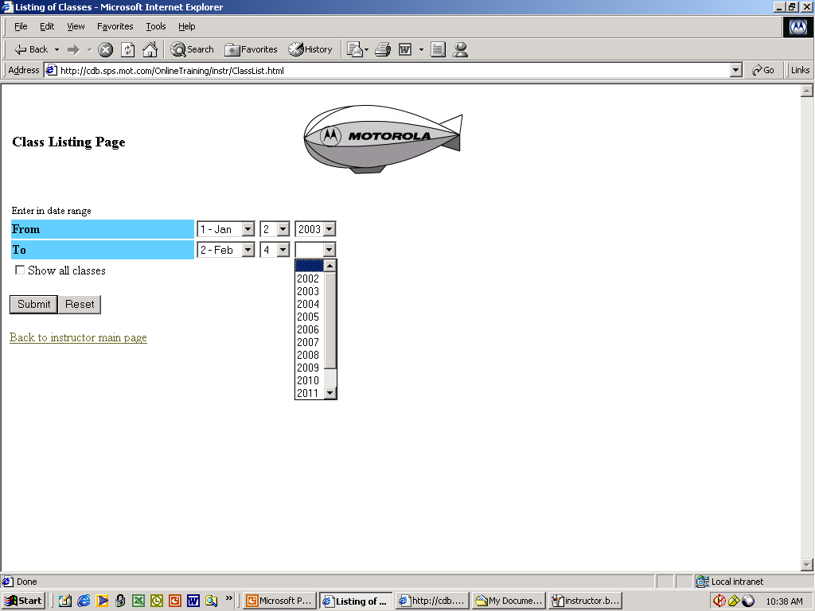
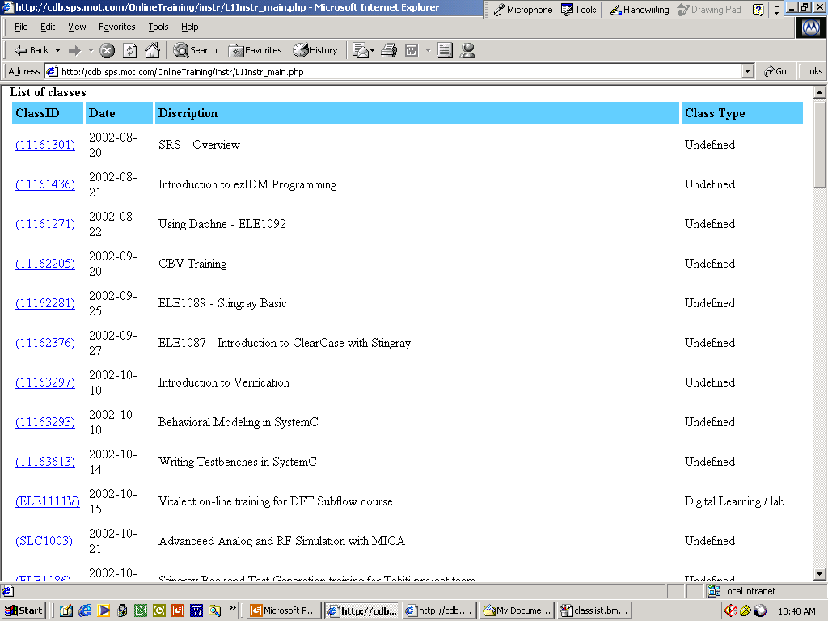

Slide 8

Accomplishments
Implemented new forms
Organized data per individual user
Implemented Password protection
Modified Delete class feature
Enhanced system with more colors!
Improved Readability / Better user interface (Questions with answers)
Developed a more polished system
Skills used: mySQL, PHP, HTML

Slide 9



SoC Web Consolidation Project
Objective is to reduce the total number of viewable web pages, simplify navigation of the site, and create a central and beneficial website everyone will use.
Communication
Stop and talk about it!

Slide 10
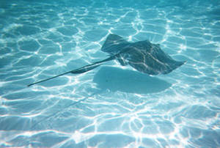


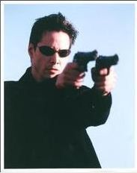

Stingray Basic Training
+ More relevant to education
+ Interesting!

Slide 11
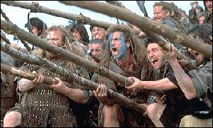



Other Activities this Summer
Manual Labor
Week
Motovate Intern Leadership Conference
Other companies
Motorola Interns

Slide 12
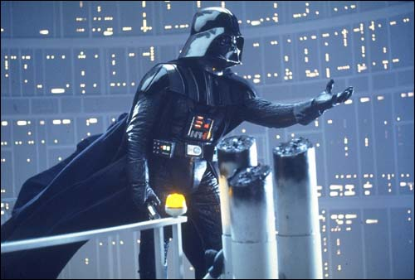
Intern Leadership Conference
Learn to be a great leader!
Motovate 2003

Slide 13
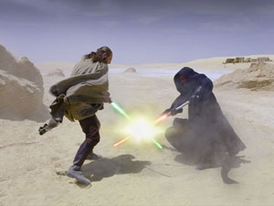
Challenges
Did you experience any challenges or conflicts? If so, how did you handle those and what was the result?
How has your experience differed from the expectations you had before the summer began?

Slide 14

Thank You!

