Slide 1

Oliver's Presentation IV
The Return of Oliver... Again

Slide 2



About Me
4th Internship
Junior @ UT Austin
Computer Science

Slide 3

Initial Plans
Learn Python to work with OpenAccess Python API
Write various programs using Python to test the OA/Python API and examine how useful it could be.

Slide 4

What is OpenAccess?
Database to store chip design data
Uses an open standard API
Community effort driven

Slide 5
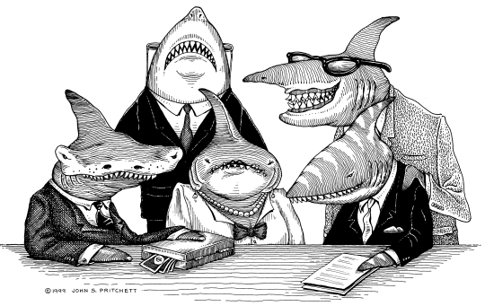

The Bane of my Internship
Lawyers.
Disclaimer: I don’t actually hate lawyers. I am sure they provide a helpful resource to Motorola and promote our general well-being. =)

Slide 6

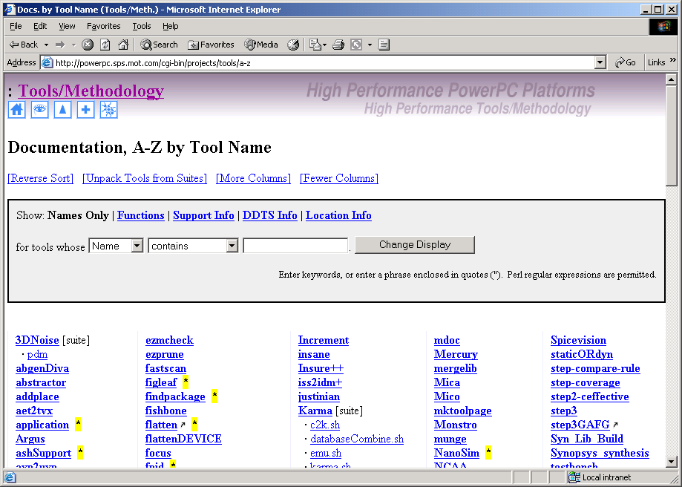
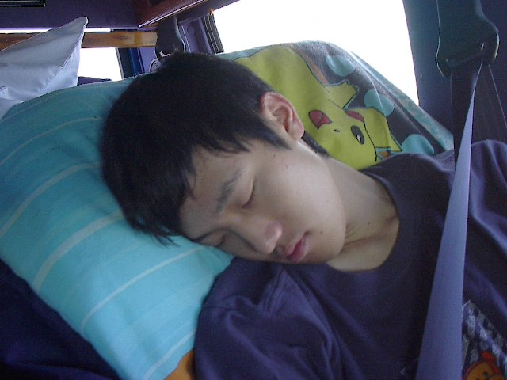
While I was waiting…
XML -> S-expressions Converter
Updated Tools Documentation
website to parse XML files
C++ Event Handler
ZZZZzzzzz…

Slide 7
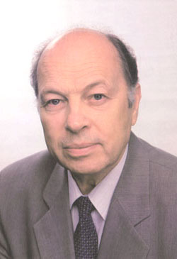

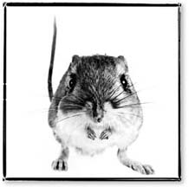
OA/Python Arrives!!
Simple OA/C++ -> OA/Python scripts
OA/Python Dumper(s)
OA/Python VIM Dumper

Slide 8

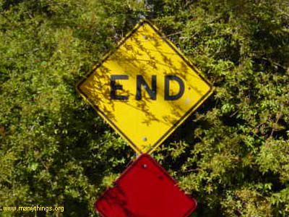
Questions?

