Slide 1

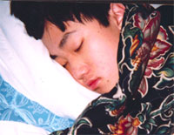
Oliver's Presentation
Accurate representation of work at Motorola.. just kidding. =)

Slide 2

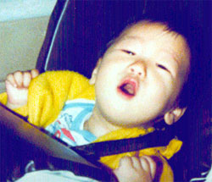
Background
-Just graduated from high school
-Worked at Motorola last summer

Slide 3

Projects
- Web "stuff"
- C++ programming
- Web-based check in/out library system
[oliver] make
g++ main.C -o main
[oliver]

Slide 4
What I learned...
- Developer/Customer interaction
- Teamwork/help
- More programming know-how
- Differences between high school and Motorola =)

