Slide 1
Regression 3 Ways
Oliver Will
DataPhilly Workshop
2020-02-18
https://github.com/owill/DataPhilly20210218

Slide 2
About me
PhD in applied mathematics from University of Southern California
Post doc in the statistics department of the University of Washington
Market researcher for 15 years
Currently at Kantar
Previously at IQVIA
Interest in programming languages

Slide 3
Outline of the presentation
Refresher on linear regression
Do the same simulation, visualization, regression, and analysis 3 times in
R
Python
Julia
Might not get to logistic regression
Beginner workshop, but we’re going to go fast

Slide 4
Three statistical programming languages
R
1995
Graduate class in S-PLUS in 1997 and learned about R
Scheme with Fortran subroutines
Open source version of S-PLUS
Python
1991
Programming as a postdoc in 2001. Tried Perl and Python
C scripting language
Julia
2009
Learned it for this presentation out of curiosity
?, but Hadoop is on the scene
Try to stay away from a discussion of which language is best

Slide 5
Why Julia?
Today on LinkedIn
2,344 Python jobs in Philadelphia
131 Python data scientist jobs
1,798 R jobs
12 Julia jobs
Look at this article
https://www.hpcwire.com/2020/01/14/julia-programmings-dramatic-rise-in-hpc-and-elsewhere/
Might be a great language to mine Ethereum in

Slide 6
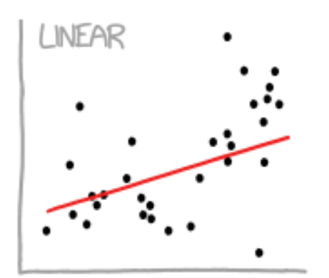
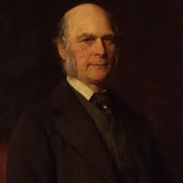
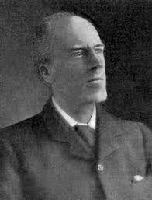
Linear regression refresher
Francis Galton, 1822-1911
First linear regression
Karl Pearson, 1857-1936
Correlation
Notes:
Biography.com

Slide 7
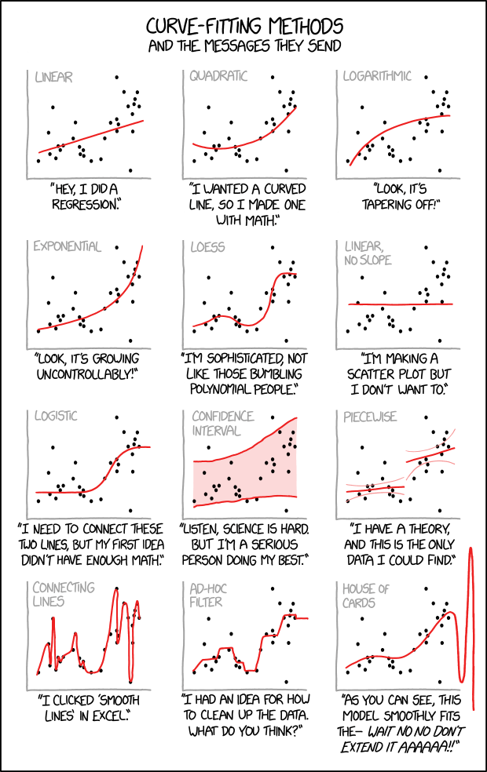
Xkcd: Curve-Fitting comic
Randall Monroe https://xkcd.com/2048/

Slide 8
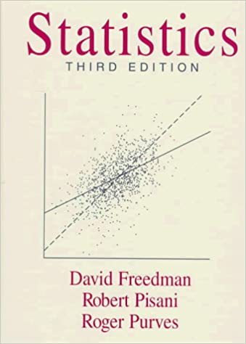


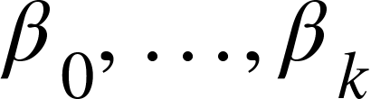
Refresher on the theory of linear regression
One variable called the response
One or more called predictors
One or more coefficients
All the numbers are continuous, -∞ to +∞

Slide 9

Data for a linear regression
n observations
n responses, y
k+1 coefficients, 𝛽
n x (k+1) predictors, x (and the ones!)
See how the data are represented in the 3 languages

Slide 10


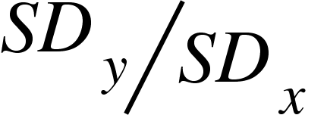
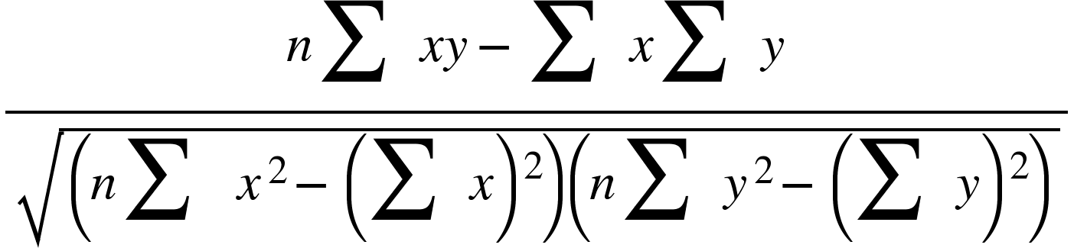
Desirable properties of a relationship of x to y through 𝛽
Follow Freedman, Pisani, and Purves (one predictor k = 1)
Mean of x be at the mean of y
Spread of x maps to the spread of y
Change of x leads to what average change in y
are on the line

Slide 11
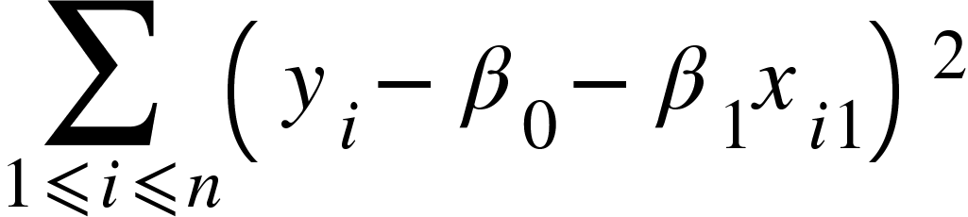
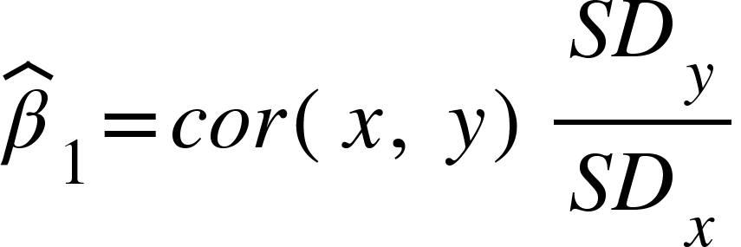
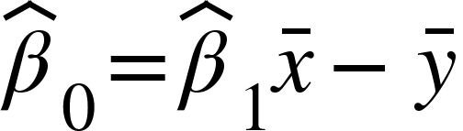
How do we get these desirable properties?
Find 𝛽 that minimizes the sum of squares between the predictors and response. Ordinary least squares (OLS).
Vector calculus problem. You get this solution

Slide 12
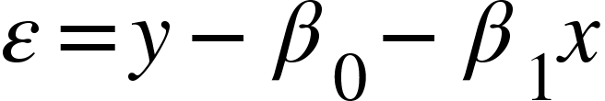
What are the key assumptions of linear regression?
LINE
L - Linearity
I - Independence of errors
N - Normality
E - Equality of errors
Gelman - Statistical Modeling, Causal Inference, and Social Science
Validity. Data should answer research question
Linearity and additivity
Independence of errors
Equal variance of errors
Normality of errors
Further assumptions if looking for causality
If you are concerned 3 and 4, you should do a hold-out sample as well
https://statmodeling.stat.columbia.edu/2013/08/04/19470/

Slide 13
Assumptions for linear regression
Assumptions by Gelman are presented in order of importance
0 feels like common sense
Assumptions 1 and 2 are the most important for using linear regression
Reason for introducing desirable properties
Assumptions 3 and 4 are mainly for individual value prediction
I create a lot regressions and almost never check 3 and 4
R² is a useful and not used for model checking
Maybe linear regression should be used as a descriptive statistic?

Slide 14
Continue in JupyterLab. . .

Slide 15
Observation
R
Amazed at the variety of syntax
My speed at getting things done
Python
Disappointed to extract data from Pandas into Scikit-Learn
Focusing on the object type leads the way
Julia
Impressed by the consistency
Only one with most recent version
Wonder what Spark.jl is like?
Surprised at how much I liked Jupyter Notebooks. I probably would remove Anacondas from my workflow if I were using Python or Julia more

Slide 16
Polls
If this were a live presentation, I’d be asking you these polls

Slide 17
Where are you in your career?
Academic
Private industry
Volunteer / hobby / interest
Student

Slide 18
Which statistical programming language do you use?
R
Python
Julia
Spark or Hadoop environment (including Java and Scala)
Closed source statistical (SAS, Stata, Eviews, etc.)
Mathematical/numerical (Mathematica, Matlab, Octave, etc.)
Excel
Other

