Slide 1
CareTrack Database for Nursing Home: Autumn Lake Healthcare
Presented by: Sarah Welsh, Darrel Abang, Oreoluwa Williams, & Jaelyn McCracken

Slide 2
Intro: Autumn Lake Healthcare
Privately owned management that provides care for older patients after accidents or surgeries
Nursing homes are important for people who need assistance with everyday living. Staff includes doctors and nurses who must oversee the medical care, activities, and status of patients
A personalized care plan is created based on this assessment to meet each resident's particular needs
It's important to keep accurate records of care plans, drug administration records, medical records, and other pertinent data for the residents. This guarantees resident care management efficiency, order, and compliance with regulations.

Slide 3
Process Modeling Requirements
The Nursing home has patients and many levels of Staff in it. Staff is categorized into Nurses, Doctors, and Management.
Staff has attributes such as Name (First Name, Last Name), Address, Phone Number, DoB, Gender, SSN, Schedule, Salary, StaffType and Staff ID (unique for each staff member).
Patient has Information such as Name (First name, Last Name), Gender, RoomNo, Date of Birth, SSN (unique for each patient), and StartDate.
Each patient has Guests, and the Guest could be a Visitor or an EmergencyContact.
The Guest contains Information such as Name (First Name, Last Name), Relationship, PhoneNo, Email, and a unique GuestID.

Slide 4

Data Modeling Requirements
Allow user to manually input information for patients, staffs, guests, room assignments, guests, medical conditions, and diagnoses.
Allow user to manually search, create, and update all the above information.
Allow user to generate list of patients, staffs, guests, medical records, room assignments, etc.
Allow user to create patient information for medical records, caretaking, and incidents of emergency.
Allow user to produce list of patients with diagnoses and medications.
There are many other user requirements that this database will generate.

Slide 5
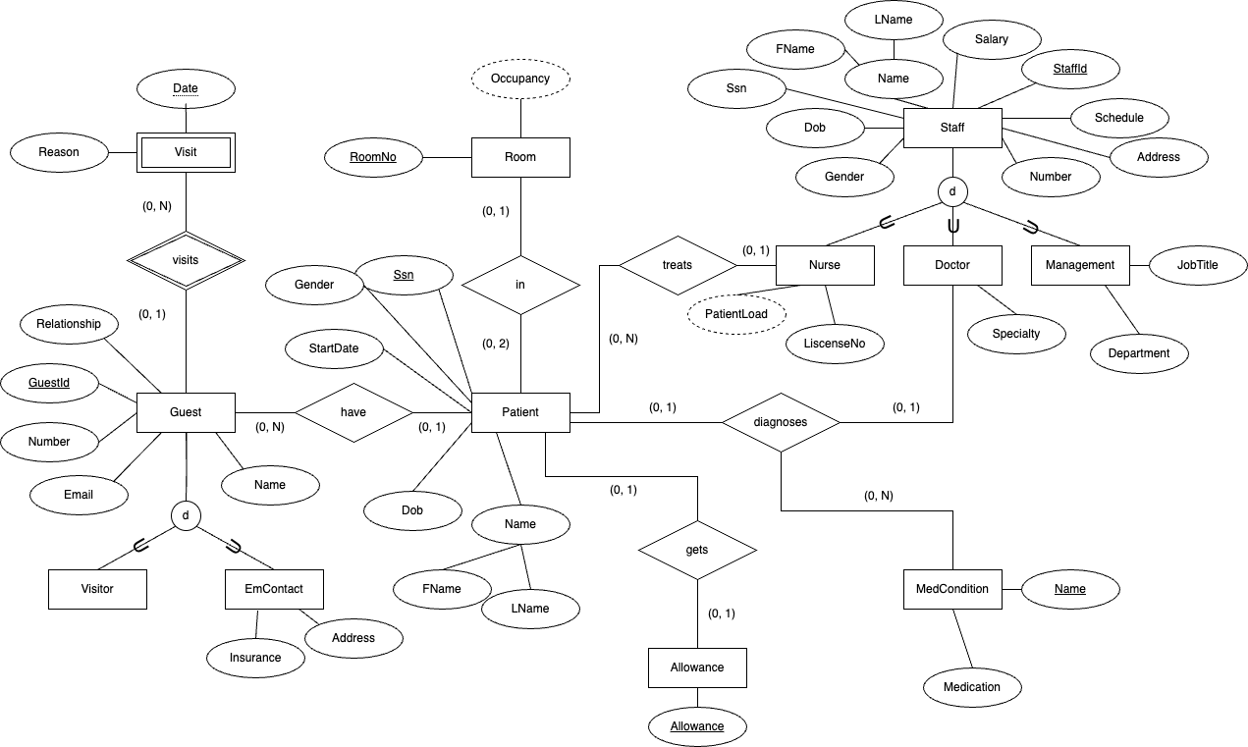
ERD

Slide 6
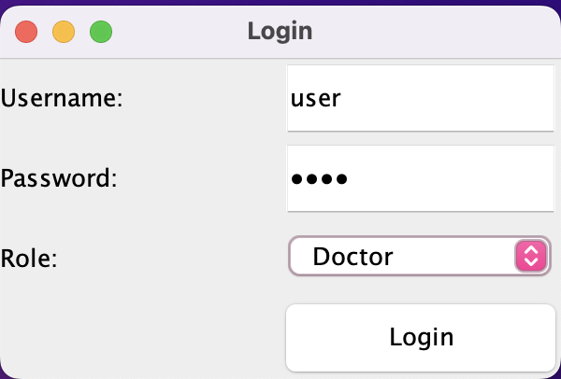
Login Page

Slide 7
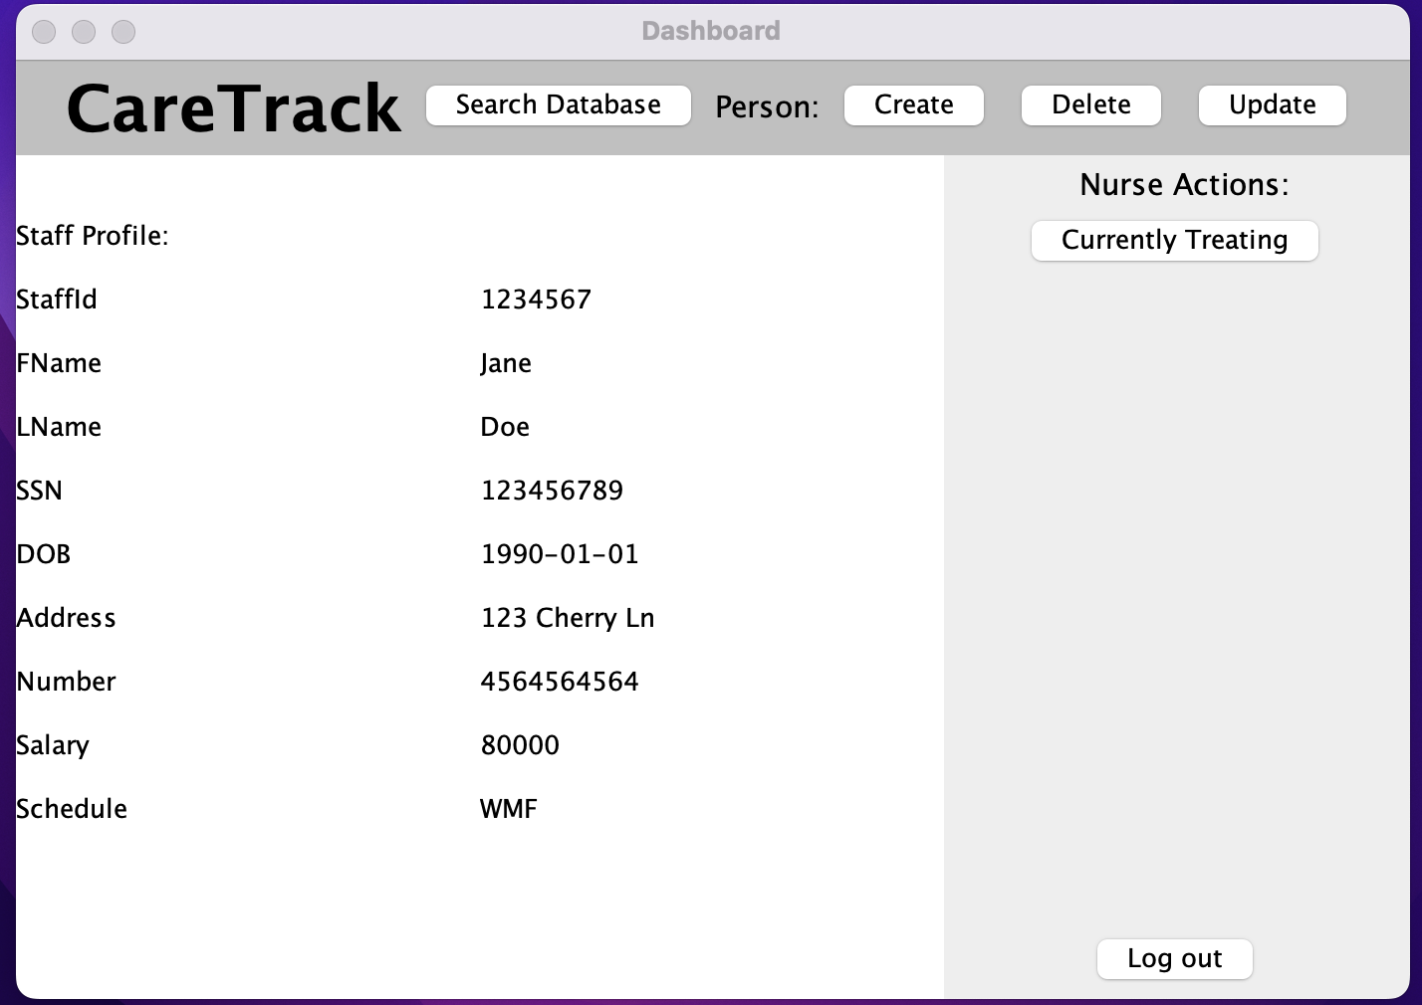
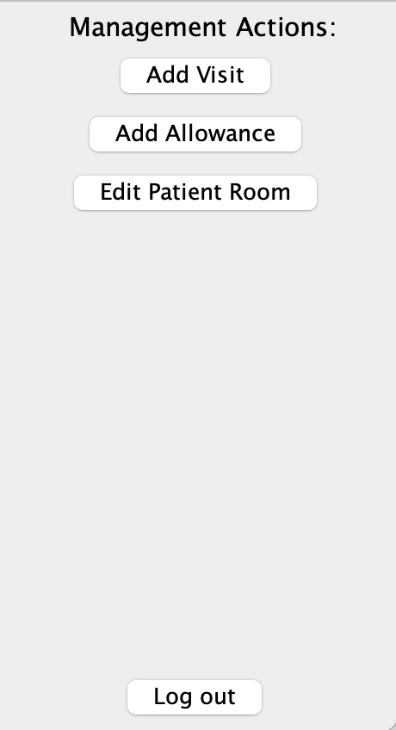
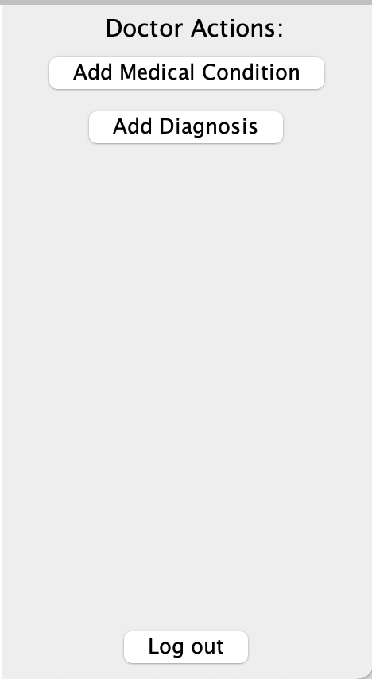
Dashboard

Slide 8
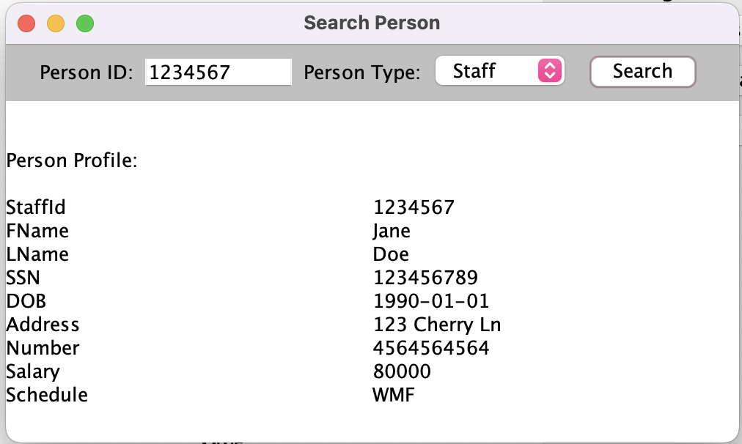
Search Page

Slide 9
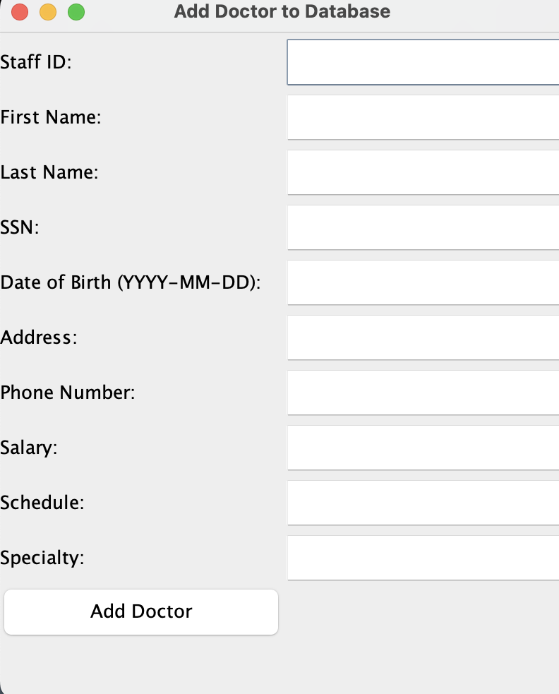
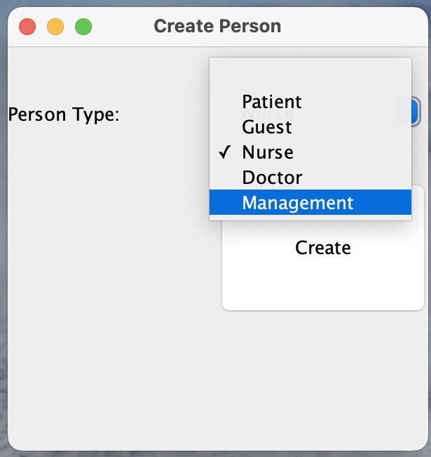
Create Page

Slide 10
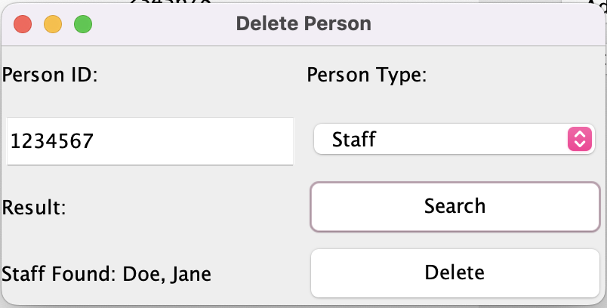
Delete Page

Slide 11
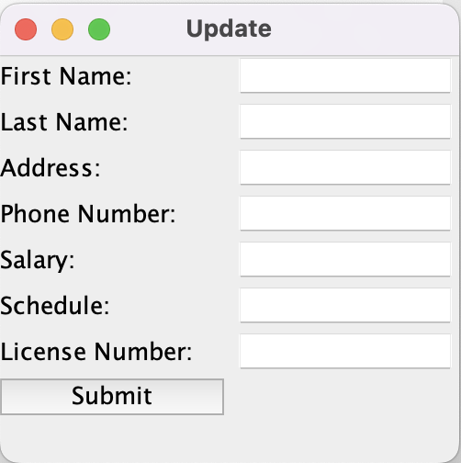
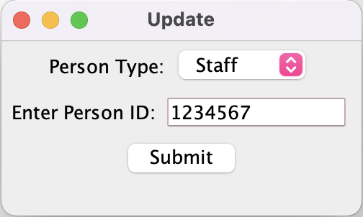
Update Page

Slide 12
Next Steps
Keep working on and implementing 'Create' page
Include all information on 'Search' page. For ex: diagnosis, who is assigned to what nurse or doctor, medication, etc

Slide 13
Thank You

