Slide 1

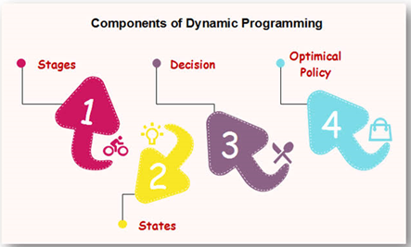
Dynamic Programming
Cse-237 : Algorithm design and analysis

Slide 2
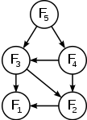
Finding a solution
Divide-and-Conquer Algorithms : Split a problem into separate (independent) sub-problems, solve the sub-problems, and combine the results for a solution to the original problem.
Can be thought of as top-down algorithms
Example : The sub-problem graph for the Fibonacci Sequence

Slide 3
Finding a solution …
Dynamic Programming Algorithms : proceeds by solving small (overlapped) sub-problems, remembering the results, then combining them to find the solution to larger problems.
can be thought of as bottom-up algorithm
For example, consider the recursive formulation for generating the Fibonacci series: F_{i} = F_{i−1} + F_{i−2}, with base case F₁ = F₂ = 1. Then F₄₃ = F₄₂ + F₄₁, and F₄₂ = F₄₁ + F₄₀. Now F₄₁ is being solved in the recursive sub-trees of both F₄₃ as well as F₄₂.

Slide 4
introduction
Bellman. Pioneered the systematic study of Dynamic Programming (DP) in the 1950s.
DP applies to optimization problems in which a set of choices must be made in order to arrive at an optimal solution.
As choices are made, subproblems of the same form arise – overlapped subproblems.
DP is effective when a given problem may arise from more than one partial set of choices.
The key technique is to store the solution to each subproblem in case it should appear – memoization process

Slide 5
Elements of dynamic programming
Two key elements of Dynamic Programming are – optimal substructure and overlapping subproblems
Steps to solve using Dynamic Programming :
Characterize the structure of an optimal solution – an optimal solution to a problem (instance) contains optimal solutions of subproblems
Recursively define the value of an optimal solution – a recursive solution contains a “small” number of distinct subproblems repeated many times

Slide 6
Elements of dynamic programming …
Memoization/Tabulation algorithm – after computing a solution to a subproblem, store it in a table. Subsequent calls check the table to avoid redoing work.
Compute the value of an optimal solution in a bottom-up fashion
Construct an optimal solution from computed information
Dynamic Programming reduces computation by
Solving subproblems in a bottom-up fashion.
Storing solution to a subproblem the first time it is solved.
Looking up the solution when subproblem is encountered again.

Slide 7
Dynamic Programming Applications
Application areas:
Bioinformatics
Control Theory
Information Theory
Operations research
Graphics, AI, Systems …

Slide 8
Dynamic Programming Applications …
Some famous algorithms:
Viterbi for Hidden Markov Models (HMMs)
Unix diff for comparing two files
Smith-Waterman for sequence alignment
Bellman-Ford for shortest path routing in networks
Cocke-Kasami-Younger for parsing Context Free Grammars (CFG)

Slide 9
Dynamic Programming Applications …
Some famous
Computing a binomial coefficient
Longest common subsequence
Warshall’s algorithm for transitive closure
Floyd’s algorithm for all-pairs shortest paths
Constructing an optimal binary search tree
Some instances of difficult discrete optimization problems: traveling salesman, knapsack

Slide 10
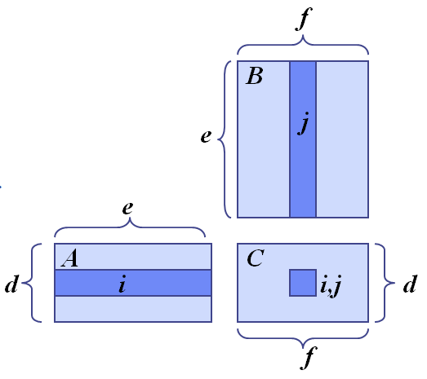
Matrix-chain multiplication
Problem : Given a sequence of matrices A₁ A₂ … A_{n}, with A_{i} of dimension m_{i}×n_{i}, insert parenthesis to minimize the total number of scalar multiplications.
Review: Matrix Multiplication C = A * B
Dimensions of A and B are d x e and e x f
Computational complexity is O(d⋅e⋅f )

Slide 11
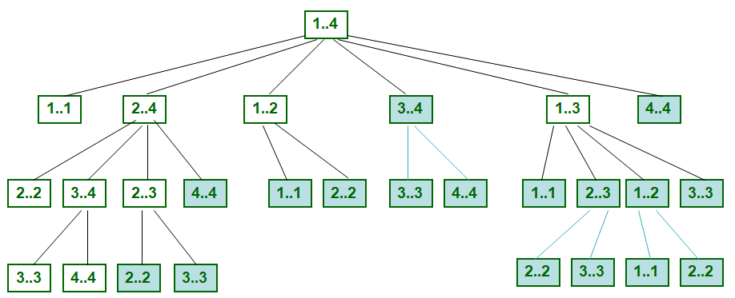
Overlapped subproblems

Slide 12
Tabulation vs Memoization
Two different ways to store the values so that the values of a subproblem can be reused
Tabulation (Bottom Up) and Memoization (Top Down)
Problem : Let’s describe a state for our DP problem to be dp[x] with dp[0] as base state and dp[n] as our destination state. So, we need to find the value of dp[n].
Bottom Up approach - start the transition from the bottom base state i.e dp[0] and follow the state transition relation to reach the destination state dp[n].
Top Down approach - start the transition from the top destination state i.e dp[n] and follow the state transition relation from which the destination state dp[n] can be reached.

Slide 13
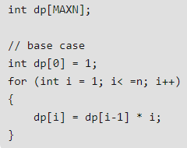
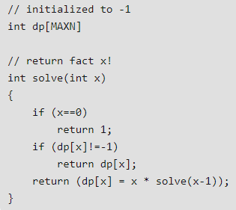
Tabulation vs Memoization …
Factorial of a number : Define a state as dp[x], where dp[x] is to find the factorial of x number, i.e. dp[x] = dp[x-1] * x
Tabulated version
Memoized version

Slide 14
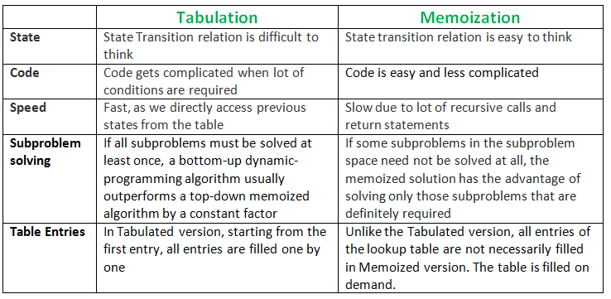
Tabulation vs Memoization …

Slide 15

Top-down vs bottom-up process
Problem : Interpret the words – though the second letter in each word is ambiguous.
Solution : Which one process will lead to the solution – TOP-DOWN or BOTTOM-UP?

Slide 16
Matrix-chain multiplication solution
Greedy Approach : repeatedly select the product that uses the most operations.
Counter-example :
Sequence of Matrices : A₁ A₂ A₃ A₄
Dimensions : 10 x 5, 5 x 10, 10 x 5, 5 x 10
Greedy solution : (A₁ * A₂) * (A₃ * A₄ ) which takes 500 + 500 + 1000 = 2000 ops
Optimal solution : A₁ * ( A₂ * A₃ ) * A₄ ) which takes 250 + 250 + 500 = 1000 ops

Slide 17
Matrix-chain multiplication solution …
Greedy Approach : repeatedly select the product that uses the fewest operations.
Counter-example :
Sequence of Matrices : A₁ A₂ A₃ A₄
Dimensions : 20 x 10, 10 x 5, 5 x 10, 10 x 15
Greedy solution : A₁ * ( ( A₂ * A₃ ) * A₄ ) which takes 500 + 1500 + 3000 = 5000 ops
Optimal solution : ( A₁ * A₂ ) * ( A₃ * A₄ ) which takes 1000 + 750 + 1500 = 3250 ops

Slide 18
Matrix-chain multiplication solution …
DP Approach : Given a chain of matrices ⟨A₁, A₂, …, A_{n}⟩, where A_{i} has dimensions p_{i-1} x p_{i}, fully parenthesize the product A₁ ⋅ A₂ ⋅⋅⋅ A_{n} in a way that minimizes the number of scalar multiplications.
Define subproblems : sub-optimal parenthesization (op)
Let A_{i...j} where i ≤ j, denote the matrix product A_{i} A_{i+1} ... A_{j}
Any parenthesization of A_{i} A_{i+1} ... A_{j} must split the product between A_{k} and A_{k+1} for i ≤ k < j.
A₁ ⋅ A₂ ⋅⋅⋅ A_{i} ⋅ A_{i+1} ⋅⋅⋅ A_{n}
p₀ x p₁ p₁ x p₂ p_{i-1} x p_{i} p_{i} x p_{i+1} p_{n-1} x p_{n}

Slide 19
Matrix-chain multiplication solution …
Characterizing Equation : optimal cost N_{i} _{j} for the subproblem A_{i} A_{i+1} ... A_{j} can be defined as
Recall that A_{i} is a d_{i-1} × d_{i} dimensional matrix.
Note that subproblems are not independent, - the subproblems are overlapped.

Slide 20
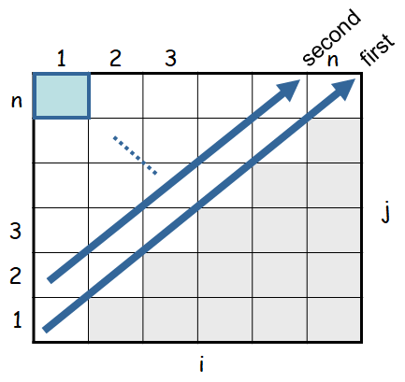
Computing the Optimal Costs
Length = 1: i = j, i = 1, 2, …, n
Length = 2: j = i + 1, i = 1, 2, …, n-1
0 if i = j
m[i, j] = min {m[i, k] + m[k+1, j] + p_{i-1}p_{k}p_{j}} if i < j
^{i≤k<j}
m[1, n] gives the optimal
solution to the problem

Slide 21
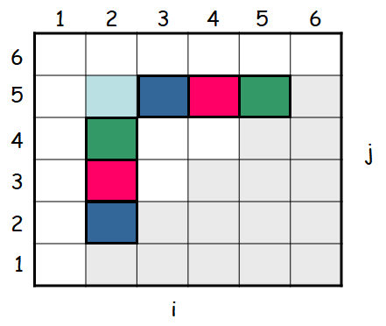
Computing the Optimal Costs …
m[2, 2] + m[3, 5] + p₁p₂p₅
m[2, 3] + m[4, 5] + p₁p₃p₅
m[2, 4] + m[5, 5] + p₁p₄p₅
k = 2
m[2, 5] = min
k = 3
k = 4
Values m[i, j] depend only on values that have been previously computed

Slide 22
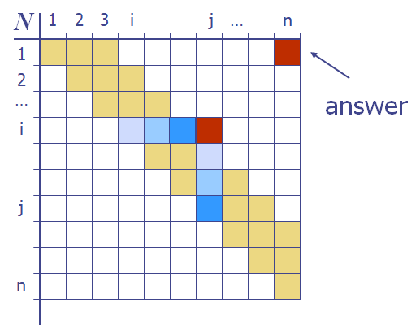
Mcm solution using dp
The bottom-up construction fills in the N array by diagonals.
N_{i,j} gets values from previous entries in i^{th} row and j^{th} column.
Filling in each entry will take O(n) time.
Total run time: O(n³).
Getting actual parenthesization can be done by remembering “k” for each N entry.

Slide 23
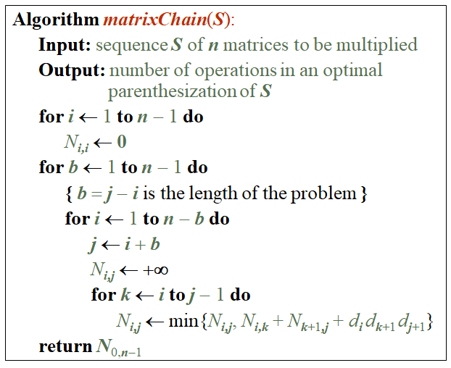
dp algorithm for mcm problem
Since subproblems are overlapped, bottom-up fashion will be faster than the recursive style.
N_{i,i}’s are easy, so start with the base states
Then do problems of “length” 2,3,… subproblems, and so on.
Running time: O(n³).

Slide 24
Working example of Mcm problem
Matrix | Dimension
A₁ | 30 x 20
A₂ | 20 x 15
A₃ | 15 x 5
A₄ | 5 x 10
A₅ | 10 x 5
A₆ | 5 x 10
m
6
s
1
5
2
j
3
i
4
4
3
2
5
1
6
0
0
0
0
0
0
A₁
A₂
A₃
A₄
A₅
A₆

Slide 25
Working example of Mcm problem
m
s
6
1
6
1
5
2
j
5
2
i
j
3
i
3
4
4
4
4
3
3
2
5
2
5
9000
1500
750
250
500
6
1
2
3
4
5
1
0
0
0
0
0
0
A₁
A₂
A₃
A₄
A₅
A₆

Slide 26
Working example of Mcm problem
m
s
6
1
6
1
5
2
j
5
2
i
j
3
i
3
4
4
4
3
4
3
4500
2500
625
500
5
2
1
3
3
5
5
2
9000
1500
750
250
500
6
1
2
3
4
5
1
0
0
0
0
0
0
A₁
A₂
A₃
A₄
A₅
A₆

Slide 27
Working example of Mcm problem
m
s
6
1
6
1
5
2
j
5
2
i
j
3
i
3
4
4
6000
2125
1250
4
3
3
2
3
4
3
4500
2500
625
500
5
2
1
3
3
5
5
2
9000
1500
750
250
500
6
1
2
3
4
5
1
0
0
0
0
0
0
A₁
A₂
A₃
A₄
A₅
A₆

Slide 28
Working example of Mcm problem
m
s
6
1
6
1
5
2
j
5
2
i
j
5125
3000
3
i
1
3
3
4
4
6000
2125
1250
4
3
3
2
3
4
3
4500
2500
625
500
5
2
1
3
3
5
5
2
9000
1500
750
250
500
6
1
2
3
4
5
1
0
0
0
0
0
0
A₁
A₂
A₃
A₄
A₅
A₆

Slide 29
Working example of Mcm problem
m
s
6
1
6
1
5
6500
2
j
5
3
2
i
j
5125
3000
3
i
1
3
3
4
4
6000
2125
1250
4
3
3
2
3
4
3
4500
2500
625
500
5
2
1
3
3
5
5
2
9000
1500
750
250
500
6
1
2
3
4
5
1
0
0
0
0
0
0
A₁
A₂
A₃
A₄
A₅
A₆

Slide 30

Construct the optimal solution
An optimal solution can be constructed from the computed information stored in the table s[1...n, 1...n].
s[i, j] = a value of k such that an optimal parenthesization of A_{i} A_{i+1} ⋅⋅⋅ A_{j} splits the product between A_{i} … A_{k} and A_{k+1} ⋅⋅⋅ A_{j}
The final matrix multiplication is
For each sub-product recursively find the corresponding value of k that results in an optimal parenthesization

Slide 31
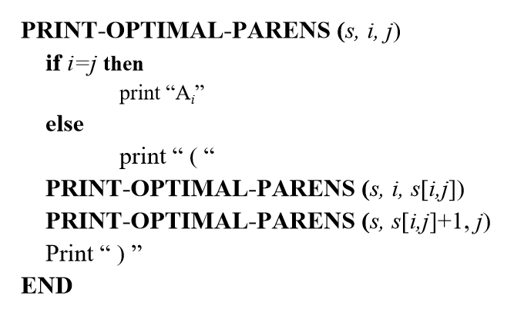
Construct the optimal solution

Slide 32
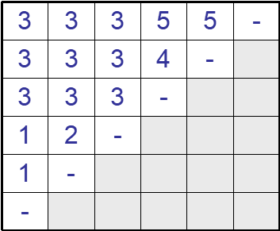
Construct the optimal solution …
1
2
3
4
5
6
6
s[1, n] = 3 ⇒ A_{1..6} = A_{1..3} A_{4..6}
s[1, 3] = 1 ⇒ A_{1..3} = A_{1..1} A_{2..3}
s[4, 6] = 5 ⇒ A_{4..6} = A_{4..5} A_{6..6}
5
4
3
j
2
1
i

Slide 33
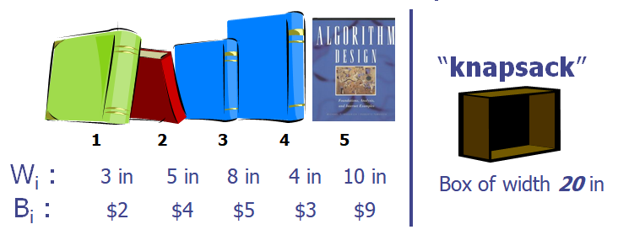
0-1 knapsack problem
Given : A set S of n items, with each item i having a positive weight, w_{i} and a positive benefit b_{i}
Goal : Choose items with maximum total benefit but with weight at most W.
Objective : maximize
Constraint :

Slide 34
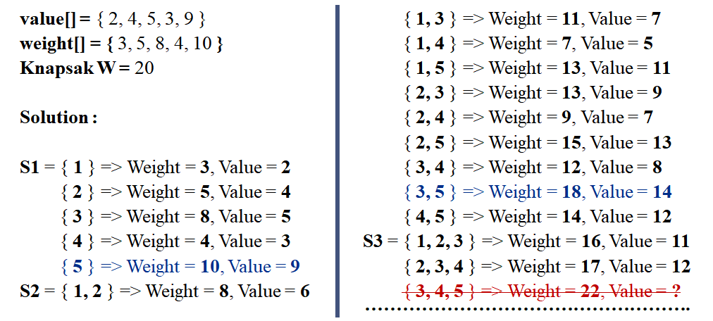
0-1 knapsack Solution

Slide 35
0-1 knapsack Solution …
Optimal Substructure : To consider all subsets of items, there can be two cases for every item: 1) the item is included in the optimal subset or 2) the item is not included in the optimal set.
The weight of k^{th} item exceeds the weight w of the knapsack – so this item cannot be included in the knapsack and the maximum benefit is B[k-1, w]
Otherwise, the benefit is the maximum achieved by either not including k^{th} item ( i.e., B[k-1, w]), or by including k^{th} item (i.e., B[k-1, w-w_{k}]+b_{k})

Slide 36
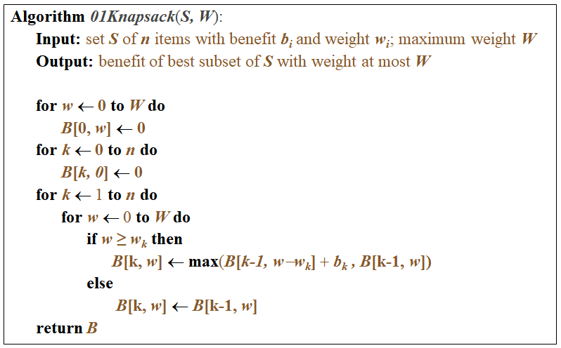
0-1 knapsack algorithm

Slide 37
0-1 knapsack algorithm – Example …
Let’s the algorithm on the following data:
n = 4 (# of elements)
W = 5 (max weight)
Elements (weight, benefit):
(2,3), (3,4), (4,5), (5,6)
i/w | 0 | 1 | 2 | 3 | 4 | 5
0 | 0 | 0 | 0 | 0 | 0 | 0
1 | 0
2 | 0
3 | 0
4 | 0

Slide 38
0-1 knapsack algorithm – Example
Characterizing Equation :
Items:
1: (2,3)
2: (3,4)
3: (4,5)
4: (5,6)
i/w | 0 | 1 | 2 | 3 | 4 | 5
0 | 0 | 0 | 0 | 0 | 0 | 0
1 | 0
2 | 0
3 | 0
4 | 0
0
3
3
3
3

Slide 39
0-1 knapsack algorithm – Example
Characterizing Equation :
Items:
1: (2,3)
2: (3,4)
3: (4,5)
4: (5,6)
i/w | 0 | 1 | 2 | 3 | 4 | 5
0 | 0 | 0 | 0 | 0 | 0 | 0
1 | 0 | 0 | 3 | 3 | 3 | 3
2 | 0
3 | 0
4 | 0
0
3
4
4
7

Slide 40
0-1 knapsack algorithm – Example
Characterizing Equation :
Items:
1: (2,3)
2: (3,4)
3: (4,5)
4: (5,6)
i/w | 0 | 1 | 2 | 3 | 4 | 5
0 | 0 | 0 | 0 | 0 | 0 | 0
1 | 0 | 0 | 3 | 3 | 3 | 3
2 | 0 | 0 | 3 | 4 | 4 | 7
3 | 0
4 | 0
0
3
4
5
7

Slide 41
0-1 knapsack algorithm – Example
Characterizing Equation :
Items:
1: (2,3)
2: (3,4)
3: (4,5)
4: (5,6)
i/w | 0 | 1 | 2 | 3 | 4 | 5
0 | 0 | 0 | 0 | 0 | 0 | 0
1 | 0 | 0 | 3 | 3 | 3 | 3
2 | 0 | 0 | 3 | 4 | 4 | 7
3 | 0 | 0 | 3 | 4 | 5 | 7
4 | 0
0
3
4
5
7

Slide 42
0-1 knapsack algorithm – Example
Optimal Cost : This algorithm only finds the max possible value that can be carried in the knapsack – i.e., the value in B[n,W]
To know the items that make this maximum value, we need to trace back through the table.
1: (2,3)
2: (3,4)
3: (4,5)
4: (5,6)
i/w | 0 | 1 | 2 | 3 | 4 | 5
0 | 0 | 0 | 0 | 0 | 0 | 0
1 | 0 | 0 | 3 | 3 | 3 | 3
2 | 0 | 0 | 3 | 4 | 4 | 7
3 | 0 | 0 | 3 | 4 | 5 | 7
4 | 0 | 0 | 3 | 4 | 5 | 7

Slide 43
More slides Will be added …

Slide 44
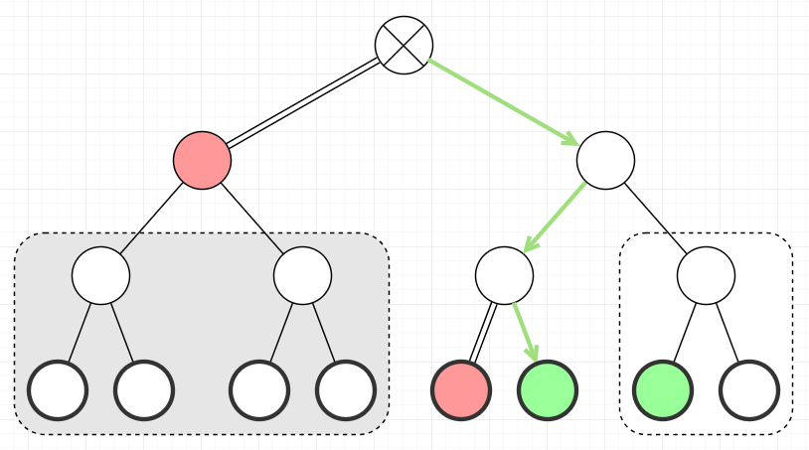
Branch-and-Bound
Explore it o NEXT DAY

