Slide 1

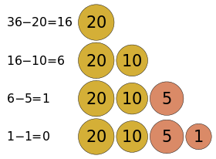
Greedy Algorithm
CSE-237 : ALGORITHM DESIGN AND ANALYSIS

Slide 2
EXAMPLE#1 – FINDING THE CHAMPIONS
Problem: Pick k scores out of n scores such that the sum of these k scores is the largest.
Algorithm:
FOR i = 1 to k
pick out the largest number and
delete this number from the input.
ENDFOR

Slide 3
EXAMPLE#2 – CONFERENCE SCHEDULING
A set of activities (conferences) – each conference has a start time and a finish time:
What is the maximum number of activities that can be completed?
Conf ID | 1 | 2 | 3 | 4 | 5 | 6 | 7 | 8 | 9 | 10 | 11
Start Time | 1 | 3 | 0 | 5 | 3 | 5 | 6 | 8 | 8 | 2 | 12
Finish Time | 4 | 5 | 6 | 7 | 8 | 9 | 10 | 11 | 12 | 13 | 14

Slide 4
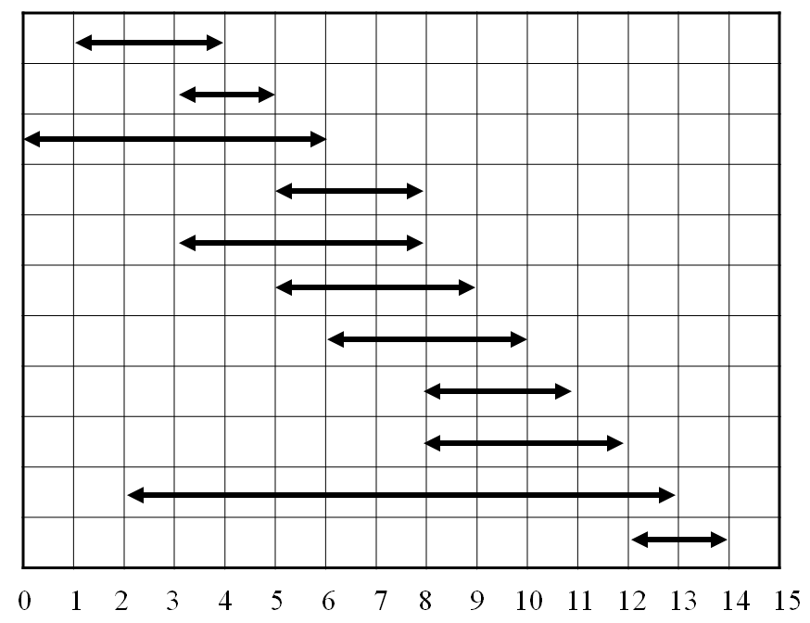
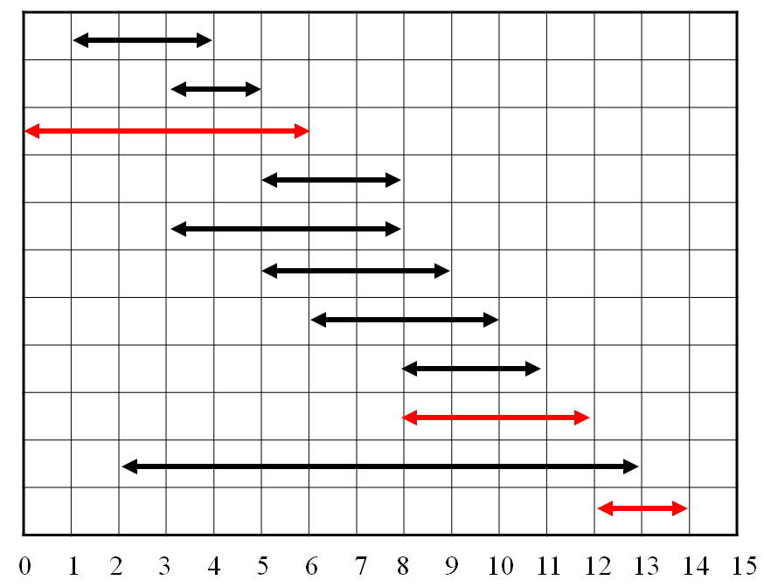
EXAMPLE#2 – CONFERENCE SCHEDULING …
INTERVAL REPRESENTATION
EARLY START STRATEGY

Slide 5
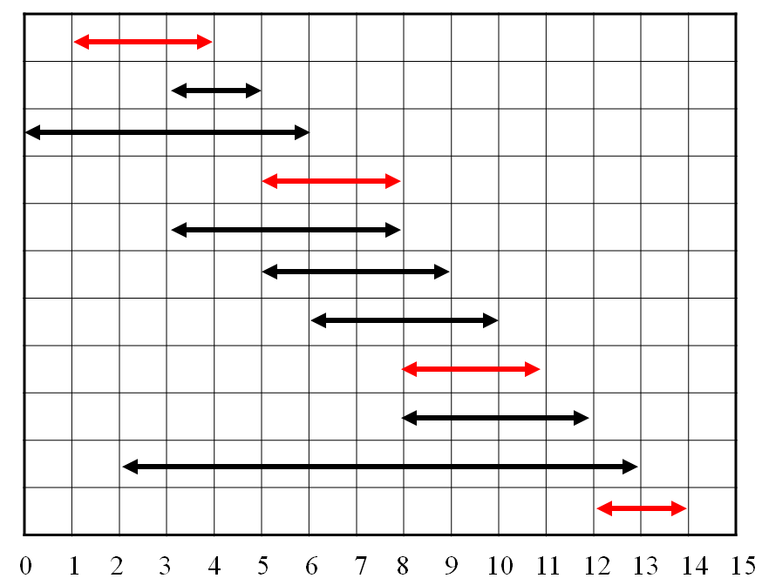
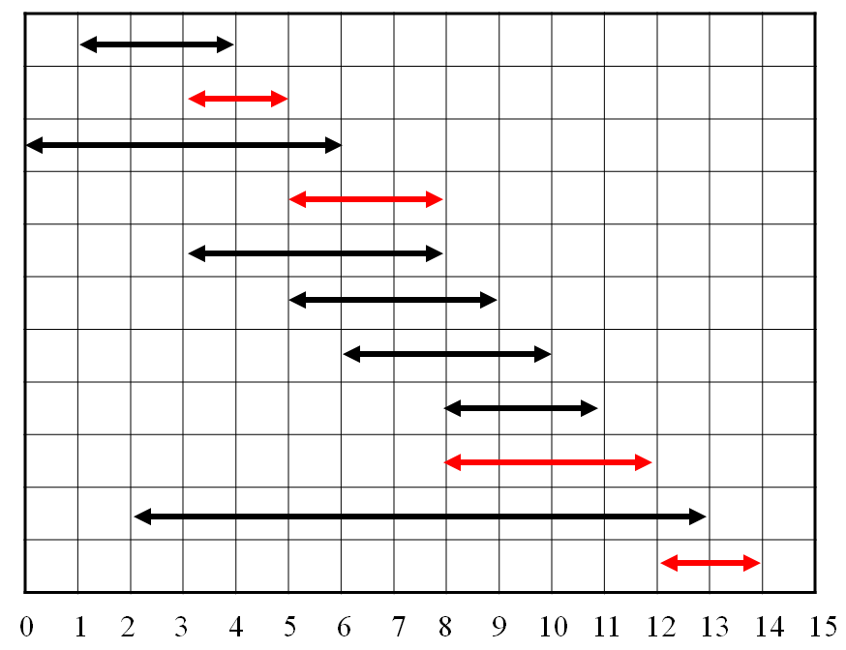
EXAMPLE#2 – CONFERENCE SCHEDULING …
EARLY FINISH STRATEGY
LATELY FINISH STRATEGY

Slide 6
WHY IT IS GREEDY?
Greedy in the sense that
it leaves as much opportunity as possible for the remaining activities to be scheduled
The greedy choice is the one that
maximizes the amount of unscheduled time remaining

Slide 7
OPTIMIZATION PROBLEMS
A problem that may have many feasible solutions and each solution has a value.
In the maximization problem - we wish to find a solution to maximize the value
In the minimization problem - we wish to find a solution to minimize the value
A greedy algorithm works in phases – taking the best solution right now, without regard for future consequences.

Slide 8
GREEDY METHOD
Greedy strategy usually progresses in a top-down fashion, making one greedy choice after another, reducing each problem to a smaller one.
Two ingredients that are exhibited by most problems that lend themselves to a greedy strategy:
Greedy-Choice property - when we have a choice to make, make the one that looks best right now.
Optimal Substructure - an optimal solution to the problem contains within it optimal solutions to sub-problems

Slide 9
GREEDY METHOD …
Characteristics of greedy algorithm:
make a sequence of choices
each choice is the one that seems best so far, only depends on what's been done so far
choice produces a smaller problem to be solved
Optimal Substructure
Greedy Choice

Slide 10
FEATURES OF GREEDY SOLUTION
To construct the solution in an optimal way, algorithm maintains two sets:
One contains chosen items (solution/candidate set) and the other contains rejected
The greedy algorithm consists of four (4) function:
Selection Function - used to chose the best candidate to be added to the solution.
Feasibility Function - checks the feasibility of a set
Objective Function - used to assign value to a solution or partial solution
Solution Function - used to indicate whether a complete solution has been reached

Slide 11
STRUCTURE OF GREEDY ALGORITHM
Initially the set of chosen items (solution/candidate set) is empty.
At each step
item will be added in a solution set by using selection function.
IF the set would no longer be feasible
reject items under consideration (and is never consider again).
ELSE IF set is still feasible THEN
ADD the current item.
A feasible set (of candidates) is promising if it can be extended to produce not merely a solution, but an optimal solution to the problem. [ An empty set is always promising why? ]

Slide 12
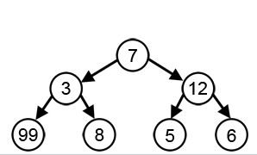
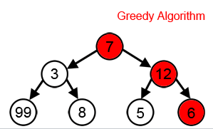
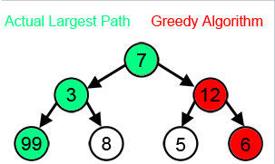
FAILURE OF GREEDY ALGORITHM
Problem #1: With a goal of reaching the largest sum
Possible Solutions
Greedy Solution
Optimal Solution

Slide 13
FAILURE OF GREEDY ALGORITHM
Problem #2: Find the minimum # of 4, 3, and 1 cent coins to make up 6 cents.
Available Cents: 4, 3, 1
Greedy Solution: 4+1+1
Better Solution: 3+3

Slide 14
APPLICATION OF GREEDY STRATEGY
Optimal solutions:
change making for “normal” coin denominations, (minimum/maximum) spanning tree, single-source shortest paths, scheduling problems, Huffman codes
Approximations
Traveling salesman problem (TSP), knapsack problem, other combinatorial optimization problems (CSP, WTAP, VRP)

Slide 15
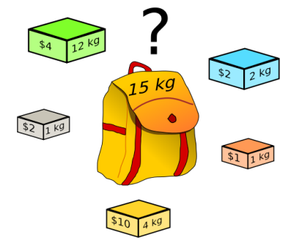
KNAPSACK PROBLEM
Statement : A thief robbing a store and can carry a maximal weight of w into their knapsack. There are n items and i^{th} item weight is w_{i} and is worth v_{i} dollars. What items should thief take?
Constraint : The knapsack weight capacity is not exceeded and the total benefit is maximal.
Variants of Kanpsack Problem:
0-1 knapsack : items are indivisible. (either take an item or not)
Fractional knapsack : items are divisible. (can take any fraction of an item)

Slide 16
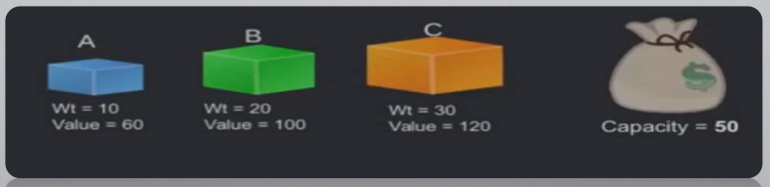
KNAPSACK PROBLEM - EXAMPLE
0-1 KNAPSACK
FRACTIONAL KNAPSACK
Take B and C
Total weight = 50
Total value = 220
Take A,B and 2/3rd of C
Total weight = 50
Total value = 240

Slide 17
KNAPSACK PROBLEM - SOLUTION
Greedy Approach
Calculate the ratio value/weight for each item.
Sort the item on basis of this ratio.
Take the item with the highest ratio and add them until we can’t add the next item as a whole.
At the end add the next item as much (fraction) as we can.
Greedy Algorithm
INPUT: AN INTEGER N
Positive values w_{i} and v_{i} such that 1 <= i <= n
Positive value W.
OUTPUT:
N values of xi such that 0 <= x+i <=1
Total profit P

Slide 18
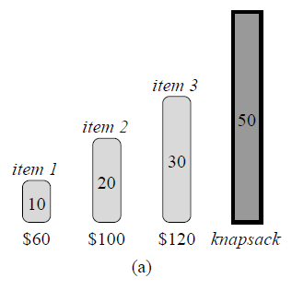
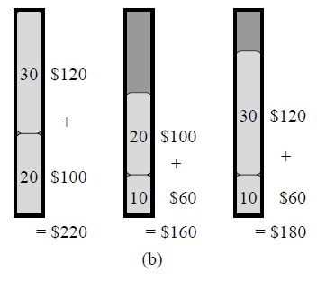
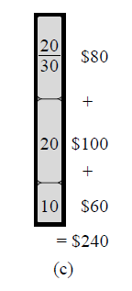
KNAPSACK PROBLEM – SOLUTION …
Knapsack Problem
0-1 Solution
Fractional Solution

Slide 19
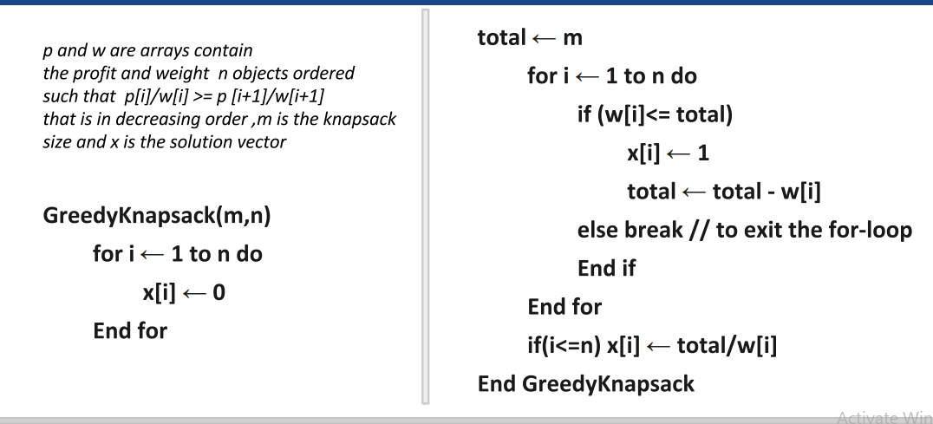
FRACTIONAL KNAPSACK - ALGORITHM

Slide 20
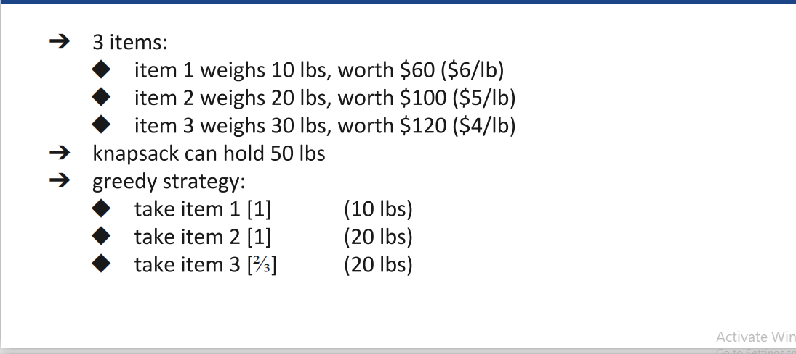
FRACTIONAL KNAPSACK - EXAMPLE

Slide 21
FRACTIONAL KNAPSACK - COMPLEXITY
If the items are already sorted into decreasing order of vi / wi, then the while-loop takes a time in O(n);
As main time taking step is sorting, the whole problem can be solved in
O(n log n) using merge/quick sort => sort: O(n log n), loop: O(n)
O(n²) using selection/bubble sort => sort: O(n²), loop: O(n)
O(n) using max-heap sort => heap: O(n) loop: O(log n)

Slide 22
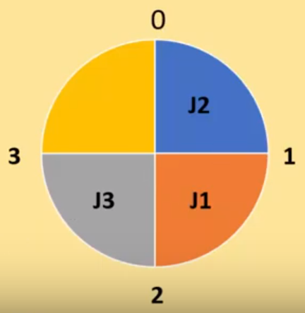
JOB SCHEDULING WITH DEADLINE
Statement : If there are a set of jobs which are associated with deadline d_{i} >= 0 and profit p_{i} > 0. For any job i the profit is earned if and only if the job is completed by its deadline.
Objective : Find a sequence of jobs, which is completed within their deadlines and gives maximum profit.
Constraint : Any job takes single unit of time to execute, any job can’t execute beyond its deadline, and only one job can be executed at a time.

Slide 23
JOB SCHEDULING WITH DEADLINE - SOLUTION
Standard Greedy Approach
SORT all the jobs based on the profit in an increasing order.
Let d be the maximum deadline that will define the size of solution array.
Create a solution array S with d slots.
Initialize the content of array S with zero.
Check for all jobs.
/* Nothing is gained by scheduling it earlier, and scheduling it earlier could prevent another more profitable job from being done */
If scheduling is possible using r^{th} slot of array S to job i having a deadline r.
Otherwise look for location (r-1), (-2)...1.
Schedule the job if possible else reject.
Return array S as the answer.

Slide 24
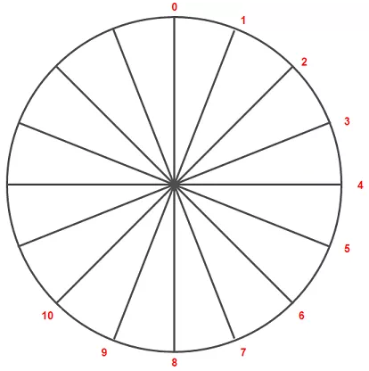
JOB SCHEDULING WITH DEADLINE - EXAMPLE
Task | Deadline | Profit
1 | 9 | 15
2 | 2 | 2
3 | 5 | 18
4 | 7 | 1
5 | 4 | 25
6 | 2 | 20
7 | 5 | 8
8 | 7 | 10
9 | 4 | 12
10 | 3 | 5

Slide 25
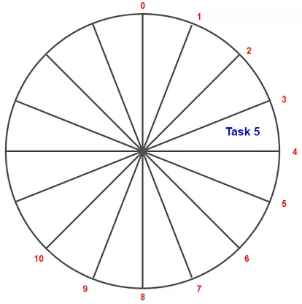
JOB SCHEDULING WITH DEADLINE - EXAMPLE
Task | Deadline | Profit
5 | 4 | 25
6 | 2 | 20
3 | 5 | 18
1 | 9 | 15
9 | 4 | 12
8 | 7 | 10
7 | 5 | 8
10 | 3 | 5
2 | 2 | 2
4 | 7 | 1

Slide 26
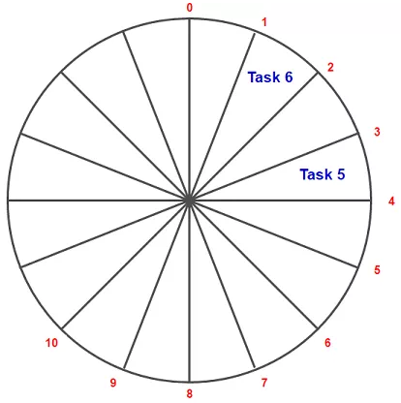
JOB SCHEDULING WITH DEADLINE - EXAMPLE
Task | Deadline | Profit
5 | 4 | 25
6 | 2 | 20
3 | 5 | 18
1 | 9 | 15
9 | 4 | 12
8 | 7 | 10
7 | 5 | 8
10 | 3 | 5
2 | 2 | 2
4 | 7 | 1

Slide 27
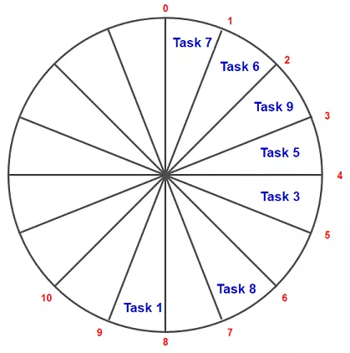
JOB SCHEDULING WITH DEADLINE - EXAMPLE
Task | Deadline | Profit
5 | 4 | 25
6 | 2 | 20
3 | 5 | 18
1 | 9 | 15
9 | 4 | 12
8 | 7 | 10
7 | 5 | 8
10 | 3 | 5
2 | 2 | 2
4 | 7 | 1

Slide 28
JOB SCHEDULING WITH DEADLINE - EXAMPLE
Task | Deadline | Profit
5 | 4 | 25
6 | 2 | 20
3 | 5 | 18
1 | 9 | 15
9 | 4 | 12
8 | 7 | 10
7 | 5 | 8
10 | 3 | 5
2 | 2 | 2
4 | 7 | 1

Slide 29
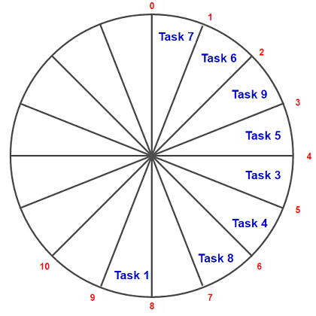
JOB SCHEDULING WITH DEADLINE - EXAMPLE
Task | Deadline | Profit
5 | 4 | 25
6 | 2 | 20
3 | 5 | 18
1 | 9 | 15
9 | 4 | 12
8 | 7 | 10
7 | 5 | 8
10 | 3 | 5
2 | 2 | 2
4 | 7 | 1

Slide 30
JOB SCHEDULING WITH DEADLINE - EXAMPLE
Task | Deadline | Profit
5 | 4 | 25
6 | 2 | 20
3 | 5 | 18
1 | 9 | 15
9 | 4 | 12
8 | 7 | 10
7 | 5 | 8
10 | 3 | 5
2 | 2 | 2
4 | 7 | 1
The scheduled jobs are
7, 6, 9, 5, 3, 4, 8, 1
Total profit is 109
Time complexity: O(n2)

Slide 31
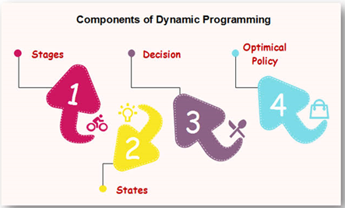
DYNAMIC PROGRAMMING
Explore it on NEXT DAY

