Slide 1
LMS
Owis Bukhari

Slide 2
LMS
This project is a learning management system (LMS) that allows instructors to create and deliver courses, students to register for and take courses, and principals to manage the courses.

Slide 3
01
02
03
Availability
Useability
Maintainability
Non-Functional Requirements

Slide 4
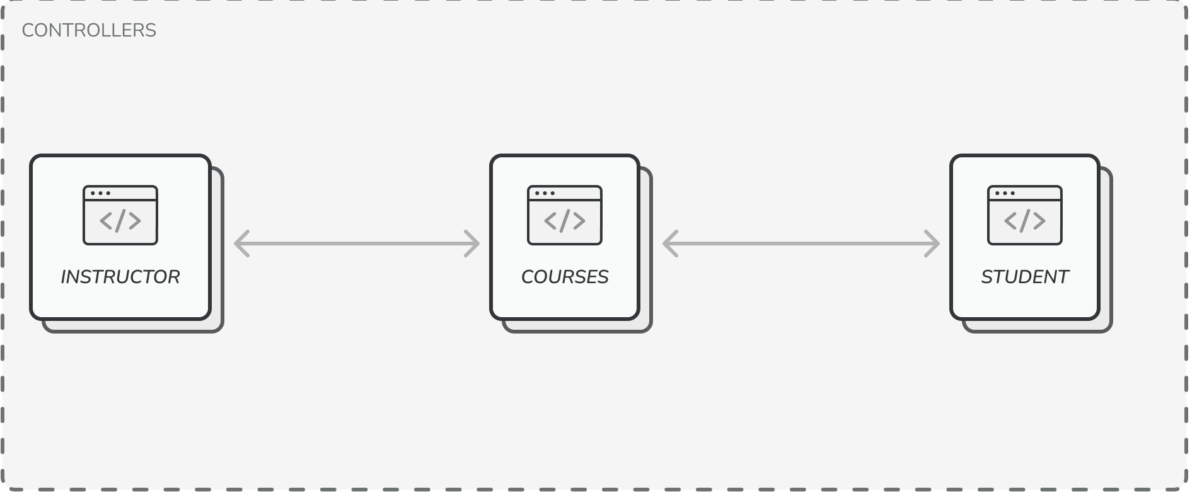
System Architecture MVC

Slide 5
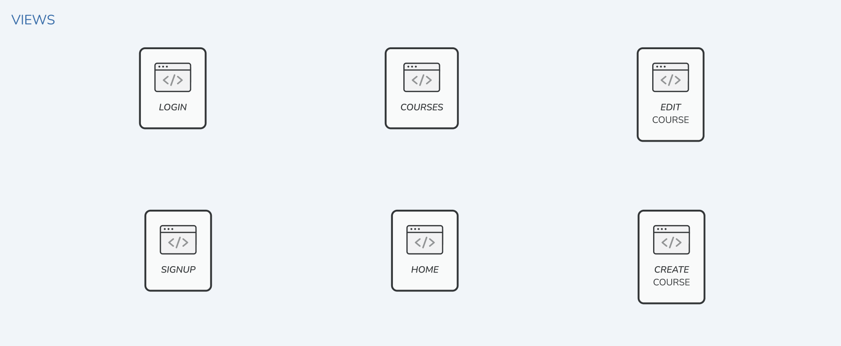
System Architecture MVC

Slide 6
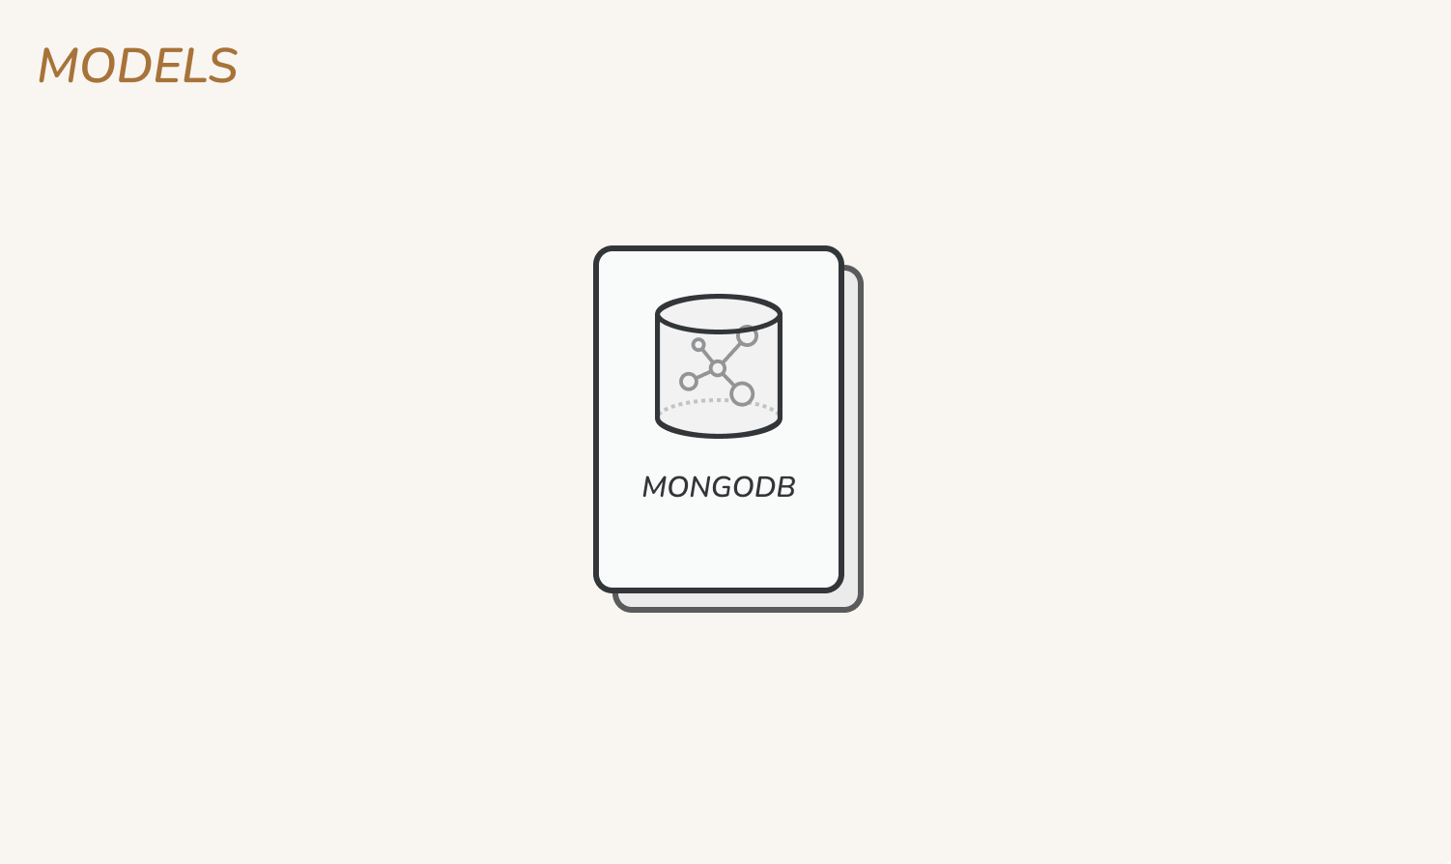
System Architecture MVC

Slide 7




Tools
NODEJS
MONGODB
EJS
TAILWIND

Slide 8
Thank You
Any Questions

