Slide 1
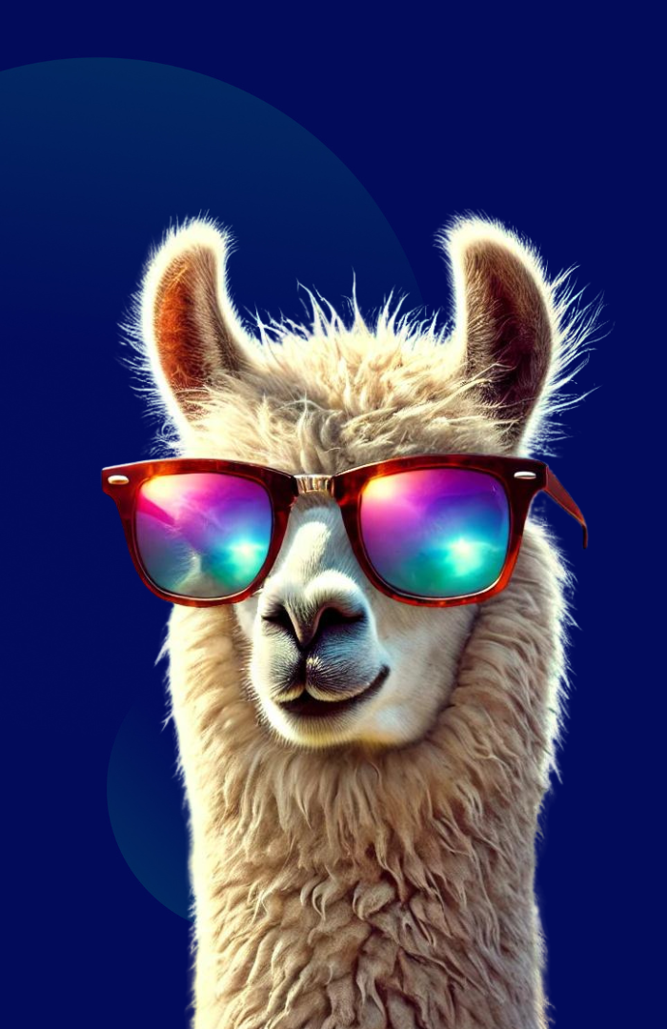
CLIChatBot
A simple, local chatbot by Llama 3.2
Takuya Ishii
26.05.2025

Slide 2
Requirements
Server-client architecture
Able to answer simple questions in accountancy
"Qu’est-ce qu’un bilan comptable ?"
"Comment calculer l’amortissement linéaire d’un bien ?"
"Quelle est la différence entre charges fixes et charges variables ?"
No external API calling, should work offline
Command-line interface

Slide 3







Architecture
Database (chat history storage)
Server
Client
(CLI interface)
LLM (llama-cpp-python)

Slide 4
Features
Limitations
Interactive command-line chat interface
Multi-lingual
Configurable system messages to customize the assistant's behavior
Conversation history management
Persistent chat history during the session
Chat history is clearable
Hallucination - caveat of 3B model
No recovery of past chat history
Not optimized for multi-session handling - file-locking by SQLite
No user-authentication
No connection to external documents (RAG capacity)
Lack of agentic capacity (code generation -> execution)

