Slide 1






HDMI
Warmup Scoreboard
Marshall Secretary
HDMI
Attempt
Board
owlcms
Competition Router
Announcer Timekeeper
Referee phones

Slide 2



HDMI extender
Announcer Scoreboard
Announcer
Main Scoreboard
Timekeeper Box
HDMI extender
4<
Timekeeper
Platform 1 Switch
publicresults
Attempt Board
USB
USB
Referee Box
Clock/Down
Remote Scoreboards
USB
Competition Router
Internet Access Router
Jury Box
Jury
HDMI extender
Video Streaming
Marshall Scoreboard
Marshal
owlcms
Warmup Scoreboard
Secretary
Video Switch
Video 1
Video 2
Platform 2 Switch
Networked Cameras (NDI)
Extra platforms are identical to Platform 1

Slide 3

HDMI
Announcer Scoreboard
Announcer
HDMI
Main Scoreboard
HDMI
Attempt Board
Timekeeper Box
4<
Timekeeper
Platform 1 Switch
publicresults
USB
USB
Referee Box
Clock/Down
Remote Scoreboards
USB
Competition Router
Internet Access Router
Jury Box
Jury
HDMI extender
Video Streaming
Marshall Scoreboard
Marshal
owlcms
HDMI
Warmup Scoreboard
Secretary
Video Switch
Video 1
Platform 2 Switch
Video 2
Extra platforms are identical to Platform 1
Networked Cameras (NDI)

Slide 4

HDMI
Main Scoreboard
Announcer
Timekeeper Box
4<
HDMI
Attempt Board
Timekeeper
USB
Platform 1 Switch
USB
publicresults
Referee Box
Clock/Down
USB
Jury Box
Jury
Internet Access Router
Competition Router
HDMI
Warmup Scoreboard
Marshal
owlcms
Video Streaming
HDMI
video
Main Scoreboard
Announcer
Timekeeper Box
HDMI
4<
Attempt Board
Timekeeper
USB
Platform 2 Switch
USB
Referee Box
Clock/Down
USB
Jury Box
Jury
HDMI
Warmup Scoreboard
Marshal

Slide 5

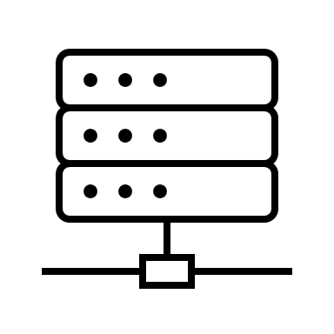

Competition Site
Scoreboards
Gym 1
Gym 2
Gym 3
Referee Phone/Tablet
owlcms
publicresults
Marshall
Announcer

Slide 6
Scoreboards
Gym 1
Gym 2
Gym 3
Referee Phone/Tablet
owlcms
publicresults
Marshall
Announcer

Slide 7
4<
USB
Timekeeper Box
Announcer
HDMI
Marshall Scoreboard
Marshal
USB
Referee Box
Clock/Down
USB
Platform 1 Switch
Publicresults fly.dev
Jury Box
Jury
HDMI
Phone/remote Scoreboards
Attempt Board
Rpi400
HDMI
Competition Router
Internet Access Cellular Router
Main Scoreboard 1
Rpi400
HDMI
Facebook Live Streaming
Main Scoreboard 2
Rpi400
owlcms
HDMI
Warmup Scoreboard
Rpi400
Secretary
OBS Video

Slide 8
4<
USB
Timekeeper Box
Announcer
HDMI
Marshall Scoreboard
Marshal
USB
Referee Box
Clock/Down
HDMI
Platform 1 Switch
Publicresults fly.dev
Attempt Board
Rpi400
HDMI
Phone/remote Scoreboards
Main Scoreboard
HDMI
Competition Router
Internet Access Cellular Router
Warmup Scoreboard
Rpi400
owlcms
Facebook Live Streaming
OBS Video
Secretary
Platform 2 Switch
Extra platforms are identical to Platform 1

Slide 9
HDMI
Announcer Scoreboard
Announcer
Timekeeper Box
4<
Timekeeper
USB
Marshall Scoreboard
Marshal
USB
Platform 1 Switch
publicresults
Referee Box
Clock/Down
USB
Phone/remote Scoreboards
Jury Box
Jury
Competition Router
Internet Access Router
HDMI
Attempt Board
HDMI
owlcms
Facebook Live Streaming
Main Scoreboard
HDMI
Warmup Scoreboard
Secretary
Video Switch
Video 1
Platform 2 Switch
Video 2
Extra platforms are identical to Platform 1
Networked Cameras (NDI)

