Slide 1
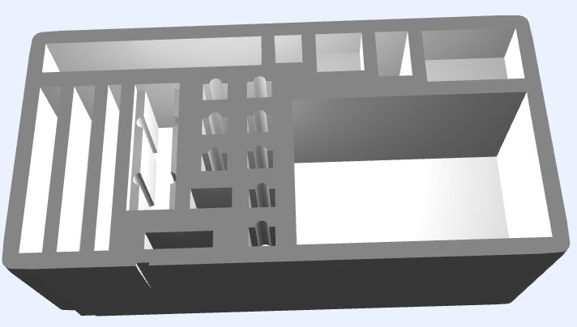
Timekeeper Controls
Down Signal
Portable Monitors x 4
Referee Hub
Jury Controls
Rpi400 computers
x 4 (marshal,
warmup room,
platform displays,
jury)
Rpi 5
keyboard
WiFi Router
Rpi 5
server with SSD (announcer + owlcms)
Referee Buttons x 3
Jury Buttons x 3 (or 5)
Cables, power supplies, monitor stands, etc. 5 x packing cube (one per role)
Ethernet Switch

