Slide 1
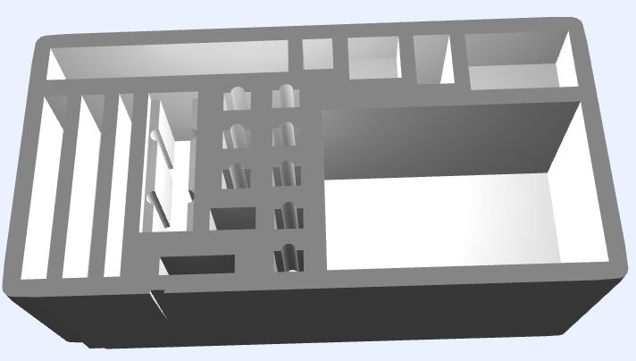
Portable Monitors x 4 (announcer, marshal, clock, jury)
Timekeeper Controls
Down Signal
Referee Hub
Jury Controls
Raspberry Pi 500 computers x 4 (marshal,
warmup room,
platform displays,
jury)
Rpi 5
keyboard
WiFi Router
Raspberry Pi 5
server with SSD (announcer + owlcms)
Referee Buttons x 3
Jury Buttons x 3 (or 5)
Cables, power supplies, monitor stands, etc. 5 packing cubes (announcer+scoreboard, marshal, warmup, clock+attempt board, jury)
Ethernet Switch

