Slide 1





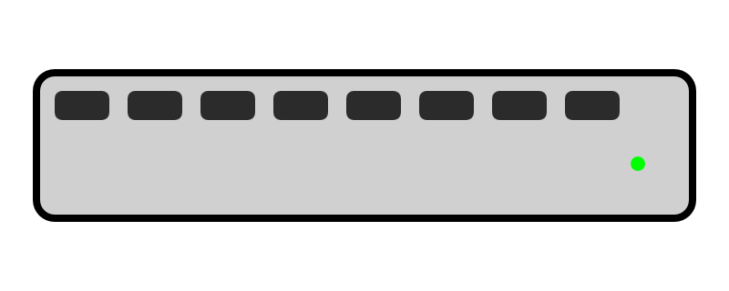


4<
USB
Timekeeper Box
Announcer + owlcms (*)
Main Scoreboard
10m HDMI
Main Attempt Board
10m HDMI
USB
Platform Switch
Competition Router
Referees + Down
Platform Clock (**)
Internet
Marshal (**)
Secretary (not included)
Warmup Scoreboard
HDMI
Warmup Room Displays (***)
Warmup Attempt Board
HDMI
* Raspberry Pi 5 with SSD and portable monitor ** Raspberry Pi 500 with portable monitor *** Raspberry Pi 500 (TVs used as monitors)
USB
Jury
Jury (**)

