Slide 1


Resilience Development in Leadership Through Direct Feedback

Slide 2
Committee Members
Committee Chair: Dr. Barnette
Methodologist: Dr. Eitutis
Subject Matter Expert: Dr. Horsley/ Dr. Barnette
Peer Reviewer: Simon Ostrander

Slide 3
Researcher positionality
Resilience is an essential trait for leadership, not just as a means to recover from challenges but as a proactive capacity to grow stronger through adversity. Direct feedback, when structured and delivered with professionalism and respect, serves as the cornerstone for fostering this resilience. Leaders must embody resilience to inspire and cultivate it within their teams.
This research is rooted in the belief that leadership is a shared journey, where feedback is a two-way process. By receiving and providing constructive feedback, leaders and team members co-create an environment of trust, accountability, and continual growth. Authentic leadership—one that respects the humanity of all team members—is the foundation of resilience and transformative feedback practices.

Slide 4
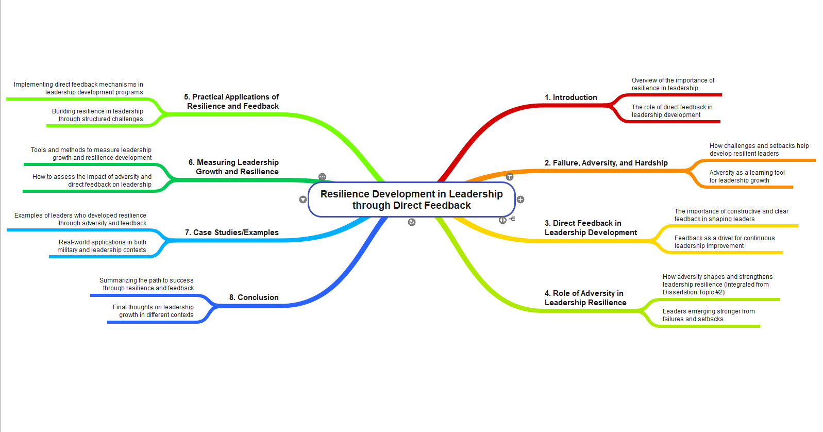
CONCEPT MAP

Slide 5
Chapter 1 Topic Background and Context
Direct feedback is often avoided in modern leadership, weakening development and resilience.
This study focuses on how executive leaders use direct feedback to build emotional strength and adapt to challenges.
The goal is to reintroduce feedback as a necessary leadership tool for growth, not as criticism or judgment.

Slide 6
Chapter 1 Research Problem and Purpose
Leaders rarely receive honest feedback due to power dynamics, fear, and organizational politeness.
This study explores how direct feedback—when processed reflectively—leads to leadership resilience.
A grounded theory model will be built to explain the feedback-to-resilience process in real-world executive contexts.

Slide 7
Chapter 1 Research Goals
Personal Goal: To reframe leadership by empowering future leaders with the courage to give and receive direct feedback without fear.
Practical Goal: To offer a grounded feedback model leaders and coaches can use to build resilience and improve leadership development programs.
Intellectual Goal: To contribute a new theoretical model showing how feedback functions as a process for identity growth and resilience in executive leadership.

Slide 8
Chapter 1 Research Question
Primary Research Question: How do executive leaders develop resilience through the experience and internalization of direct feedback?
Supporting Questions:
What emotional and reflective processes do leaders undergo after receiving direct feedback?
What organizational factors affect how feedback is delivered and processed?
How does feedback contribute to leadership identity development?

Slide 9
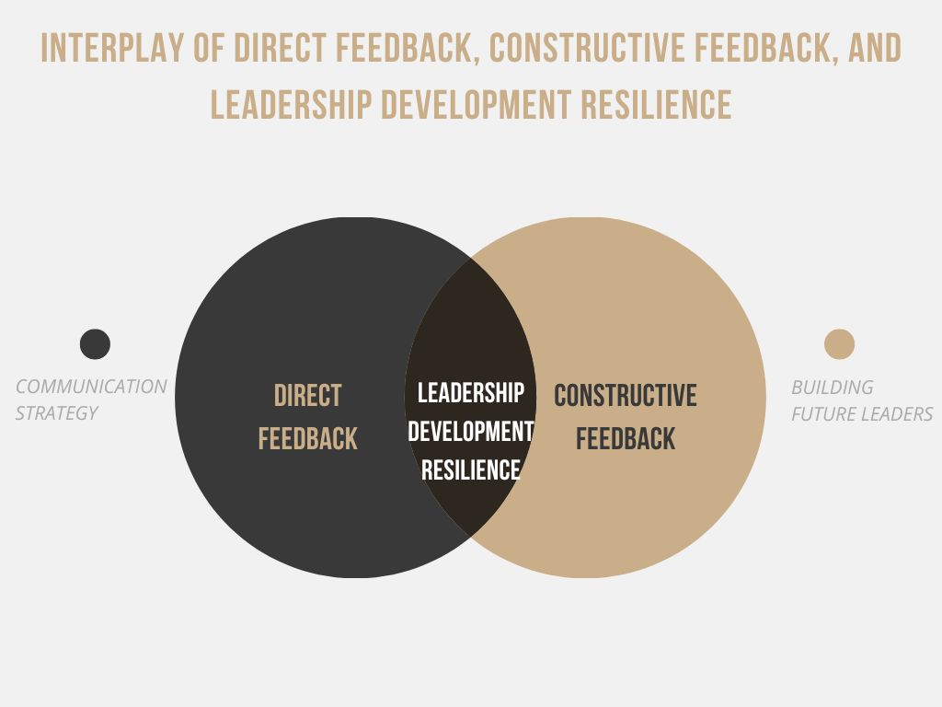
Chapter 1 Theoretical Framework (Venn)
Venn Diagram

Slide 10
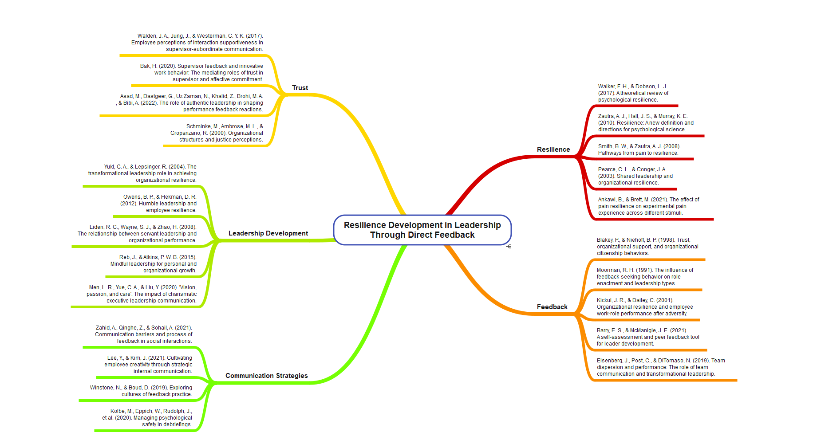
LITERATURE MAP

Slide 11
Chapter 2 Literature Review
Feedback in leadership is a well-researched topic, but few studies explore how direct feedback contributes to resilience.
Emotional Intelligence theory shows that leaders who can regulate their emotional responses are more likely to turn feedback into actionable growth.
Psychological Safety is necessary to foster honest, critical feedback in executive environments. Without it, leaders receive filtered or performative responses.
Reflective Practice allows feedback to be internalized—not just heard—leading to lasting behavior change and identity development.
The review highlights a major gap: we still lack a process-based model of how direct feedback leads to resilience in real-world leadership.

Slide 12
Chapter 3 Methodology
Methodology: Constructivist grounded theory
Design: Anonymous qualitative interviews with 20–30 executive leaders
Data Collection: Participants respond in writing to 10 open-ended questions about their experiences receiving direct feedback
Participants: Government professionals, veterans, diplomats, and executives—anonymous due to the sensitive nature of their roles
Analysis: Line-by-line open coding, followed by focused and theoretical coding
Purpose: To generate a grounded model that explains how direct feedback leads to resilience development in high-pressure leadership contexts
Ethical considerations: Participants remain fully anonymous; no names, titles, or organizations are collected to protect confidentiality.

Slide 13
Chapter 4 Findings
Emotional discomfort is a catalyst: Leaders describe pain, shock, or defensiveness as a necessary part of growth.
Honest, unfiltered feedback has a lasting impact: The most transformative feedback was direct and specific.
Reflection builds resilience: Leaders who actively reflected—mentally or in writing—described more meaningful change.

Slide 14
Chapter 5 Discussion
Present a grounded theory showing the link between direct feedback, reflection, and leadership resilience.
Identify how psychological safety and emotional intelligence influence the way feedback is received.
Recommend feedback practices that create resilient leaders in executive, government, and high-performance settings.

Slide 15
Questions

Slide 16
references
Ankawi, B., & Brett, M. (2021). The effect of pain resilience on experimental pain experience across different stimuli. Pain Research and Management, 26(2), 101-112.
Bak, H. (2019). Supervisor feedback and innovative work behavior: The mediating role of trust and affective commitment. Journal of Business and Psychology, 34(2), 239-251.
Barry, E. S., & McManigle, J. E. (2021). A self-assessment and peer feedback tool for leader development. Journal of Leadership, Accountability and Ethics, 18(4), 109-122.
Blakey, P., & Niehoff, B. P. (1998). Trust, organizational support, and organizational citizenship behaviors. Academy of Management Review, 23(3), 901-916.
Buckley, C., Natesan, S., Breslin, A., & Gottlieb, M. (2020). Finessing feedback: Recommendations for effective feedback in the emergency department. Annals of Emergency Medicine, 75(3), 445-451.
Carmeli, A., Brueller, D., & Dutton, J. E. (2009). Learning behaviors in the workplace: The role of high-quality interpersonal relationships and psychological safety. Systems Research and Behavioral Science, 26(1), 81-98.
Gálvez-López, E. (2023). Formative feedback in a multicultural classroom: A review. Teaching in Higher Education, 1(20), 1-20.
Gichuhi, J. M. (2021). Shared leadership and organizational resilience: A systematic literature review. International Journal of Organizational Leadership, 10(Special Issue), 67-88.
Goff, P., Guthrie, J. E., Goldring, E., & Bickman, L. (2014). Changing principals’ leadership through feedback and coaching. Journal of Educational Administration, 52(5), 682-704.
Han, Y., & Perry, J. L. (2020). Employee accountability: Development of a multidimensional scale. International Public Management Journal, 23(2), 224-251.
Henderson, M., Phillips, M., Ryan, T., Boud, D., Dawson, P., Molloy, E., & Mahoney, P. (2019). Conditions that enable effective feedback. Higher Education Research & Development, 38(7), 1401-1416.
Johnson, C. E., Keating, J. L., & Molloy, E. K. (2020). Psychological safety in feedback: What does it look like, and how can educators work with learners to foster it? Medical Education, 54(6), 559-570.
Kickul, J. R., & Dailey, C. (2001). Organizational resilience and employee work-role performance after adversity. Journal of Occupational Health Psychology, 12(4), 391-405.
Kritek, P. A. (2015). Strategies for effective feedback. Annals of the American Thoracic Society, 12(4), 557-560.
Levey, J., & Levey, M. (2019). Mindful leadership for personal and organizational resilience. Clinical Radiology, 74(7), 739-745.
Leslie, J. B., & Fleenor, J. W. (1998). Feedback to managers. Greensboro, NC: Center for Creative Leadership.
Liden, R. C., Wayne, S. J., & Zhao, H. (2008). The relationship between servant leadership and organizational performance. Leadership Quarterly, 19(3), 161-177.
Men, L. R., Yue, C. A., & Liu, Y. (2020). “Vision, passion, and care:” The impact of charismatic executive leadership communication on employee trust and support for organizational change. Public Relations Review, 46(3), 101927.

Slide 17
references
Moorman, R. H. (1991). The influence of feedback-seeking behavior on role enactment and leadership types. Journal of Management Development, 10(1), 43-55.
Odeh, R. B. S. M., Obeidat, B. Y., Jaradat, M. O., Masa’deh, R., & Alshurideh, M. T. (2023). The transformational leadership role in achieving organizational resilience through adaptive cultures. International Journal of Productivity and Performance Management, 72(2), 440-468.
Owens, B. P., & Hekman, D. R. (2012). Humble leadership and employee resilience. Journal of Organizational Behavior, 33(3), 307-324.
Pearce, C. L., & Conger, J. A. (2003). Shared leadership and organizational resilience. Leadership Quarterly, 14(3), 233-256.
Quebec Fuentes, S., & Jimerson, J. B. (2020). Role enactment and types of feedback. Journal of Educational Supervision, 3(2), 6.
Reb, J., & Atkins, P. W. B. (2015). Mindful leadership for personal and organizational growth. Journal of Business Ethics, 130(4), 639-659.
Schminke, M., Ambrose, M. L., & Cropanzano, R. (2000). Organizational structures and justice perceptions. Research in Organizational Behavior, 22(4), 15-31.
Smith, B. W., & Zautra, A. J. (2008). Pathways from pain to resilience. Journal of Occupational Health Psychology, 13(2), 87-92.
Steffens, N. K., Fonseca, M. A., Ryan, M. K., Rink, F. A., Stoker, J. I., & Pieterse, A. N. (2018). How feedback about leadership potential impacts ambition, organizational commitment, and performance. Leadership Quarterly, 29(6), 637-647.
Vella, S.-L. C., & Pai, N. B. (2019). A theoretical review of psychological resilience: Defining resilience and resilience research. Archives of Medicine and Health Sciences, 7(2), 233-239.
van Dierendonck, D., Haynes, C., Borrill, C., & Stride, C. (2007). Effects of upward feedback on leadership behavior toward subordinates. Journal of Management Development, 26(3), 228-238.
Walker, B. H. (2020). Resilience: What it is and is not. Ecology and Society, 25(2), 11.
Walker, F. H., & Dobson, L. J. (2017). A theoretical review of psychological resilience. Journal of Psychological Research, 14(3), 201-217.
Wang, R., He, Y., Li, H., Zhang, J., Chen, Q., Xu, L., & Feng, L. The Mediating Effect of Online Positive Feedback in the Relationship between Social Support and Psychological Resilience Among Emergency Department Nurses.
Wang, Z., Gong, S. Y., Xu, S., & Hu, X. E. (2019). Elaborated feedback and learning. Computers & Education, 136, 130-140.
Whiteman, G., Forbes, B. C., Niemelä, J., & Chapin, F. S. (2004). Bringing feedback and resilience of high-latitude ecosystems into the corporate boardroom. AMBIO: A Journal of the Human Environment, 33(6), 371-376.
Wilkinson, A. D., & Rennaker, M. A. (2022). The relationship between servant-leadership and employee resilience. International Journal of Servant-Leadership, 16(1), 309-337.
Winstone, N., & Boud, D. (2019). Exploring cultures of feedback practice. Higher Education Research & Development, 38(2), 411-425.

Slide 18


