Slide 1
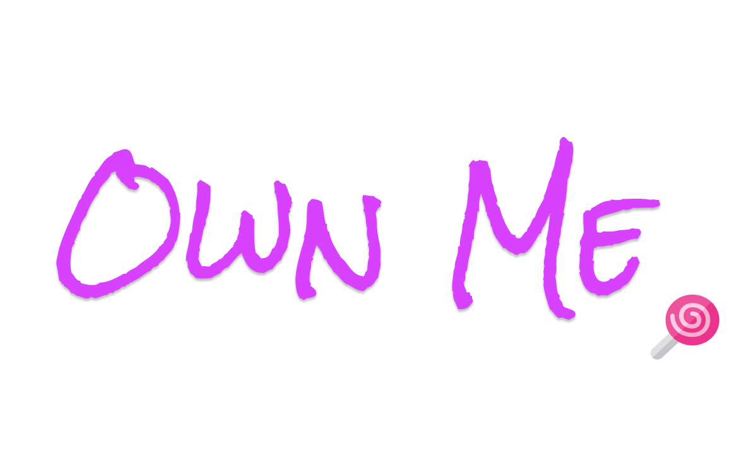

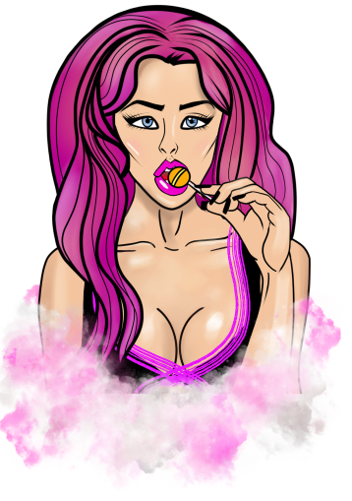
www.ownme.io
Buy, trade, sell, view and promote your hottest digital “Assets” as NFTs.
Promiscuous * Dangerous * Lucrative

Slide 2

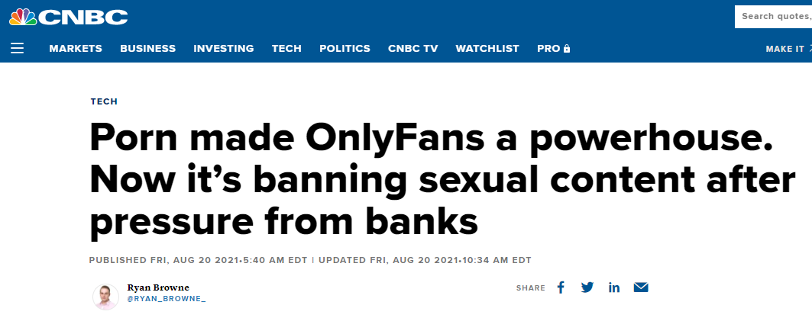
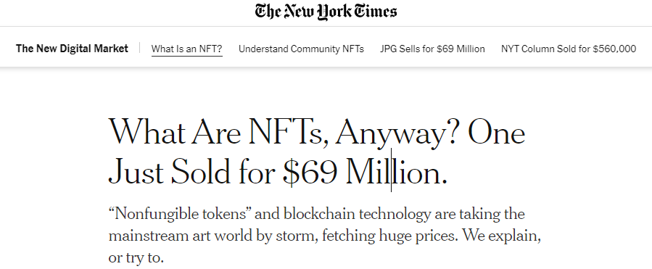
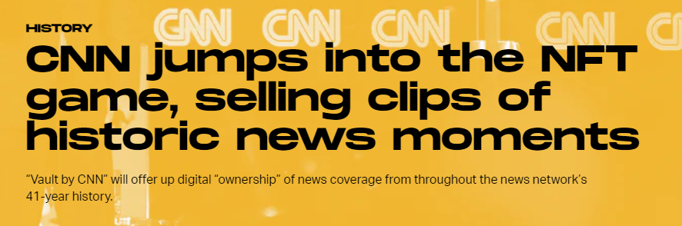
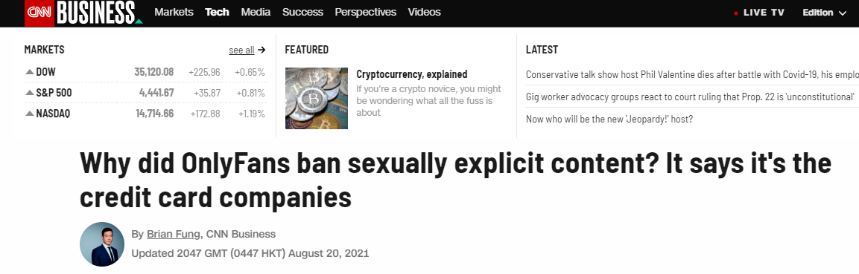
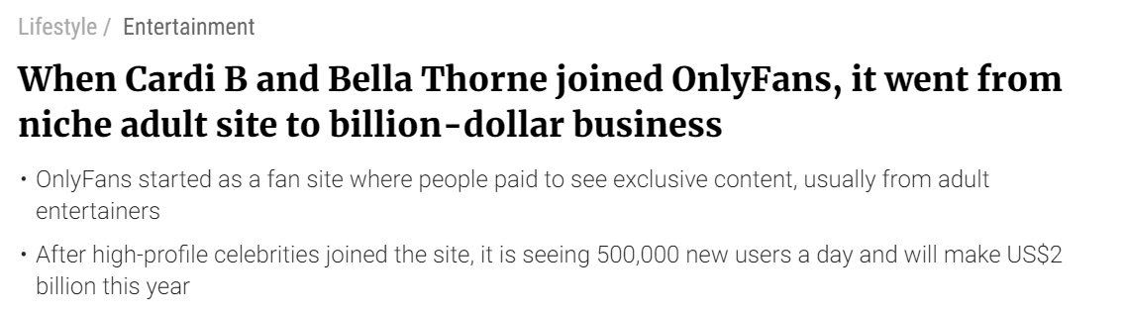
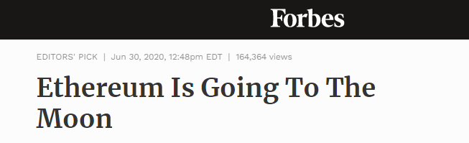
The Opportunity
Traditional payment processors are denying adult content creators.
Demand has not disappeared. Creators and consumers are looking for alternatives.
NFTs and Crypto are continuing to explode and grow market capital.
Adult content is always in demand. Covid-19 has changed the game.

Slide 3

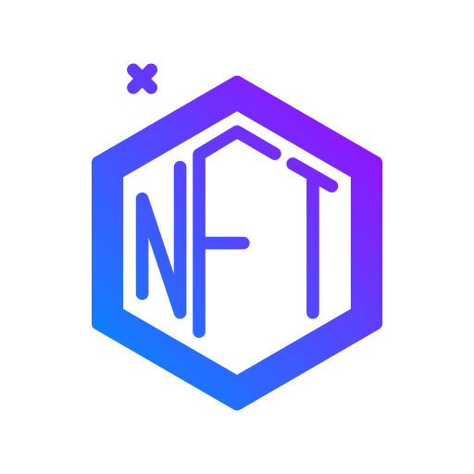


Our Proposal
+
+
1.) Use the Ethereum blockchain instead of traditional banking solutions. Create the $NUDE token.
2.) Use decentralized blockchain NFT technology to store adult creators content.
3.) Create a trendy designed social app experience tailored specifically for the adult content industry.

Slide 4

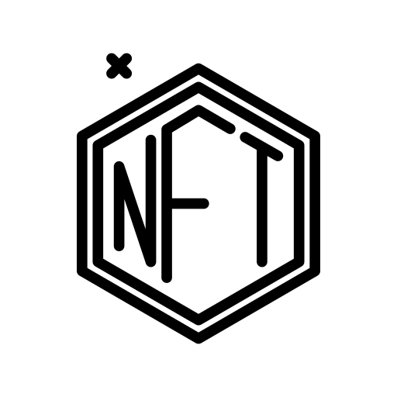

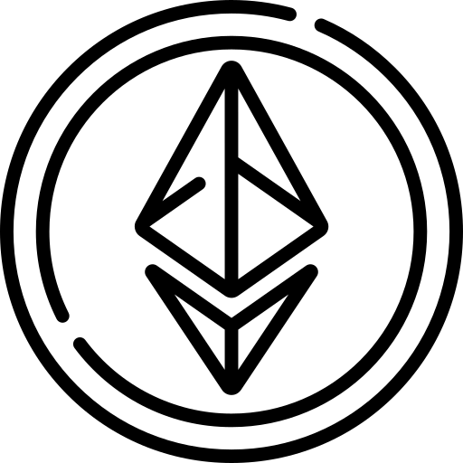

The Market
Adult Content Industry
$100 Billion
NFT Marketplace Industry
$25 Billion
Ethereum Market Cap
$100 Billion
Social Media Industry
$60 Billion

Slide 5

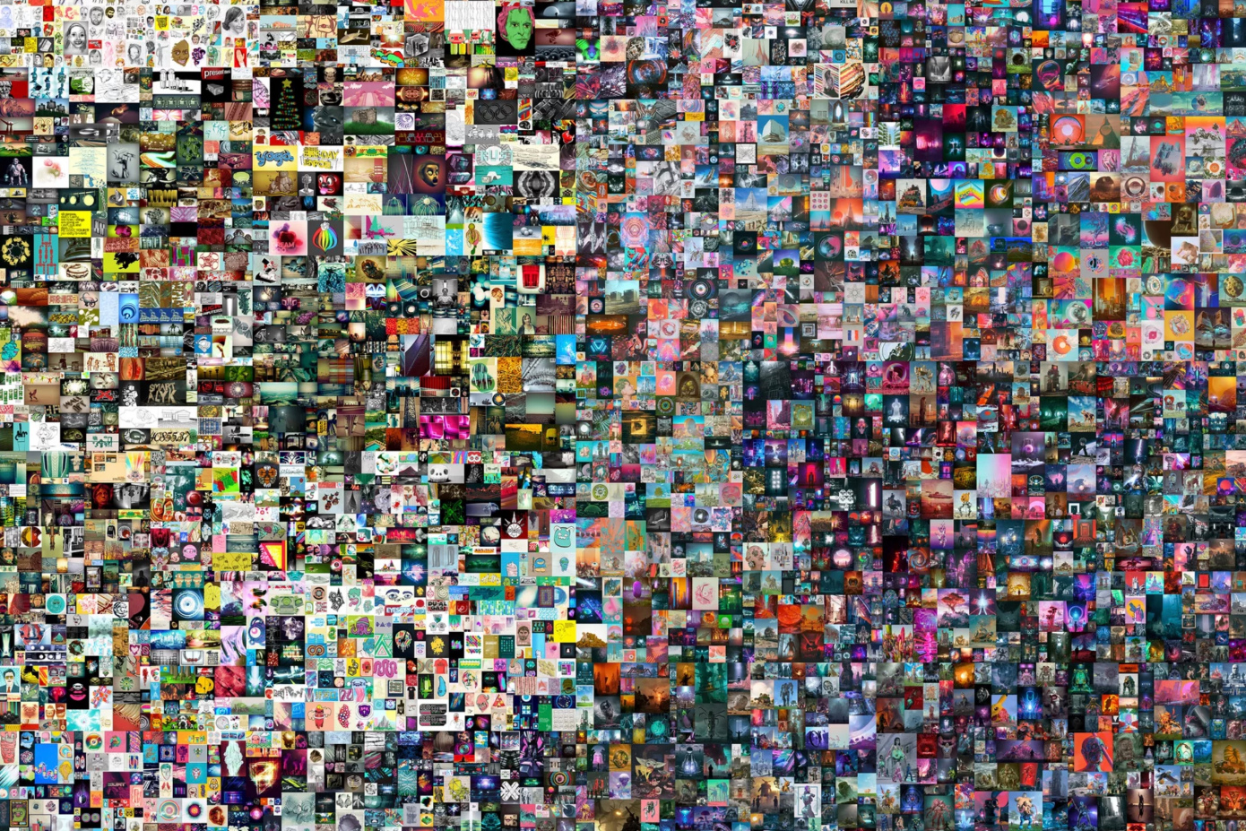

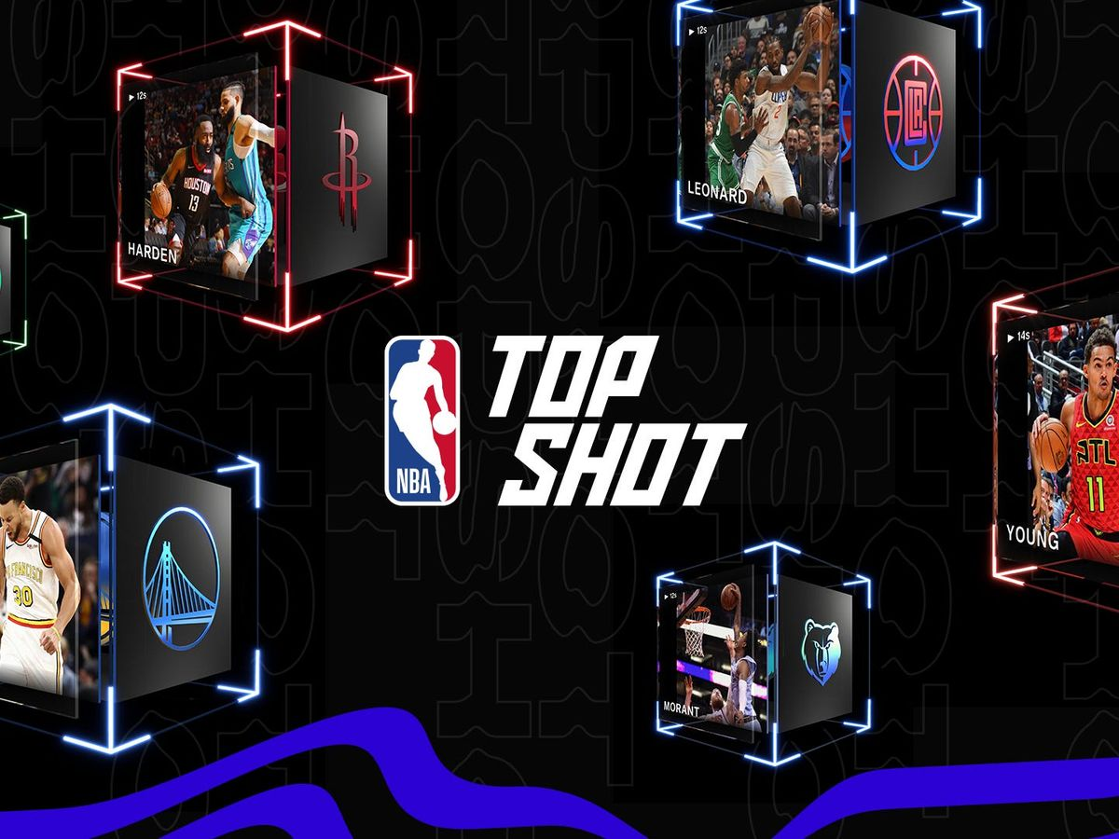
Market Validation
'The First 5000 Days', the 1st purely digital NFT based artwork offered by a major auction house has sold for $69,346,250.
Revenue at OnlyFans grew by 553% in the year 2019 to November 2020, and users spent $2.36 billion on the adult creator website.
NFTs have a nearly $28 billion market cap with sports-related NFTs — such as the NBA’s Top Shots trading cards — being the most popular.

Slide 6

Our Product
$NUDE token.
NFTs.
Auction House.
Candy shop.
Gumball machine.
Profiles.
Subscriptions.
Followers / Likes.
Timeline.
Featured creators.
Hidden / encrypted NFTs.

Slide 7
Our Progress
Figmas
Web app frontend
Server backend
Smart contracts, $NUDE.
Social media
Custom art
Pitch deck
Twitch streaming

Slide 8

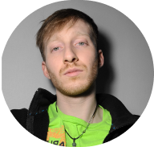
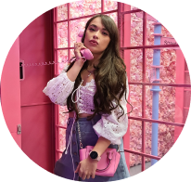
Our Team
Christopher Trimboli
Sylvia Makuch
Founder / CEO / Lead Engineer
Lead Designer / Digital Artist

Slide 9

Why we need investment?
Influencer promotions.
Advertisement / Marketing.
Third party security audits.
Software developers.
ID verification / moderation team.
Infrastructure costs.
Legal costs.
Content creation / video production.
Compete with funded competition.

Slide 10

How do we make money?
10% cut on each transaction.
Celebrity promotions.
Company plugs.
Advertisements.
Merch.
Crypto. $NUDE token.

Slide 11


Our Competition
Only Fans suffers majorly by using traditional banking solutions. We are using the blockchain and do not have the same concerns. Not adult content niched. Trying to appeal to everyone
Nafter is using the Binance smart chain for their tokens. Binance has many centralized concerns and is in deep with controversial Tether. We just use regular Ethereum. Not adult content niched. Trying to appeal to everyone.
…

Slide 12
Why are we better then everyone else?
Lowball transaction fees. They charge 20%, we charge 10%.
Blockchain, not dependent on big banks, hard to cancel.
Lead founder / CEO is an experienced, talented, software engineer.
We have a niched product design specific for adult content.
We have innovative ideas that have never been done before.
We are smaller, fresher, can pivot, adapt quicker.
We combine the crypto, social media and adult content industries.
We are not rich yet and are more hungry then the fat cats.

