Slide 1



www.ownme.io
Buy, trade, sell, view and promote your hottest digital “Assets” as NFTs.
Promiscuous * Dangerous * Lucrative

Slide 2

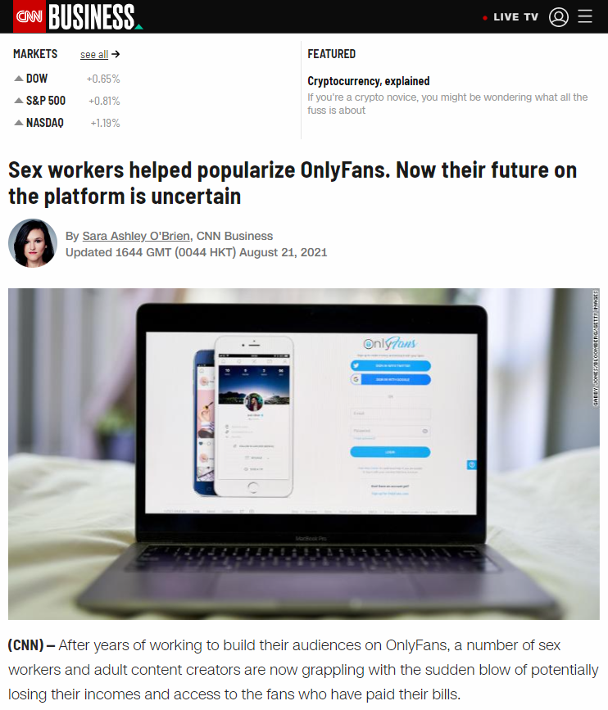
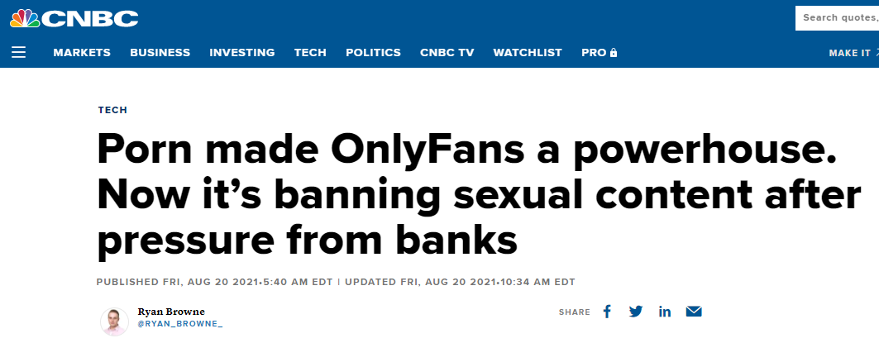
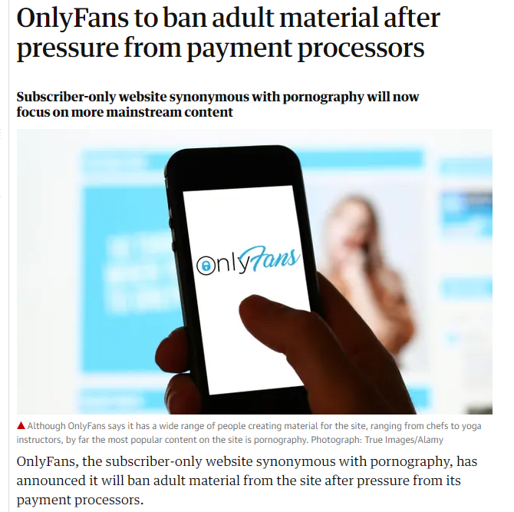
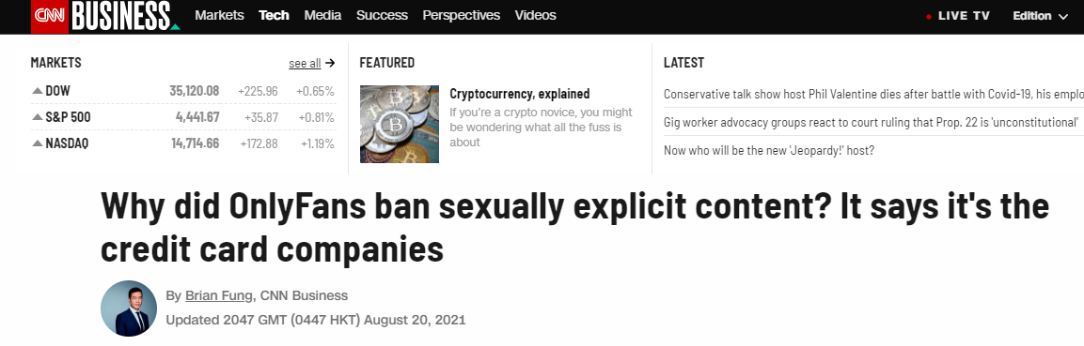
The Opportunity
Traditional payment processors are denying adult content creators. Demand has not disappeared. Creators and consumers are looking for alternatives.

Slide 3

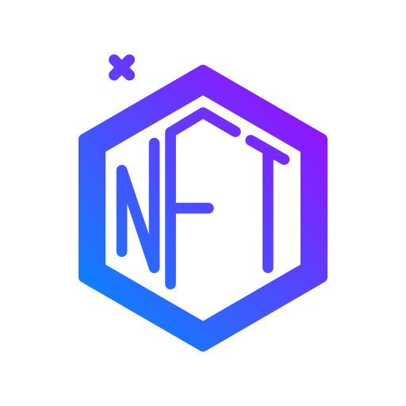


Our Proposal
1.) Use the Ethereum blockchain instead of traditional banking solutions like Visa / PayPal.
3.) Create a trendy designed app experience tailored specifically for the adult content industry.
2.) Use decentralized NFT technology to store creators content.
+
+

Slide 4

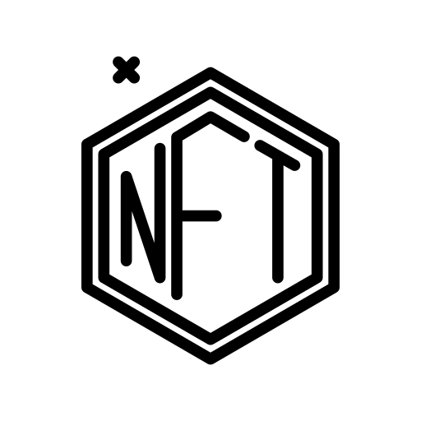



The Market
Adult Content Industry
$100 Billion
NFT Marketplace Industry
$5 Billion
Adult Content Industry
$100 Billion
Social Media Industry
$60 Billion

Slide 5

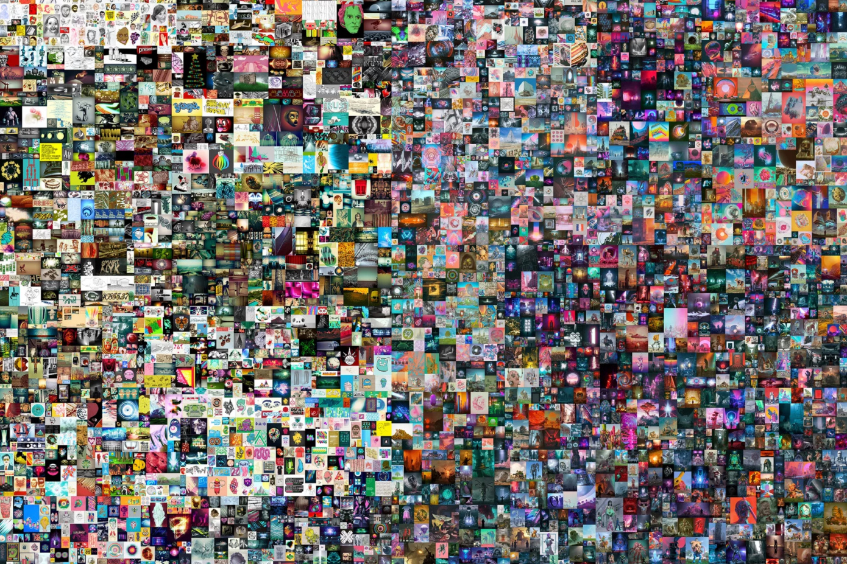

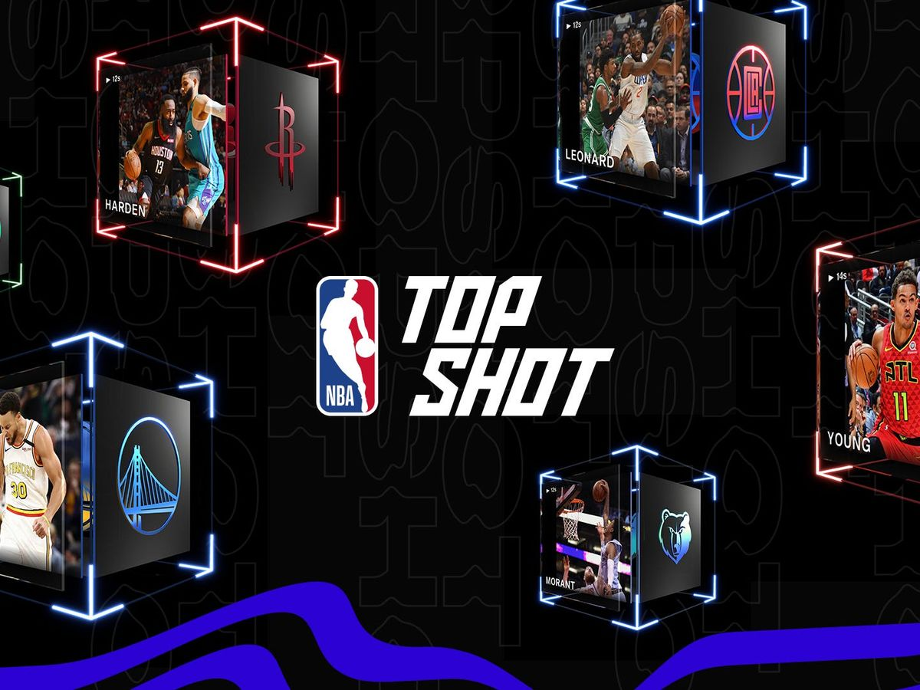
Market Validation
'The First 5000 Days', the 1st purely digital NFT based artwork offered by a major auction house has sold for $69,346,250.
Revenue at OnlyFans grew by 553% in the year 2019 to November 2020, and users spent $2.36 billion on the adult creator website.
NFTs have a nearly $28 billion market cap with sports-related NFTs — such as the NBA’s Top Shots trading cards — being the most popular.

Slide 6


Our Team
Christopher Trimboli
Christopher Trimboli
Christopher Trimboli
Founder / CEO / Lead Engineer
Founder / CEO / Lead Engineer
Founder / CEO / Lead Engineer

Slide 7
Why we need investment?
Influencer promotions.
Advertisement / Marketing.
Third party security audits of smart contracts and code.
Hire software developers.
Infrastructure costs.
Legal costs.
Grow the team and social medias.
Content creation.

Slide 8
How do we make money?
10% on each transaction.
Celebrity promotions.
Company plugs.
Advertisements.
Merch.
Crypto. $NUDE token.

Slide 9
Our Competition
Nafter
Only Fans
Patreon
Fanlify

Slide 10
Why we are better then everyone else?
Lowball transaction fees.
Blockchain, not dependent on big banks.
Lead founder is a experienced, talented software engineer.
We have a niched product design specific for adult content.
We have innovative ideas that have never been done before.

Slide 11
Conlclusion

