Slide 1



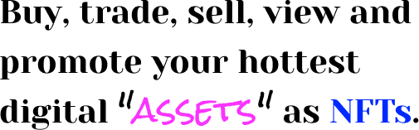

Slide 2

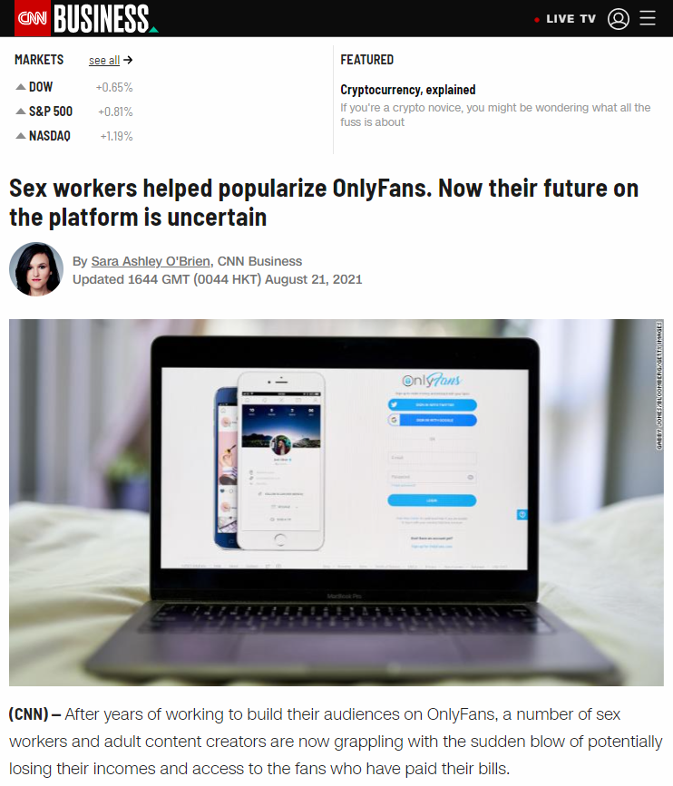
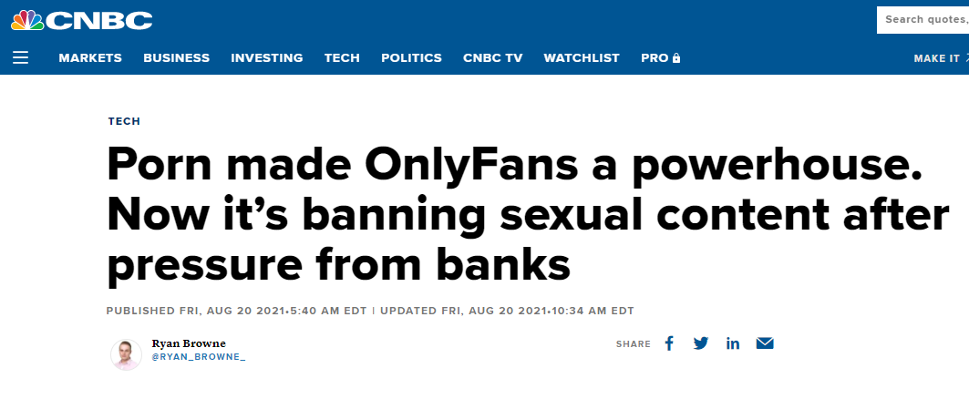
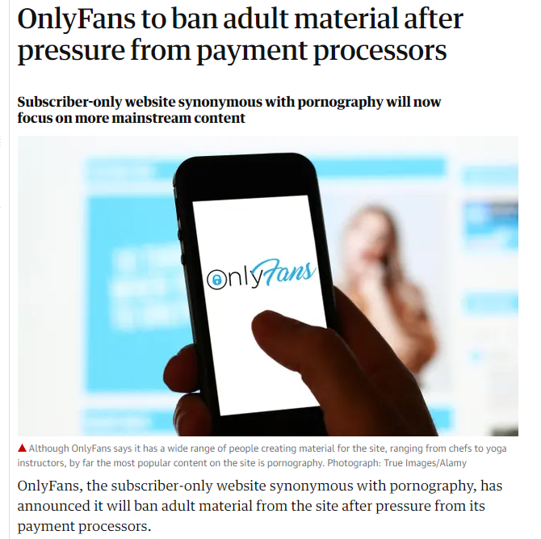
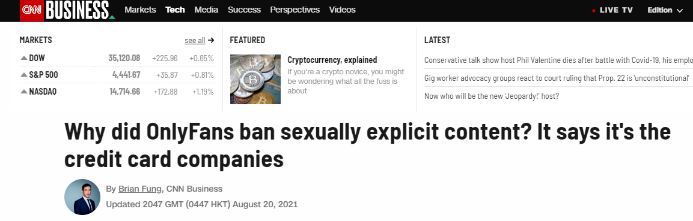
The Opportunity
Traditional payment processors are denying adult content creators. Demand has not disappeared. Creators and consumers are looking for alternatives.

Slide 3
Our Proposal
Use the Ethereum blockchain instead of traditional banking solutions like Visa / Paypal.
Use decentralized NFT technology to store creators content.
Create a trendy designed app experience tailored specifically for the adult content industry.

