Slide 1

Ferrero Business Case: Loan Approval Prediction
Georgopoulos Spyros
28/4/2024

Slide 2
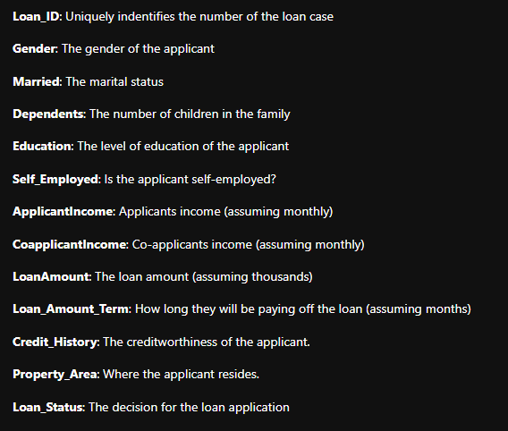
Exercise 1 - Overview
I will start providing the variables meanings as I understand it for reference:

Slide 3
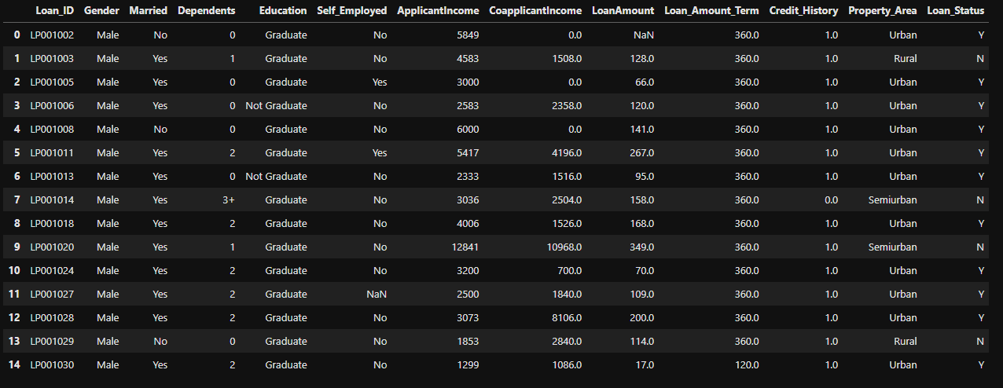
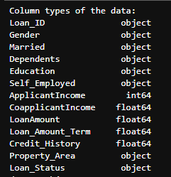
Questions 1-2 | Data Observation

Slide 4
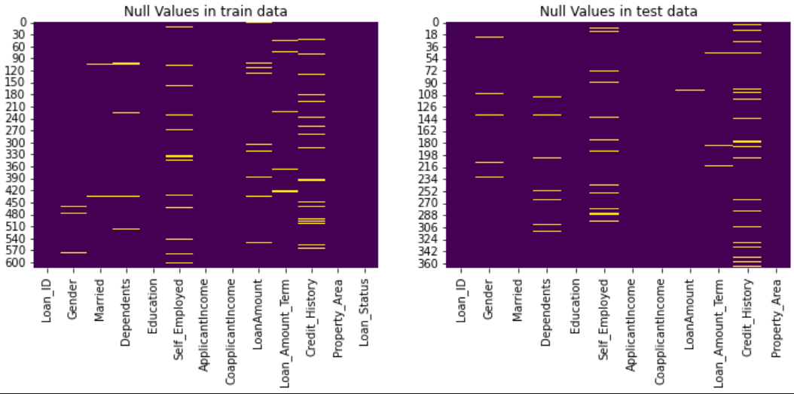
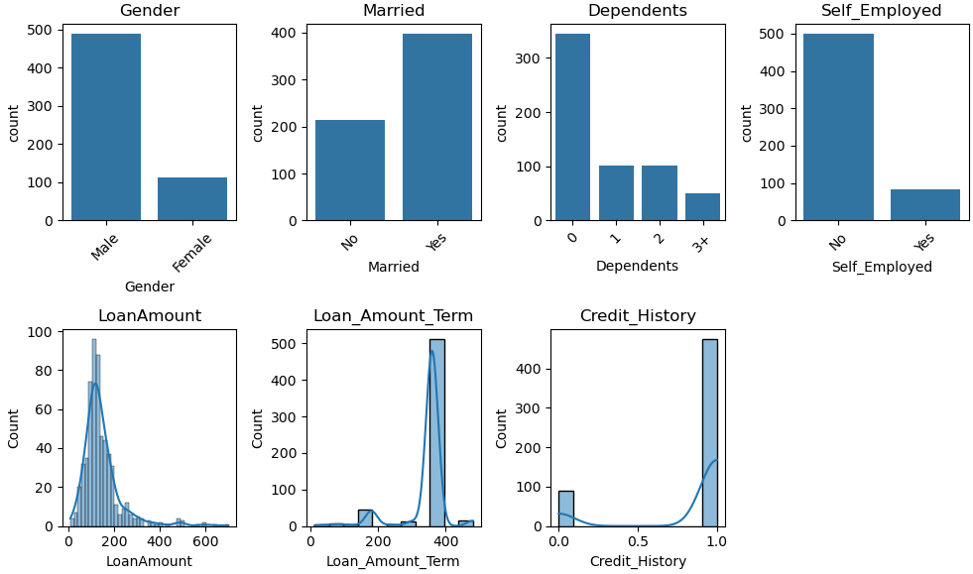
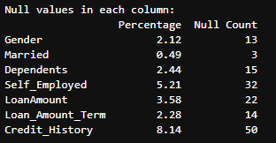
Questions 3-4 | Null Values Handling
Deletion: Remove rows or columns with null values. This is suitable when the null values are relatively few
compared to the total dataset and removing them won't significantly affect the analysis.
2. Forward or Backward Fill: Use the value from the previous or next row to fill null values
3. Predictive Modeling: Use machine learning algorithms to predict missing values.
4. Statistical Imputation: Replace null values with a suitable substitute, such as the mean, median, mode,
or a constant value. To be in place to determine a substitute strategy we should take a quick look
to the distributions of the null columns.
Steps to address the null problem for these columns:
Check cardinality of the column
Check the distribution of the column
Most frequent value for the categorical columns
Mean for the numerical ones

Slide 5
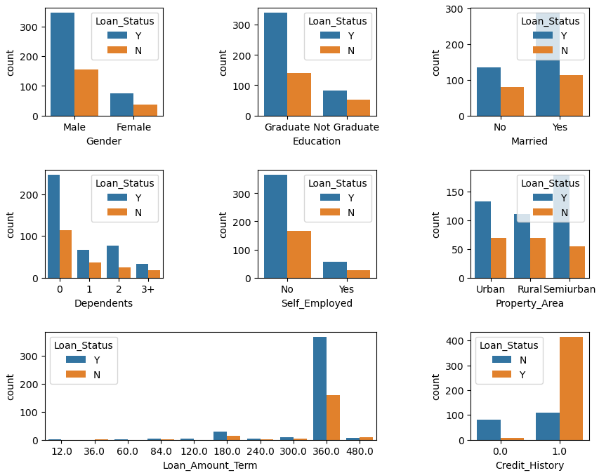
Question 5 | Distribution Plots (Categorical columns)
Proportion of male and female applicants is more or less same for both approved and unapproved loans
For graduates it is more likely to approve a loan
Proportion of married applicants is higher for the approved loans
The distribution of applicants with 1 or 3+ dependents is similar across both the categories of Loan Status. For 1 and 2 it varies
There is nothing significant for the Self-employed or not category.
Proportion of loans getting approved in semiurban area is higher as compared to that in rural or urban areas.
People with credit history as 1 are more likely to get their loans approved

Slide 6
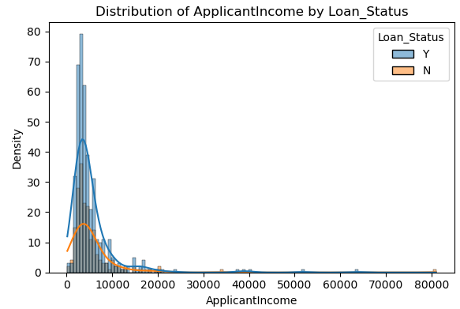
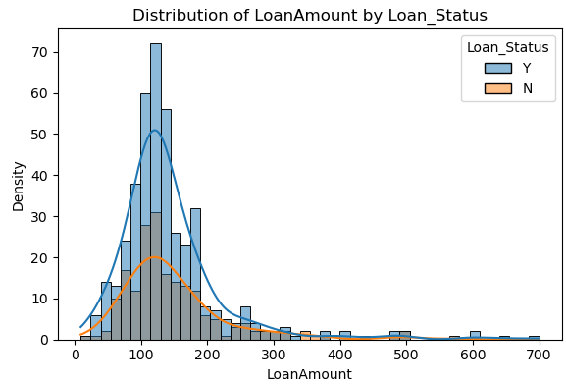
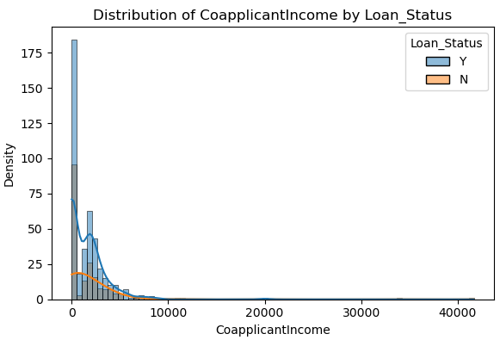
Question 5 | Distribution Plots (Numerical columns)
All three distributions are skewed to the right since we have people of different education levels and the income disparity in the society can be depicted.
Outlier presence
Not normal distributions
Positive skewness (more applicants for lower amounts)
rejections and approvals happen across the loan amount spectrum
the graphs suggest a potential relationship between loan amount/income and loan approval. However, it's likely that other factors also play a role in the loan approval process.

Slide 7
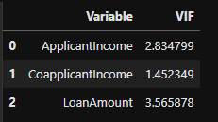
Questions 6-10 | Preprocessing before the modeling part | Multicollinearity
Multicollinearity check for numerical using VIF:
There is some collinearity on the numerical part of the data but no to the point of removing a column. Especially since we do not have a large dataset.
Multicollinearity check for categorical using pandas get dummies:
Setting a small threshold (0.3) there were only these 2 pairs.
Again, I did not feel that removing a any data will benefit the model

Slide 8
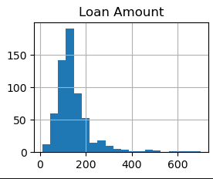
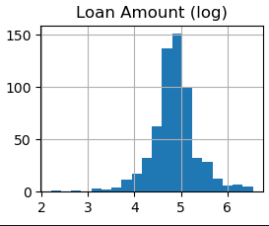
Questions 6-10 | Preprocessing before the modeling part | Outliers
Outliers Presence:
Outliers were present in all 3 numerical columns (LoanAmount, ApplicantIncome, CoApplicantIncome)
I used Log transform to convert the variable distribution to resemble a normal one
Questions 6-10 | Preprocessing before the modeling part | Feature Engineering
Column transformation:
Adding up ApplicantIncome with CoApplicantIncome forming a variable than represents the total income (TotalIncome)

Slide 9

Questions 6-10 | Preprocessing before the modeling part | Train-Test Split
Why seed=42:
When specifying a random seed, the split method uses this values to generate random indices for splitting the data into training and validation sets. This ensures that the random numbers generated by this code will be reproducible in future runs

Slide 10
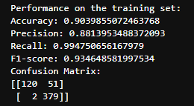
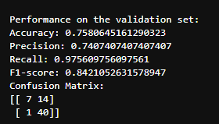
Questions 6-10 | Preprocessing before the modeling part | Modeling
Used a standard scaler for numerical columns
Used an ordinal encoder for encoding the categorical columns
Created a pipeline to apply the above to the train/validation/test datasets
Created a RF model (simple or using gridSearch)
Output metrics for train and validation data

Slide 11
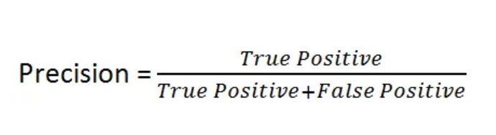
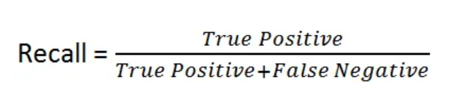
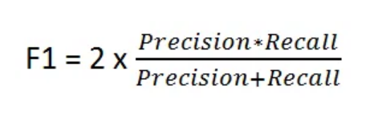
Questions 6-10 | Preprocessing before the modeling part | Metrics Discussion
Regulatory Compliance:
Bank’s model approves a loan what should not be approved.
Increase Precision
Minimize False Positive
Risk Management:
Bank’s model declines a loan what should have been approved.
Increase Recall
Minimize False Negative
F1 Score

Slide 12
Questions 6-10 | Preprocessing before the modeling part | Cross Validation
1. Robustness:
Robust estimate of model performance by repeatedly splitting the data into training and validation sets to average results which leads to a more stable generalization.
2. Optimal use of data:
All data points are used for both purposes (train and test)
3. Bias – Variance Tradeoff:
Increases how well the model generalizes to unseen data avoiding overfit and underfit since the validation takes place in many different sets

Slide 13
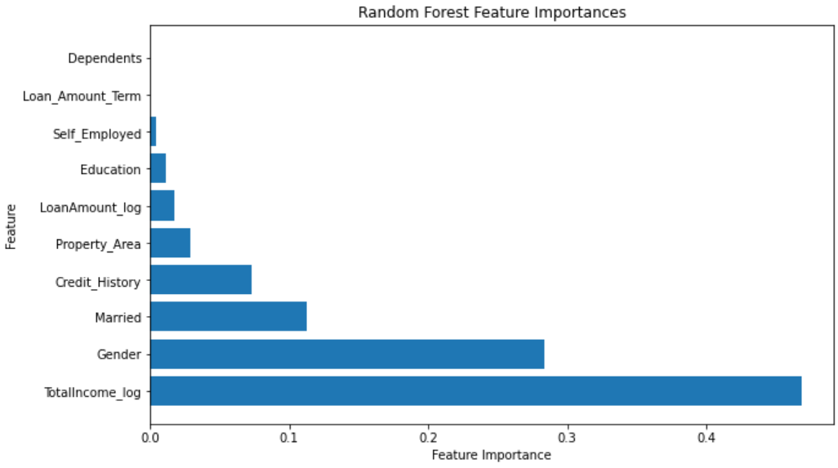
Questions 6-10 | Preprocessing before the modeling part | Conclusions and Possible Enhancements
Conclusions:
1. Having achieved an average score for f1 of 86% is good first point for the loan approval purpose project.
2. Need to monitor carefully the validation of the significant variables (Income, Credit History)
3. The inclusion of gender as a significant predictor raises questions about potential biases or discrimination in the loan approval process.
Enhancements:
1. Gather more data points!
2. Re-train without the zero importance features
3. Try different algorithms (maybe ensemble)
4. Dive deeper into EDA to identify new ways of feature engineering
5. More advanced encoding techniques
6. Start thinking on the deployment and maintenance processes

Slide 14
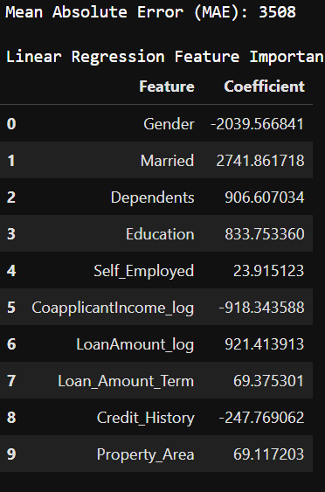
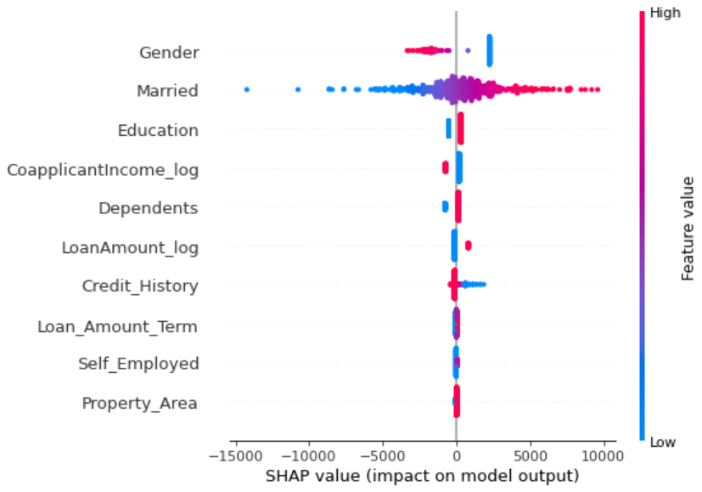
Exercise 2 – Linear Regression

Slide 15
Exercise 2 – Why Bayesian Approach?
Linear Regression
- Single coefficient value per feature
- Strategy = OSL
- Not uncertainty measures
Bayesian Regression
- Model parameters are random variables with a probability distribution
- Strategy = Prior belief through prior distributions
- Uncertainty distribution for the parameters being propagated from prior to posterior

Slide 16
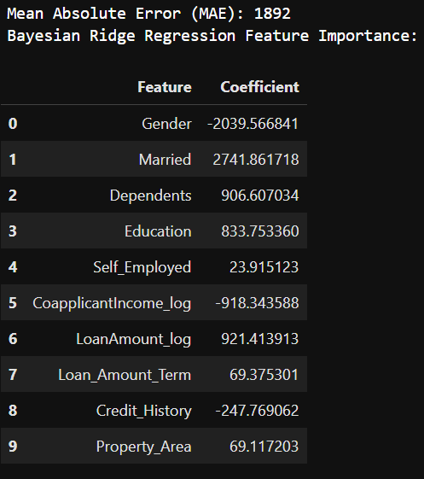
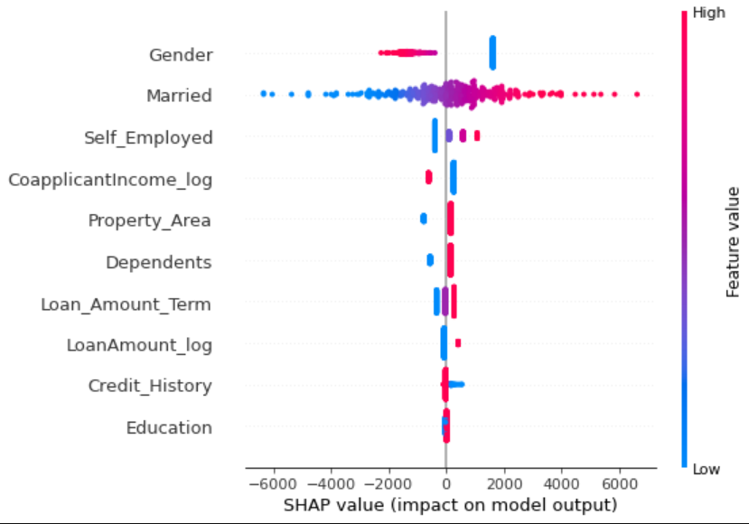
Exercise 2 – Bayesian Approach – Ridge regression*(see next page)

Slide 17
Overall I would really like to thank you for the opportunity to be a part of that particular level of the interview process.
I really enjoyed the project and the process so far.
I hope I have more or less covered the most part of it successfully and implemented a decent analysis given that the time was limited.
*I had some trouble applying Bayesian Linear regression. I have never used such model in the past. I studied about it and understood how to implement but the pymc library was unable to be installed in both of my computers regardless my efforts/debugging/environments. I did not want to leave questions unanswered so I turned to Bayesian Ridge Regression for boosting my initial Linear Regression Model.

