Slide 1

Ferrero Business Case: Loan Approval Prediction
Georgopoulos Spyros
28/4/2024

Slide 2
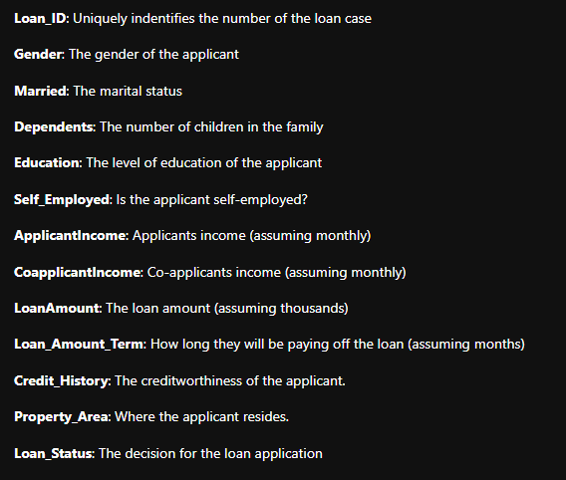
Exercise 1 - Overview
I will start providing the variables meanings as I understand it for reference:

Slide 3
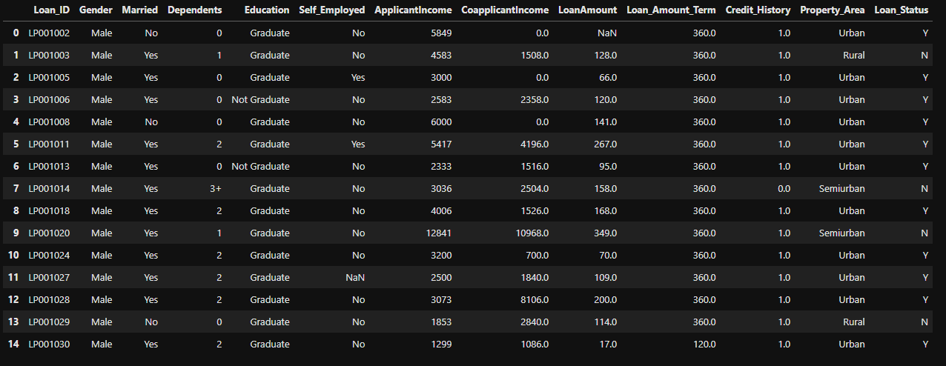
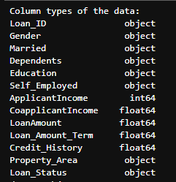
Questions 1-2 | Data Observation

Slide 4
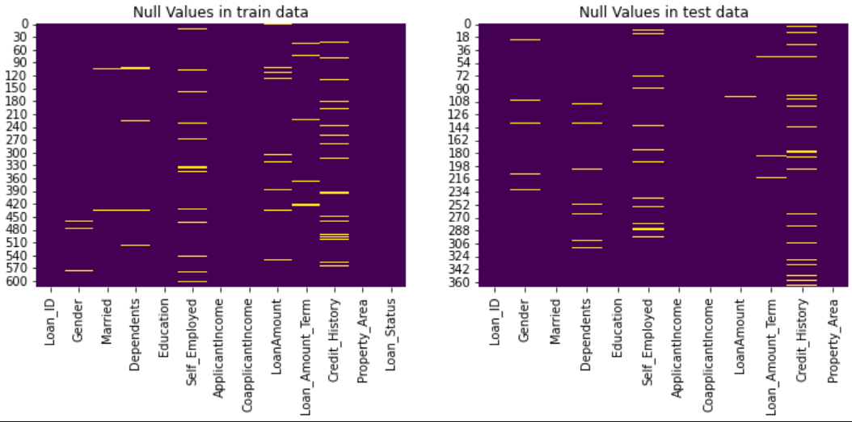
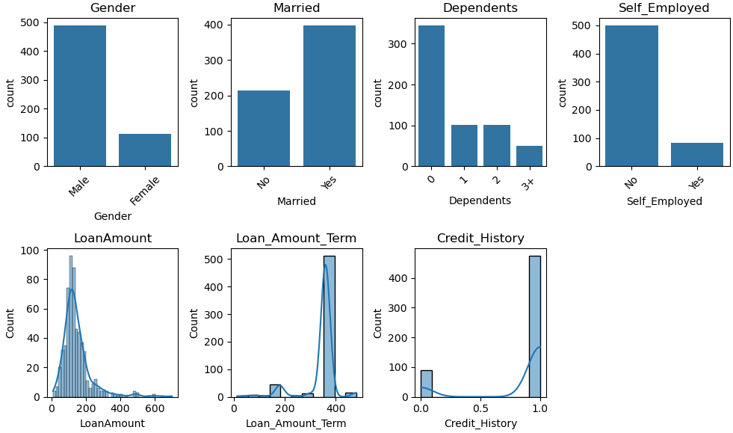
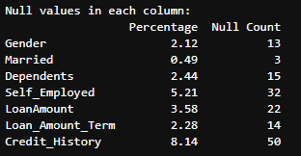
Questions 3-4 | Null Values Handling
Deletion: Remove rows or columns with null values. This is suitable when the null values are relatively few
compared to the total dataset and removing them won't significantly affect the analysis.
2. Forward or Backward Fill: Use the value from the previous or next row to fill null values
3. Predictive Modeling: Use machine learning algorithms to predict missing values.
4. Statistical Imputation: Replace null values with a suitable substitute, such as the mean, median, mode,
or a constant value. To be in place to determine a substitute strategy we should take a quick look
to the distributions of the null columns.
Steps to address the null problem for these columns:
Check cardinality of the column
Check the distribution of the column
Most frequent value for the categorical columns
Mean for the numerical ones

Slide 5
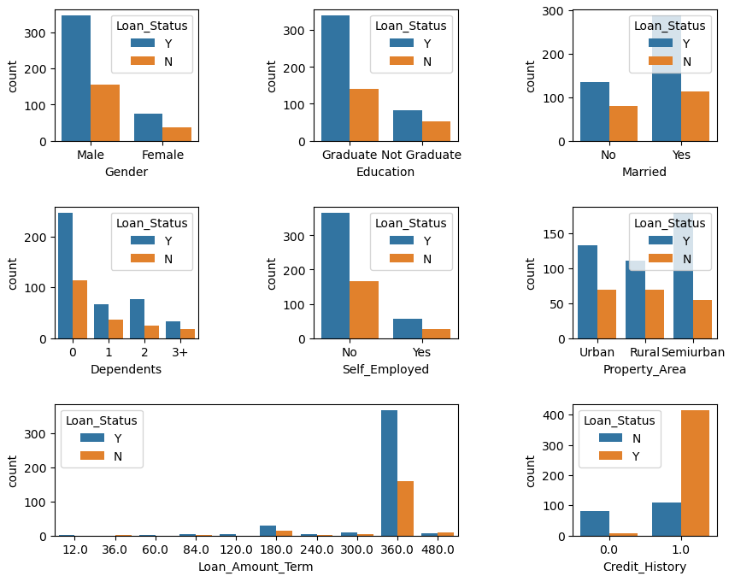
Question 5 | Distribution Plots (Categorical columns)
Comments on that

Slide 6
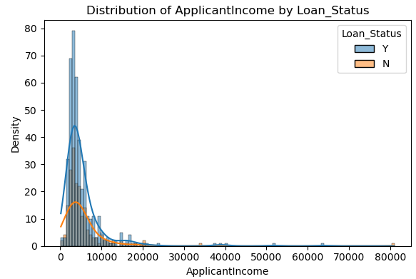
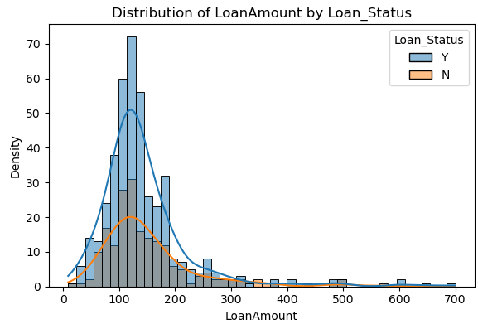
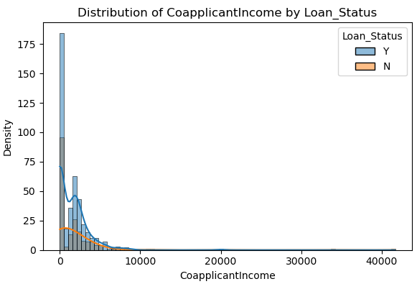
Question 5 | Distribution Plots (Numerical columns)
Comments on that

Slide 7
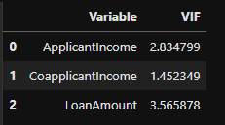
Questions 6-10 | Preprocessing before the modeling part | Multicollinearity
Multicollinearity check for numerical using VIF:
There is some collinearity on the numerical part of the data but no to the point of removing a column. Especially since we do not have a large dataset.
Multicollinearity check for categorical using pandas get dummies:
Setting a small threshold (0.3) there were only these 2 pairs.
Again, I did not feel that removing a any data will benefit the model

Slide 8
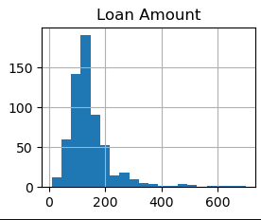
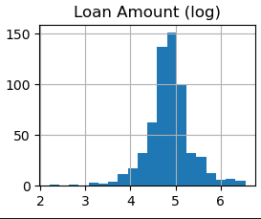
Questions 6-10 | Preprocessing before the modeling part | Outliers
Outliers Presence:
Outliers were present in all 3 numerical columns (LoanAmount, ApplicantIncome, CoApplicantIncome)
I used Log transform to convert the variable distribution to resemble a normal one
Questions 6-10 | Preprocessing before the modeling part | Feature Engineering
Column transformation:
Adding up ApplicantIncome with CoApplicantIncome forming a variable than represents the total income (TotalIncome)

Slide 9

Questions 6-10 | Preprocessing before the modeling part | Train-Test Split
Why seed=42:
When specifying a random seed, the split method uses this values to generate random indices for splitting the data into training and validation sets. This ensures that the random numbers generated by this code will be reproducible in future runs

Slide 10
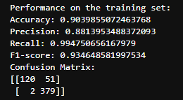
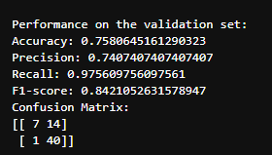
Questions 6-10 | Preprocessing before the modeling part | Modeling
Used a standard scaler for numerical columns
Used an ordinal encoder for encoding the categorical columns
Created a pipeline to apply the above to the train/validation/test datasets
Created a RF model (simple or using gridSearch)
Output metrics for train and validation data

Slide 11
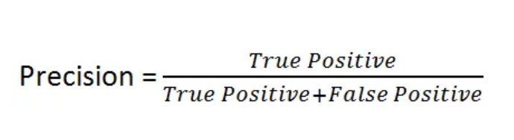
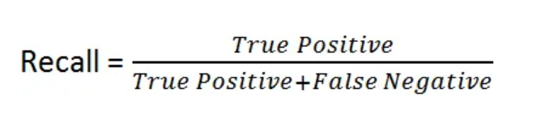
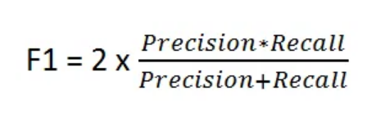
Questions 6-10 | Preprocessing before the modeling part | Metrics Discussion
Regulatory Compliance:
Bank’s model approves a loan what should not be approved.
Increase Precision
Minimize False Positive
Risk Management:
Bank’s model declines a loan what should have been approved.
Increase Recall
Minimize False Negative
F1 Score

Slide 12
Questions 6-10 | Preprocessing before the modeling part | Cross Validation
1. Robustness:
Robust estimate of model performance by repeatedly splitting the data into training and validation sets to average results which leads to a more stable generalization.
2. Optimal use of data:
All data points are used for both purposes (train and test)
3. Bias – Variance Tradeoff:
Increases how well the model generalizes to unseen data avoiding overfit and underfit since the validation takes place in many different sets

Slide 13
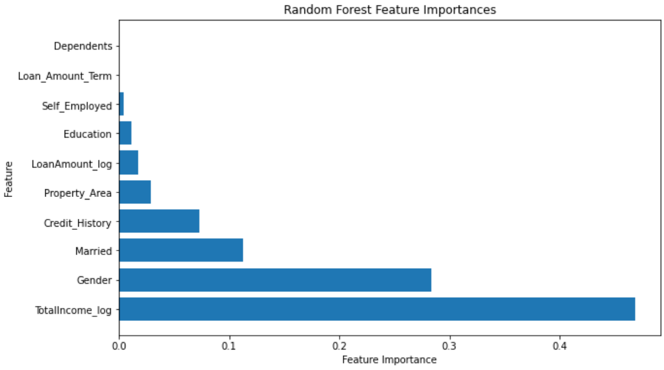
Questions 6-10 | Preprocessing before the modeling part | Conclusions and Possible Enhancements
Conclusions:
1. Having achieved an average score for f1 of 86% is good first point for the loan approval purpose project.
2. Need to monitor carefully the validation of the significant variables (Income, Credit History)
3. The inclusion of gender as a significant predictor raises questions about potential biases or discrimination in the loan approval process.
Enhancements:
1. Gather more data points!
2. Re-train without the zero importance features
3. Try different algorithms (maybe ensemble)
4. Dive deeper into EDA to identify new ways of feature engineering
5. More advanced encoding techniques
6. Start thinking on the deployment and maintenance processes

Slide 14
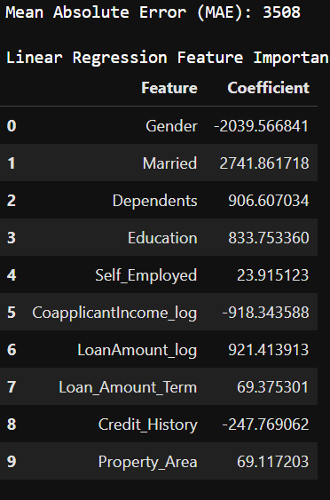
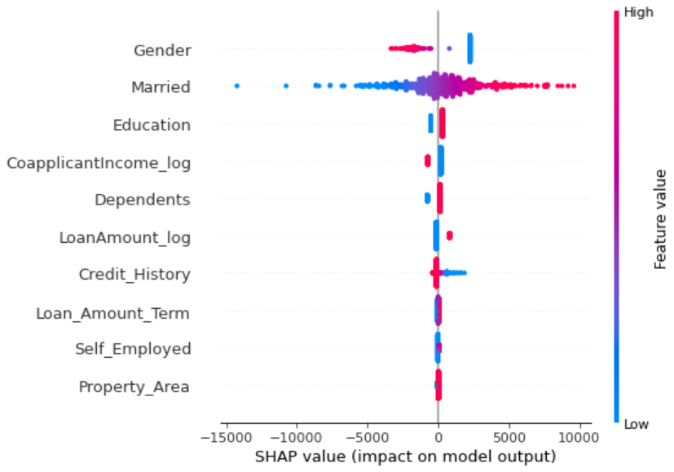
Exercise 2 – Linear Regression

Slide 15
Exercise 2 – Why Bayesian Approach?
Linear Regression
- Single coefficient value per feature
- Strategy = OSL
- Not uncertainty measures
Bayesian Regression
- Model parameters are random variables with a probability distribution
- Strategy = Prior belief through prior distributions
- Uncertainty distribution for the parameters being propagated from prior to posterior

Slide 16
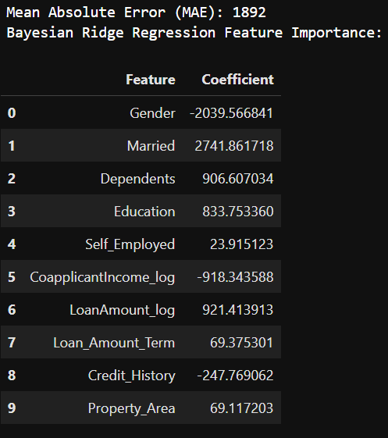
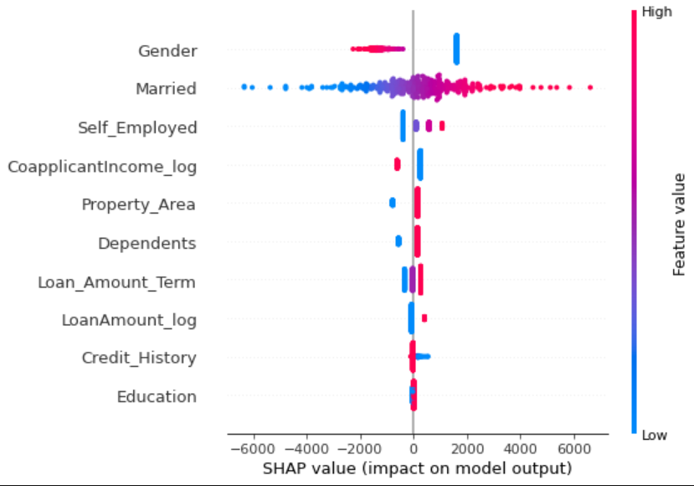
Exercise 2 – Bayesian Approach

Slide 18
https://www.projectpro.io/article/loan-prediction-using-machine-learning-project-source-code/632
https://github.com/limchiahooi/loan-approval-prediction/blob/master/loan-approval-prediction.ipynb

