Slide 1
컴퓨터 비전 세미나
12191584 김창수

Slide 2
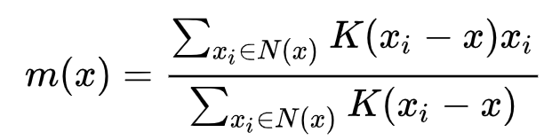
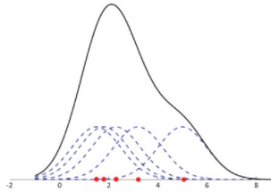
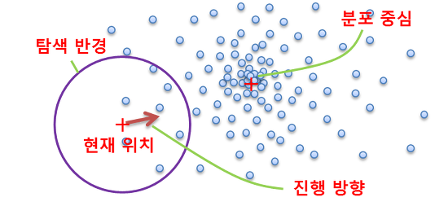
Mean-shift
The weighted mean of the density in the window determined by K is

Slide 3
Index
Segmentation
Active contours
Otsu’s algorithm
Region splitting and merging
Watershed

Slide 4
Active Contours
Snakes solve problems where the approximate shape of the boundary is known.
Initialize the boundary curve (Automatically, Manually)
The “Active” contour moves, like a wiggling “snake”.
- minimize the energy function from an external and internal force.
When most points on the contour line up with boundary, The contour stops moving.

Slide 5
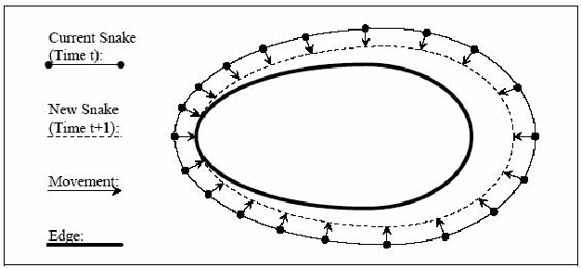
Active Contours
The curve is represented as a set of sequentially connected points.
The curve is usually closed, so the “first” and “last” points are connected.
Curve move around as the points moves.

Slide 6
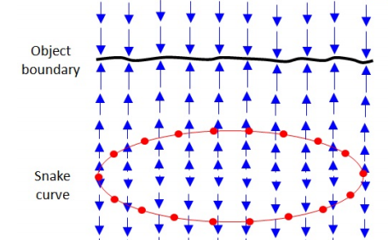


Active Contours
The energy function of the snake is the sum of its external energy and internal energy.
External Energy(Image Energy):
defined such that the contour seeks the boundary of the image.
measures the gradient magnitude in the image at the location of each snake point

Slide 7


Active Contours
Internal Energy(Shape Energy):
is composed of the continuity of the contour and the smoothness of the contour.
the first-order term makes the snake act like membrane and the second-order term makes it act like a thin plate.

Slide 8
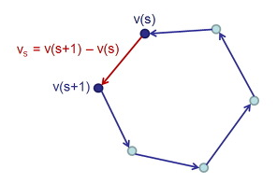
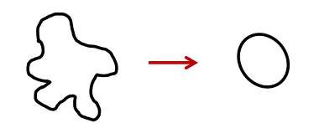

Active Contours
$↓$
$\frac{dv}{ds}=v\left(s+1\right)−v(s)$
make the curve shrink

Slide 9
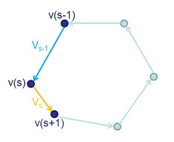


Active Contours
$↓$
$\frac{dv}{ds}=(v\left(s+1\right)−v\left(s\right))−(v\left(s\right)− v\left(s−1\right))$
make the curve smooth

Slide 10
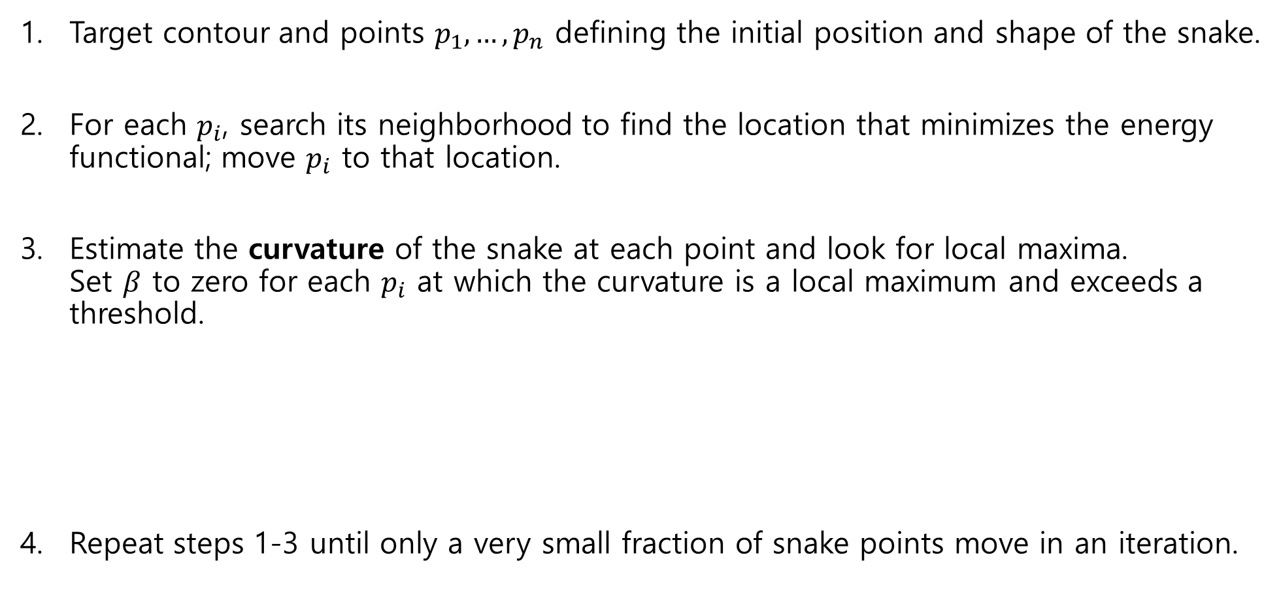
Active Contours
Target contour and points $p_{1}, …, p_{n}$ defining the initial position and shape of the snake.
For each $p_{i}$, search its neighborhood to find the location that minimizes the energy functional; move $p_{i}$ to that location.
Estimate the curvature of the snake at each point and look for local maxima. Set $β$ to zero for each $p_{i}$ at which the curvature is a local maximum and exceeds a threshold.
Repeat steps 1-3 until only a very small fraction of snake points move in an iteration.

Slide 11
Active Contours
When image size is large, this method works slowly.
Sensitive to noise.
Snakes are extensively used in medical image processing, and particularly to locate object boundaries.

Slide 12
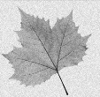
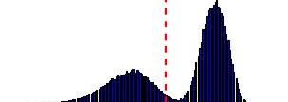
Otsu’s method
The simplest method of image segmentation is called the thresholding method.
Otsu’s method identifies the optimal threshold by making use of histogram of the image.
The algorithm assumes that the image contains two classes of pixels following bimodal histogram.

Slide 13

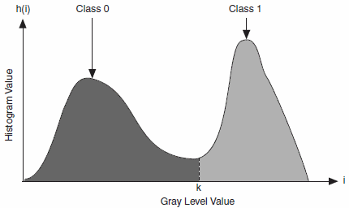




Otsu’s method
Normalized histogram:
Select threshold $k$ to segment image: class $C_{1}:[0, k]$ class $C_{2}:[k+1, L−1]$
Prob of pixels assigned to $C_{1}$:
Prob of pixels assigned to $C_{2}$:

Slide 14
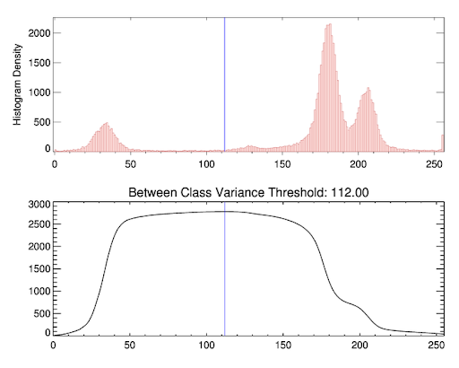



Otsu’s method
Mean value of the pixels in $C_{1}$: $m_{1}= \frac{1}{P_{1}(k)}\sum_{i=0}^{k−1}{ i∗p_{i}}$
Mean value of the pixels in $C_{2}$: $m_{2}= \frac{1}{P_{2}(k)}\sum_{i=k}^{L−1}{ i∗p_{i}}$
Find the threshold $k$ that maximizing
the between-class variance.

Slide 15
Otsu’s method
The method breaks down when the two classes are very unequal(i.e., different sizes).
If the variances of the object are large compared to the mean difference,
If the image is severely corrupted by additive noise,
the sharp valley of the gray level histogram is degraded.
Then Otsu's method results in the segmentation error.
Otsu's method is a one-dimensional discrete analog of Fisher's Discriminant Analysis

Slide 16
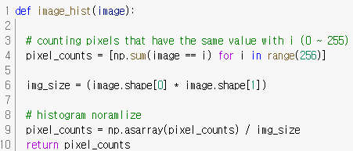
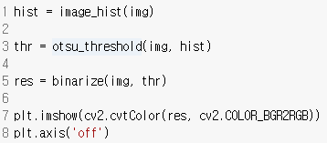

Otsu’s method

Slide 17
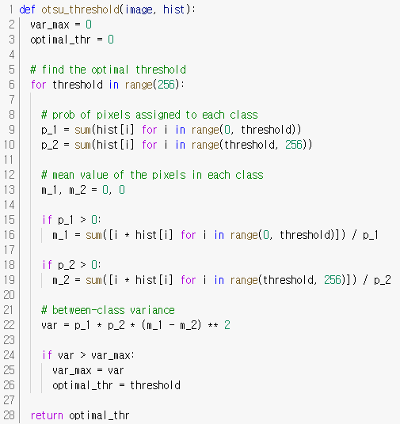
Otsu’s method

Slide 18
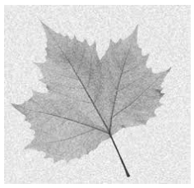
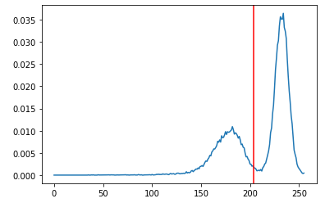
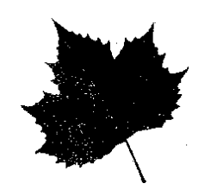
Otsu’s method
1
0

Slide 19
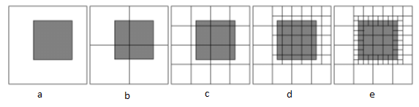
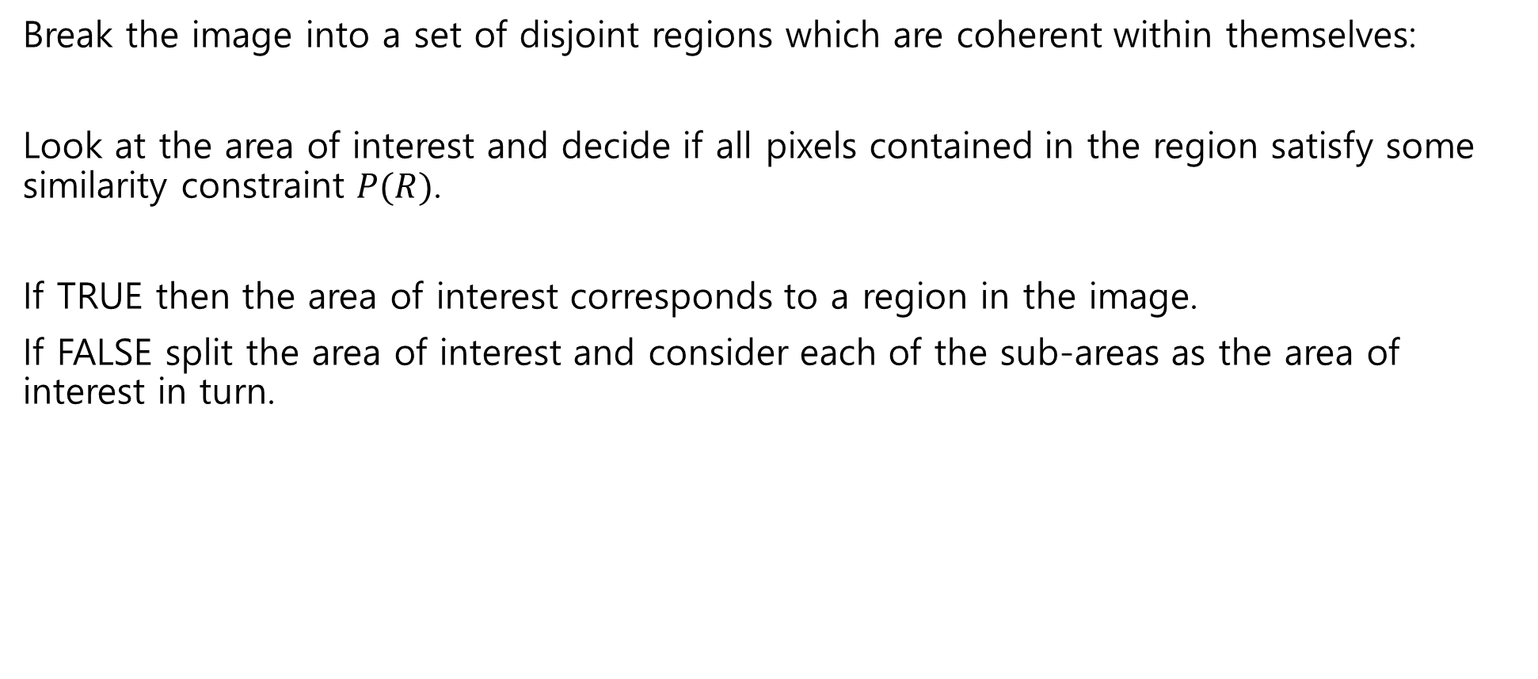
Region splitting
Break the image into a set of disjoint regions which are coherent within themselves:
Look at the area of interest and decide if all pixels contained in the region satisfy some similarity constraint $P(R)$.
If TRUE then the area of interest corresponds to a region in the image.
If FALSE split the area of interest and consider each of the sub-areas as the area of interest in turn.

Slide 20
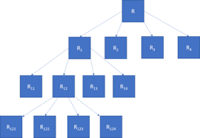

Region merging
We can describe the splitting of the image using a tree structure, using a quadtree
merge adjacent regions $R_{i}$ and $R_{j}$ if $P(R_{i}∪R_{j})$ = TRUE
Iterate until no further merging is possible

Slide 21
Region splitting and merging
Meaningful regions may not be uniform:
- surface properties of a solid body will vary in brightness or color
It is very unusual in practice for an image to be composed of uniform regions of similar intensity, color, etc.

Slide 22
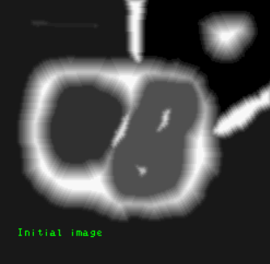
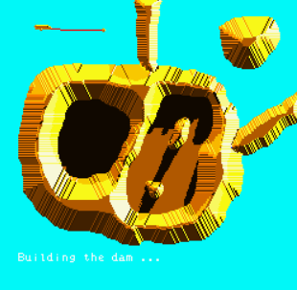
Watershed
Any grayscale image can be viewed as a topographic surface where high intensity denotes peaks and hills while low intensity denotes valleys.
start filling every isolated valley with water. - the rising water from different valleys will start to merge.

Slide 23
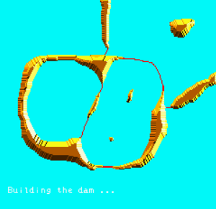
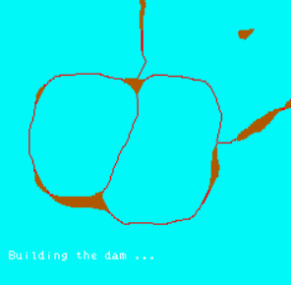
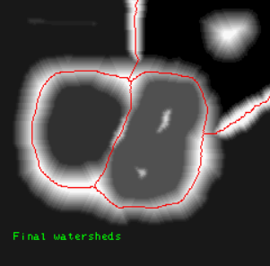
Watershed
build barriers in the locations where the water would merge. - barriers are called watershed lines
continue filling water and building watershed until the water level reaches the height of the highest peak. - only watershed lines will be visible and that will be the final segmentation result.

Slide 24
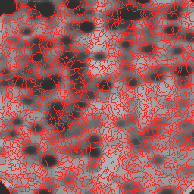
Watershed
But this approach gives you oversegmented result due to noise.
Label the region which we are sure of being the foreground or object with one color,
label the region which we are sure of being background or non-object with another color.
The region which we are not sure of anything, label it with 0. That is our marker.
Apply watershed algorithm, Then our marker will be updated with the labels we gave.
And the boundaries of objects will have a value of -1.

