Slide 1
컴퓨터 비전 세미나
12191584 김창수

Slide 2
3. Image Processing
3-1. Point operators
3-2. Linear filtering

Slide 3
3. Image Processing
to preprocess the image and convert it into a form, suitable for further analysis.
Examples of such operations include exposure(노출) correction and color balancing, reducing image noise, increasing sharpness(선명), or straightening(똑바로) the image by rotating it.
Additional examples include image warping(뒤틂) and image blending, which are often used for visual effects.
most computer vision applications, require care in designing the image processing stages in order to achieve acceptable results.

Slide 4
3-1. Point operators (point processes)
where each output pixel’s value depends on only the corresponding input pixel value plus, potentially, some globally collected information or parameters
ex) brightness and contrast adjustments / color correction and transformations
3-1. Point operators

Slide 5


3-1-1. Pixel Transforms
general image processing operator is a function that takes one or more input images and produces an output image
x is in the D-dimensional domain (usually D = 2 for images)
f and g operate over some range, which can either be scalar or vector-valued for color images or 2D motion.
3-1. Point operators

Slide 6




3-1-1. Pixel Transforms
commonly used point operators
multiplication and addition with a constant
a and b are often called the gain and bias parameters; are said to control contrast and brightness
dyadic (two-input) operator (linear blend operator)
perform a temporal cross-dissolve(흩어짐) between two images or videos, as seen in slide shows and film production
gamma correction
highly used non-linear transform that applied to images before further processing
is used to remove the non-linear mapping between input radiance(빛) and quantized pixel values
gamma 2.2 is a reasonable fit for most digital cameras.
3-1. Point operators

Slide 7
3-1-2. Color Transforms
In fact, adding the same value to each color channel not only increases the apparent intensity of each pixel, it can also affect the pixel’s hue(색조) and saturation(채도)
Chromaticity coordinates(색 좌표) or even simpler color ratios(색 비율) can first be computed and then used after manipulating the luminance(밝기) Y to re-compute a valid RGB image with the same hue and saturation.
Similarly, Color balancing can be performed either by multiplying each channel with a different scale factor or by the more complex process.
3-1. Point operators

Slide 8
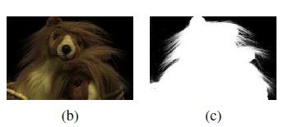
3-1-3. Compositing(합성) and matting(지우기)
The process of extracting the object from the original image is often called matting, while the process of inserting it into another image is called compositing.
The intermediate representation used for the foreground object between these two stages is called an alpha-matted color image
In addition to the three color RGB channels, an alpha-matted image contains a fourth alpha channel alpha (or A) that describes the relative amount of opacity(불투명도) or fractional coverage at each pixel
3-1. Point operators

Slide 9

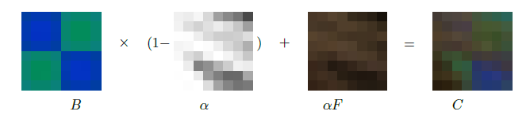
3-1-3. Compositing and matting
Pixels within the object are fully opaque (a = 1), while pixels fully outside the object are transparent (a = 0).
Pixels on the boundary of the object vary smoothly between these two extremes.
To composite a new image on top of an old image, the over operator is used.
a = 1 인 픽셀 : 배경 부분을 연하게(1 – a = 0) + 물체를 진하게(a = 1) => 물체 픽셀
a = 0 인 픽셀 : 배경 부분을 진하게(1 – a = 1) + 물체를 연하게(a = 0) => 배경 픽셀
3-1. Point operators

Slide 10
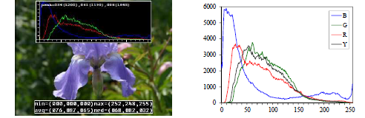
3-1-4. Histogram equalization(균일화)
We can visualize the lightness values in an image by plotting the histogram of the color channels and luminance values.
Notice that the image in Figure has both an excess of dark values and light values, but that the mid-range values are largely under-populated.
how to simultaneously brighten some dark values and darken some light values, while still using the full extent of the available dynamic range?
One popular answer to this question is to perform histogram equalization(균일화)
3-1. Point operators

Slide 11

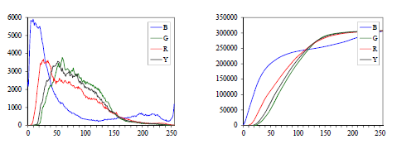
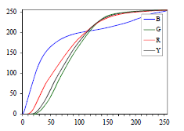
3-1-4. Histogram equalization
Cumulative distribution(누적 분포) c(I) is the integrated original distribution h(I).
-> scaled
We can look up its corresponding percentile c(I) and determine the final value that pixel should take.
When working with eight-bit pixel values, the I and c axes are rescaled from [0, 255]
3-1. Point operators

Slide 12
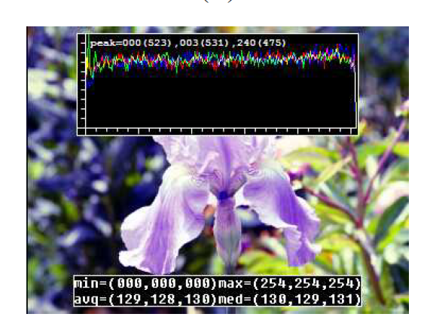
3-1-4. Histogram equalization
Blue Line 기준
요소 적음
-> 좁은 범위로 매핑
요소가 많은 부분이 흩어짐
요소가 적은 부분이 모임
요소 많음 요소 적음
요소 많음
-> 넓은 범위로 매핑
ex) 밝기 0부터 50을 가지는 요소가 10000개였다면, 밝기 0부터 200을 가지는 요소가 10000개가 됨
3-1. Point operators

Slide 13
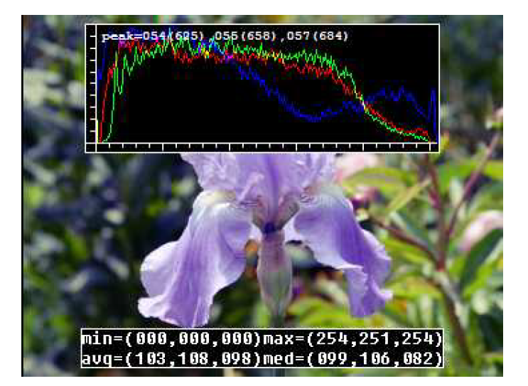
3-1-4. Histogram equalization
As we can see, the resulting histogram is flat; (it is “flat” in the sense of a lack of contrast and being muddy(탁한) looking).
One way to compensate for this is to only partially compensate for the histogram unevenness
which is a linear blend between the cumulative distribution function and the identity transform (a straight line)
Another potential problem with histogram equalization(in general, image brightening) is that noise in dark regions can be amplified and become more visible.
3-1. Point operators

Slide 14
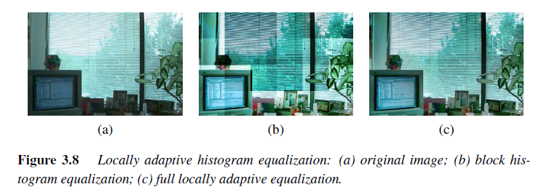
3-1-4. Locally Adaptive Histogram equalization
While global histogram equalization can be useful, for some images it might be preferable to apply different kinds of equalization in different regions.
Instead of computing a single curve, subdivide the image into M x M pixel blocks and perform separate histogram equalization in each sub-block
One way to eliminate blocking artifacts is to use a moving window.
3-1. Point operators

Slide 15
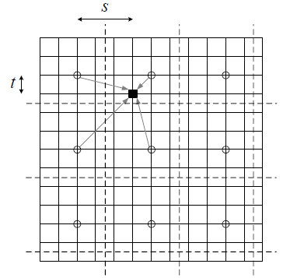
3-1-4. Histogram Interpolation(보간)
A more efficient approach is to compute non-overlapped block-based equalization(균일화) functions as before, but to then smoothly interpolate the transfer functions as we move between blocks.
This technique is known as adaptive histogram equalization (AHE)
The weighting function for a given pixel can be computed as a function of its horizontal and vertical position (s, t) within a block.
Instead of blending the four lookup tables for each output pixel, we can instead blend the results of mapping a given pixel through the four neighboring lookups.

Slide 16

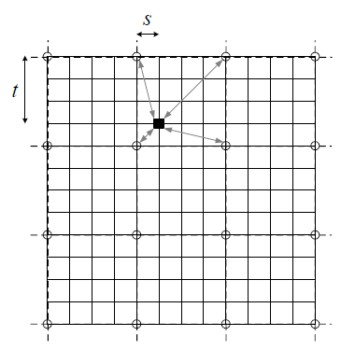
3-1-4. Histogram Interpolation(보간)
A variant on this algorithm is to place the lookup tables at the corners of each M x M block.
In addition to blending four lookups to compute the final value, we can also distribute each input pixel into four adjacent lookup tables.
w(I, j, k, l) is the bilinear weighting function between pixel (I, j) and lookup table (k, l).
notice that the gray arrows in Figure point both ways
This is an example of soft histogramming.

Slide 17
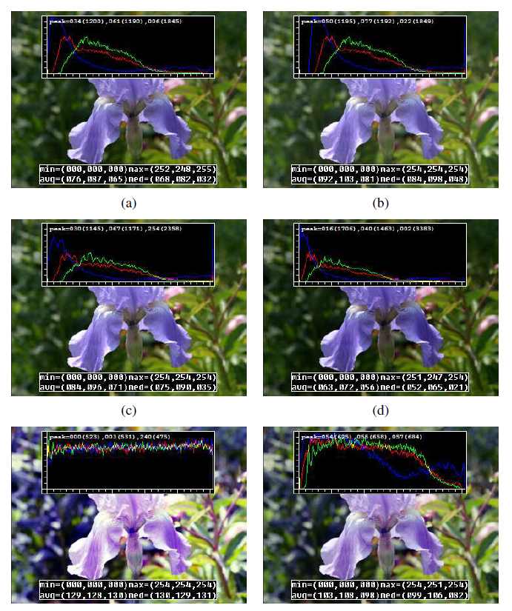
original ->
brightness increased (additive offset, b = 16)
gamma (partially) linearized ( = 1:2)
contrast increased (multiplicative gain, a = 1.1)
full histogram equalization
partial histogram equalization
3-1. Point operators

