Slide 1

Catering Combined
Many Cuisines, One Place
Owen Shepherd, Robert De Matteo

Slide 2
The problem
You are hosting an event for 30-40 people and would like to explore different cuisine options that catering companies offer.
You do an online search and realise that all the catering companies have different websites.
In addition catering companies offer similar types of food.
The solution:

Slide 3
Many catering companies on the one website
Each catering company specializes in a cuisine type (e.g. Italian, German, Korean)
Catering Combined
Many Cuisines, One Place

Slide 4
Walk through

Slide 5
Features
User type | View landing, provider sites, read reviews | Make a booking | Create/Modify a listing | Edit a listing | Leave a review | Delete a review | Receipt of email when account created or modified
Guest | ✓ | ✕ | ✕ | ✕ | ✕ | ✕ | ✕
User | ✓ | ✓ | ✕ | ✕ | ✓ | ✕ | ✓
User-admin | ✓ | ✓ - as a test for provider | ✓ | ✓ | ✕ | ✓ | ✓
Provider | ✓ | ✓ | ✓ | ✕ | ✕ | ✕ | ✓

Slide 6
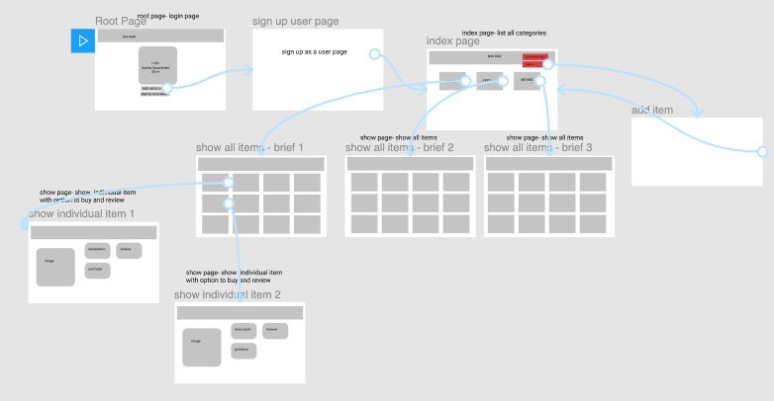
A walk-through of your design process and decisions
Our first idea was to create a Department like store

Slide 7
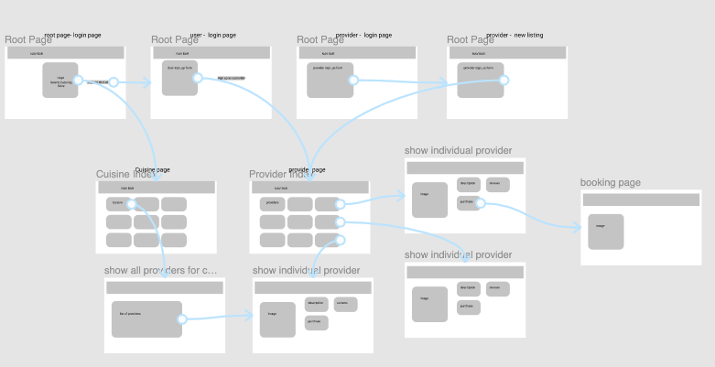
Version 2 - CC

Slide 8
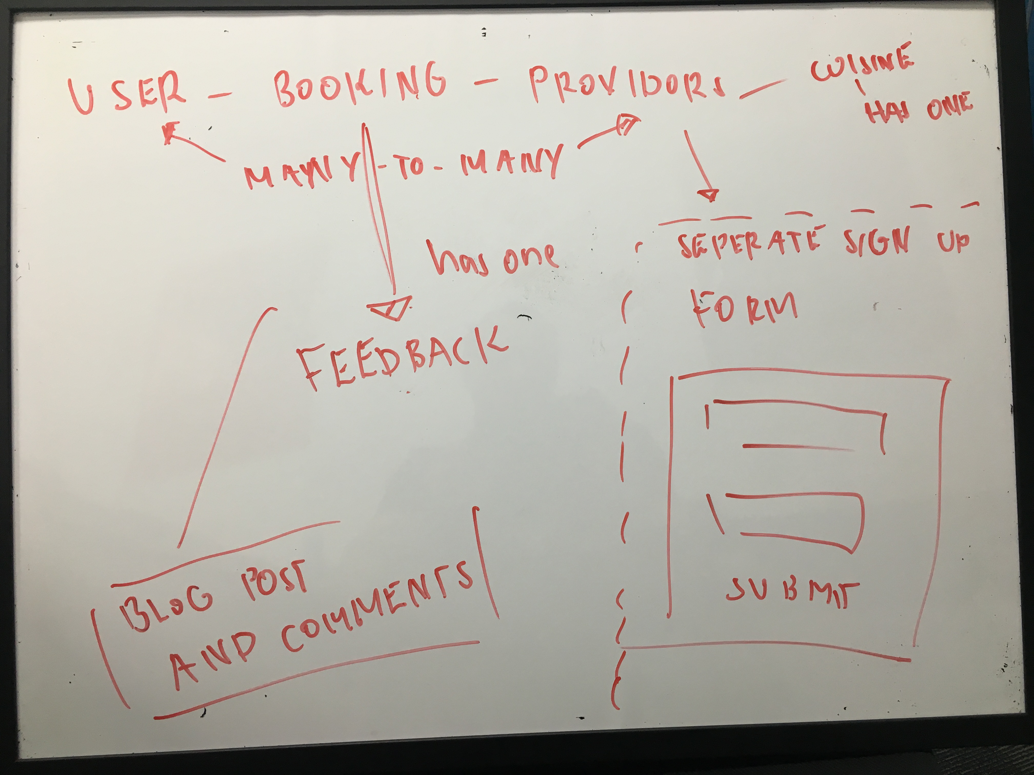

Slide 9
challenges, ethical issues, favourite parts, etc
Challenges
GitHub
Bootstrap
Devise – configuring 2 models
Satisfaction
💡 How to retrieve data from related database tables

Slide 10
development/build process
Development/build process/design
Design was kept simplistic and as minimal as possible
Emphasis was placed on create a familiar and intuitive user experience
Some images were used to liven up certain pages (as seen in sign up pages)

Slide 11
Ethical issues
One issue that may arise within the Catering Combined application (and any two-sided marketplace application, for that matter) is the chance that users will misuse the service by either failing to provide adequate services as was advertised or not providing them entirely. These problems are largely mitigated by larger corporate marketplaces (such as eBay) through harsh disciplinary action against fraudulent users as well as fail-safes to ensure that users who are subject to malicious activity are refunded or otherwise compensated

Slide 12
Favourite parts
debugging
feeling like it was possible for me to create a fully working application; while I would've liked to have spent more time on the styling and other visual features of the application, I'm pleased with the functionality of the application thus far

Slide 13
Thanks
To all the educators that helped
Aaron
Harrison
Leah
Anhar
Rob’s girls for feedback

