Slide 1

Catering Combined
Many Cuisines, One Place
Owen Shepherd, Robert De Matteo

Slide 2
You are to deliver a 7 minute presentation to the class.
The presentation should include,
A walk-through of your live App website and its features
A walk-through of your design process and decisions
A review of your development/build process including challenges, ethical issues, favourite parts, etc
Answer questions from the audience
Use this presentation as an opportunity to pitch your ideas to 'investors'.

Slide 3
The problem
You are hosting an event for 30-40 people and would like to explore different cuisine options that catering companies offer.
You do an online search and realise that all the catering companies have different websites.
In addition catering companies offer similar types of food.
The solution:

Slide 4
Many catering companies on the one website
Each catering company specializes in a cuisine type (e.g. Italian, German, Korean)
Catering Combined
Many Cuisines, One Place

Slide 5
Walk through

Slide 6
Features
User type | View landing, provider sites, read reviews | Make a booking | Create/Modify a listing | Edit a listing | Leave a review | Delete a review | Receipt of email when account created or modified
Guest | ✓ | ✕ | ✕ | ✕ | ✕ | ✕ | ✕
User | ✓ | ✓ | ✕ | ✕ | ✓ | ✕ | ✓
User-admin | ✓ | ✓ - as a test for provider | ✓ | ✓ | ✕ | ✓ | ✓
Provider | ✓ | ✓ | ✓ | ✕ | ✕ | ✕ | ✓

Slide 7
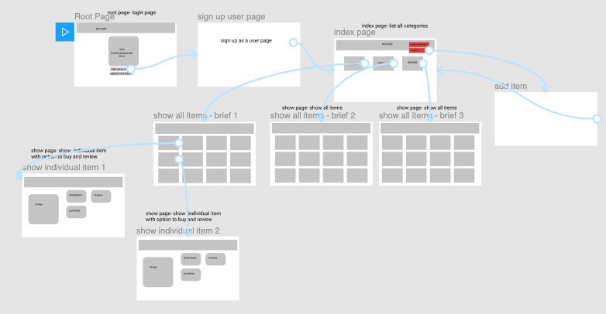
A walk-through of your design process and decisions
Our first idea was to create a Department like store

Slide 8
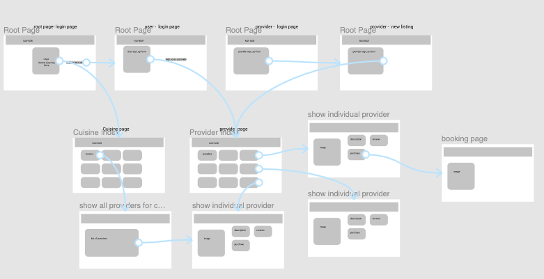
Version 2 - CC

Slide 9
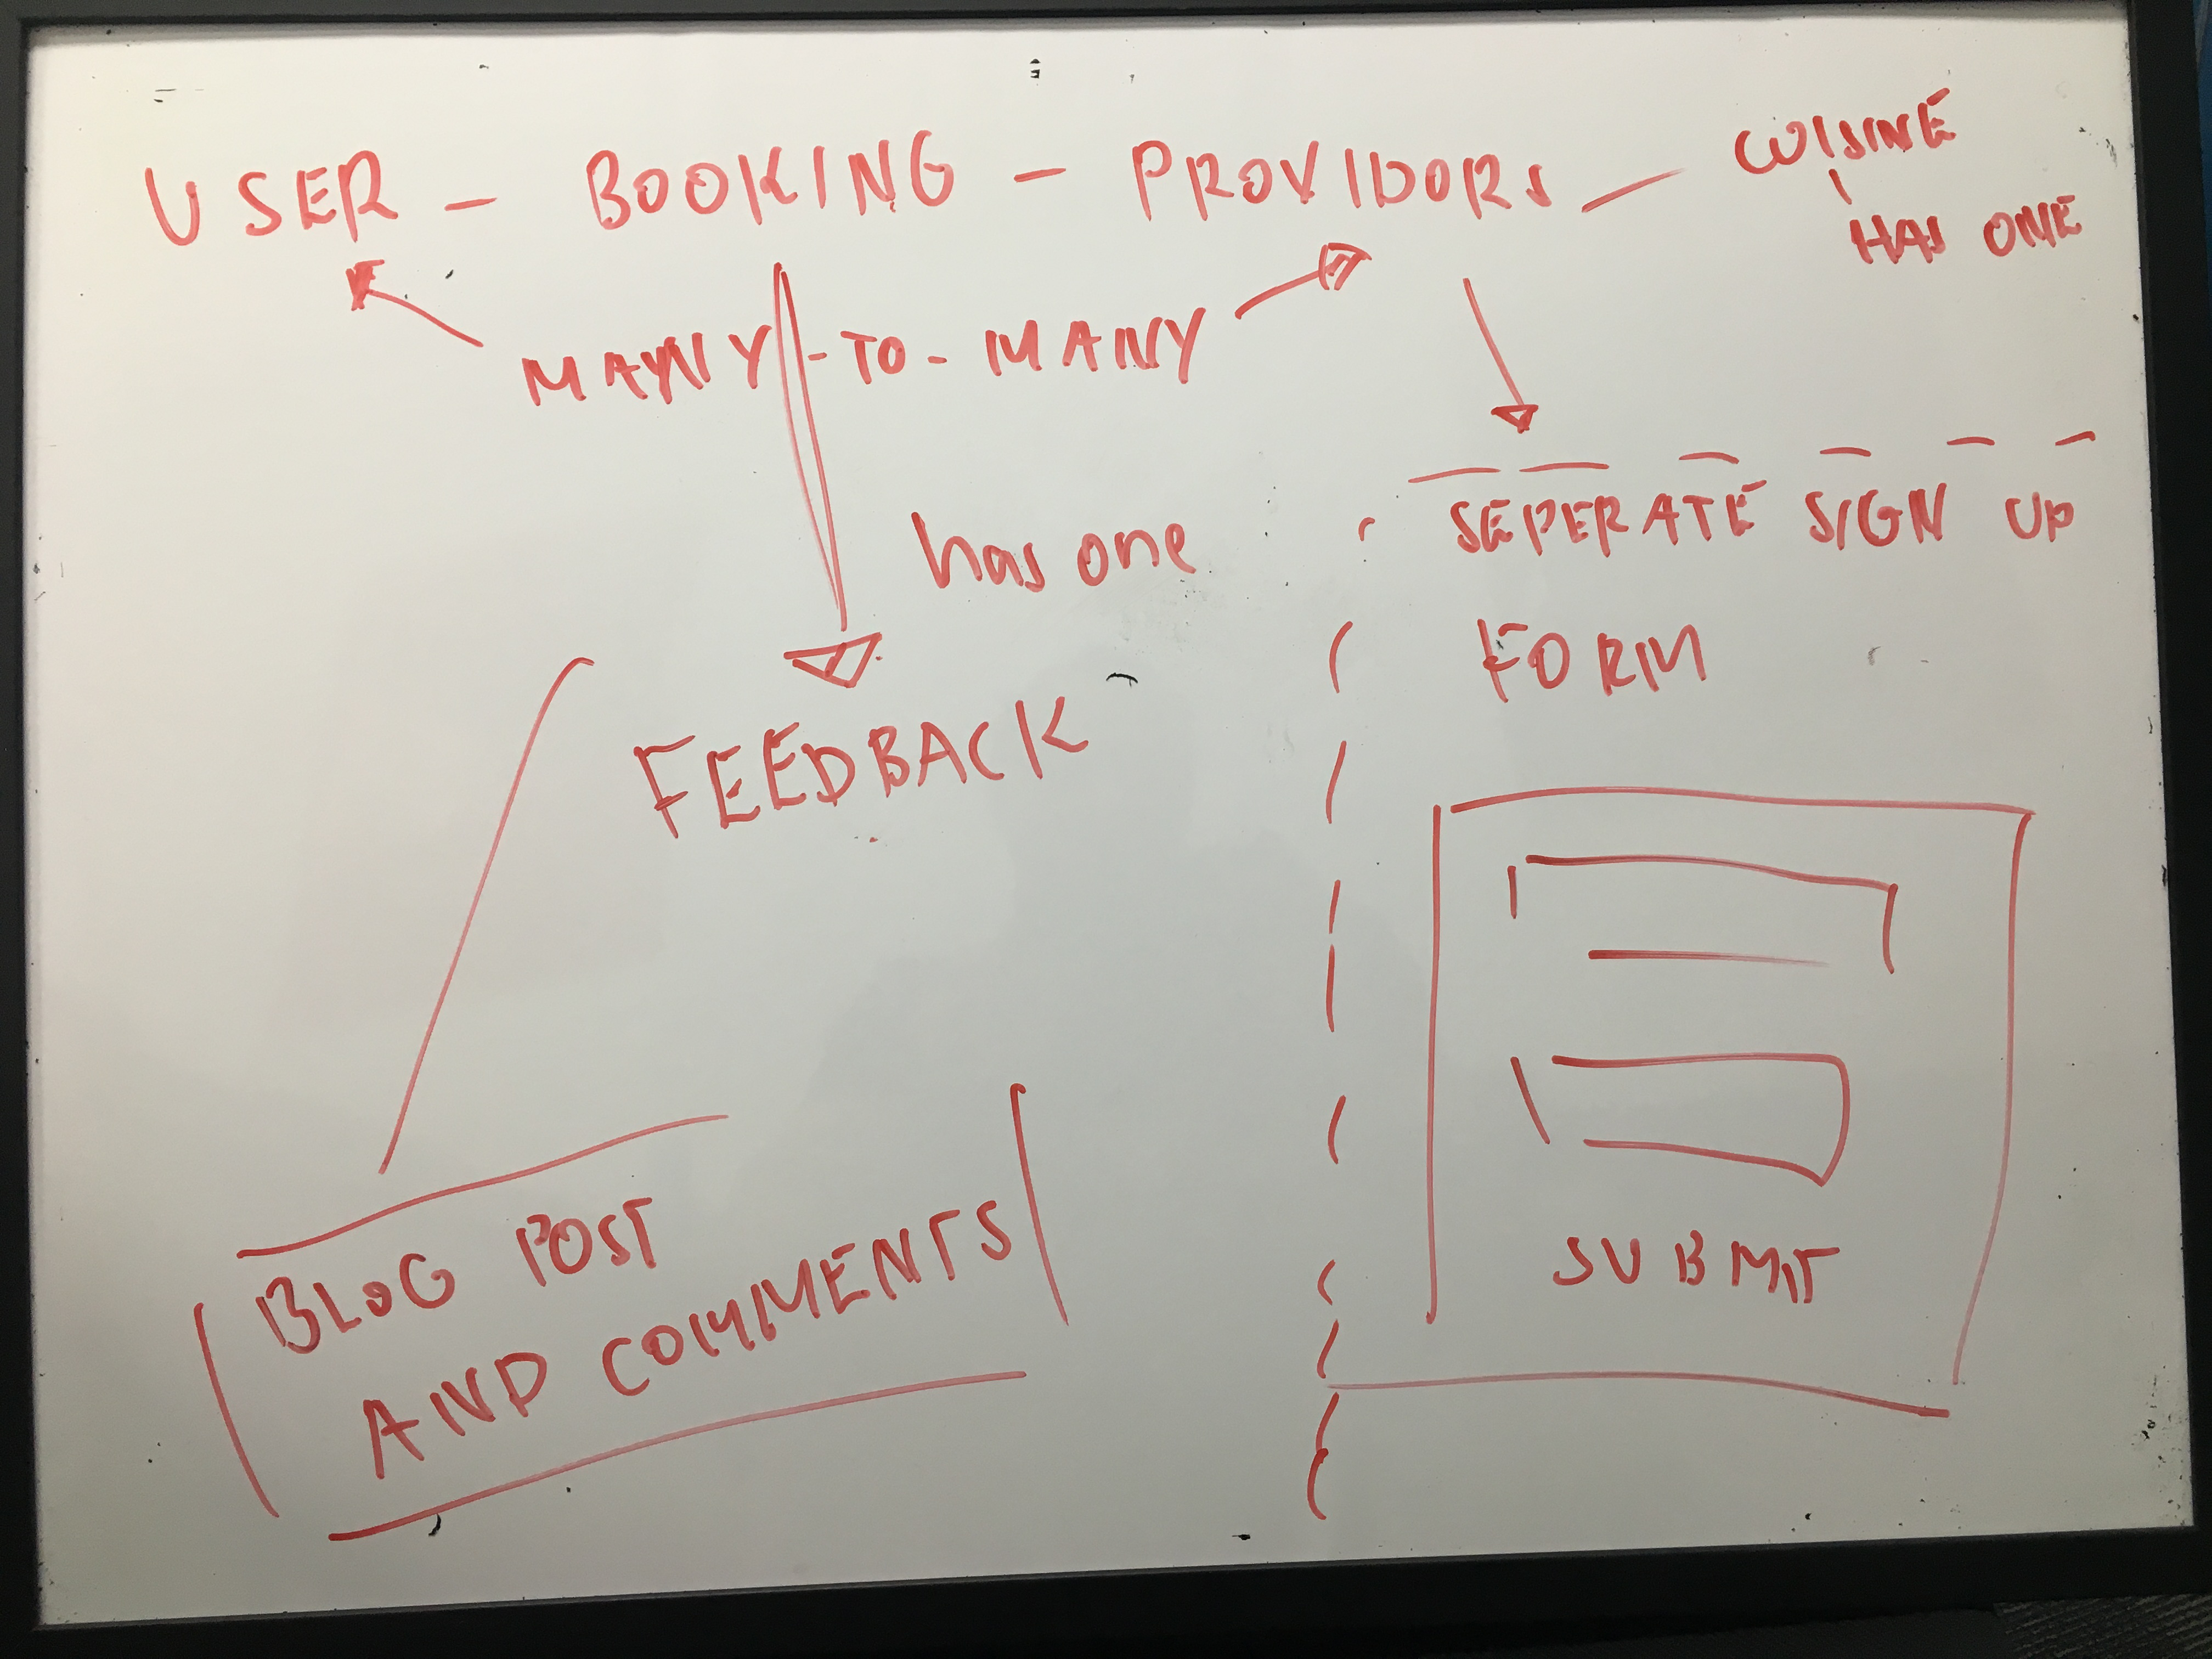

Slide 10
review of your development/build process including challenges, ethical issues, favourite parts, etc
Challenges
GitHub
Bootstrap
Devise – configuring 2 models
Satisfaction
💡 How to retrieve data from related database tables
Favourite parts
debugging

Slide 16
review of your development/build process including challenges, ethical issues, favourite parts, etc

