Slide 1
Study Progress
Terminology extraction

Slide 2
Data set
1.BNC CORPORA
1. Encoded in XML file.
2. Around 4.6 GB
3. With proper part of speech tag
4. Not separated in different domain yet when I got them.

Slide 3
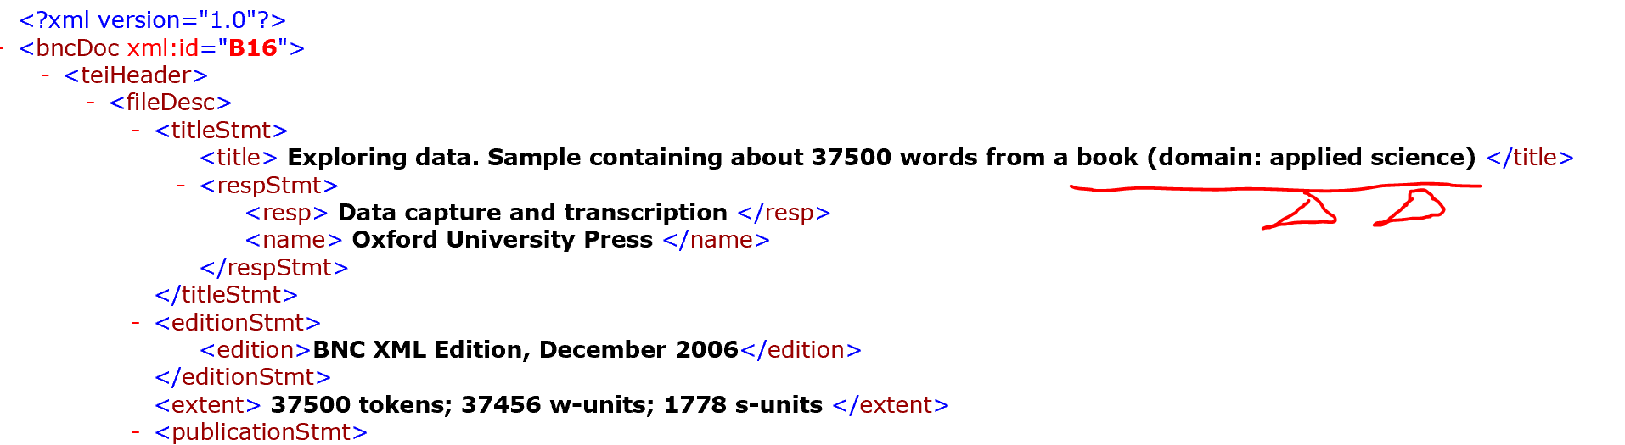
Data set

Slide 4
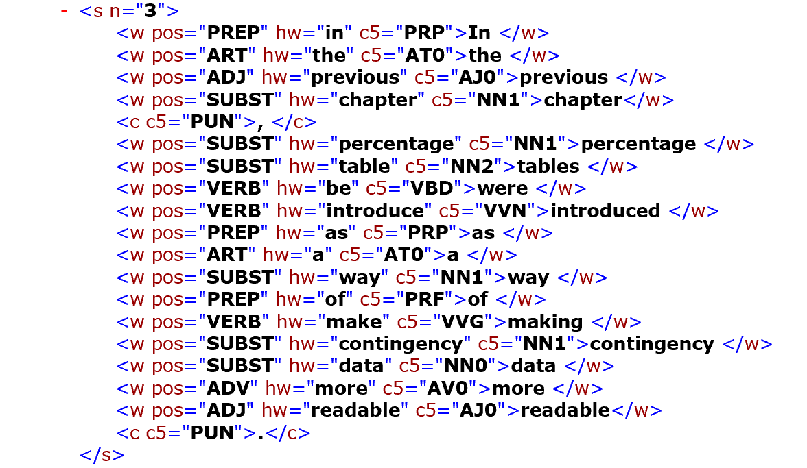
Data set
Notes:
Tagging in a sentence level

Slide 5
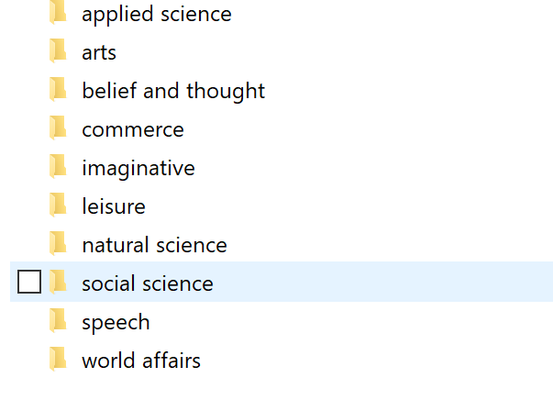
Data set

Slide 6
Data set
2.ScienceDirect Articles (Sciencie 2017)
Plain Texts.
Stored in txt files, train set and test set are well separated
https://scienceie.github.io/resources.html

Slide 7
More recent(Advanced) works
EM algorithm based method
(EM-based Hybrid Model for Bilingual Terminology Extraction from Comparable Corpora , 2010)

Slide 8
More recent(Advanced) works
EM-algorithm based method
Unsupervised model.
Terminology extraction in a bilingual setting.
There are Source document and Target document
From each types of documents, a cluster of terms are generated

Slide 9
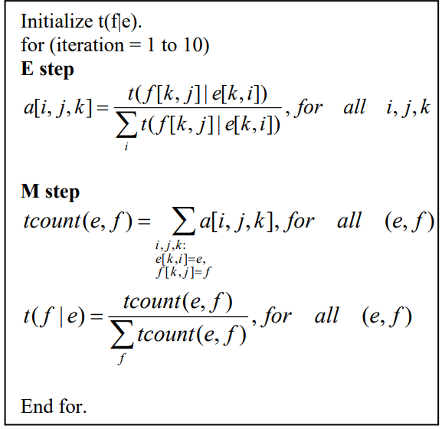
t(f|e): probability a term in source document is mapped to a target document.
f[k, j]: the j-th term in the k-th aligned target document.
e[k, i]: the i-th term in the k-th aligned source document.

Slide 10
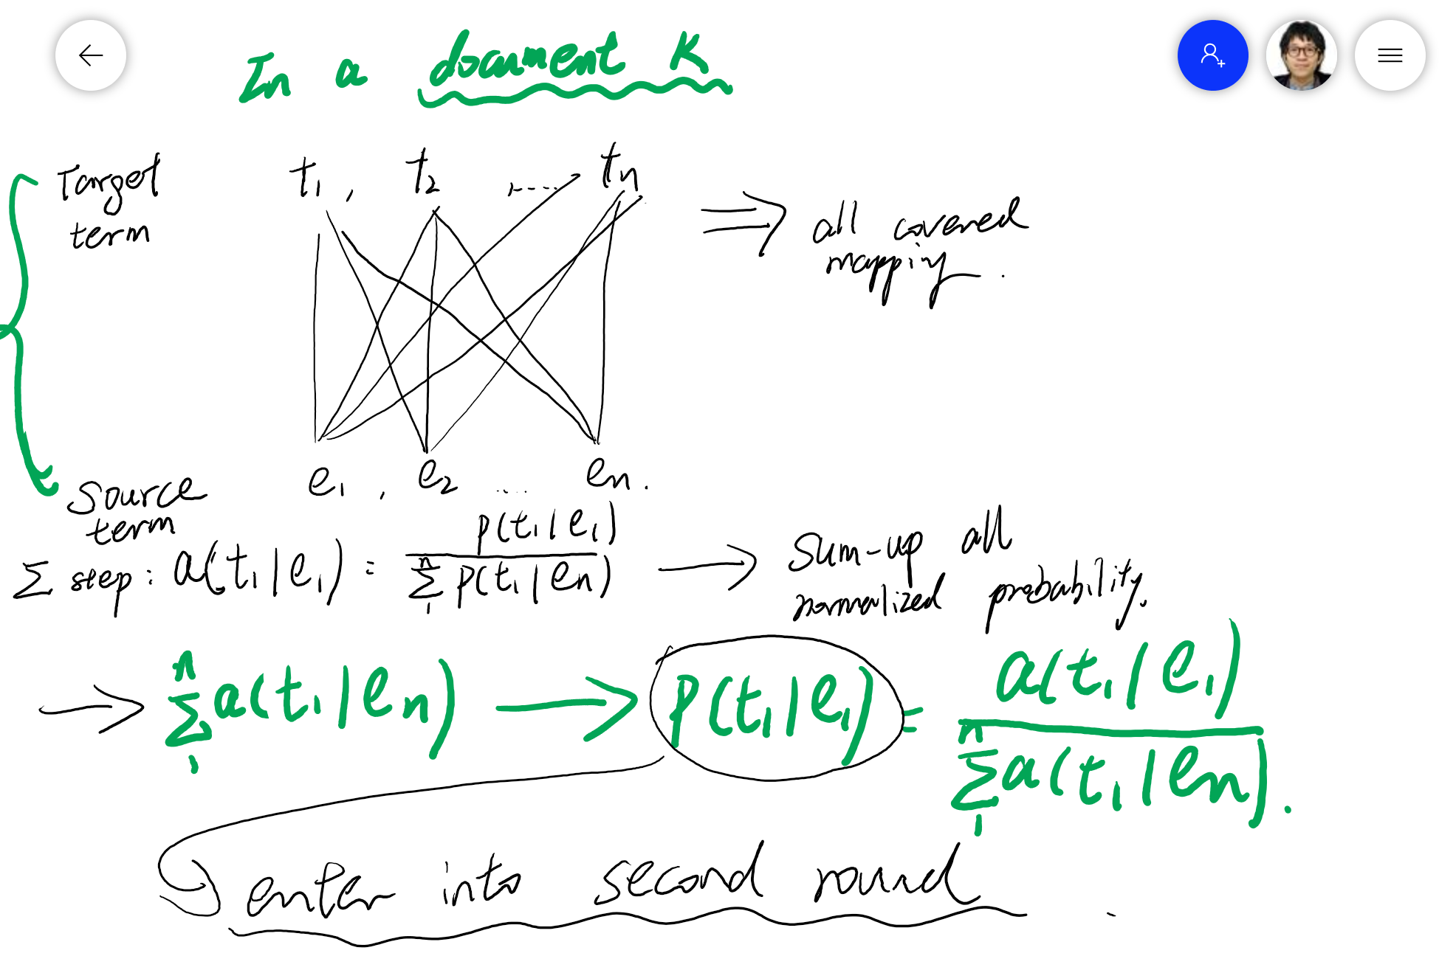
More recent(Advanced) works
At each iteration, the pair with probability over 0.8 will be filtered out

Slide 11
More recent(Advanced) works
Calculation of initial term alignment probability t(f|e)
Context similarity *Document-level similarity*Related term similarity

Slide 12
More recent(Advanced) works
2. Deep learning approaches in terminology extraction
(the focus is on term in a broader sense, e.g., name entity, event, relation extraction)
(Adversarial training for multi-context joint entity and relation extraction, 2018)
Focus is put on the extraction/retrieval aspect.

Slide 13
More recent(Advanced) works
Adversarial training:
Both clean and adversarial data are used to train the model so that the model could what’s correct and what’s incorrect.
Underlying algorithm: MinMax algorithm.
The goal is, for each word w, a head vector and a relation vector are computed.
e.g. John live in California , head: California, relation: lives_in

Slide 14
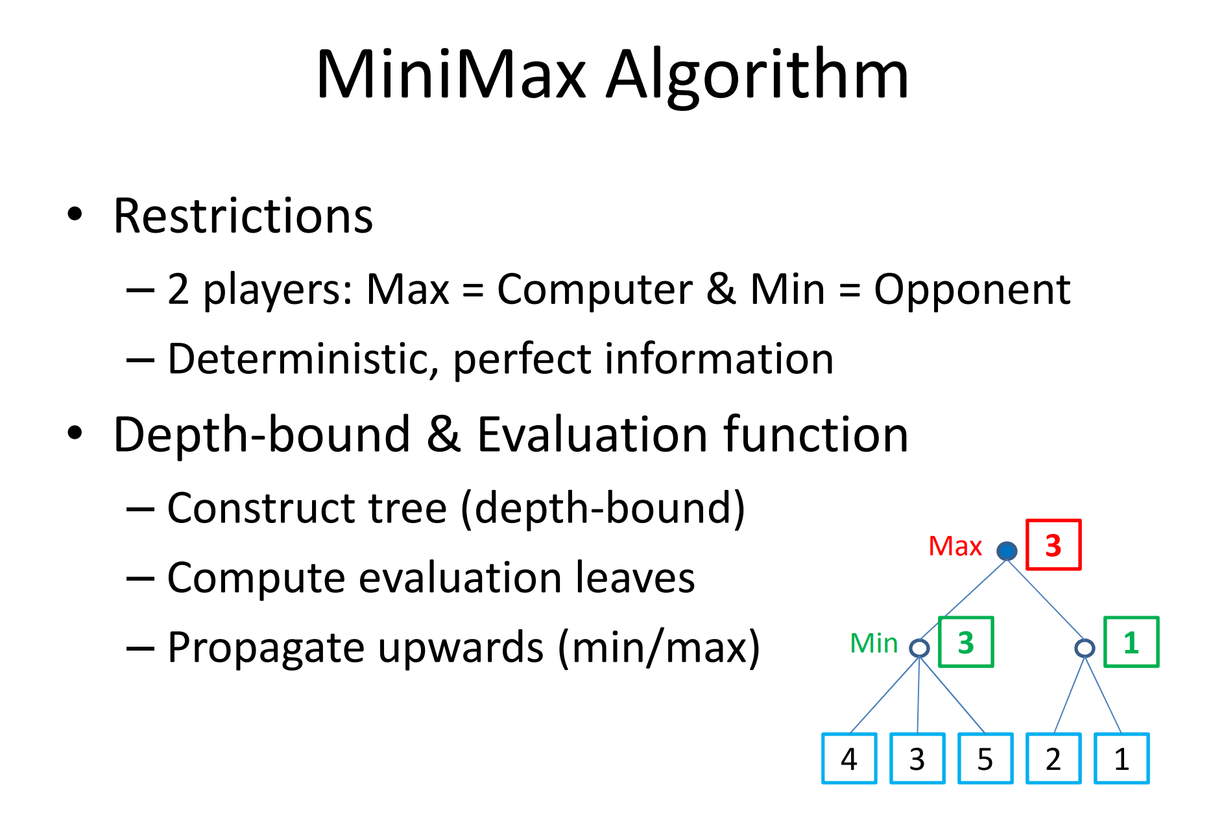
More recent(Advanced) works

Slide 15
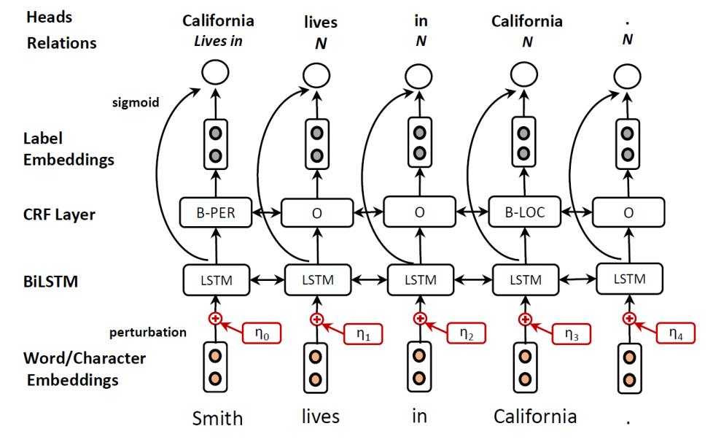
More recent(Advanced) works
Pre-training on word level and character level embedding.
The Character level embedding is for recording the morphological information.
Concatenation of the two embeddings

Slide 16
More recent(Advanced) works
Generate example from the created embedding, change the learnt parameters so that the loss function could get maximal value

Slide 17
More recent(Advanced) works
The joint embeddings are then fed into the BiLSTM layer.
Linear-chain CRF layer for the label prediction. The focus seems to be on the beginning of the sentence

Slide 18
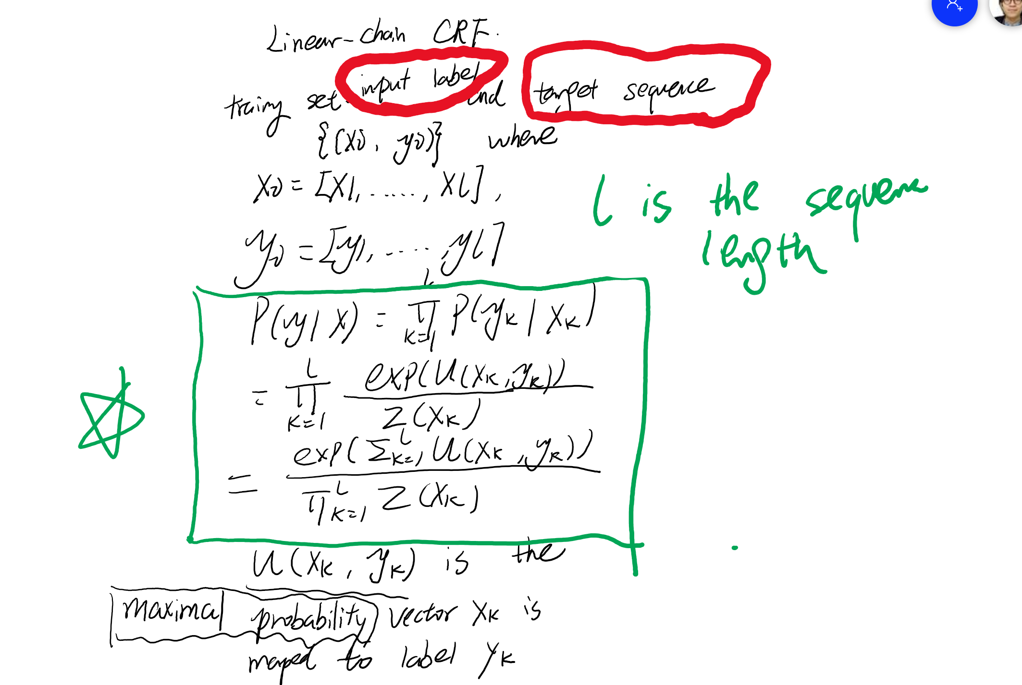
More recent(Advanced) works

Slide 19
Plan from Now
Refresh my memory on the deep learning staff: Pytorch and Tensorflow
Get familiar with myself on Deep Learning and ANN architecture.
Represent the Baseline model by 30th of June

