Slide 1

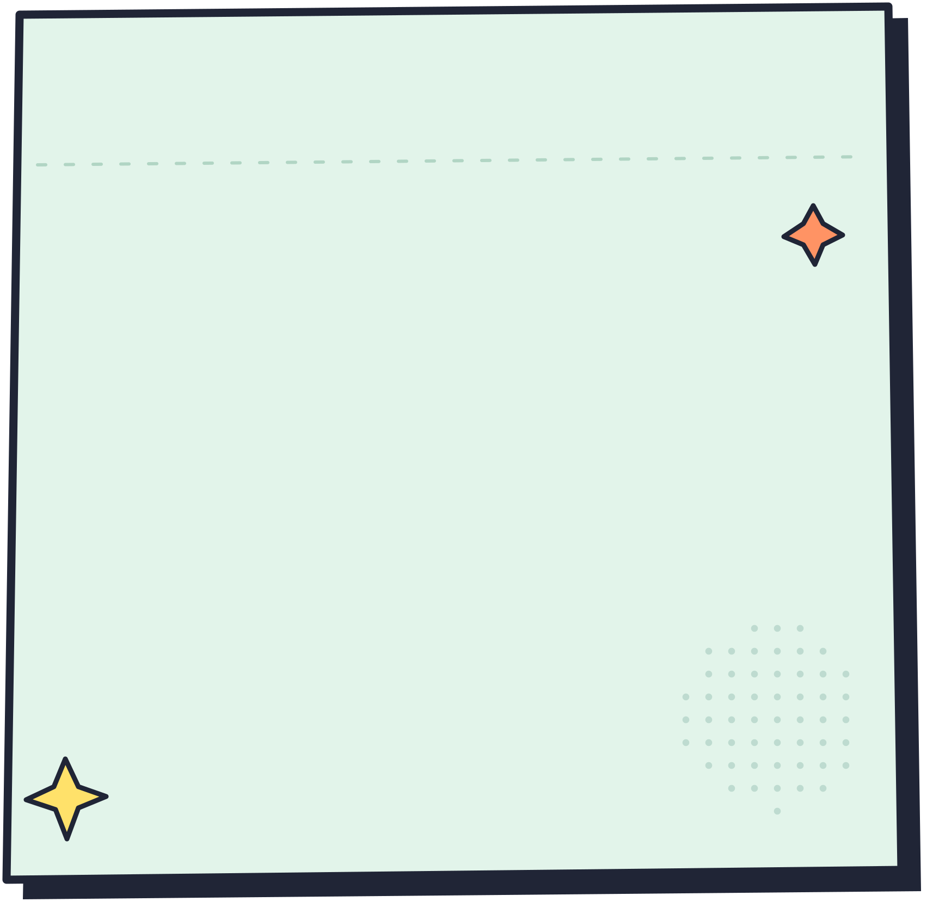

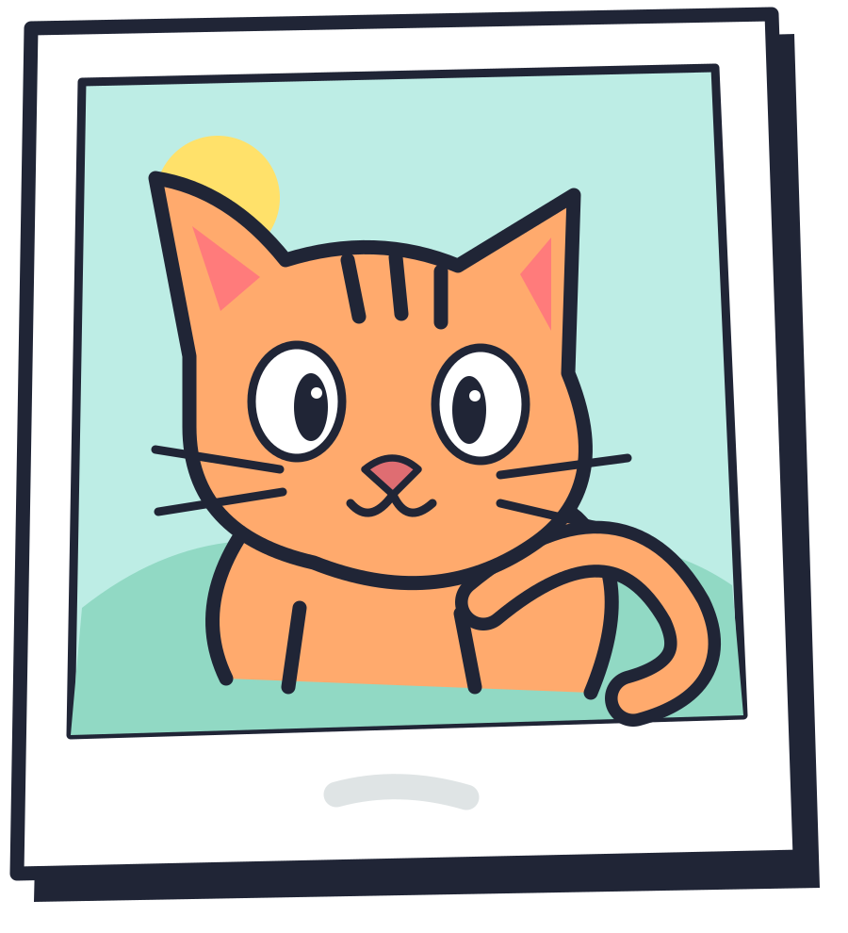


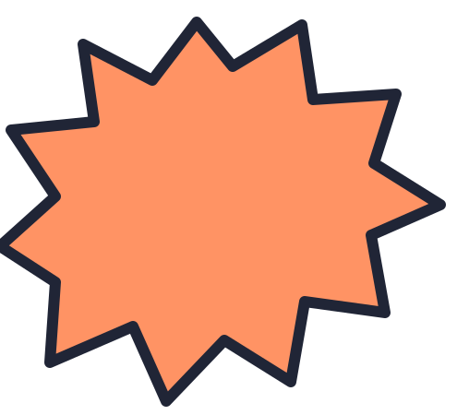
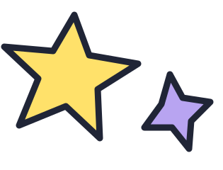
A04 / ITAI 2376 / GROUP 4
DEEP LEARNING FOR AN 11-YEAR-OLD
Can a Computer
Learn From Its
ONE PRACTICE ROUND
Dog?
Mistakes?
How Artificial Intelligence (AI)
Gets Better at Guessing
THE PHOTO
Oops!
PRESENTED BY
Esther Odaibo
King Owusu
ANSWER KEY: CAT!
Louis Delgado
Zain Ahmed
A mistake is a place to start.
Notes:
A04 | ITAI 2376 | Group 4
Deep Learning for an 11-Year-Old
Can a Computer Learn From Its Mistakes?
How Artificial Intelligence (AI) Gets Better at Guessing
Presented by Esther Odaibo, King Owusu, Louis Delgado, and Zain Ahmed.
One practice round: the computer guesses “Dog?” but the answer key says “Cat.” A mistake is a place to start.
The cartoon computer is a visual character used to introduce the training example.

Slide 2
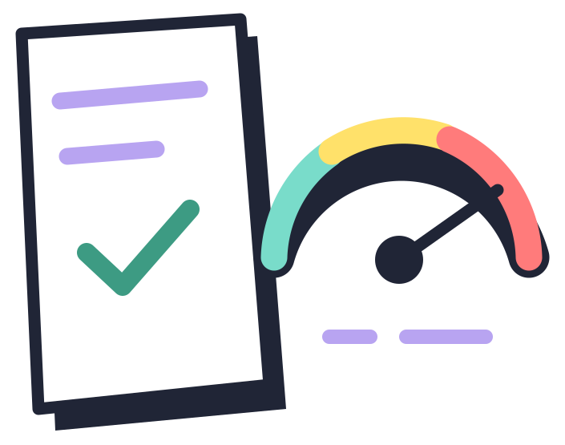
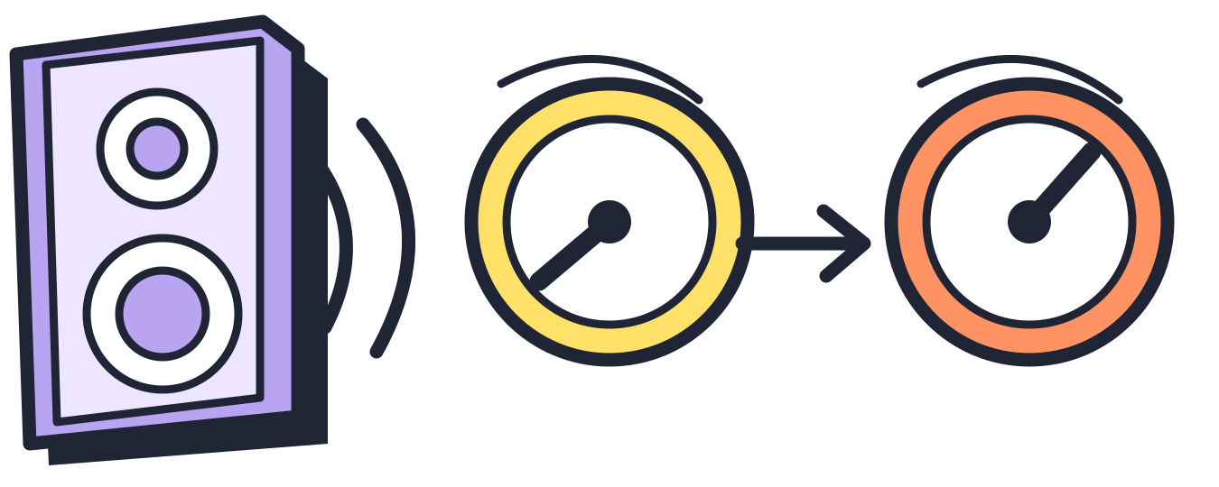

GROUP 4 / THE PRACTICE ROUND
How Does a Computer Know When It’s Wrong?
People label practice photos “cat” or “dog.” The labels are an answer key, not clues for the guess.
1
INPUT
2
FORWARD PASS
3
LOSS CALCULATION
“Look at the picture”
“Make a guess”
“Check the answer”
The computer gets a photo. The answer label stays hidden for now.
Using its current settings, the network makes a guess: “Dog?”
The label says “cat.” Loss is an error score: bigger means more wrong.
4
WEIGHT UPDATE
5
NEXT ITERATION
“Adjust the controls”
“Practice again”
SPEAKER VOLUME
Like volume controls, weights make signals count more or less.
They are number settings, not real knobs. The computer adjusts them to try to lower its error score.
Try more labeled photos with the new settings. Each practice round is an iteration.
2
5
Big question: Which controls should we adjust, and by how much?
Notes:
How Does a Computer Know When It’s Wrong?
Imagine teaching a computer to tell cats from dogs. People label the practice photos “cat” or “dog.” Those labels are the answer key, saved for checking after the computer guesses.
Input → Forward Pass → Loss Calculation → Weight Update → Next Iteration
INPUT — “Look at the Picture”
The computer receives a photo, but it does not get to peek at the answer label.
FORWARD PASS — “Make a Guess”
The photo’s information passes through the neural network. Using its current settings, the computer predicts: “I think it’s a dog!”
LOSS CALCULATION — “Check the Answer”
The answer key says “cat.” The computer compares its prediction with that label. Its loss is an error score: a bigger score means a bigger mismatch.
WEIGHT UPDATE — “Adjust the Controls”
Think of turning a speaker’s volume from 2 to 5. Those numbers are settings that control how strongly you hear the sound. Weights work a little like volume controls: they change how strongly signals inside the network influence its guess. The computer adjusts these settings to try to lower its error score. There are no actual knobs; the settings are stored as numbers.
NEXT ITERATION — “Practice Again”
The computer tries more labeled photos using its adjusted settings. Each new practice round is an iteration.
Our big question: Which controls should we adjust, and by how much?
Source basis: the explanation and examples developed and approved in this conversation. This redesign changes the visual presentation, not the instructional framing. Full explanations are kept here so that slide text can remain readable.

Slide 3
GROUP 4 / GRADIENT DESCENT / LOUIS DELGADO
From Space Orbits to “Cat or Dog?”
One old idea connects them: use slope information to improve a guess.
1847 / CAUCHY’S CHALLENGE
GRADIENT / THE SLOPE CLUE
AI / THE SAME IDEA
HIGHER ON THIS MAP = MORE ERROR
Dog?
Augustin-Louis Cauchy
Orbit calculations were hard!
Cauchy developed a method
to improve estimates using
the slope of an error score.
Gradient: slope information
that points uphill.
Label: CAT
Same cat. Same answer key.
AI uses the slope to change
its weights, the settings that
influence its guesses.
Descent: step the other way
to try to lower the error.
Check the slope again.
Long before AI!
Space or cats: check the slope, then step toward less error.
Sources: Cauchy (1847); Lemaréchal (2012); Google Machine Learning Crash Course. Details in notes.
Notes:
PRESENTER: Louis (James) Delgado | Group 4
SUGGESTED NARRATION (about 60 seconds)
Remember our cat photo and the computer that guessed “Dog?” The way we improve that guess has a history long before AI. In 1847, Augustin-Louis Cauchy described a method motivated by difficult astronomical calculations, including determining the orbit of a celestial body. Instead of solving every unknown in one giant leap, use slope information to improve a starting estimate.
Here is our bridge: an orbit calculation has settings describing the orbit, while a neural network has weights describing how signals influence its guess. In each case, we can measure a mismatch. Picture that error as height on a map. The gradient tells us which way is steepest uphill. Descent means taking a controlled step in the opposite direction, then calculating the slope again. The cat photo and CAT answer key do not change. The computer changes its settings.
HISTORICAL PRECISION
Lemaréchal reproduces and analyzes Cauchy’s 1847 note. The opening specifically identifies astronomical calculation as the motivation and orbital elements as the unknowns. Cauchy discusses algebraic equations describing motion, not directly integrating the differential equations of an orbit. It is accurate to link the method’s motivation to orbit calculation; do not claim that Cauchy invented orbital mechanics or artificial intelligence.
CONCEPTUAL PRECISION
The gradient is a vector of partial derivatives in a multi-parameter setting. It points toward steepest local increase in the ordinary Euclidean geometry. For a sufficiently small step at a differentiable point with a nonzero gradient, moving opposite it lowers the objective locally. The drawn path is an analogy, not a literal space orbit or a measured training result. Global optimality is not guaranteed. We use “slope information” rather than implying the gradient points downhill.
REFERENCES
Cauchy, A.-L. (1847). Méthode générale pour la résolution des systèmes d’équations simultanées. Comptes rendus de l’Académie des sciences, 25, 536–538.
Lemaréchal, C. (2012). Cauchy and the gradient method. Documenta Mathematica, Extra Volume ISMP, 251–254. https://doi.org/10.4171/DMS/6/27 ; https://ems.press/books/dms/251/4938
Google. Machine Learning Crash Course: Linear regression — Gradient descent. https://developers.google.com/machine-learning/crash-course/linear-regression/gradient-descent
Google. Convolutional neural networks, with Keras and TPUs, section “Gradient descent.” https://codelabs.developers.google.com/codelabs/keras-flowers-convnets
ARTWORK
Cat photo, cartoon computer, speech bubble, paper background, speaker and control artwork match the user-supplied A04_Group4_Title_Intro_Comic(1).pptx. The lesson keeps the ongoing cat-versus-dog practice story. The orbit and loss-map diagrams are illustrative, not real observations.

Slide 4
GROUP 4 / GRADIENT DESCENT / LOUIS DELGADO
Help the Computer Find “Cat”
Same photo. Same CAT answer key. Adjust the controls, not the cat!
LOSS LANDSCAPE / A MAP OF POSSIBLE SETTINGS
WEIGHTS / “CONTROL SETTINGS”
ANSWER KEY
LOSS = ERROR SCORE
Like speaker volume, weights
change how strongly signals
influence the computer’s guess.
Dog?
Bigger mismatch
with the CAT label
Smaller mismatch
Cat?
CAT
2
5
This photo and label stay put.
Example settings, not actual cat / dog weights.
WEIGHT = ONE CONTROL SETTING
LEARNING RATE / “STEP SIZE”
Tiny steps can be slow.
Huge jumps may overshoot.
Move the setting. Try to lower the loss.
Going downhill means smaller loss, not always smaller weights!
Illustrative example. Sources: Google Machine Learning Crash Course and Google Codelabs. Details in notes.
Notes:
PRESENTER: Louis (James) Delgado | Group 4
SUGGESTED NARRATION (about 60 seconds)
The answer key still says CAT. We do not fix the wrong guess by changing that answer. We change the network’s weights. Think about turning a speaker from volume 2 to volume 5: the numbers are settings, and changing them changes the result. Weights are numerical settings that change how strongly signals influence the prediction. There are no physical knobs inside the model.
On this map, moving left or right changes one weight setting. Moving up or down changes the error score, called loss. A point higher up disagrees more strongly with our CAT label. A lower point has less mismatch. The slope gives the local clue, and gradient descent moves the setting in the opposite direction to try to lower loss. Our key discovery was that going downhill does NOT necessarily mean making a weight smaller: sometimes a weight must increase for error to decrease.
The learning rate controls how strongly we apply the update. Tiny steps may be slow; giant steps may overshoot. Recalculate and repeat on many training examples.
CONNECTION TO KING’S SECTION
Backpropagation calculates gradients. Gradient descent uses those gradients to update weights. A natural transition: “King explained how we find the slopes. Now we use them to change the controls.”
ACCURACY NOTES
The plotted horizontal axis is a weight, not time, practice rounds, or the position of the cat. It is a simplified illustrative slice of a loss landscape with other parameters held fixed, not data from a trained classifier. Values 2 and 5 are speaker-volume examples, not actual cat/dog model weights. Weights do not normally correspond one-to-one with hand-labeled features like ears, whiskers, or tails. The CAT target comes from the label attached to the training example. Classifier loss generally depends on predicted probabilities and the target, not merely whether a class name is right. Not every finite step reduces loss, and mini-batch updates need not improve every individual example. A globally best solution is not guaranteed.
REFERENCE UPDATE RULE (for presenter understanding, not required on the slide)
new weight = old weight - learning rate × gradient component
The learning rate scales the gradient; actual update magnitude depends on both.
REFERENCES
Google. Machine Learning Crash Course: Linear regression — Gradient descent. https://developers.google.com/machine-learning/crash-course/linear-regression/gradient-descent
Google. Machine Learning Crash Course: Linear regression — Hyperparameters. https://developers.google.com/machine-learning/crash-course/linear-regression/hyperparameters
Google. Convolutional neural networks, with Keras and TPUs, section “Gradient descent.” https://codelabs.developers.google.com/codelabs/keras-flowers-convnets
ARTWORK
The illustrated cat photo, cartoon computer, speech bubble, speaker, number controls and paper texture continue the graphics and characters from the user’s uploaded comic title/introduction deck. The text and diagrams are editable PowerPoint objects; illustrations remain image assets.

Slide 5
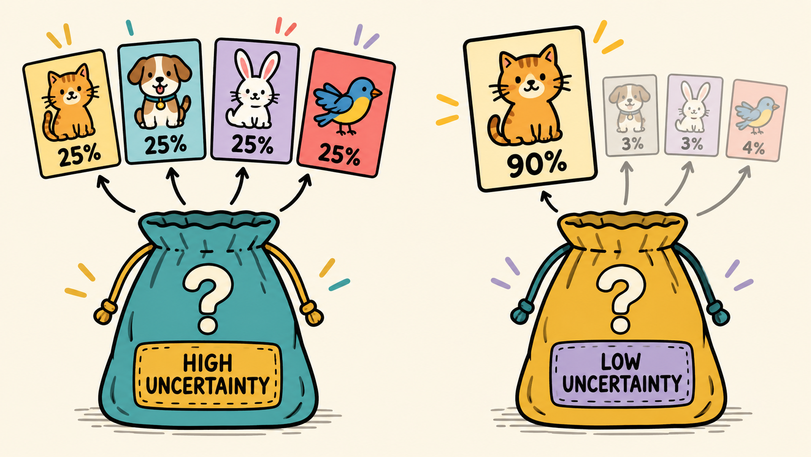
A04 / ENTROPY AND CROSS ENTROPY / ESTHER ODAIBO
Entropy: How Unsure Is the Computer?
Entropy turns the computer's uncertainty into a number.
THE REAL IDEA
The computer gives every possible answer a chance.
Similar chances = high entropy
One clear favorite = low entropy
WHY IT MATTERS
It shows whether the model feels certain or unsure before it chooses a label.
WHERE THE ANALOGY STOPS
A real network does not feel confused. It calculates entropy from probabilities.
Quick check: Which bag has greater entropy, and what makes it greater?
Source: Google for Developers, Machine Learning Glossary
ESTHER ODAIBO | GROUP 4
Notes:
Speaker notes: Think of a mystery bag. If four answers each have about the same chance, the computer has high uncertainty, so entropy is high. If one answer has most of the probability, entropy is low. Entropy measures uncertainty inside one probability distribution. It does not say whether the favorite answer is correct.
Source: Google for Developers, Machine Learning Glossary. https://developers.google.com/machine-learning/glossary

Slide 6
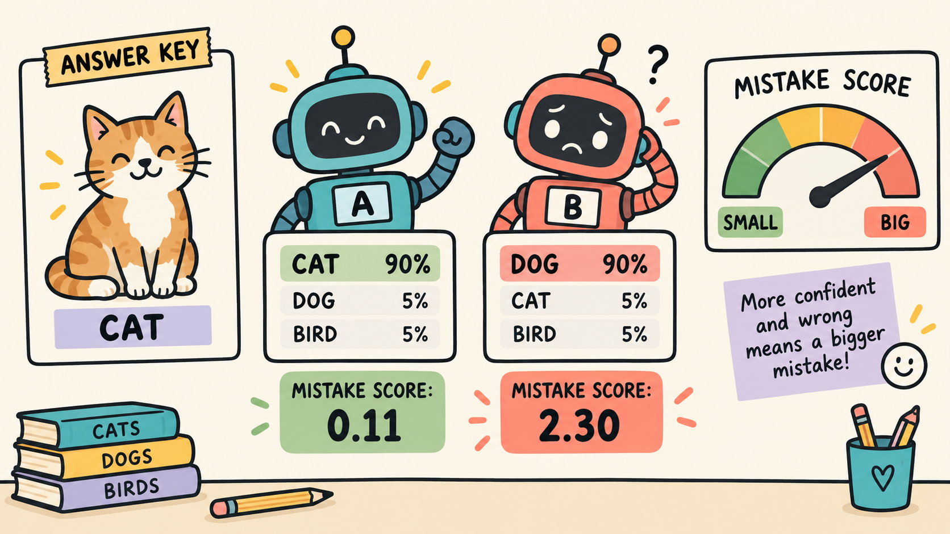
A04 / ENTROPY AND CROSS ENTROPY / ESTHER ODAIBO
Cross Entropy: The Mistake Score
Cross entropy compares the prediction with the correct answer.
WHAT PROBLEM DOES IT SOLVE?
It measures how far the predicted chances are from the correct label.
THE REAL RULE
Loss = −log(chance given to the correct answer)
High chance for the correct answer gives a small loss. A confident wrong guess gives a large loss.
HOW LEARNING USES IT
Training tries to lower this score. Backpropagation then helps decide which weights to adjust.
Analogy limit: The score measures the mistake. It does not choose the weight changes by itself.
Source: TensorFlow, CategoricalCrossentropy documentation
ESTHER ODAIBO | GROUP 4
Notes:
Speaker notes: Now we reveal the answer key. Cross entropy looks at the probability the model gave the correct class. Giving the correct class a high chance produces a small loss. Being confidently wrong produces a much larger loss. During training, the network tries to reduce this loss. The mistake-score analogy stops here because cross entropy measures the error, while backpropagation calculates how the weights contributed to it.
Source: TensorFlow, tf.keras.losses.CategoricalCrossentropy. https://www.tensorflow.org/api_docs/python/tf/keras/losses/CategoricalCrossentropy

Slide 7
A04 / BACKPROPAGATION / KING OWUSU
Backpropagation: Learning From Mistakes
Backpropagation is a method that helps a neural network learn from its mistakes.
1
SHOW A PICTURE
2
MAKE A GUESS
3
FIND THE MISTAKE
“It’s a cat!” 🐱
“Dog?” ❌
“How wrong?” 📊
The network is shown a photo of a cat. It has no idea yet what the right answer is.
Using its current settings, the network predicts “Dog” — and that guess is wrong.
The real answer is “cat.” The network scores how wrong that guess was.
4
GO BACKWARD
5
FIX THE WEIGHTS
“Send the error back” 🔙
“Adjust it” 🔧
That error score travels backward through the network, layer by layer — showing each part how much it contributed to the mistake.
The network figures out which weights to change, so it guesses better next time.
Key takeaway: Backpropagation helps a neural network understand what contributed to its error.

Slide 8
A04 / BACKPROPAGATION / KING OWUSU
The Learning Loop
Backpropagation repeats this cycle again and again until the network gets better.
1
INPUT
2
NEURAL NETWORK
3
PREDICTION → ERROR
“Data goes in” 📥
“Process it” 🧠
“Spot it” ❌
Raw input — like a photo — enters the neural network to begin the loop.
The network passes the input through its layers and comes up with a prediction.
The prediction is compared to the answer to score how wrong it was.
4
BACKPROPAGATION
5
ADJUST & REPEAT
“Send it backward” 📐
“Try again!” 🔧
The error travels backward through the network, and the network calculates gradients — directions that show how to reduce the error.
The network adjusts its weights using the gradients, then tries again!
🔁 The loop: Input → Predict → Error → Backprop → Adjust → Repeat!

Slide 9
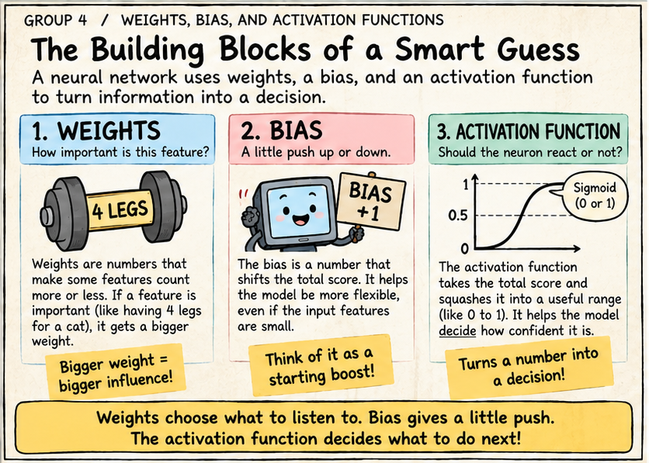

Slide 10
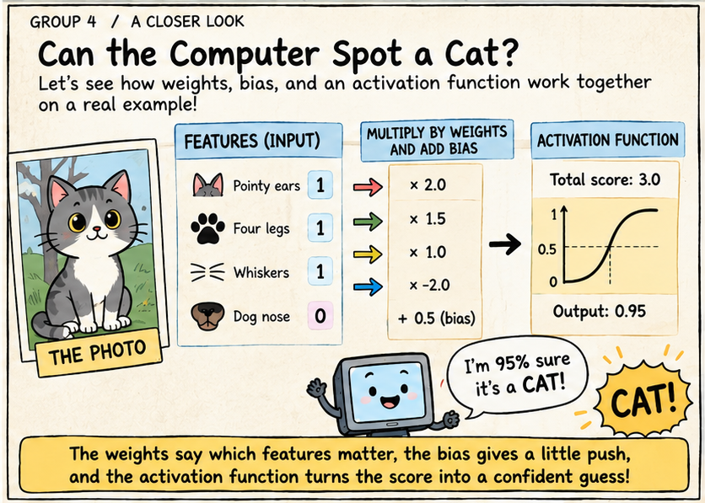

Slide 11
