Slide 1
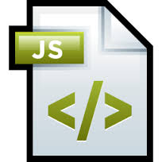
Java Script Scopes

Slide 2
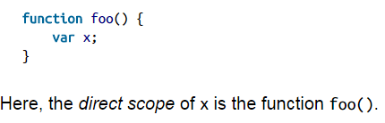
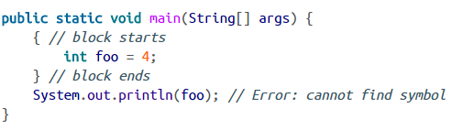
Scope
Scope is a place where variables are defined and can be accessed. For example:
Most mainstream languages are block-scoped: variables “live inside” the innermost surrounding code block. Here is an example from Java:
In Java, there are only two scopes:
global scope: global environment for functions, vars, etc.
function scope: every function gets its own inner scope
The variable foo is accessible only inside the block that directly surrounds it. If we try to access it after the end of the block, we get a compilation error.

Slide 3
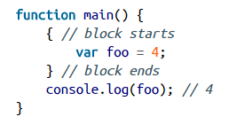
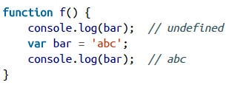
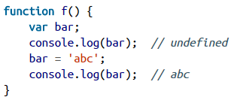
Function Scope
In JavaScript the variables are function-scoped: only functions introduce new scopes; blocks are ignored when it comes to scoping. For example:
JavaScript hoists all variable declarations, it moves them to the beginning of their direct scopes. This makes it clear what happens if a variable is accessed before it has been declared:
We can see that the variable bar already exists in the first line of f(), but it does not have a value yet; that is, the declaration has been hoisted, but not the assignment. JavaScript executes f() as if its code were:

Slide 4
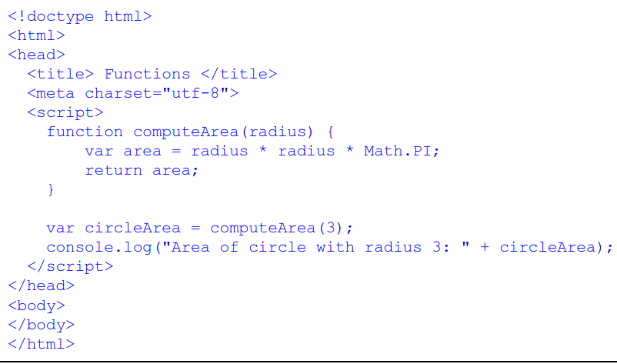
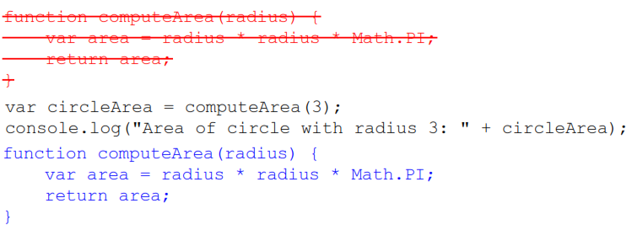
Java Script Functions
When you create a function, you're also creating a scope for executable statements.
In this code, we used function declaration to define the computeArea() function.
One of the advantages to defining functions using function declarations is that you can place your functions above or below the code that uses them.

Slide 5
Java script functions
This works because when the browser loads your page, it goes through all your JavaScript and looks for function declarations before it begins executing your code.
When you define a function at the global level like as mentioned above, JavaScript adds the function as a property of the global window object, so that the function definition is visible everywhere in your code.
Then, the browser goes back to the top of your JavaScript, and begins executing the code, top down. So, when the JavaScript interpreter gets to the first line where you call computeArea(), that function is defined, so the function call succeeds.

Slide 6
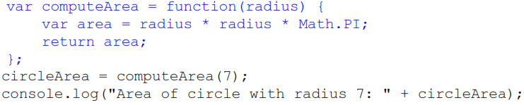
Function Expression
We've replaced the function declaration with a variable declaration: we declare the variable computeArea and initialize that variable to the result of a function expression.
Because computeArea is a global variable, the end result is almost the same: a property named computeArea is added to the global window object set to the value of the function.

Slide 7
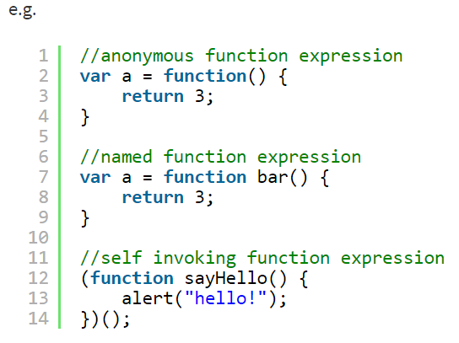
Functions defined via Functions Expressions can be named or anonymous. Function Expressions must not start with “function” (hence the parentheses around the self invoking example below)

Slide 8
Anonymous functions
Anonymous functions are functions that are dynamically declared at runtime. They’re called anonymous functions because they aren’t given a name in the same way as normal functions.
Anonymous functions are declared using the function operator instead of the function declaration.
When the function operator is called, it creates a new function object and returns it. Here’s an example that creates a function and assigns it to a variable called flyToTheMoon:

Slide 9
Here’s a typical example of a named function:
function flyToTheMoon()
{
alert("Zoom! Zoom! Zoom!");
}
flyToTheMoon();
Here’s the same example created as an anonymous function:
var flyToTheMoon = function()
{
alert("Zoom! Zoom! Zoom!");
}
flyToTheMoon();

Slide 10
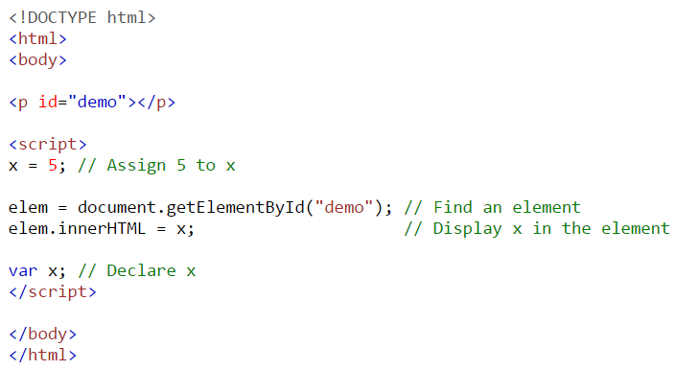
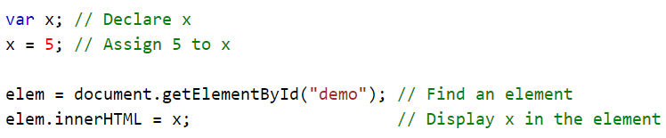
JavaScript Declarations are Hoisted
In JavaScript, a variable can be declared after it has been used. In other words; a variable can be used before it has been declared.
Example:1
Example:2
Hoisting is JavaScript's default behavior of moving all declarations to the top of the current scope (to the top of the current script or the current function).
To quote Ben Cherry’s excellent article: “Function declarations and function variables are always moved (‘hoisted’) to the top of their JavaScript scope by the JavaScript interpreter”.

Slide 11
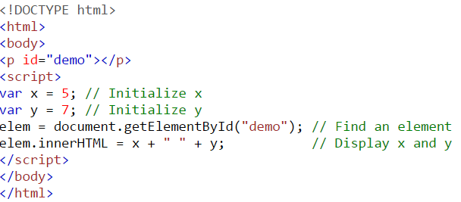
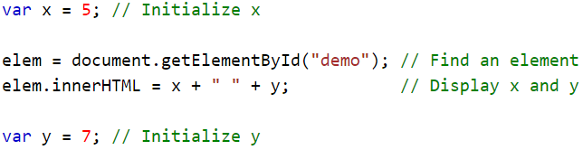
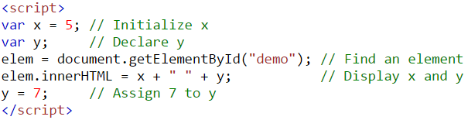
JavaScript Initializations are Not Hoisted
JavaScript only hoists declarations, not initializations.
Example-1
Please check the output of both the examples.
Example-2
This is same as
How ‘y’ is undefined in the example-2?
This is because only the declaration (var y), not the initialization (=7) is hoisted to the top. Because of hoisting, y has been declared before it is used, but because initializations are not hoisted, the value of y is undefined.

Slide 12
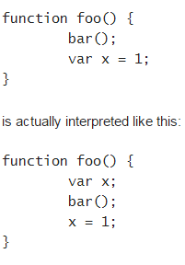
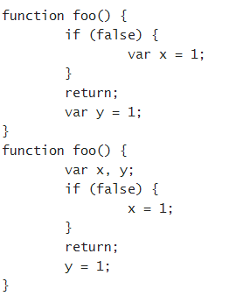
Examples
The following two functions are equivalent:

Slide 13
Declare Your Variables At the Top !
Hoisting is an unknown or overlooked behavior of JavaScript.
If a developer doesn't understand hoisting, programs may contain bugs (errors).
To avoid bugs, always declare all variables at the beginning of every scope.
Since this is how JavaScript interprets the code, it is always a good rule.
Objects belong to the global scope if:
They are define outside of a function scope
They are defined without var
Fixable with 'use strict'

Slide 14
Global Scope
The term global scope describes the visibility of your variables.
If a variable or function is global, it can be got at from anywhere. In a browser, the global scope is the window object. So if in your code you simply have: var x = 9;
You’re actually setting the property window.x to 9
A variable that is declared inside a function using the var keyword, will have a local scope.
A variable that is declared inside a function without var keyword, will have a global scope means acts like a global variable.

Slide 15
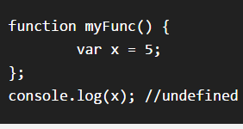
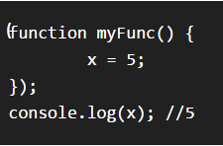
Local scope vs global scope
Local scope
Since x was initialised within myFunc(), it is only accessible within myFunc().
Global scope
If you declare a variable & forget to use the var keyword, that variable is automatically made global. So this code would work:
Thus function uses a global variable instead of local one, it runs the risk of changing a value on which some other part of the program. To avoid this problem declare all variables with var.

Slide 16
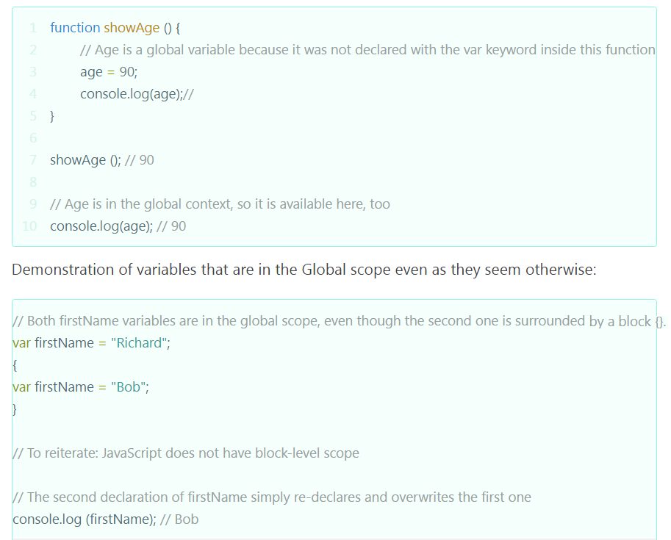
Examples

Slide 17
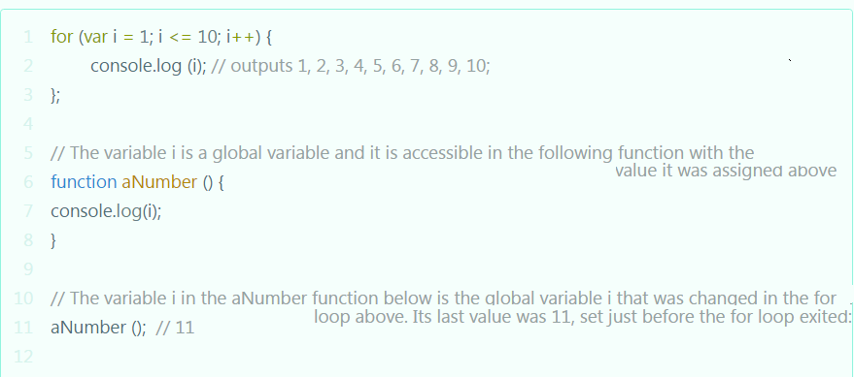
Another example

Slide 18
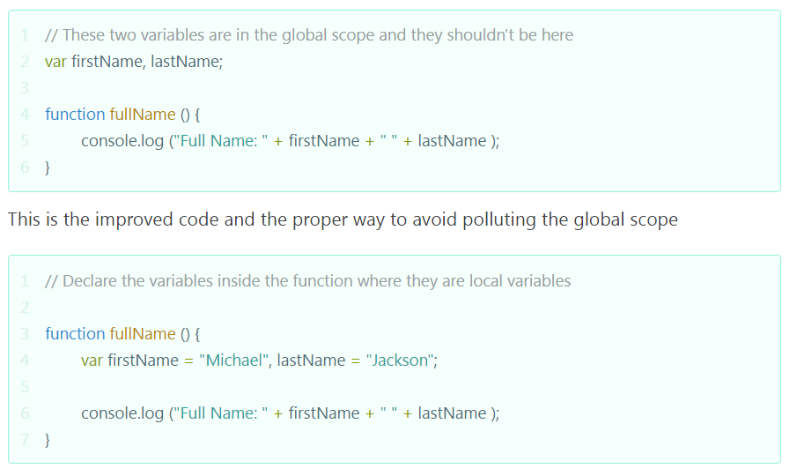
You have to know that it is important to avoid creating many variables in the global scope

Slide 19
Lexical scope in Java
In Java, every block ( {} ) defines a scope.
public class Scope {
public static int x = 10;
public static void main(String[] args) {
System.out.println(x);
if (x > 0) {
int x = 20;
System.out.println(x);
}
int x = 30;
System.out.println(x);
}
}

Slide 20
Lexical scope in JavaScript
var x = 10; // foo.js
function main() {
print(x);
x = 20;
if (x > 0) {
var x = 30;
print(x);
}
var x = 40;
var f = function(x) { print(x); }
f(50);
}

Slide 21
Initialization of functions and variables
In JavaScript, all local variables and functions are properties of the special internal object, called LexicalEnvironment.
The top-level LexicalEnvironment in browser is window. It is also called a global object.
When the script is going to be executed, there is a pre-processing stage called variables instantiation.

Slide 22
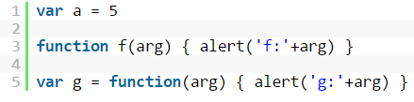
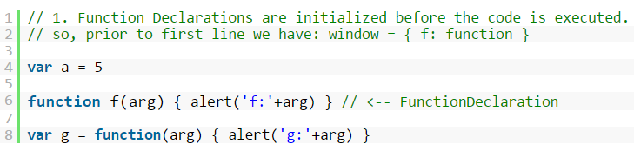

First, the interpreter scans the code for which are declared as function name {...} in the main code flow.
It takes every declaration, creates the function from it and puts it into window.
For eg., consider the code:
At this stage, the browser finds function f, creates the function and stores it as window.f:
As a side effect, f can be called before it is declared:

Slide 23
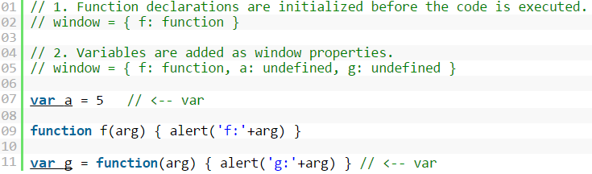
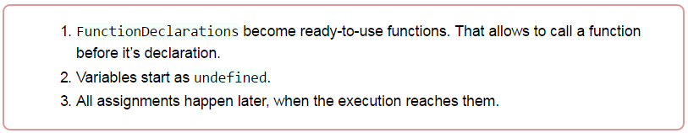
Second, the interpreter scans for var declarations and creates window properties. Assignments are not executed at this stage. All variables start as undefined.
The value of g is a function expression, but the interpreter doesn’t care. It creates variables, but doesn’t assign them.
So to summarize as
Note that, it is impossible to have a variable and a function with the same name.

Slide 24
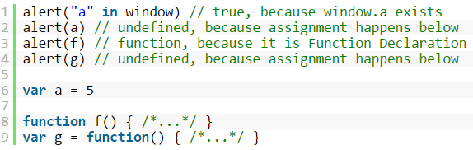
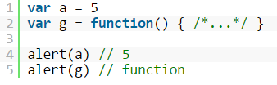

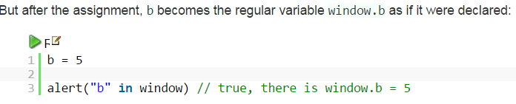
Third: the code starts running. When a variable or function is accessed, the interpreter gets it from window:
After the assignments, a becomes 5 and g becomes a function. In the code below, alerts are moved below. Note the difference:
If a variable is not declared with var, then, of course, it doesn’t get created at initialization stage. The interpreter won’t see it:

Slide 25
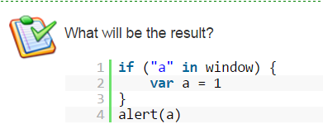

Slide 26
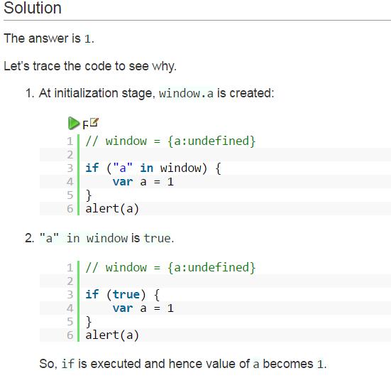

Slide 27
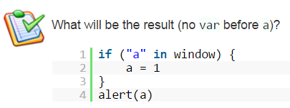

Slide 28
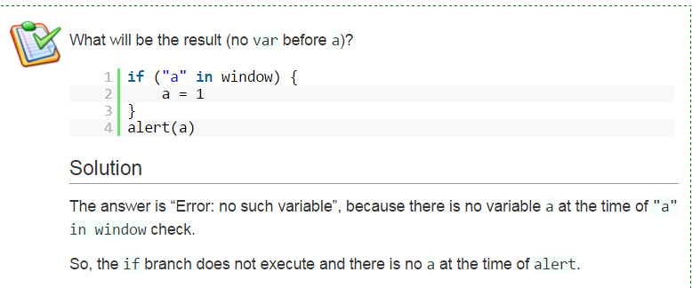

Slide 29
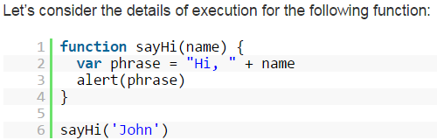
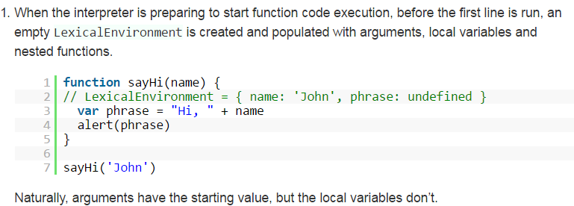
Function variables
When the function runs, on every function call, the new LexicalEnvironment is created and populated with arguments, variables and nested function declarations.
This object is used internally to read/write variables. Unlike window, the LexicalEnvironment of a function is not available for direct access.

Slide 30
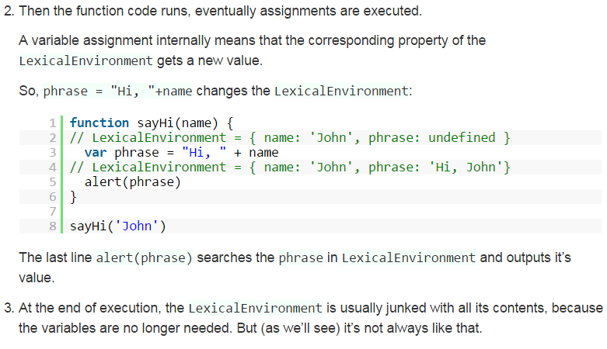

Slide 31
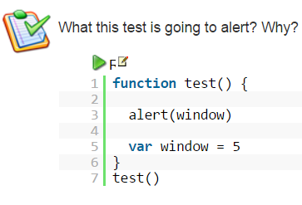

Slide 32
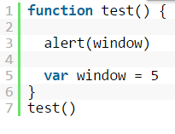

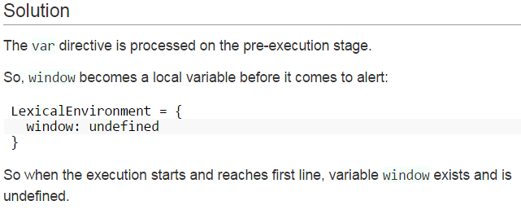
The output is

Slide 33
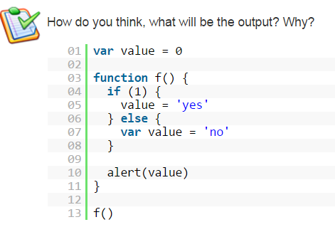

Slide 34
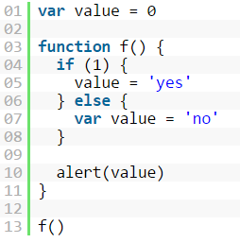
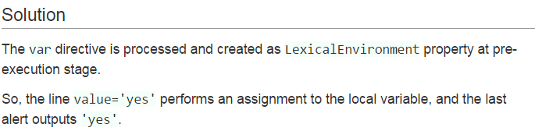

Slide 35
Points to note
Local Variables Have Priority Over Global Variables in Functions.
you declare a global variable and a local variable with the same name, the local variable will have priority when you attempt to use the variable inside a function (local scope):
Any variable declared or initialized outside a function is a global variable, and it is therefore available to the entire application.
If a variable is initialized (assigned a value) without first being declared with the var keyword, it is automatically added to the global context and it is thus a global variable

Slide 36
Exercises
Write a function to that takes two numbers and returns smallest of two, or square of two if they are equal and demonstrate js scope variables.
Write JS function to show Local Variables Have Priority Over Global Variables.

