Slide 1
Introduction to Convolutional Neural Network
Subtitle

Slide 2
What is convolutional neural network?

Slide 3
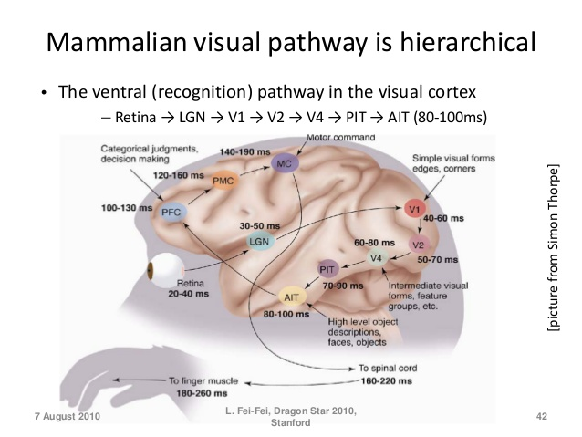
Convolutional Neural Network (CNN)
Notes:
Mammalian brain
Hierarchy of features
At a higher level, every time you see something, a series of clusters (layers) of neurons get activated. Each of these clusters detect features.

Slide 4
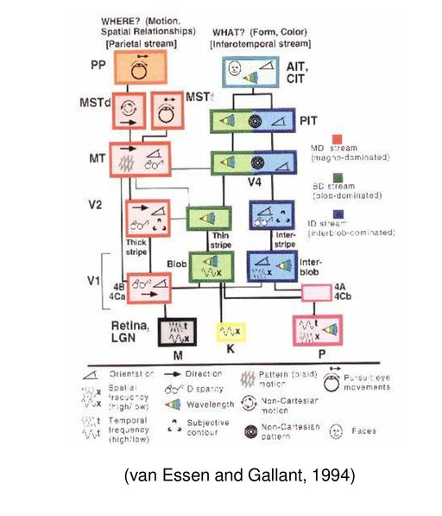
Convolutional Neural Network (CNN)
Notes:
Mammalian brain
Hierarchy of features
At a higher level, every time you see something, a series of clusters (layers) of neurons get activated. Each of these clusters detect features.

Slide 5
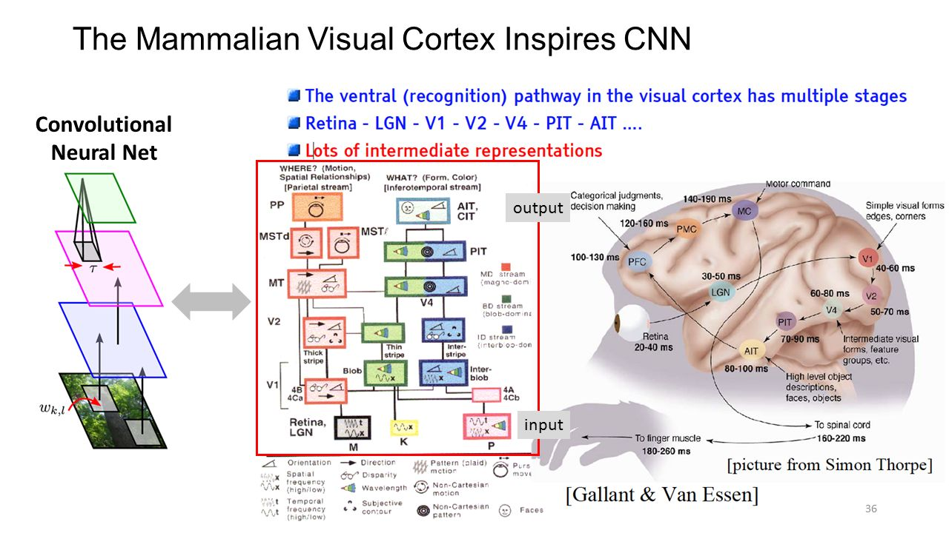
Convolutional Neural Network (CNN)
Add your first bullet point here
Add your second bullet point here
Add your third bullet point here

Slide 6
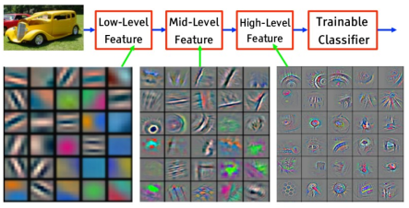
Convolutional Neural Network (CNN)
Add your first bullet point here
Add your second bullet point here
Add your third bullet point here

Slide 7
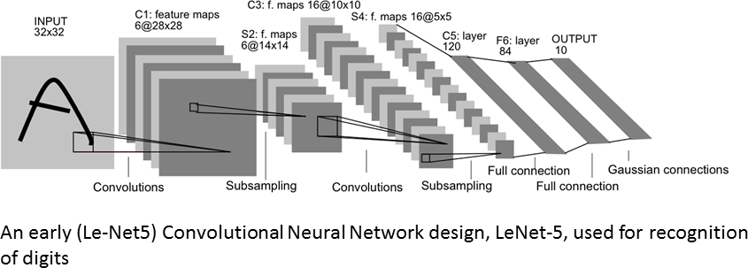
Convolutional Neural Network (CNN)
https://www.rsipvision.com/exploring-deep-learning/

Slide 8
What is CNN made of?

Slide 9
Ingredients of CNN
https://www.rsipvision.com/exploring-deep-learning/

Slide 10
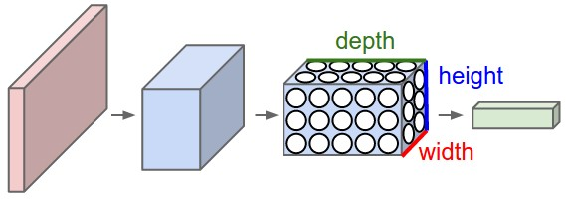
Ingredients of CNN
http://cs231n.github.io/convolutional-networks/
Notes:
Convolutional layer
A ConvNet arranges its neurons in three dimensions (width, height, depth), as visualized in one of the layers. Every layer of a ConvNet transforms the 3D input volume to a 3D output volume of neuron activations. In this example, the red input layer holds the image, so its width and height would be the dimensions of the image, and the depth would be 3 (Red, Green, Blue channels).
Kernel (Filter, feature detector)
Patch (receptive field)
Feature map (activation map)
Stride, Padding

Slide 11
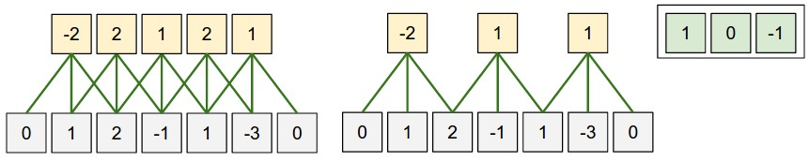
Ingredients of CNN
http://cs231n.github.io/convolutional-networks/
Notes:
Convolutional layer
Kernel (Filter, feature detector)
Patch (receptive field)
Feature map (activation map)
Stride, Padding

Slide 12
Ingredients of CNN
Convolutional Neural Network (CNN)
https://github.com/vdumoulin/conv_arithmetic
Notes:
Stride

Slide 13
Ingredients of CNN
Convolutional Neural Network (CNN)
https://github.com/vdumoulin/conv_arithmetic
Notes:
Padding

Slide 14
Ingredients of CNN
Convolutional Neural Network (CNN)
https://github.com/vdumoulin/conv_arithmetic
Notes:
dilated

Slide 15
Ingredients of CNN
https://www.rsipvision.com/exploring-deep-learning/

Slide 16
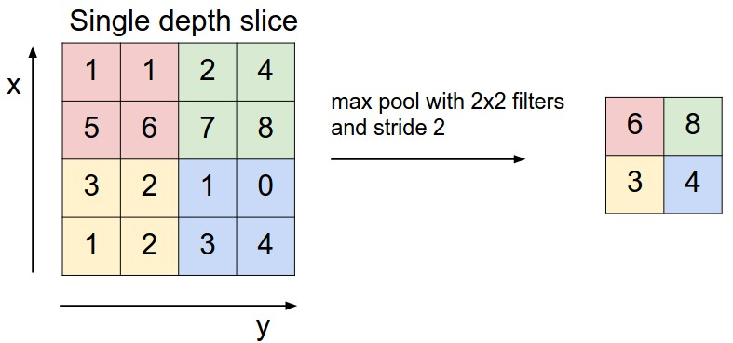
Ingredients of CNN
http://cs231n.github.io/convolutional-networks/
Notes:
Pooling layer
Reduce the amount of parameters and computation in the network to control overfitting
Max pooling
Average pooling

Slide 17
Ingredients of CNN
https://www.rsipvision.com/exploring-deep-learning/

Slide 18
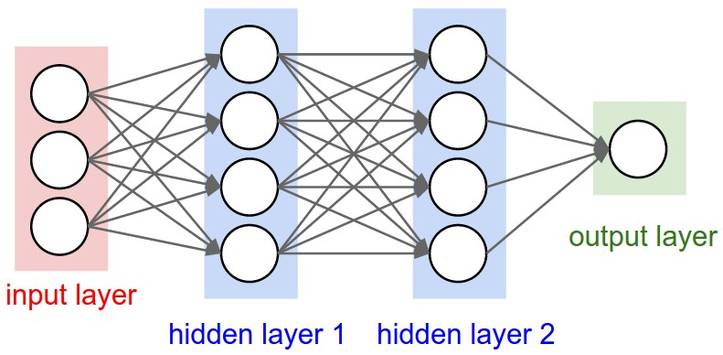
Ingredients of CNN
http://cs231n.github.io/convolutional-networks/
Notes:
Convolutional layer
Kernel (Filter, feature detector)
Patch (receptive field)
Feature map (activation map)
Stride, Padding

Slide 19
Let’s make one!
Notes:
ReLU – activiate the effective neurons --- separate specific excitation and unspecific inhibition
The rectifier is, as of 2018, the most popular activation function for deep neural networks.^{[5][6]}
^{Optimizer – SGD (batch)}
Stochastic gradient descent (often shortened to SGD), also known as incremental gradient descent, is a stochastic approximation of the gradient descent optimization and iterative method for optimizing a differentiable objective function. In essence, SGD tries to find minima or maxima by iteration.
Softmax vs LogSoftmax: -- plays well with cross entropy loss
^{Loss – Cross Entropy Loss}

