Slide 1
Reducing travel time between home and work

Slide 2
Table of Contents
Summary
Process
Discussion
conclusion
References
Recognition

Slide 3
Summary
At present, Bogotá lives one of the worst vehicle congestion in its history (https://www.bbc.com/mundo/noticias-39045803), this can be verified according to an article from the BBC world, based on this problem we intend to perform a market study to find the best place to establish a business (in this exercise we will install a cafeteria) and at the same time find a place of residence within the selected locality, in order to make viable the undertaking of a new business and reduce the time of displacement between these two places

Slide 4
Process
The following data sources will be needed to extract and generate the required information.
Geo-coded locations of the neighborhoods in the city of Bogotá extracted from the Bogotá Urban Laboratory
https://bog ota-laburbano.opendatasoft.com/explore/dataset/barrios_prueba/table/
Number of commercial establishments, type and location, which will be obtained from the Foursquare API.
Distance from residential and commercial areas that will be checked between the data sources of Laboratorio Urbano Bogotá and the Foursquare API.

Slide 5
Process
In this project we will direct our efforts to find two specific places with different characteristics within the selected locality.
In the first step we will search within the locality which are the neighborhoods that concentrate most of the commerce, since this assures us that in these areas we will have greater probability of success in sales for our store, followed by this analysis we will exclude those neighborhoods that already have cafeteria businesses since the intention is to enter an area that has low competition in this field.
In the second step we will search within the locality for the residential neighborhoods that we will identify according to the recreation or rest areas also that have a low density of trade but enough for small supplies.
The third and final step will be to focus on the most promising areas of both housing and commercial that meet our criteria, we will compare the locations and define which are the two points that have the least distance since our goal is to reduce the travel time between these two places.

Slide 6
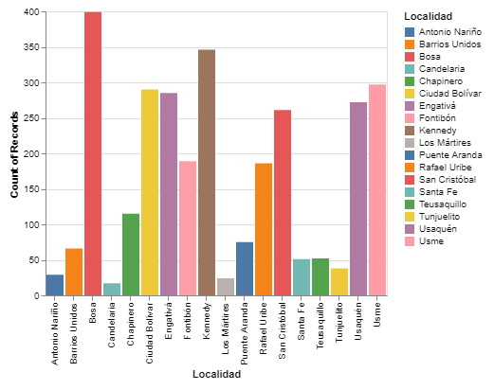
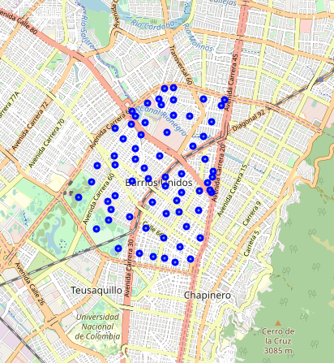
Discussion
First it was necessary to observe the distribution of neighborhoods in the localities to decide which one would work with, in this case “Barrios Unidos”.

Slide 7
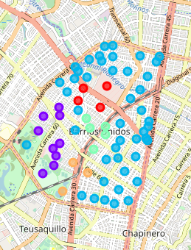
Discussion
To delve deeper into our data we use an unsupervised learning model of closterizacion called Agglomerative Clustering, once we get the result we analyze each of the resulting groups.

Slide 8
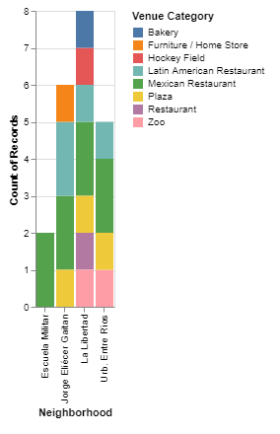
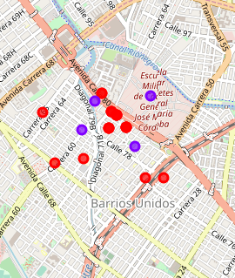
Discussion
In Cluster 0 we see that the places near the neighborhoods are mostly residential areas, the low volume of trade indicates a good option to find our home.

Slide 9
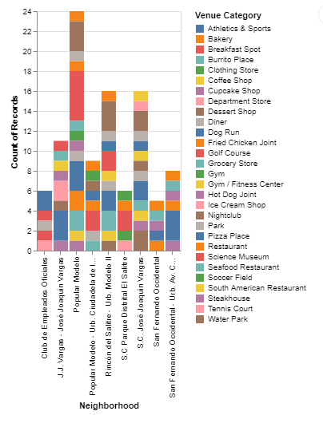
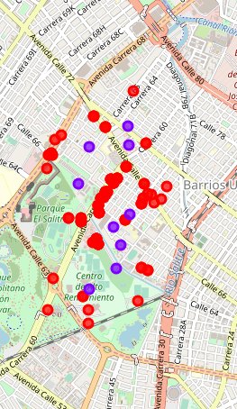
Discussion
Cluster 1, although it has a high number of commercial stores, also highlights social recreation places such as tennis courts, water parks, gyms and soccer fields, emerging as housing neighborhoods.

Slide 10
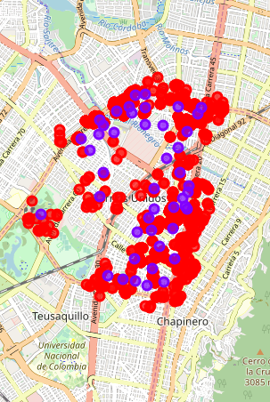
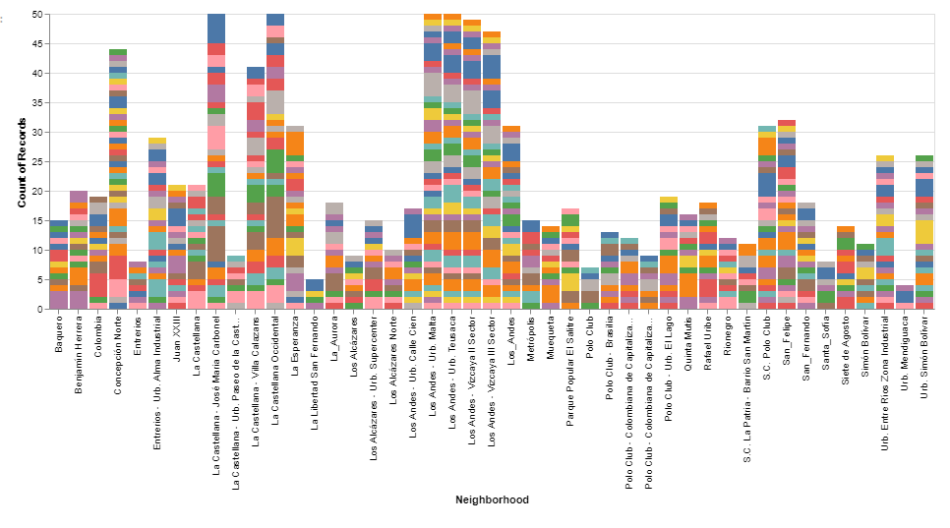
Discussion
Cluster 2 stands out for being the one that concentrates the largest number of commercial premises, it also shows us that these establishments border the boundaries of the town, coinciding with the main avenues, these characteristics ensure a high flow of people and increase our probability of Have a high number of sales in business.

Slide 11
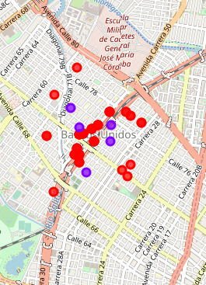
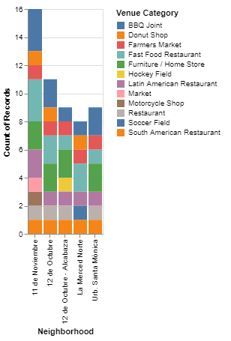
Discussion
Cluster 3 is a small commercial area that is built around the avenue that runs through the town from south to north, just like cluster 2, the high traffic of people on these roads guarantees greater demand for products and therefore higher sales.

Slide 12
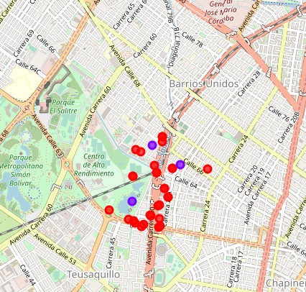
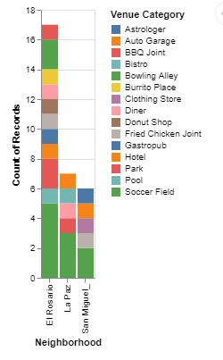
Discussion
Cluster 4, the places that make up this group are bowling alleys, soccer fields, parks, swimming pools and garages, this indicates that it can be a winery area, so we will discard this cluster for our search.

Slide 13
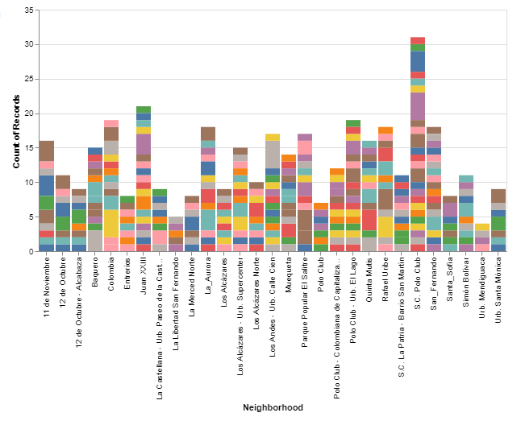
Discussion
those neighborhoods that already have coffee establishments are eliminated, we go from having 50 possible neighborhoods to 29 potential neighborhoods where to install our cafeteria

Slide 14
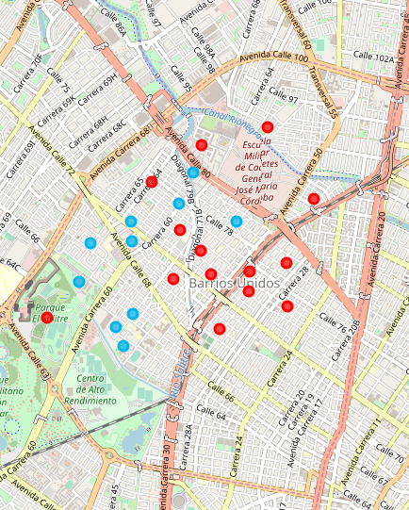
Discussion
We filter the neighborhoods that are less than 1 km away, which leaves us 24 places spread over 10 housing districts and 14 commercial neighborhoods, visualizing the housing neighborhoods in blue and the commercial neighborhoods in red

Slide 15
Conclusion
The structure and quality of the data is an aspect that still has a lot of potential to be improved.
The number of groups found by the model can be adjusted so that the number of neighborhoods is more homogeneous.
End users can become much broader since this need is found in almost all social layers.
The costs for a market study can be greatly reduced by making use of this application.
The cost of living in the different neighborhoods is a factor that can influence the final result, the analysis can be improved by integrating this data.

Slide 16




Referencia

Slide 17
Recognition
To my family, friends and ojuaca who have always supported me in my search for knowledge.

