Slide 1

Training Independent Subnetworks for Robust Prediction

Slide 2
Why do we need Robust Prediction?
For example, a confident misprediction can lead to misdiagnosis.

Slide 3
How to make Robust Prediction?
Bayesian neural network
Ensemble methods

Slide 4
How to make Robust Prediction?
Bayesian neural network
Ensemble methods
Problems?
Computation cost.

Slide 5
Robust Prediction for free?
One can prune away 70-80% of the connections in a neural network without adversely affecting performance.
So a neural network has sufficient capacity to fit 3-4 independent subnetworks simultaneously.

Slide 6
Robust Prediction for free?
One can prune away 70-80% of the connections in a neural network without adversely affecting performance.
A neural network has sufficient capacity to fit 3-4 independent subnetworks simultaneously.
How to combine independent subnetworks into one neural network?

Slide 7
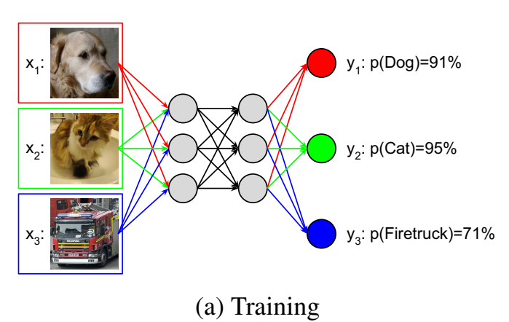
MIMO (Multi-input Multi-out Networks)

Slide 8
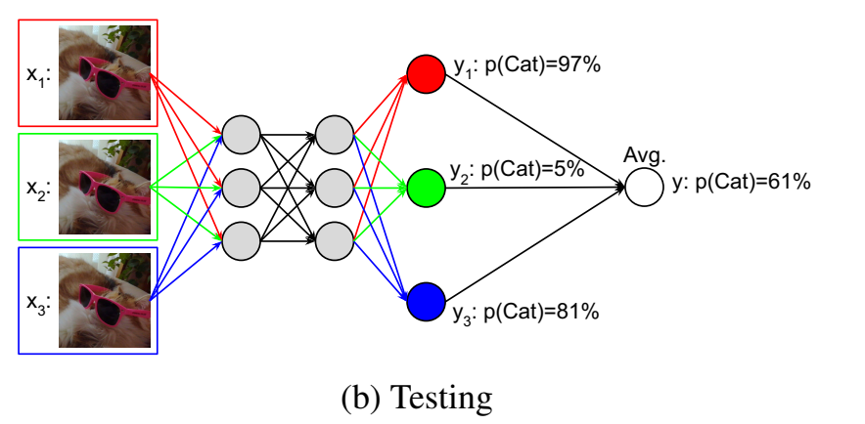
MIMO (Multi-input Multi-out Networks)

Slide 9
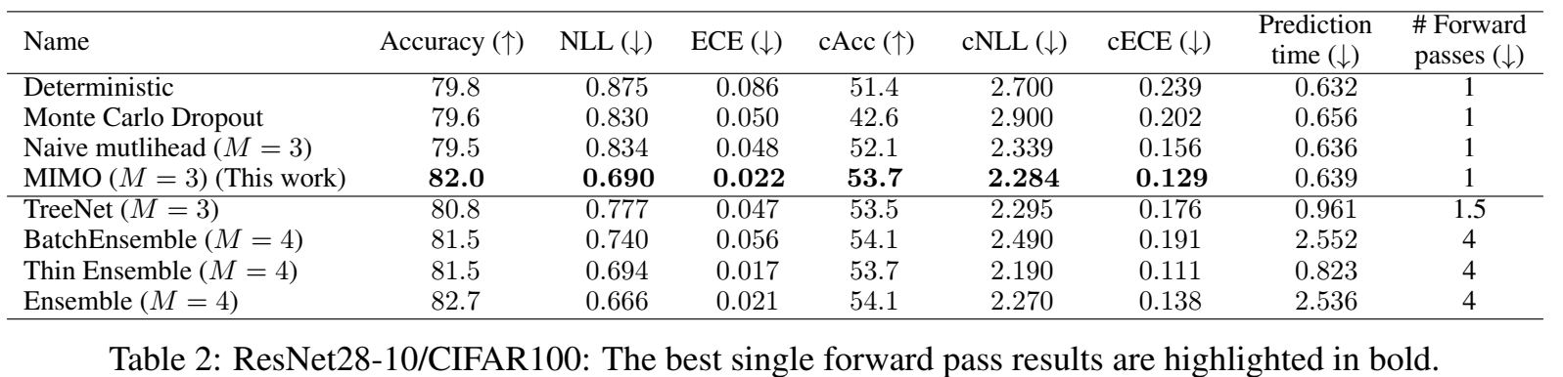
Does it work?
Notes:
Definition of robust. ECE~(expected calibration error)

Slide 10
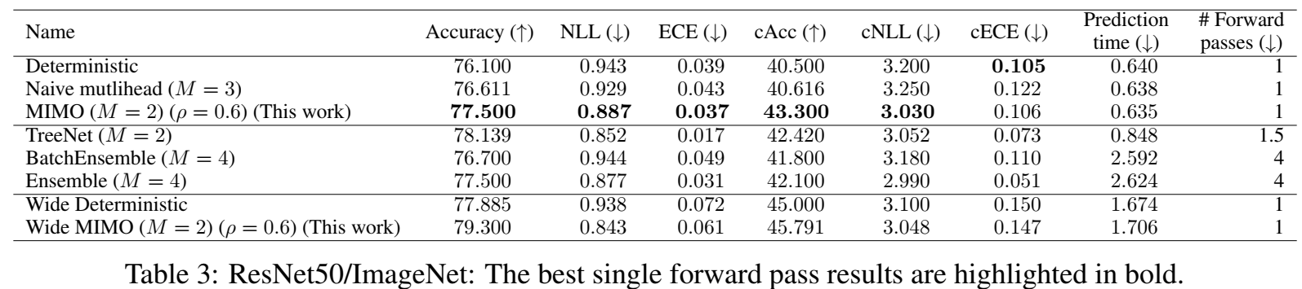
Does it work?
Notes:
Definition of robust. ECE

Slide 11
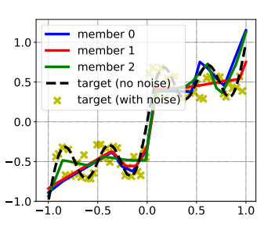
Analysis – Toy data

Slide 12
Analysis – Toy data

Slide 13
Analysis – Toy data

Slide 14
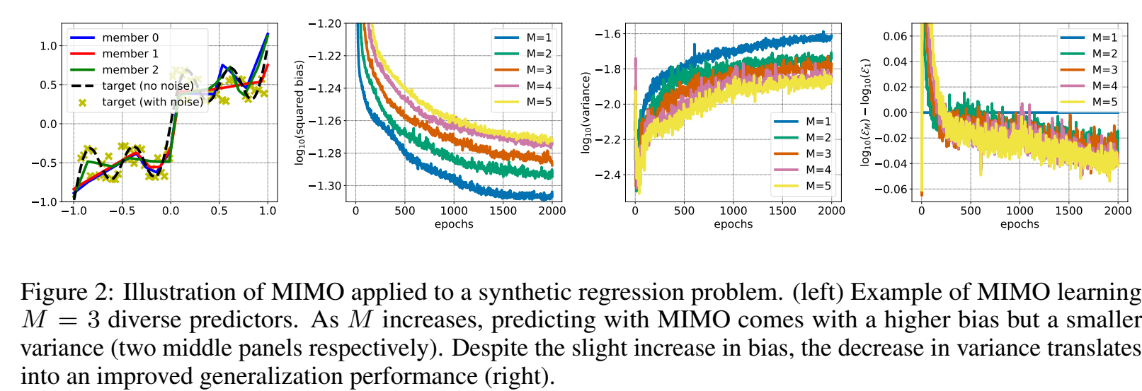
Analysis – Toy data

Slide 15
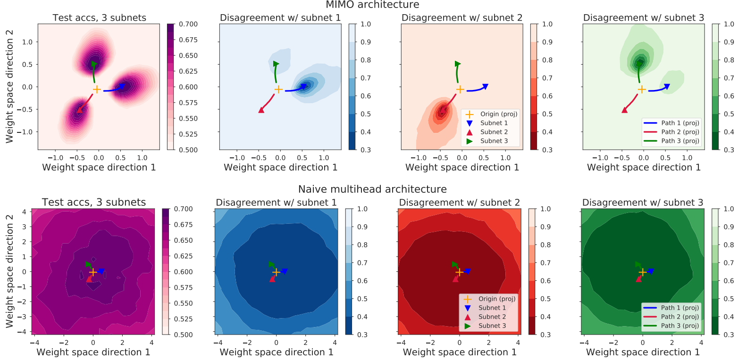
Analysis – Loss landscape on Cifar-10

Slide 16
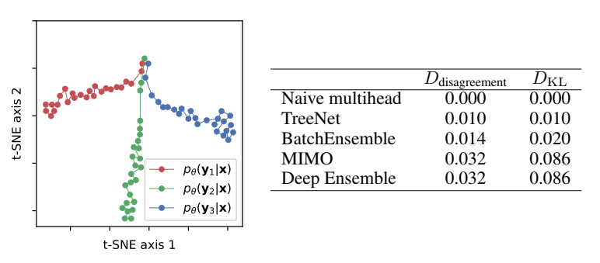
Analysis – Function trajectory on Cifar-10

Slide 17
Baselines
Naïve multihead: Share input layer but not output layer.
TreeNet: the input and the first two residual groups are shared, but the final residual group and the output layer are trained separately for each member.
Deep ensemble: Random initialization.

Slide 18
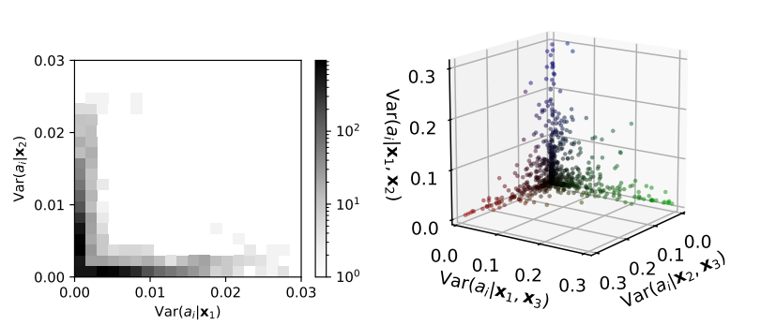
Analysis – Independence of subnets on Cifar-10
Notes:
Each pre-activation.

Slide 19
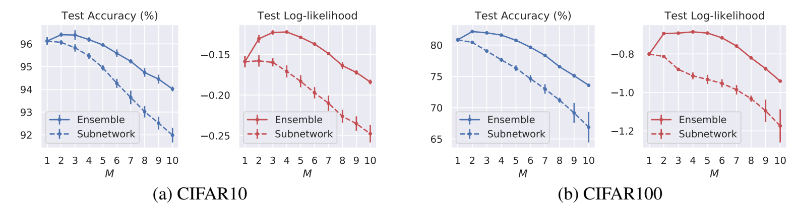
Analysis – Numbers of subnets on Cifar-10
Notes:
Each pre-activation.

Slide 20
Conclusion
MIMO successfully makes use of the ‘sparsity’ of neural networks to imitate the behavior of large ensemble model with low computation costs.
Notes:
Each pre-activation.

